Slide 2
CONTENTS
Methods of cleaning
CIP and COP
Dismantling and cleaning
Jet cleaning
Foam cleaning
Gel cleaning
Cleaning equipment

Slide 3
CLEANING AND SANITATIZING PROCEDURES
Methods of cleaning
There are main two types of cleaning and sanitization procedures being employed in food processing plants
Dismantling and cleaning
Cleaning in place or in place cleaning
Modern food processing plants are designed to permit cleaning by CIP
However old processing units still use the dismantling technique

Slide 4
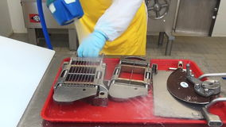
DISMANTLING AND CLEANING
Dismantling and cleaning
Cleaning in place

Slide 5
DISMANTLING AND CLEANING
This is the old method and still widely used
Plant must be designed to permit rapid dismantling
After dismantling plant surfaces are manually and mechanically cleaned by brushing and flushing mechanisms
This method of cleaning ensure the visual inspection of the plant surfaces
It is very effective if carried out efficiently

Slide 6
CLEANING AND SANITATIZING PROCEDURES
This technique involves
Hand brushes
Scrapping devices
Scouring pads
Small processing equipment can be cleaned easily by this technique
Large processing tanks like fermenters and storage vessels are more laborious and may lead to ineffective cleaning

Slide 7
CLEANING AND SANITATIZING PROCEDURES
Most of the times, dismantling and cleaning is manual
Some milk processing plants have installed automatic systems for cleaning
High and low pressure spray jets are used
Pressure upto 700 to 1000 Psi could be used for cleaning

Slide 8
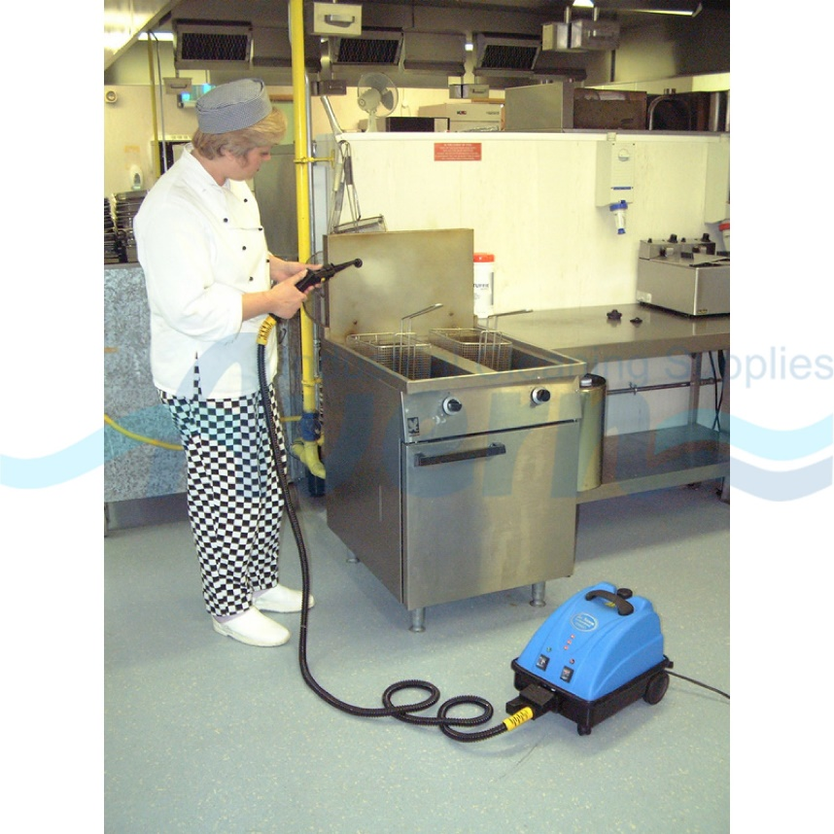
CLEANING AND SANITATIZING PROCEDURES
STEAM JET CLEANING
Jets employing steam can be used for cleaning
Although steam is difficult to handle
They can also make soil stick to the surface
So the soils must be removed first

Slide 9
CLEANING AND SANITATIZING PROCEDURES
FOAM CLEANING
This type of cleaning prolongs the exposure time of the detergent
Rich lather or blanket is form over the surface of the equipment
Most of the times foaming agents are added to the detergent
Mostly meat processing units are cleaned using this method

Slide 10
CLEANING AND SANITATIZING PROCEDURES
GEL CLEANING
In this gel or any thickening agent is added to prolong the penetration time
Mostly it is used for the inclined and vertical surfaces
Walls are also cleaned through this method
Both foam and gel cleaning are completed by thorough flushing and rinsing by water

Slide 11
CLEANING AND SANITATIZING PROCEDURES
CLEANING EQUIPMENTS
Following equipment are used
Brooms and scrappers
Mops and buckets
Squeegees
Air, steam and water jets
Vacuum Cleaners
Two phase cleaning guns

Slide 12
CLEANING AND SANITATIZING PROCEDURES
DISADVANTAGES OF DISMANTLING AND CLEANING
It is laborious
Time taking
Mechanical damage of equipment can occur adding to the maintenance cost
If not performed effectively, can be the basis of contamination of product

Slide 13
CLEANING IN PLACE
To prevent disadvantages of dismantling cleaning
In-place-cleaning developed for use in plants handling liquid foodstuffs
Modern food industry uses automated mechanised cleaning equipment
Provides desired mechanical force

Slide 14
CLEANING IN PLACE
In principle, method used same as that for dismantling and cleaning
Initial wash water rinse
Detergent solutions used to strip food residues and soiling films from internal surfaces of system
Sterilisation of cleaned surfaces, using a chemical sterilant follows rinse
No time consuming dismantling or reassembling required.

Slide 15
CLEANING IN PLACE
Exact arrangement of cleaning system depends on complexity of plant layout
Basically, make-up or storage tank containing cleaning solution piped into system
This tank suitably isolated to avoid leakage of chemical solutions into process stream

Slide 16
CLEANING IN PLACE
System is emptied and ready for cleaning after production run ends
Raw material storage tanks and product receivers are isolated
Cleaning solution storage tank opened to the system

Slide 17
CLEANING IN PLACE
Factors Influencing Degree of Cleaning Achieved (by dismantling or CIP) include:
Temperature
Composition, concentration of detergent solutions
Contact time between detergent solutions and soil deposit
Degree of turbulence promoted
Nature and thickness of soil film.

Slide 18
CLEANING IN PLACE
Quality of water supplied to plant important
Water be bacteriologically acceptable
Water must be softened before detergent added
If mineral content of water high
water conditioners (sequestering agents – sodium polyphosphates) must be added
Prevent precipitation on pipeline and equipment surfaces.

Slide 19
CLEANING IN PLACE
EXAMPLE OF IN-PLACE-CLEANING IN A STILL BEVERAGE PLANT
Still beverage plants - fruit pulp, sugar, acidulants, colours and flavours normally used
Some plants do not employ fruit pulp at all
With Tetra Pak system, these plants normally adopt CIP method

Slide 20
CLEANING IN PLACE
Typical cycle:
System is flushed with normal water
Followed with hot water
Dilute sodium hydroxide solution circulated in the system
NaOH - 1 to 1.5%
Temperature - 90°C
Retention time - 20 minutes.

Slide 21
CLEANING IN PLACE
Afterwards Flushing with simple water
Dilute nitric acid is circulated through the system:
Nitric acid - 0.75 %
Temperature - 70 to 80°C
Retention time - 15 minutes
Rinse with water
The tetra pack machine is sterilized with hot air at 120°C for 30 min

Slide 22
EVALUATION OF CLEANING PROCESS
The evaluation survey consist of following standards
Physical cleanliness
All visual product wastes, foreign matter, slime etc must be absent from the processing equipment
Chemical cleanliness
This means freedom from undesirable chemicals including cleaning compounds. Electron Spectroscopy for Chemical Analysis(ESCA) is used
Microbiological cleanliness
Most dominant factor, must be controlled through proper sanitation. ATP Bioluminescence monitoring is used

