Slide 1
Acids & Basis relative strength of acids
Contents:-
1.HISTORY:-
2.ACIDS;-
What are Acids.
Physical Properties.
Chemical Properties.
Uses.
Examples.
3..BASES:-
What are Bases.
Physical Properties.
Chemical Properties.
Uses
Examples.

Slide 2
4.Concepts of Acids and Bases:-
Arrhenius Concept of Acids and Bases.
Bronsted-Lowry Concept.
Lewis Concept of Acids and Bases.
5.pH Scale:-
Definition.
pH
POH
Uses of pH

Slide 3
1.HISTORY;-
JABIR BIN HAYYAN:
Jabir Bin Hayan who was the first Muslim chemist and he discovered Nitric acid (HNO₃),Hydrochloric acid(HCL), Sulphuric acid(H₂SO₄).
LEVOISIER:
In 1787,He named the binary compounds of oxygen as acids. Such as;CO₂,SO₂
SIR HUMPHREY DAVY:
He discovered acids without oxygen such as hydrochloric acid(HCL). He called acids have the main component is hydrogen.

Slide 4
2.ACIDS
WHAT ARE ACIDS:
According to Arrhenius concept acid is specie which gives hydrogen ions in aqueous solution.
According to Bronsted Lowry concept acid is a molecule or ion which gives proton to Other Specie.
According to Lewis concept acid is a molecule or ion which accept the Pair of electrons.
PHYSICAL PROPERTIES:
Acid tastes sour for example citrus fruit or lemon juice taste.
Convert blue litmus into red.
Corrosive in concentrated condition.
Electric current can be passed from their aqueous solution.

Slide 5
CHEMICAL PROPERTIES: a)Reaction with Metals:-
Acids reacts with metals according to their reactivity demand and form H₂ gas and respective salt.
Zn+H₂SO₄ ZnSO₄+H₂ b) Reaction with Carbonates and Bicarbonates;-
They react with carbonates and bicarbonates to form CO₂ gas and respective salt.
CACO₃+2HCl CACl₂+CO₂ +H₂O
c)Reaction with Bases:-
Acids reacts with bases to form H₂O and Salt. This reaction is called as neutralization reaction.
NaOH+ HCl NaCl+H₂O

Slide 6
d)Reaction with Sulphites and Bisulphites:- Acids reacts with Sulphites and Bisulphites to form salt and SO₂. CaSO₃+2HCl CaCl₂+SO₂ +H₂O USES:- a)H₂SO₄:It is used in Fertilizers, Chemicals, Explosives, Paints, Medicines and as a electrolyte in lead storage batteries. b)HNO₃;It is used in fertilizers, paints, medicines and for painting on copper plates. c)HCL: It is used in cleansing process of metals and also in printing industries.

Slide 7
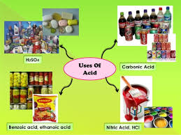
D)C7H6O2:-
Benzoic acid is used in preserving process of food.
E)CH3COOH:-
Acetic acid is used in the preserving process of food and making food tasteful. It is also used in treatment of wasp biting.

Slide 8
EXAMPLES:-
Nitric acid
Hydrochloric acid
Benzoic acid
Acetic acid
Phosphoric acid
Citric acid
Lactic acid
Formic acid
Malic acid
Uric acid
Tartaric acid

Slide 9
3.BASES
WHAT ARE BASES:
According to Arrhenius concept base is specie which gives hydroxyl ions in aqueous solution.
According to Bronsted Lowry concept base is a molecule or ion which accepts proton to Other Specie.
According to Lewis concept base is a molecule or ion which gives the Pair of electrons.
PHYSICAL PROPERTIES:-
Bitter in taste.
Slippery when touches as soap.
Converts red litmus into blue.
Non Corrosive except concentrated solution of NaOH, KOH.
Electric current can easily pass through their aqueous solution.

Slide 10
CHEMICAL PROPERTIES:
A)Reaction with acids:-
Bases reacts with acids to form water and salt, This reaction is called as neutralization reaction.
2KOH+H₂SO₄ K₂SO₄+2H₂O
B)Reaction with Ammonium salt:-
They react with ammonium salt to form ammonia gas.
NH₄Cl+Ca(OH) NaCl+NH₃ +H₂O
C)Precipitation of Hydroxides:-
Bases when mixed with the solution of heavy metals like Cu, Fe, Zn, Pb and Ca. They form precipitates of insoluble metal hydroxides.

Slide 11
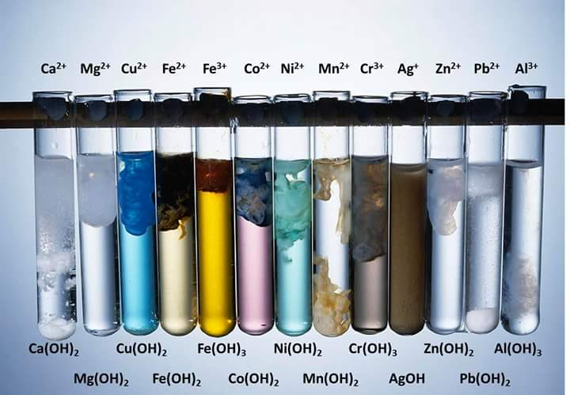
CuSO₄+2NaOH Cu(OH)+Na₂SO₄
Blue precipitate
ZnCl₂+2NaOH Zn(OH)₂+2NaCl
White precipitate
FeCl+3NaOH Fe(OH)₃+3NaCl
Brown precipitate
Pb(NO₃)+2NaOH Pb(OH)₂ +2NaNO₃
White precipitate

Slide 12
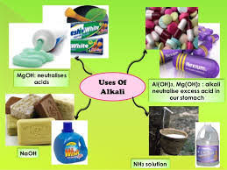
USES:
_{A)NaOH:}
It is used in the soap preparation.
_{B)Ca(OH)2:}
It is used in bleaching powder preparation, for sorting hard water and used to neutralize acidity of soil and lakes due to acid rain.
_{C)KOH:}
It is used in alkaline batteries.
_{D)Mg(OH)2:}
It is used as base for neutralizing the acidity of stomach. It is also used for the treatment of honey biting.
_{E)Al(OH)3:}
It is used as foaming agent.

Slide 13
EXAMPLES:-
Sodium Hydroxide
Calcium Hydroxide
Potassium Hydroxide
Magnesium Hydroxide
Aluminium Hydroxide
Ammonium Hydroxide
Lithium Hydroxide
Barium Hydroxide
Iron Hydroxide

Slide 14
4.Concepts of Acids and Bases:-
Arrhenius Concept of Acids and Bases:-
He described his method in 1787:
Acid is a specie which gives H ion in aqueous solution.
e. g
HA H⁺ +A⁻
Arrhenius Acids are HCl,HNO₃,CH₃COOH,HCN.
Base is a specie which gives OH ions in aqueous solution.
e. g,
BOH B⁺ +OH-
Arrhenius bases are Ca(OH)₂,NH₄(OH),KOH, NaOH.

Slide 15
Bronsted Lowry Concept:-
Danish chemist Bronsted and English chemist Lowry proposed their acid and base theories on the basis of proton transfer.
Acid is a molecule or ion which gives proton.
e. g
HCl + H₂O H₃O⁺ + C^{l-}
HNO3,HCN,H2O,HCL are the examples of Bronsted Lowry acids.
Base is a molecule or an ion which accepts proton from acid.
e.g
HCl + NH₃ NH4⁺ + Cl⁻
H2O,CO32-,HCO3- are the examples Bronsted Lowry bases.

Slide 16
Conjugate Acid:-
Conjugate acid is specie which come into existence by acceptance of proton by base.
HCl + H₂O H₃O⁺ + Cl⁻
H₃O⁺ ,NH₄⁺,HCO₃⁻ are examples of conjugate acids.
Conjugate Base:-
Conjugate base is specie which come into existence by donation of proton by acid.
HCl + NH₃ NH4⁺ + Cl⁻
NO₃⁻,CN⁻,OH⁻,Cl⁻ are the examples of conjugate bases.

Slide 17
Lewis Concept of Acid & Base:
G.N .Lewis gave his concept in 1923.
Acid is a specie which accepts the pair of electrons .
While base is a specie which donates the pair of electrons.
e. g
BF₃ + NH₃ BF₃ NH₃ BF₃ NH₃
In above example; NH₃ is a Lewis base while BF₃ is a Lewis acid.

Slide 18
pH Scale:
The scale which explains pH of various substances is called pH Scale.
.pH :
Anti-log of Hydrogen ion concentration is called pH.
.pOH :
Anti-log of hydroxyl ion concentration is called pOH.
Uses of pH:
1. It is used to detect the acidicity or basicidity of a solution.
2. It is used to manufacture medicines and cultures of a specific pH.
3. It is used to generate solutions of required concentration of biological reactions.

Slide 19
.pH Scale:

