Slide 1
ENTO-306
Agricultural pests and their management
Identification of important agricultural pests
Their mode of damages
Control measures
By: Dr. Muhammad Zeeshan Majeed

Slide 2
Insect Pests of Mango Crop in Pakistan

Slide 3
ENTO-306 Agricultural pests and their management 4(3-1)
Mangifera indica (2nd largest fruit crop of Pakistan / 1.7 million ton annual production/ 170 thousands hectares area under cultivation)
Pakistan is 6th largest producer in the world behind India, China, Mexico, Indonesia and Thailand (FAO STAT).
The main mango growing districts in the Punjab province are Multan, Bahawalpur, Muzzaffargarh and Rahim yar Khan. In the province of Sindh it is mainly grown in Mir pur Khas, Hyderabad and Thatta in the province of NWFP it is grown in D.I Khan, Peshawar and Mardan.
Mango malformation and mango blight (Erwinia sp. of bacteria) major diseases.

Slide 4
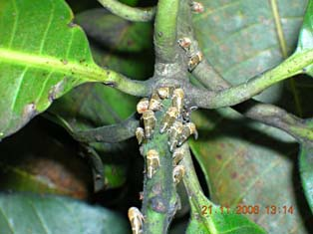
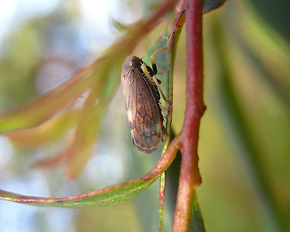
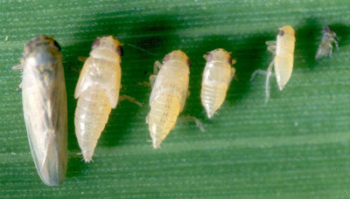
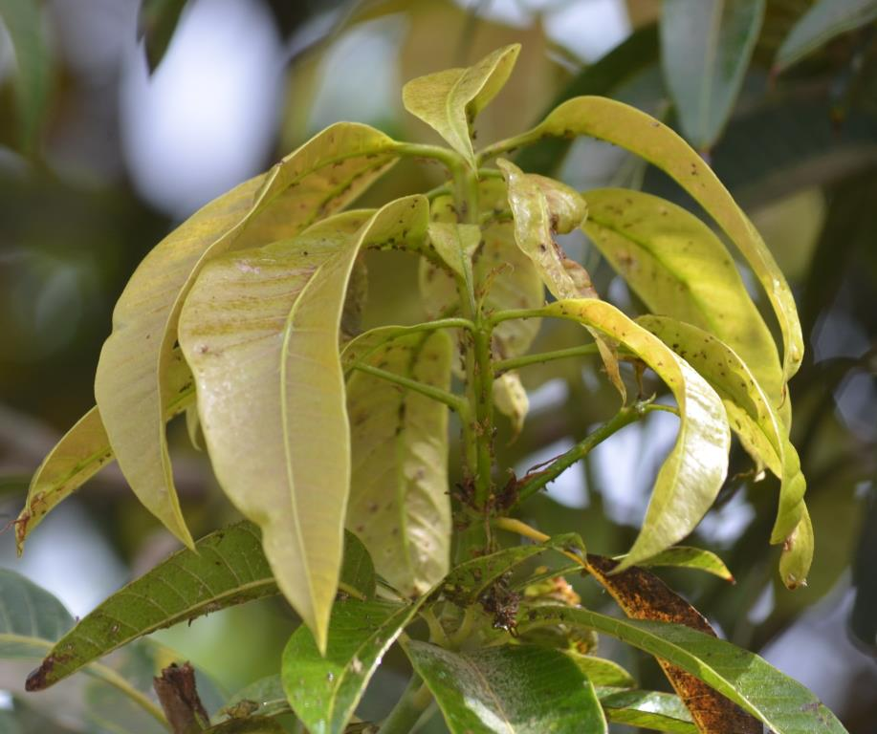
ENTO-306 Agricultural pests and their management 4(3-1)
Insect pests of Fruit Crops Mango leafhopper (Amritodus atkinsoni; Cicadellidae, Homoptera)
Host plants: Mango
A destructive pest of Mango plant, widely distributed in mango orchards
Identification
Adult: Light brown with 2 spots on scutellum (4-5 mm length)
Eggs: ~200 cigar shaped (0.5 mm) laid singly in panicle tissues, unopened flowers and your foliage.
Nymph: Pale yellowish in color
Life history:
Life cycle: One month
Eggs: about 200 eggs per female (hatching in one week)
Nymph: 2-3 weeks (5 nymphal instars)
No. of generations: 2-3 (February to June)
Damage:
Active period: Throughout the year
(Maxi. population in March-April)
Maximum damage caused in February-March (to inflorescence and young sprouts).
De-sapping of young foliage and sprouts, and tender leaves and twigs.
Withering , deformation and yellowing of plant leaves and twigs
Plant become de-vigoured
Flowers, buds and pre-mature fruit dropping and poor-quality fruits
Control:
Chemical control (Acetamiprid, Imidacloprid, Bifenthrin, Lamda-cyhalothrin)
Biological control by releasing lacewings, coccinellid beetles etc.
Notes:
Mangifera indica (2nd largest fruit crop of Pakistan / 1.7 million ton annual production/ 170 thousands hectares area under cultivation)
Pakistan is sixth largest producer in the world behind India, China, Mexico, Indonesia and Thailand (FAO STAT).
The main mango growing districts in the Punjab province are Multan, Bahawalpur, Muzzaffargarh and Rahim yar Khan. In the province of Sindh it is mainly grown in Mir pur Khas, Hyderabad and Thatta in the province of NWFP it is grown in D.I Khan, Peshawar and Mardan.
Avoid dense planting, maintain clean orchards, prune overlapping branches and infested shoots.
Do regular pruning of the trees.
Manage adequate drainage system in the orchard.
Instead of flood irrigation, follow drip system to reduce the population.
Neem based sprays can be utilized at initial stage of hopper population (Azadirachtin 3000 ppm@2ml/l).
Application of bio-agents, Metarhizium anisopliae @ 1x 108 cfu/ml or Beauveria bassiana @ 108 cfu /ml on tree trunk once during off season and twice at 7 days interval during flowering season.
Three to five sprays depending on pest intensity, first spray before flowering with 0.007 % cypermethrin, second at panicle intition satge with 0.07 % quinalphos or 0.1 % carbaryl, subsequent sprays with imidacloprid (0.0053%), thiomithaxam (0.005%) or dimethoate (0.03%).
Mango malformation and mango blight (Erwinia sp. Of bacteria) major diseases.

Slide 5
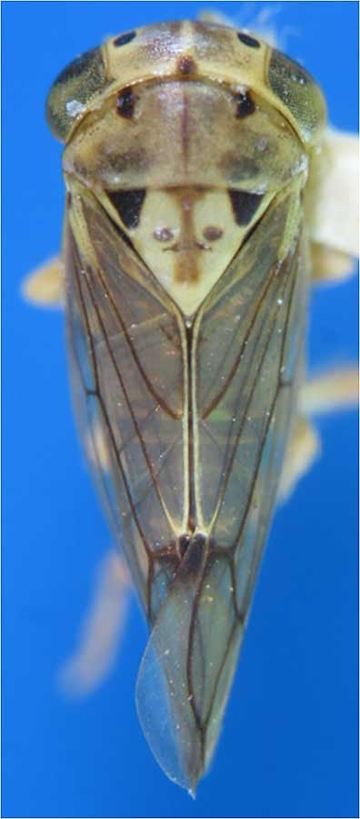
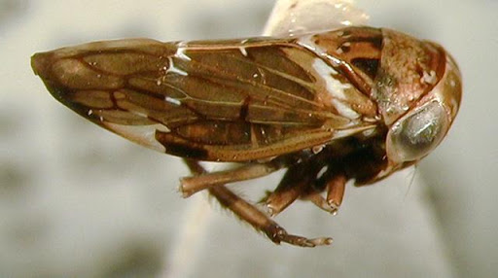

Slide 6
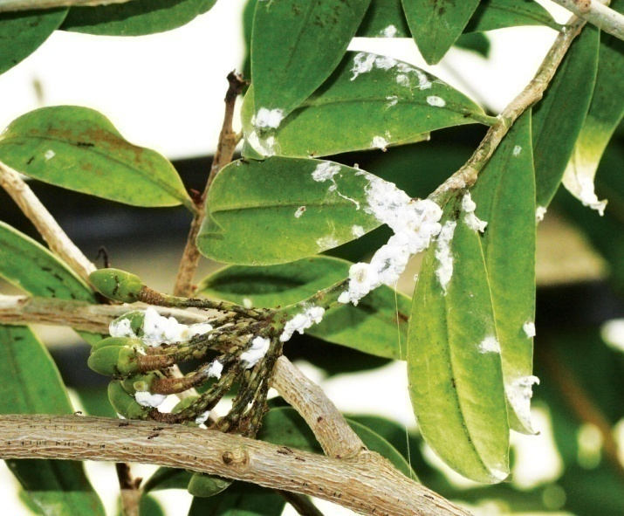
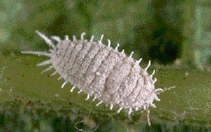
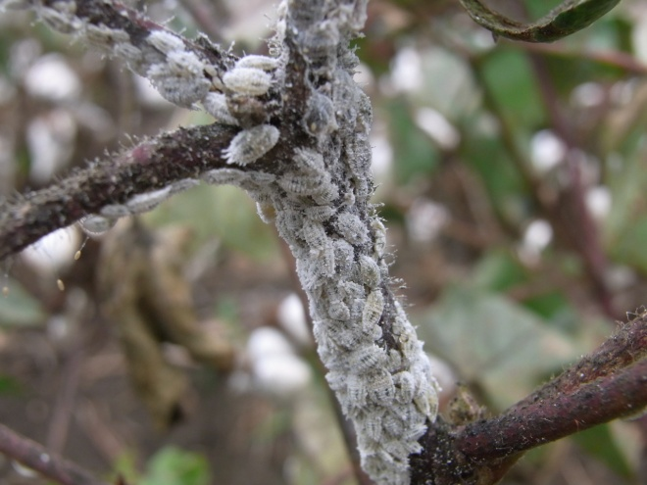
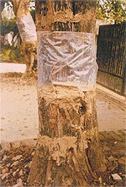
ENTO-306 Agricultural pests and their management 4(3-1)
Insect pests of Fruit Crops Mango mealybug (Drosicha stebbingi ; Pseudococcidae, Homoptera)
Host plants: Mango, Mulberry, Peaches, Guava, Fig, Rose etc.
A destructive pest of Mango plant/ widely distributed in mango orchards in Pakistan.
Identification
Adult: Females are wingless, oval, flattend body covered with a white mealy powder
Males are dipterous with black forewings and hindwings modified as halteres and with crimson colored body.
Eggs: Pink clored minute egg (masses), which later on turns pale near maturity.
Pupa: Only occurs in Male lifespan.
Life history:
Life cycle: One year
Eggs: about 200 eggs/ female laid singly which hatch in1-2 weeks.
Nymph: 3 – 6 months
Overwinters as eggs in upper soil profile near tree trunk for 5-6 months
No. of generations per annum: One
Damage:
Active period: Feb. to Jun. (Maxi. Population in Feb. to Apr.)
After egg-laying adults die in June
Egg hatching in 2nd fortnight of Dec. or early Jan. and nymphs
crawl up on the tree trunk in Jan.-Feb. and cluster around
twigs, shoots, leaves, inflorescence, young fruits etc.
De-saping of young foliage and sprouts, and tender leaves and twigs.
Retarded plant growth and pre-mature fruit falling
Control:
Regular ploughing of soil under tree trunk from May to Nov.
Collection and destruction of egg masses
Mealybug sticky traps on tree trunks in Dec.
Chemical control (Imidacloprid, Deltamethrin, Lamda-cyhalothrin)

Slide 7
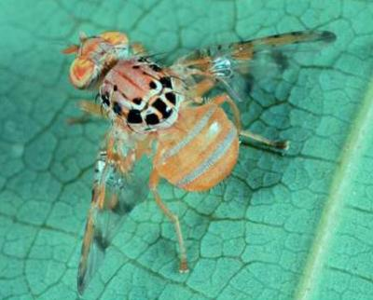
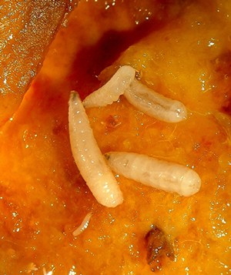
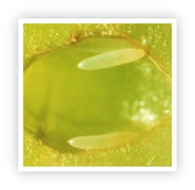
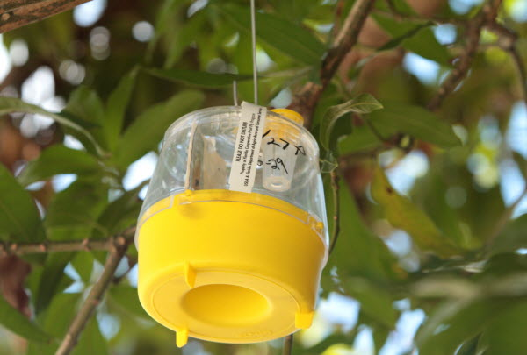
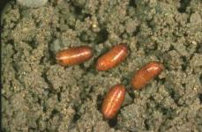
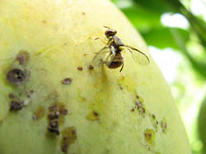
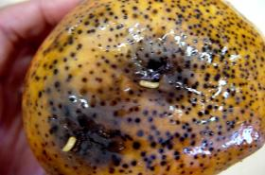
ENTO-306 Agricultural pests and their management 4(3-1)
Insect pests of Fruit Crops Mango fruit fly (Ceratitis cosyra ; Tephritidae, Diptera)
Host plants: Mango, guava, ber, peach
A destructive pest of Mango plant/ fairly distributed in mango orchards
Identification
Adult: Brownish yellow with shinny black spots on thracic notum. 5-8mm long
yellow or brown milky spots/bands on wings
Eggs: Whitish yellow elongated eggs laid inside the mature green fruits.
Larvae: Apodous, ,peg-shaped, creamy white maggots (in fruit pulp)
Pupa: Yellowish brown in colour (in 5-10 cm upper soil layer)
Life history:
Life cycle: 1 – 1.5 month
Adult: 4 – 5 days
Eggs: Hatching takes place in 2 – 3 days. (fecundity 150-350)
Larvae: One to two weeks
Pupa: 2-3 weeks
No. of generations: 2 per year (bivoltine)
Damage:
Active period: March to November
(Pupal hibernation: November to February)
Maximum damage caused in August to November
Egg-laying in fruits by puncturing with ovipositors
Attacked fruit skin/peel gets rottend, giving strong smell
and contains several maggots later on.
Fruit quality deterioration
Control:
Plouging of soil under tree trunk
Regular removal and destruction of rottened and fallen fruits
Pheromone traps (methyl eugenol oil)
Chemical control (Acetamiprid, Imidacloprid, Bifenthrin, Lamda-cyhalothrin)
Notes:
Mango Fruit fly (Ceratitis cosyra). The body and wing colour is yellowish, with black spots. Adult mediterrenean fruit flies are 4-6 mm long,The wings are spotted or banded with yellow and brown margins.
Fruit flies lay eggs under the skin ( 2-4 mm) of mature green and ripening fruit. Some fruit flies such as Bactrocera invadens, a new species recently introduced into East Africa, also lay eggs on small fruit. The eggs hatch into whitish maggots within 1 to 2 days. The maggots feed on the fruit flesh and the fruit starts to rot. After 4 to 17 days, the maggots leave the fruit, making holes in the skin. Adult fruit flies are about 4-7 mm long.
Control
Steiner and McPhail traps traps baited with a lure and toxicant (1% detergent as killing agent or any insecticide) are also used to monitor the presence and control of the flies
The melon fruit fly can successfully be managed over a local area by bagging fruits, field sanitation, protein baits, cue-lure traps, growing fruit fly-resistant genotypes, augmentation of biocontrol agents, and soft insecticides.

Slide 8
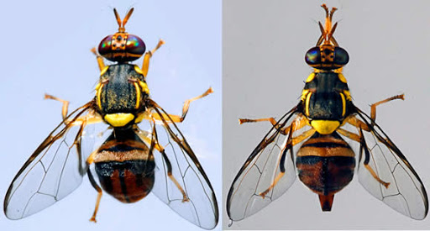
Ovipositor
Male fruit fly
Female fruit fly

Slide 9
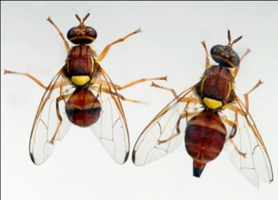
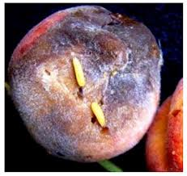
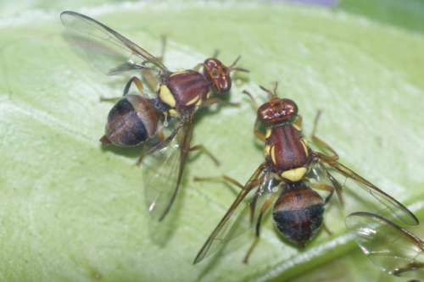
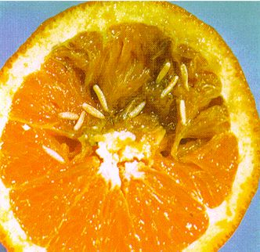
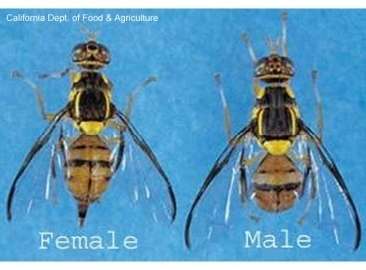
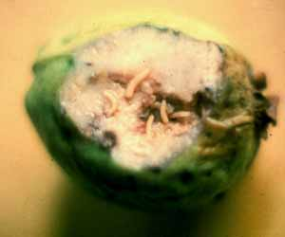
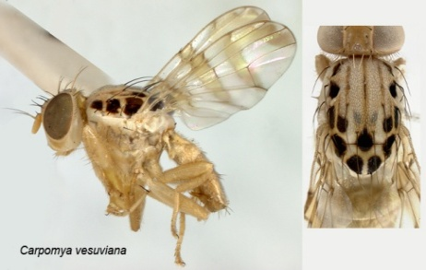
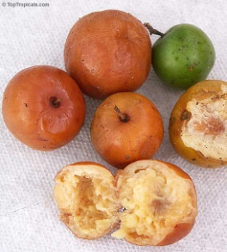
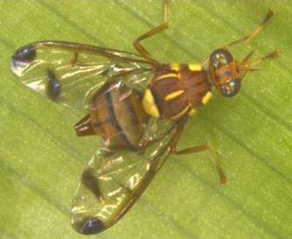
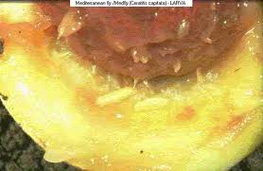
ENTO-306 Agricultural pests and their management 4(3-1)
Different other fruit fly insect pests (Tephritidae: Diptera)
Peach fruit fly (Bactocera zonata)
Citrus fruit fly (Bactocera minax)
Guava fruit fly (Bactocera dorsalis)
Ber fruit fly (Carpomya vesuviana)
Melon fruit fly (Bactocera cucurbitae)
Notes:
Regular collection and destruction of infested fallen fruits (either by burial 1-2 feet under soil or by burning)
Pheromone (Methyl eugenol) trap application in the orchards
Deep soil ploughing after crop harvesting for exposing pupae to predators, sunlight etc.
Heavy irrgation of orchard could also be effective for fruit fly control.

Slide 10
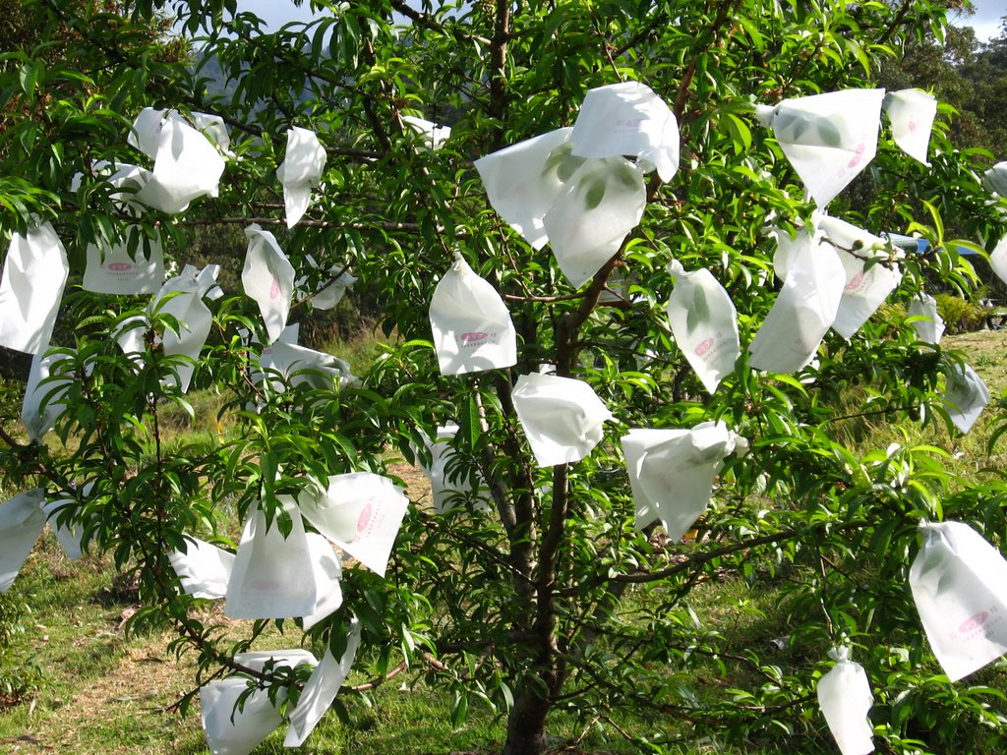
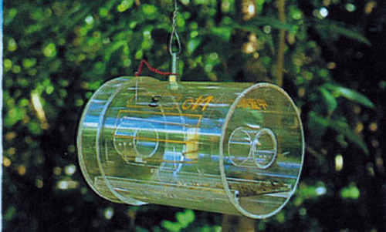
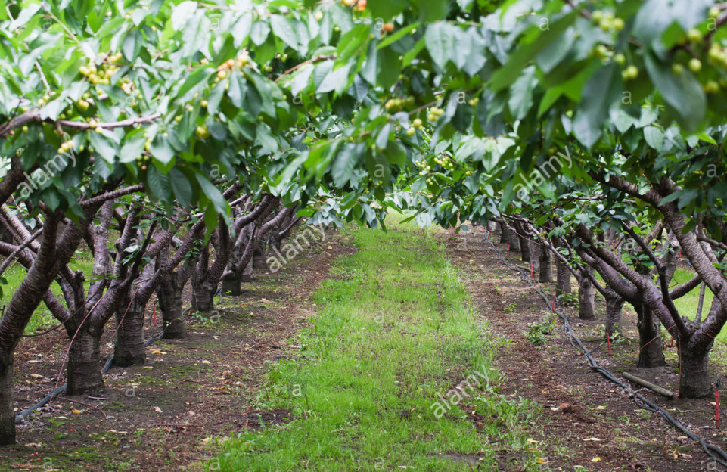
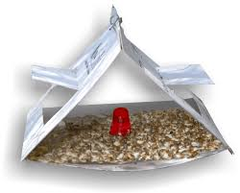
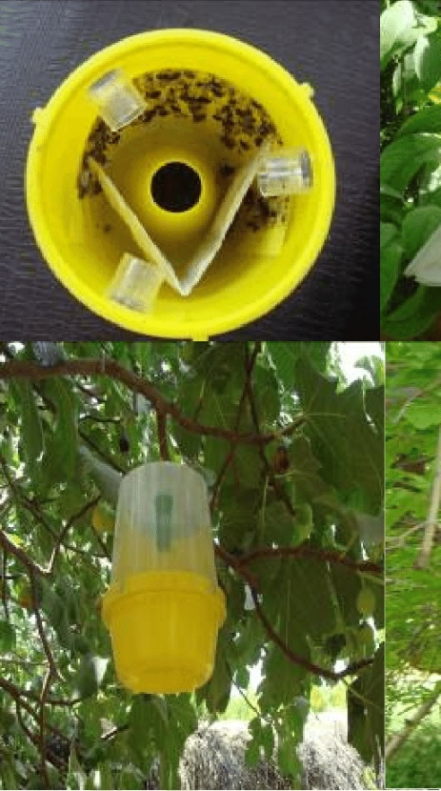
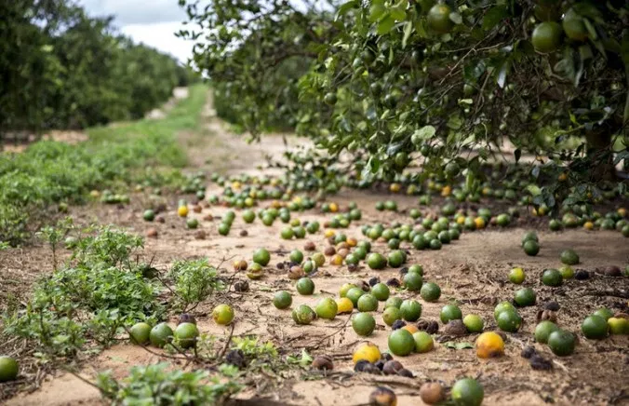

Slide 11
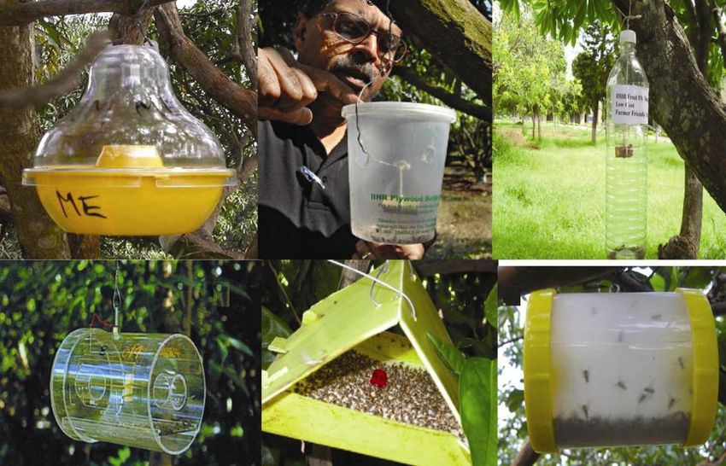
Different types of traps being used all over the world for monitoring and controlling tephritids using methyl eugenol as lure: a, McPhail trap; b, IIHR trap; c, Low-cost IIHR trap; d, Steiner trap; e, Delta trap; f, Live fruit-fly catch trap.
Notes:
Different types of traps being used all over the world for monitoring and controlling tephritids using methyl eugenol as lure: a, McPhail trap; b, IIHR trap; c, Low-cost IIHR trap; d, Steiner trap; e, Delta trap; f, Live fruit-fly catch trap.

Slide 12
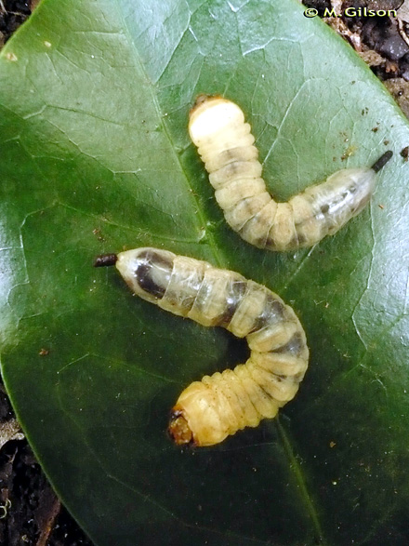
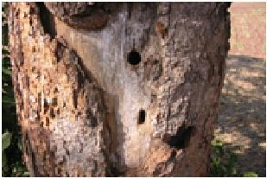
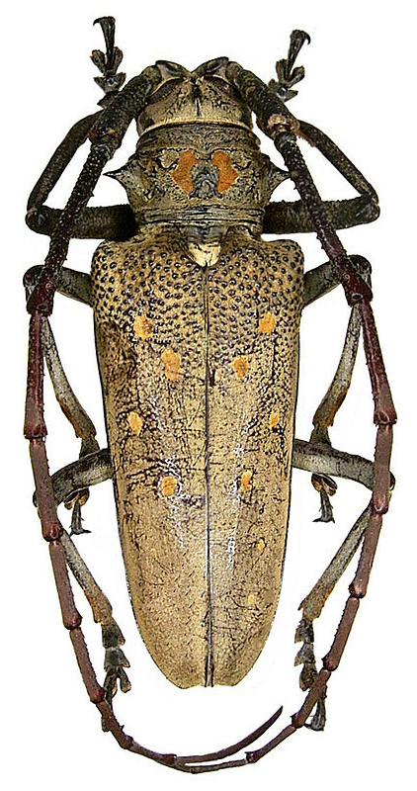
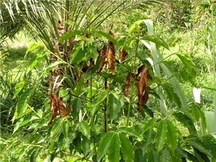
Mango/ Fig Stem Borer (Batocera rufomaculata; Cerambycidae: Coleoptera)

