Slide 1
Genetic diversity
Genetic resources and conservation
BS Biotechnology (6th Semester)
University of Sargodha

Slide 2
Migration
Migration is the act of moving from one place to another.
This activity is most commonly observed in birds but has been documented in many other animals as well, including insects, fish whales, and other mammals.
Migration is a complex behavior that involves
Timing
navigation skill
survival skills

Slide 3
Causes of migration?
Species migrate from one place to another place in response to
Climate change
Availability of food
Season of the year
Breeding season

Slide 4
How do animals know when to migrate?
Internal signals
Hormones
External signals
Temperature
Daylight hours
Scare food supply etc.

Slide 5
Types of migration
Daily migration: Many birds make daily movements from their nest in response to environmental forces E.g. light, darkness, temperature, humidity etc. Daily migration is from their resting site to feeding area, e.g. crows, sparrows,
Local migration: Local migration occurs because of heavy rain, flood, excessive cold &hot .Return to that area when crisis is over. Flowering of certain plants and ripening of fruits also cause local migration.
Seasonal migration: Seasonal migration occurs in response to change in the season. This type of migration is for food or breeding. Species migrating from the south to the north during summer known as “summer visitors” e.g. Snow bunting, red wing, shore lark

Slide 6
Types of migration
Molt migration: Most ducks, males and juveniles birds migrate short distances northward for molting (animals shed old feathers, hair, or skin, or an old shell, to make way for a new growth) leaving behind the females and young birds in breeding ground.
Irregular migration: Some birds disperse for a short Sometimes or long distance for the sake of food and safety. The birds can also swept away by powerful wind and hurricanes to very long distance e.g. blackstork (Ciconianigra), Glossyibis(Plegadisfalcinellus)

Slide 7
Types of migration
Altitude or vertical migrations: Birds living at high altitude descend at lower altitude in winter to save themselves from intense cold of high altitude. They return again to high altitude with advent of summer. Birds migrate either in flocks or in pairs e.g. blue grouse
Latitudinal or equatorial migrations: The birds migrate from east to west and vice- versa. Resident of east Europe and west Asia migrate towards the Atlantic coast e.g. California gull, golden plover
Longitudinal migration: Movement from north to south, and vice versa Birds living in northern temperate and subarctic zones during summer (getting facilities for nesting and feeding) move towards south during winter. Some tropical birds migrate during rainy season to the outer tropics to breed and return to the central tropics in dry season. E.g. gross beaks, starling

Slide 8
Benefits of migration
Despite the dangers of long-distance travel, many different animals have developed migration strategies, presumably as a defense against the greater dangers of environmental uncertainty and competition.
If species permanently migrate to a new place and start breeding there, then it will increase the genetic diversity and will leads to better adaptability and survival of the species.

Slide 9
Effects of migration on ecological communities and ecosystem function
Trophic effects: The migrating specie will cause a competition and will consume the food which will effect the native species of that area.
Transport effects: These are the result of migratory animals acting as vectors for disease, nutrients and energy, and other materials such as seeds across habitat or ecosystem boundaries.
Both of these effects have potential consequences for both local community and ecosystem dynamics.

Slide 10
Gene flow
Gene flow is the movement of genetic material or genes from one population to another. Or we can say that gene flow is the transfer of genes between the individuals of same specie.
Gene flow is also known as gene migration.
Gene flow increase the genetic variations and thus leads to increased genetic diversity.
If the rate of gene flow is high enough, then two populations are considered to have equivalent allele frequencies and therefore effectively be a single population. However, if the gene flow stops, the populations can be diverged into two different species.

Slide 11
Gene flow
Gene flow increases the variability of the gene pool by adding new alleles.
High rates of gene flow can reduce the genetic differentiation between the two groups, increasing homogeneity. For this reason, gene flow has been thought to constrain speciation by combining the gene pools of the groups, thus preventing the development of differences in genetic variation that would have led to full speciation. In some cases migration may also result in the addition of novel genetic variants to the gene pool of a species or population.

Slide 12
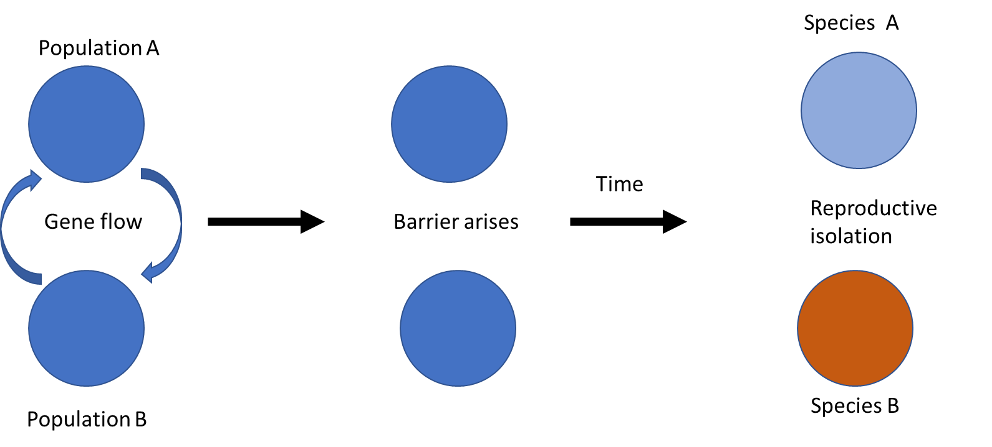
Gene flow

Slide 13
Factors effecting rate of gene flow
Mobility of species or populations ( migration of animals to different locations or spreading of pollens or seeds over long distances)
Population size
Gene flow is expected to be lower in species that have low dispersal or mobility, and when there are small population sizes.

Slide 14
Gene flow
Gene flow can occur through:
Vertical gene transfer: the transfer of genetic material is from parents to offspring. It may be through sexual or asexual reproduction.
Horizontal gene transfer: the transfer of genes between organisms either through transformation (direct uptake of genetic material by a cell from its surroundings), conjugation (transfer of genetic material between two bacterial cells in direct contact), transduction (injection of foreign DNA by a bacteriophage virus into the host cell). Horizontal gene transfer is known to occur between different species.
Hybridization: the process of an animal or plant breeding with an individual of another species or variety. In instances in which the introduced species begins to replace the native species, the native species becomes threatened and the biodiversity is reduced, thus making this phenomenon negative rather than a positive case of gene flow that augments genetic diversity.

Slide 15
Barriers to gene flow
Allopatric speciation is speciation that happens when two populations of the same species become isolated from each other due to geographic changes. Speciation is a gradual process by which populations evolve into different species. A species is itself defined as a population that can interbreed, so during speciation, members of a population form two or more distinct populations that can no longer breed with each other.

Slide 16
Barriers to gene flow
Sympatric speciation is speciation that occurs when two groups of the same species live in the same geographic location, but they evolve differently until they can no longer interbreed and are considered different species. It is different from other types of speciation, which involve the formation of a new species when a population is split into groups via a geographic barrier or migration. Sympatric speciation can be seen in many different types of organisms including bacteria, cichlid fish, and the apple maggot fly, but it can be difficult to tell when sympatric speciation is occurring or has occurred in nature.
Even though the territory that the organisms live in is the same, they are able to split into two different groups that eventually become so genetically different from one another that they can no longer breed with each other. When one group can no longer breed with another, it is a separate species.

Slide 17
