Slide 1
Landscape Photography

Slide 2
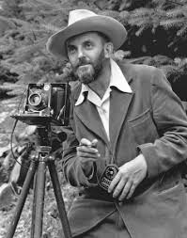
Landscape Photography. “Landscape photography is the supreme test of the photographer - and often the supreme disappointment.” - Ansel Adams.

Slide 3
Ansel Adams

Slide 5
What is the Subject
A landscape is a section or portion of scenery as seen from a single viewpoint. Scenery is the subject of a landscape image. Typically, People and animals are not shown in a landscape, unless they are relatively small in the image and have been included in the composition to show scale.
If natural scenery dominates an image, it can probably be accurately termed a landscape, even through there may be a farmhouse in the distance, a city skyline on the horizon or a road or path in the foreground.

Slide 6
Representational landscape
Representational landscape photography is straightforward:
The mountains
The beach
The Horizon
As it appears in real life. The goal of representational photography is to present the landscape as realistically as possible.
But that doesn’t mean that this is a simple type of photography to make. The weather, the quality of the light, the foliage (or lack of it), the time of day these are all important factors in creating high quality representational landscape photography.

Slide 8
Impressionistic landscape
Impressionistic landscape photography is aimed more at creating an impression of the scene in the viewer’s mind than in conveying the actual scene exactly as it appeared.
Example: A field of flowers may be framed specifically to create an impression of a valley filled with nothing but flowers, or the rapids in a mountain stream may be emphasized to give the impression of a dangerous and photograph doesn’t set out to deceive, but to emphasize some particular aspect or creat an emotional reaction.

Slide 22
Assignment
Look up the following landscape photographers online & save your favorites:
Ansel Adams (Traditional)
Michael frye (non traditional)
David muench (combination of both)
Galen Rowell (traditional)
John Clement (Traditional)
Pakistani Landscape photographer Razaq Vance (combination of both)
Then: work on your “fine my style” photos.

