Slide 1
CCNA (Exam Code: 640-801)
Data and Computer Communications
IP Addressing
Todd Lammle

Slide 2
IP Address
A unique identifier assigned to each machine on an IP network
Designates the specific location of a device on a network
A software address

Slide 3
IP Address MAC Address
Allows a host on one network to communicate with a host on other network
3rd layer address
Software address
Geographical
Hierarchical
IPv4, IPv6
Used for finding hosts on a local network
2nd layer address
Hardware address
Non-geographical
Flat

Slide 4
Terminologies
Network Address
Uniquely identifies each network
Each machine on the same network shares that network address as part of its IP address
E.g. in 172.16.30.56, 172.16 is the network address
Node / Host Address
Uniquely identifies each machine on a network
Each machine on the same network has a unique host address
E.g. in 172.16.30.56, 30.56 is the host address

Slide 5
Terminologies
Broadcast Address
A broadcast address is a logical address at which all devices connected to a multiple-access communication network are enabled to receive datagrams. A message sent to a broadcast address is typically received by all network-attached hosts, rather than by a specific host.

Slide 6
Classes of IPV4 Addresses
Class A:
Format
Network.Host.Host.Host
Range:
0000 0000 – 0111 1111
0 -127
Number of networks
2⁷ = 128 (0 -127)
Number of hosts
2²⁴ -2 = 16,777,216 – 2 = 16,777,214 (All 0’s and all 1’s reserved)
Valid Host ID’s:
Network Address: 10.0.0.0
Broadcast Address: 10.255.255.255
Valid Hosts: 10.0.0.1 – 10.255.255.254

Slide 7
Classes of IP Addresses
Class B:
Format
Network.Network.Host.Host
Range:
10xx xxxx
From:
1000 0000 – 1011 1111
128 -191
Number of networks
2¹⁴ = 16,384
Number of hosts
2¹⁶ -2 = 65536 – 2 = 65534 (All 0’s and all 1’s reserved)
Valid Host ID’s:
Network Address: 172.16.0.0
Broadcast Address:172.16.255.255
Valid Hosts: 172.16.0.1 – 172.16.255.254

Slide 8
Classes of IP Addresses
Class C:
Format
Network.Network.Network.Host
Range:
110x xxxx
From:
1100 0000 – 1101 1111
192 - 223
Number of networks
2²¹ = 2,097,152
Number of hosts
2⁸ -2 = 256 – 2 = 254 (All 0’s and all 1’s reserved)
Valid Host ID’s:
Network Address: 192.168.100.0
Broadcast Address: 192.168.100.255
Valid Hosts: 192.168.100.1 – 192.168.100.254

Slide 9
Classes of IP Addresses
Class D:
Range
224 – 239
Purpose
Multicast
Class E:
Range
240 – 255
Purpose
Scientific

Slide 10
Static and Dynamic IP Address
Static IP Address:
If your IP address at home is static, it means that it will remain the same every time you connect...from home.
Dynamic IP Address:
An IP address that can be changed at any time. This is true but, the fact is, even if you have a dynamic IP address it's possible that it won't change for months on end.
You couldn't set up a reliable server with a changeable IP address. But most of us don't care about that.

Slide 11
Public and Private IP Address
Public IP Address:
A public IP address is the address that is assigned to a computing device to allow direct access over the Internet. A public IP address is globally unique, and can only be assigned to an unique device.
Private IP Address:
A private IP address is a non-Internet facing IP address on an internal network. Private IP addresses are provided by network devices, such as routers, using network address translation (NAT).

Slide 12
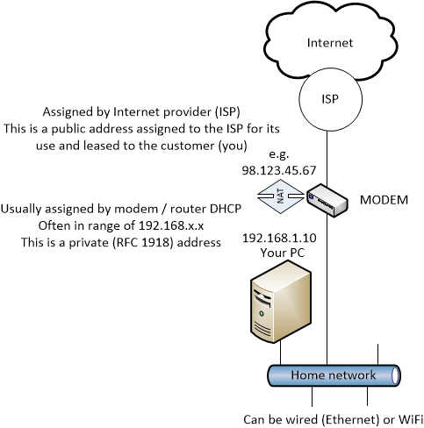
Public and Private IP Address

Slide 13
Private IP Addresses
Used on a private work
Not routable through the internet
Advantages:
Security
Saves address space
Network Address Translation (NAT)
Takes a private IP address and converts it for use on the Internet
Reserved Private Addresses
Class A: 10.0.0.0 - 10.255.255.255
Class B: 172.16.0.0 – 172.31.255.255
Class C: 192.168.0.0 – 192.168.255.255

Slide 14
Broadcast Address
Unicast
Sent to a single destination host
Layer 2 broadcasts
Sent to all nodes on a LAN
Broadcast (layer 3)
Sent to all nodes on the network

Slide 15
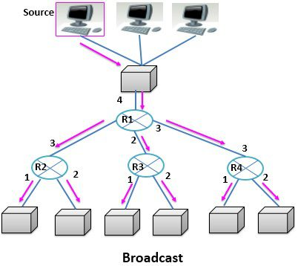
Broadcast Address

Slide 16
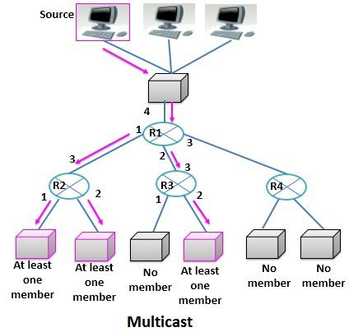
Multicast Address
Packets sent from a single host and transmitted to many devices on different networks

Slide 17
Flavors of NAT
Static NAT
Allows one-to-one mapping between local and global address
Internal host may be server or network device
Dynamic NAT
Maps an unregistered IP address to a registered IP address from out of a pool of IP registered addresses
Overloading
Most popular type
Maps multiple unregistered addresses to a single registered IP address (many-to-one)

Slide 18
Flavors of NAT

Slide 19
Subnetting Network portion increases and bits are borrowed from host. This concept belongs to classless IP addressing
Super-netting IF you increase the host portion by borrowing bits from network then this concept is called supernetting.

Slide 20
Subnet Mask
Allows the machine to distinguish the network portion and host portion of the IP address.
Subnet Masks of Classes:
Class A: 255.0.0.0
Class B: 255.255.0.0
Class C: 255.255.255.0

Slide 21
Subnetting: Example 1C:
Subnet the following IP: 192.168.10.0/26
Network address: 192.168.10.0
Subnet Mask: 255.255.255.192
No. of subnets
2² = 4 = 4 subnets
No. of hosts
2⁶-2 = 62 hosts
Valid subnets
256-192 = 64, 192.168.10.0/ 64/ 128/ 192
Broadcast address?
Valid subnets?

Slide 22
Subnetting: Example 1C cont …
Subnets 0 64 128 192
1st host 1 65 129 193
Last host 62 126 190 254
Broadcast 63 127 191 255

Slide 23
Subnetting: Example 1B:
Subnet the following IP: 172.16.0.0/18
Network address: 172.16.0.0
Subnet Mask: 255.255.192.0
No. of subnets
2² = 4 = 4 subnets
No. of hosts
2¹⁴-2 = 16382 hosts
Valid subnets
256-192 = 64.0, 128.0, 192.0
Broadcast address?
Valid subnets?

Slide 24
Subnetting: Example 1B cont …
Subnets 0.0 64.0 128.0 192.0
1st host 0.1 64.1 128.1 192.1
Last host 63.254 127.254 191.254 255.254
Broadcast 63.255 127.255 191.255 255.255

Slide 25
Subnetting: Example 1A:
Subnet the following IP: 10.0.0.0/16
Network address: 10.0.0.0
Subnet Mask: 255.255.0.0
No. of subnets
2⁸ = 256 subnets
No. of hosts
2¹⁶-2 = 65534 hosts
Valid subnets
256-255 = 1.0.0, 10.1.0.0/ 2.0.0/ 3.0.0, etc. up to 255.0.0
Broadcast address?
Valid subnets?

Slide 26
Subnetting: Example 1A cont …
First two subnets:
Subnets 10.0.0.0 10.1.0.0 …
1st host 10.0.0.1 10.1.0.1 …
Last host 10.0.255.254 10.1.255.254 …
Broadcast 10.0.255.255 10.1.255.255 …
Last two subnets:
Subnets 10.254.0.0 10.255.0.0
1st host 10.254.0.1 10.255.0.1
Last host 10.254.255.254 10.255.255.254
Broadcast 10.254.255.255 10.255.255.255

Slide 27
REVIEW

