Slide 1
What is community ?
Definition
Community is an assemblance of animal and plant species occurring together in a particular area.
Examples
Grassland,a desert,a forest

Slide 2
Plant community
A plant community is a collection or association of plant species within a designated geographical unit,which forms a relatively uniform patch,distinguishable from neighboring patches of different vegetation types.
The component of each plant community are influenced by soil type ,topography,climate and human disturbance.

Slide 3
What is sampling?
The act ,process, or technique of selecting a suitable sample specifically the act ,process or technique of selecting a representative part of a population for the purpose of determining parameters or characteristics of the whole population.

Slide 4
Methods of sampling of plant communities
There are five methods of sampling of plant communities
1.Transect
2.Bisect
3.Trisect
4.Ring Counts
5.Quadrant

Slide 5
1.Transect method
When the vegetation is to be studied along an environmental gradient(e.g.trophical to temperate,high or low rainfall areas or precipitation gradient,adjacent areas with different types of soil ,etc).
A line is laid down across a stand or several stands at right angles.
This method of linear sampling of the vegetation is called transect method

Slide 6
continue…

Slide 7
Types of transect method
Depending upon the object of study ,two types of transect can be drawn
1.Line transect or Line Intercept
2.Belt Transect

Slide 8
Line Transect
In this type of transect the vegetation is sampled only over the line.
A line is laid over the vegetation with a metric steel tape or long rope and kept fixed with the help of hooks.
This line will touch some plants on its way from one point to another.
The observer will start recording these plants from one end and will gradually move towards the other end.

Slide 9
Continue…
From this type of transect following information could be collected
(a)The number of times each species appears along the line.
(b)The trend of increase or decrease of distance between the individuals of a species.
(c)The percentage of occurrence of different species in relation to the total species.
(d)The gradual disappearance or appearance of different species along the line.

Slide 10
ii-Belt Transect
The belt is a long strip of vegetation of uniform width.
The width of the belt is determined according to the type of vegetation.
A belt is generally studied by dividing it into some equal sized segments.
Belt transects are used in determining and understanding the gradual change in abundance,dominance and frequency.

Slide 11
continue…..

Slide 12
2.Bisect
The structure of vegetation with regard to relative height,depth and lateral spread of plants in both aerial and underground parts could be determined by the use of bisects.
The extent of different aerial and underground parts are carefully measured and plotted to scale on coordinate graph paper.
This method reveals the form and interrelationship of underground systems of different species growing in the community and also their relationship to different types and layers of the soil.

Slide 13
continue..
So the bisect studies provide the following informations:
A rough floristic picture of community.
Stratigraphic distribution of different species.
Utilization of space by different species.
Underground structure of plants.
Arrangement and extent of root system etc.

Slide 14
3.Trisect
It is the photographic method of recording the dynamic characters of plant community.
In this technique a particular plot of vegetation is photographed periodically by keeping the camera in the same direction and at the same height.
This technique is effectively used in monitoring the degradation or the recovery of rangeland,secondary succession of a renuded place,spread of disease or some newly introduced weed into the area.

Slide 15
continue..
As these changes take place gradually and very slowly it is essential to keep detailed and permanent record for comparison.
A series of photographs very nicely provides that record.

Slide 16
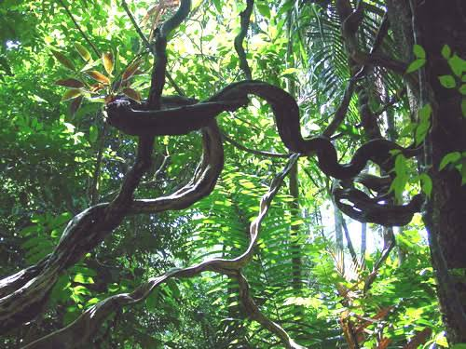
4.Ring Counts
The age of different types of woody plants e.g.trees,shrubs,liana etc may be determined by counting the annual growth rings of the aerial or subterranean stems.
Liana

Slide 17
continue.
Growth rings can also reveal the climatic history of a place chronologically like the years of high rainfall or drought,presence of some chemicals in the soil or atmosphere,forest fire,heavy snowfall etc.
The method is important in determining the successive stages of development of a vegetation and specially the sequence of dominants and subdominants

Slide 18
5.Quadrat Method
The quadrat is a square sample area of varying size marked-off in the plant community for the purpose of detailed study.
Generally a number of quadrats are studied to acquire reasonably faithful data to realise different analytic and synthetic characters of the plant community.
It is also effectively used to determine the exact differences or similarities in the structure and composition between two or more plant communities of related or unrelated vegetation.

Slide 19
Types of Quadrats
1.List Quadrat
Enlisting the names of different species growing in the quadrat.
2.List-Court Quadrat
Records the number of individuals of each species represented in each quadrat.

Slide 20
continue……
3.Chart Quadrat
Records the position and areas covered by bunches,mats or tufts of grasses,mosses etc, on the coordinated or graph paper.These graphs help to compare any change in structure of community in future.
4.Clip Quadrat
For the study of biomass or weight of each species,all individuals are uprooted.

