Slide 1
Perspective
Andleeb RAna

Slide 2
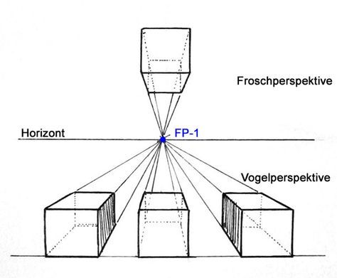
What is perspective?
a method of showing distance in a picture by making far away objects smaller

Slide 4
How many types of perspective can be ?

Slide 5
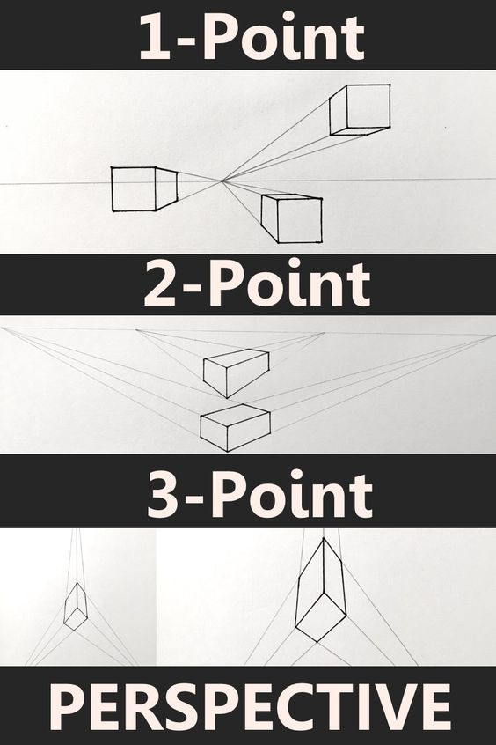
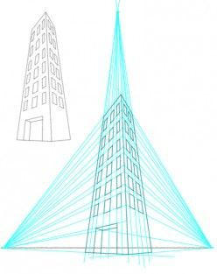
3

Slide 6
1 point

Slide 7
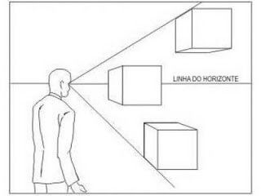
Eye level
Above
Same
Below

Slide 8
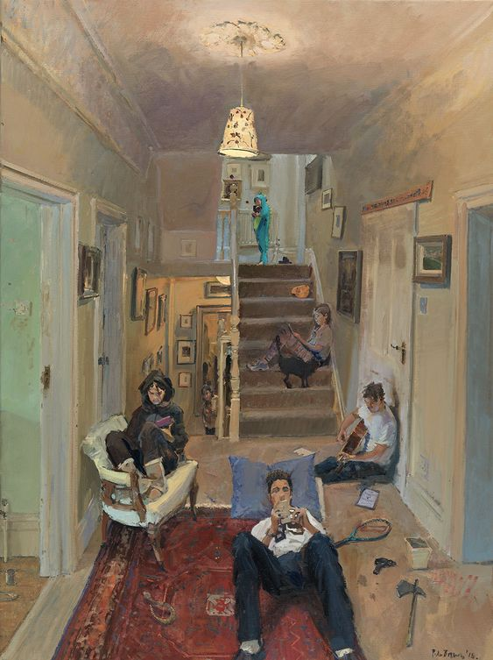

Slide 9
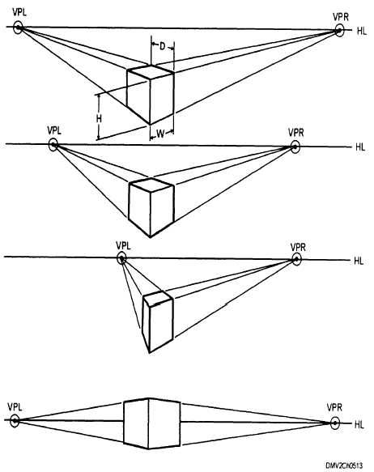
2 point
Vanishing Point
Horizon line

Slide 12
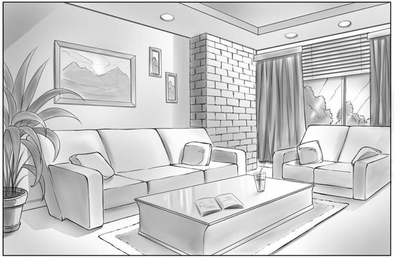

Slide 13
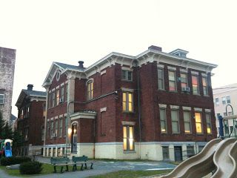

Slide 14
3 point

Slide 15
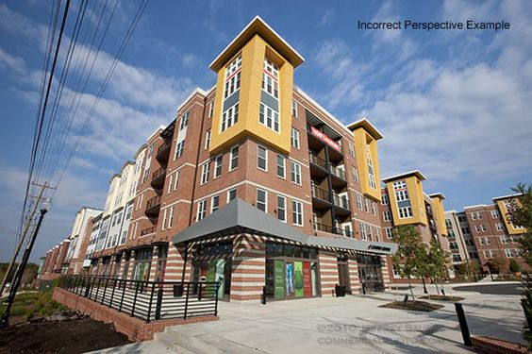

Slide 16
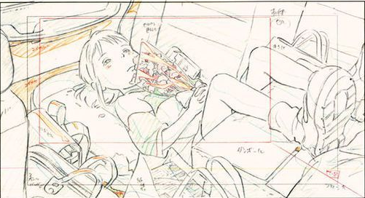
Find the perspective?

Slide 17
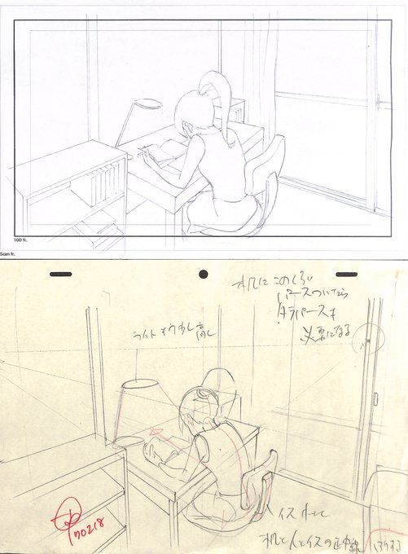

Slide 18
Find some more

Slide 19
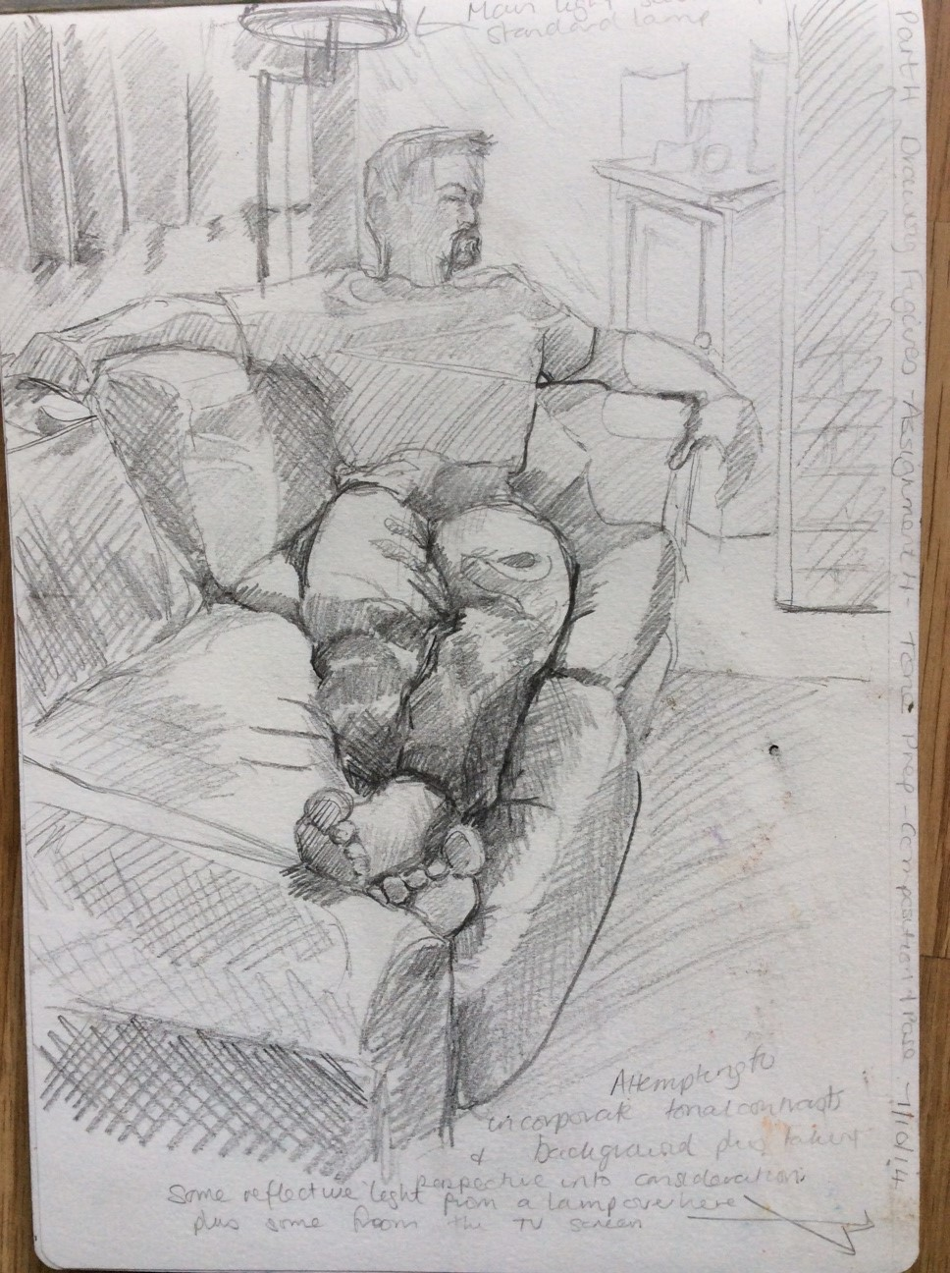

Slide 21
Try your perspective

