Slide 1
Refining Clinical Question

Slide 2
Steps for practising evidence-based physiotherapy
Step 1 : Converting information into answerable question
Step 2 : Tracking best Evidence
Step 3 :Critically appraise evidence for validity impact & applicability
(Appraise : Estimate or determine the nature, value, quality, ability, extent, or significance… )

Slide 3
Steps for practising evidence-based physiotherapy
Step 4: Apply evidence
integration of evidence with Experience knowledge & pt’s expectations
Step 5: check effectiveness and efficiency

Slide 4
Mostly clinical questions are related to
Effects of intervention
Patient’s experiences
Prognosis
Accuracy of Diagnostic tests

Slide 5
Clinical research that answers these sorts of question is therefore the most important research for clinical practice.
how to answer such questions with high-quality clinical research?
In practice , many clinical questions are complex and require the synthesis of findings of several types of research

Slide 6
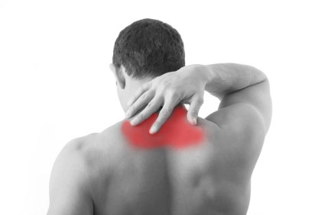
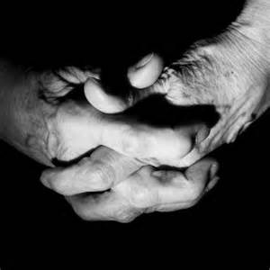
Middle age man
Acute neck pain
He is being told that a course of Cervical Mobs & manipulation will relieve his symptoms
How to proceed further
What questions can come in our mind?
Effects of manual therapy in pain?
Natural course of acute neck pain?
Patients perception/expectations of Manual therapy

Slide 7
Acute neck pain case ..cont
studies of the effectiveness of mobilization and manipulation show a moderate effect on pain and disability (Gross et al 2004)
Natural course of this condition(neck pain) indicates a fairly favorable prognosis (Borghouts et al 1998).

Slide 8
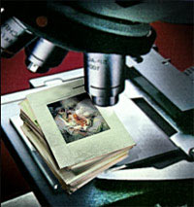
Qs about Aetiology
Questions about aetiology are usually not so important in practice
Whether sitting for long hours is likely cause of neck pain in case of software developer.
Whether lifting heavy weight was the likely reason of back pain?

Slide 9
Qs about aetiology cont..
Preclinical ….
Does my intervention cause any harm?
What type of studies will answer this question
Chest physiotherapy may be associated with brain damage in extremely premature infants
Cervical manipulation is one intervention that is known to produce occasional harm
(Di Fabio 1999)

Slide 10
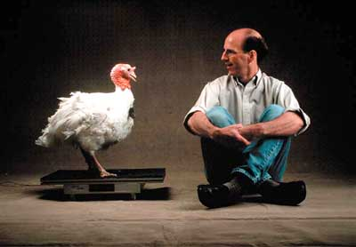
Turkey on WBV
Clinton Rubin
Notes:
Whole body vibration. National geographic. Space travel
application of extremely low level strains to animals and humans will increase bone formation, and thus may represent the much sought after “anabolic” stimulus in bone. –
( http://www.lanisimpson.com/2010/09/14/wed-915-whole-body-vibration-with-dr-clinton-t-rubin-ph-d/#sthash.rrzfvXlW.dpuf)

Slide 11
EFFECTS OF INTERVENTION

Slide 12
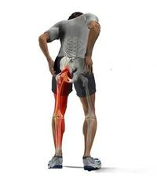
43 yrs old
LBP of acute onset(2 weeks)
Radiating pain to Lt leg
Heavy lifting at work
Gradually become worsen
No neurological deficit
Analgesics, Anti –inflammatory & bed rest
Little improvement
Referred to Physical Therapy for pain relief & physical functional restoration(prevention of disability)
Notes:
BEST Rx for Pts with back pain. What the evidence says about back pain. we are uncertain . Uncertainty prompts (give incentive to action) clinical question .
A precondition for EBPT
Appraise:- Estimate or determine the nature, value, quality, ability, extent, or significance of

Slide 13
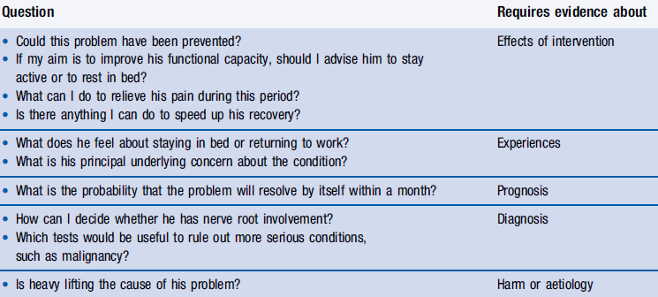

Slide 14
P: Middle age man with acute low back pain
I: Bed rest
C: to stay active
O : Pain & disability
(Pain relief & prevention of disability)

