Slide 1
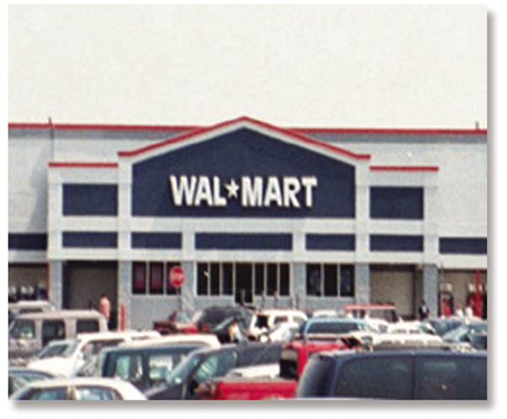
Chapter 1
An Introduction to Retailing
RETAIL
MANAGEMENT:
A STRATEGIC
APPROACH
9th Edition
BERMAN EVANS

Slide 3
Retailing
Retailing encompasses the business activities involved in selling goods and services to consumers for their personal, family, or household use. It includes every sale to the final consumer.

Slide 4
Manufacturer’s Perspective
The Four P’s of Marketing

Slide 5
Manufacturer’s Perspective
The Four P’s of Marketing
Retailers are part of the
distribution channel
Retailers are part of the
distribution channel
Product
Distribution
Price
Promotion

Slide 6
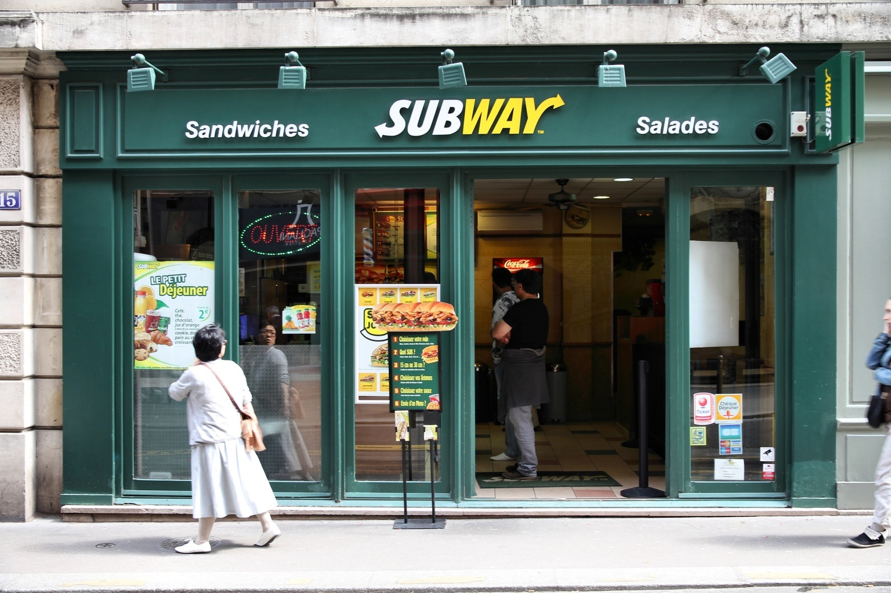
The Framework of Retailing

Slide 7
Reasons to study Retailing
Retailing is an important field to study because of its impact on the economy
its functions as liaison in distribution,
and its relationship with firms selling goods and services to retailers for their resale or use.

Slide 8
Distribution Types
Exclusive: suppliers make agreements with one or few retailers, designating such retailers as the only ones to carry certain brands or products within a specified geographic area i.e. Rolex, Apple, BMW and Benz in Pakistan
Selective: suppliers sell through a moderate number of retailers i.e. shopping products in Malls and departmental stores.
Intensive: suppliers sell through as many retailers as possible i.e. FMCG

Slide 9
The Retailer’s Role in the Sorting Process

Slide 10
Exclusive vs Intensive Distribution
Exclusive Distribution– Fate of retailer is tied to manufacturer success, retailer has no “free-rider” concerns, retailer has less price competition, manufacturer is better assured of high levels of customer support
Intensive Distribution- Manufacturer is better assured of maximizing sales (especially for convenience goods), retailers face strong competition for price and service

Slide 11
A Typical Channel of Distribution
Retailer
Manufacturer
Wholesaler
Final
Consumer
FMCG’s through Grocery/Kirana store, Mobile retailers,
Smart shops

Slide 12
Distributor as Retailer
Manufacturer
Wholesaler
Final
Consumer
Daraz.pk, Malls, Hyperstar, Pharma co’s, Metro, Automotive

Slide 13
Manufacturer as Retailer
Manufacturer
Final
Consumer
Dell, Servis, K n N’s, Sabroso, Khaadi, J.Dot, Automotive

Slide 14
Retailing in Service Sector

Slide 15
Largest Retailer in World?

Slide 16
Top 100 Retailers Amazon.com, Walmart, Metro Cash & Carry, Alibaba.com, GAP inc., H&M, Target, Sears, Kmart, Seven Eleven, Carrefour, Seiyu... https://nrf.com/2014/top100-table

Slide 17
Figure 1-7: Comparing Distribution Types

Slide 18
Special Characteristics Affecting Retailers
Three factors that most differentiate retailing from other types of business are noted and discussed here. Each factor imposes unique requirements on retail firms.

Slide 19
Special Characteristics Affecting Retailers
Small
Average
Sale
Impulse
Purchase
Retailer’s
Strategy
Popularity
of
Stores

Slide 20
Small Average Sale
This low amount creates a need to tightly control the costs associated with each transaction (inventory, bags etc) to maximize the number of customers drawn to the retailer, which may place more emphasis on special promotions to increase impulse sales by more aggressive selling.
The average amount of a sales transaction for retailers is much less than for manufacturers.

Slide 21
Impulse Purchase
Final consumers make many unplanned or impulse purchases.
This behavior indicates the value of in-store displays, attractive store layouts, and well-organized stores, catalogs, and Web sites.

Slide 22
Popularity of Stores
Many people like to shop in person; want to touch, smell, and/or try on products; enjoy browsing for unplanned purchases.
They must work to attract shoppers to stores and consider such factors as store location, transportation, store hours, proximity of competitors, product selection, parking, and ads.

Slide 23
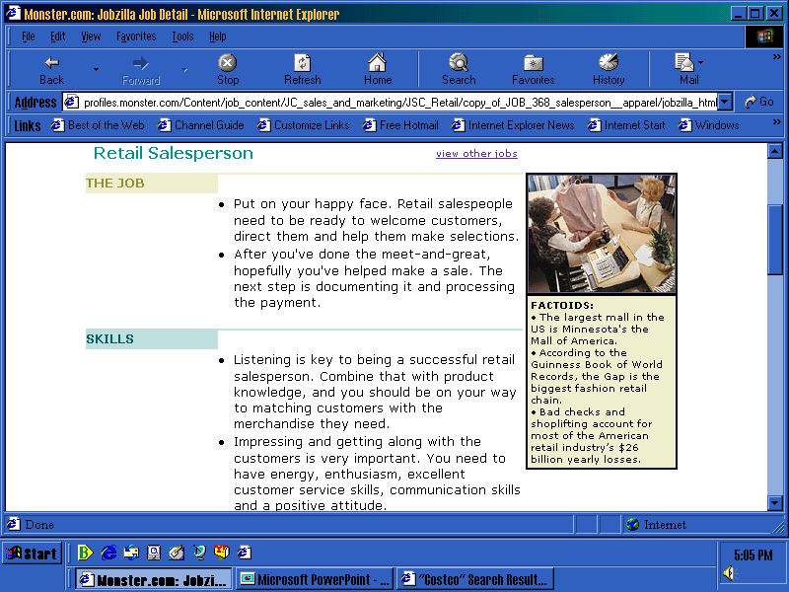
Career Pathways to Success

