Slide 1
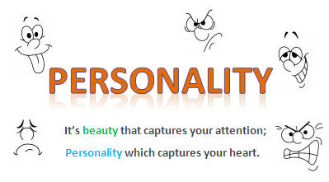
Personality
Course Code: LIS-207 (BS LIS 4th Self Support)
Ms. Qurat-ul-Ain

Slide 2
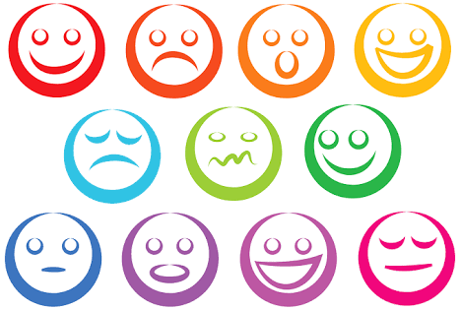
DEFINITIONS
Personalities is the sum total of individual’s Psychological traits, characteristics, motives, habits, attitudes, beliefs and outlooks.

Slide 3
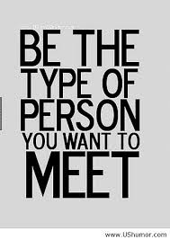
Personality is a set of psychological traits. Personality influence others interaction and adoption to avoid it or attract. Personality attract others by the attitude, morality, character, clean cloth etc.
Personality totally depends upon the psychology. The human mind make us to behave either positive or negative. It gives us order to do any thing either love or hate etc.
Attitude
Cognition.
Emotions.
Behavior.

Slide 4
Continue…
Personality is the sum total of ways in which an individual reacts and interacts with others. Or Personality is generally defined as the deeply ingrained and relatively continuing patterns of thought, feeling and behavior. In fact, when one refers to personality, it generally implies to all what is unique about an individual, the characteristics that makes one stand out in a crowd.

Slide 5
Continue…
According to the Cambridge international dictionary of English, ‘your personality is the type of person you are, which is shown by the way you behave, feel and think.’
Personality, according to the Longman dictionary of contemporary English, is the ’whole nature or character of a person.’ How a person behaves, feels and thinks, how he conducts himself in a given set of circumstances is largely determined by the state of his mind.

Slide 6
Personality determinants.
Heredity
Environment
situation

Slide 7
1.Heredity :
Heredity refers to those factors that were determined at conception. Physical structure, facial attractiveness, gender, temperament, muscle structure and reflexes, energy level, and biological rhythms are characteristics that are generally considered to be either completely or significantly influenced by who your parents were, that is by their biological, physiological and inherent psychological makeup.

Slide 8
2.Environment:
The environmental factors that apply pressures on our personality formation are the culture in which we are raised, our early conditioning, the norms among our family, friends and social groups, and other influences that we experience. The environment to which we are exposed plays a substantial role in shaping our personalities.
It relates to the social psychology. “Social psychology is the study of individual and its effect in society and effects of society on an individual.” society also create impact on the personality of an individual. Environment compels an individual to change his/her habits and personality

Slide 9
3. Situation:
A third factor, the situation, influences the effects of heredity and environment on personality. An individual’s personality although generally stable and consistent, does change in different situations. The varying demand of different situation calls forth different aspects of one’s personality. We should not therefore look upon personality patterns in isolation.
For example, a person’s behavior will be totally different when he is in office , in front of his boss. When compared to his hangout with old friends in a café.
In this way, situational factors impact a personality in a significant way. They often bring out the traits of a person that are not commonly seen.

Slide 10
QUESTIONS???

