Slide 1
Circulatory System Of Insects
Dr. M. Asam Riaz

Slide 2
Outlines
Introduction
Dorsal vessel
Sinuses and diaphragm
Pulsatile organs
Hemolymph
Hemocytes
Hemocytes functioning

Slide 3
Introduction
Insects have an open blood circulatory system.
Blood is called hemolymph moves freely in body cavity called Hemocoel and directly makes contact with tissues and organs.
The hemolymph flows freely with pressure and provides nutrients to body tissues.

Slide 5
Dorsal vessel
Blood flows in the dorsal midline below terga.
Its length is equal to body length and attached to dorsal body wall by elastic filaments.
It consists of two parts; one is anterior aorta and other isposterior heart .
Posterior heart is usually extend up to abdomen but may extend further in some species.

Slide 6
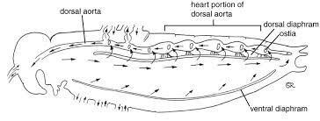
Hearts have muscles called alary muscles
slit-like openings in the lateral wall of the heart called Ostia.
The anterior and posterior lips of ostioles permits flow of hemolymph during diastole (relaxing) and prevent it during systole (contraction).
After diastole, lips are forced together by the pressure of hemolymph in heart and closed throughout systole.

Slide 7
Sinuses and diaphragm
Hemocoel of insects consists of 3 sinuses;
dorsal pericardial sinus,
a perivisceral sinus, and
a ventral perineural sinus.
Dorsal and ventral diaphragms separates the perivisceral from pericardial and perineural sinus.
Lateral limits of the diaphragm are indeﬁnite and are determined by presence of muscles, tracheae or the origins of alary muscles which form integral part of diaphragm.

Slide 8
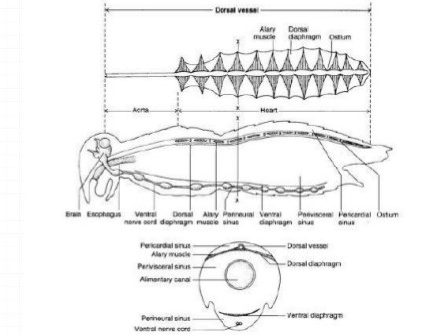
The perinueral and perivisceral sinuses are separated by the ventral diaphragm on nerve cord. It is found in both the adults and larvae of some insect orders.

Slide 9
Pulsatile organs
a minute muscular organ functioning as an accessory heart in various insects
These are the helping organs that makes easy the bulk flow of hemolymph, especially in wings, legs, antennae and ovipositor.
These are the small tube like structures that helps in the proper regulation of hemolymph throughout the body appendages.
Some insects have long cerci in which maintenance of hemolymph ﬂow might require some special feature, e.g Ephemeroptera have small, non-contractile vessels extending from posterior end of the heart into the cerci.

Slide 10
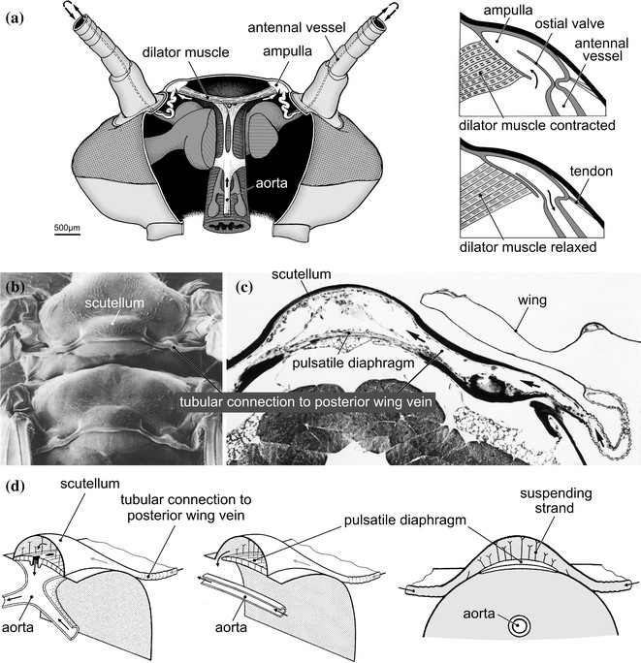

Slide 11
Hemolymph
The blood of insects is said to be as hemolymph.
It is usually of green or yellow in color because it doesn’t contain haemoglobin.
It consists of fluid plasma that contains hemocytes.

Slide 12
The pH of insect hemolymph is in-between 6-8.
The plasma of hemolymph is rich with proteins.
Many of the most abundant proteins play key roles in the transport and storage of nutrients between organs and in systemic immunity.
It consists of 20-25% water of the total body weight in many insects and it generates a pressure during ecdysis.

Slide 13
Hemocytes
Hemocytes are the cells residing in hemolymph.
Hemocytes are produced in structures known as hematopoietic organs.
They mediate the cellular arm of the insect immune response especially phagocytosis and in many insects.
25,000 to more than 100,000 per cubic millimeter, (300,000 platelets, and 7000 white blood cells found in the same volume of human blood)
The hemocytes have variously been classiﬁed by the criteria of morphology, function and molecular markers.

Slide 14
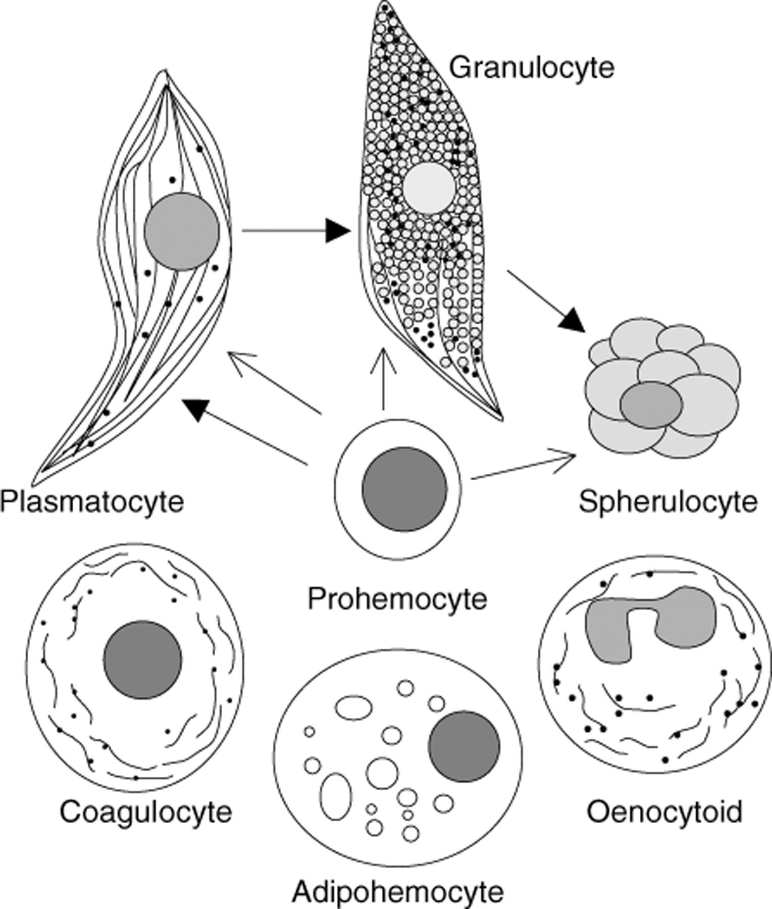
-2
3-
5-
1-
4-

Slide 15
Types of hemocytes
1- Prohemocyte
These are stem cells from which other hemocytes are developed.
These are small cells with very little cytoplasm.
2- Granulocyte
Contains large numbers of intracellular granules.
Granulocytes represent the most abundant hemocytes in many Lepidoptera.

Slide 16
3- Plasmatocyte
Large cell type that is strongly adherent and spreads across foreign surfaces.
These are not evident in aphids and anopheles.
4- Oenocytoid
Non adherent cell.
5- Spherulocyte
Large cells.
Contains circular components.

Slide 17
Hemocytes functioning
Plays a crucial role in development and immunity.
In embryo, the hemocytes phagocytose cells that performed cell death as a normal part of development.
Secrete extracellular matrix and other proteins that promote organogenesis.
Helps in wound healing and protection against infection.
Hemocytes remove a variety of small particles, including isolated bacterial cells and yeasts, as well as synthetic beads, by phagocytosis.

