Slide 1
William Stallings Data and Computer Communications 9th Edition
_{Chapter 2}
Protocols and Architecture

Slide 2
Need For Protocol Architecture
E.g. File transfer
Source must activate comms. Path or inform network of destination
Source must check destination is prepared to receive
File transfer application on source must check destination file management system will accept and store file for his user
In case of incompatible file formats, we may require file format translation
Task broken into subtasks
Implemented separately in layers in stack
Functions needed in both systems
Peer layers communicate

Slide 3
Protocol
A protocol is a set of rules that governs the communications between computers on a network. In order for two computers to talk to each other, they must be speaking the same language.

Slide 4
Key Elements of a Protocol
Syntax
Data formats
Signal levels
Semantics
Control information
Error handling
Timing
Speed matching
Sequencing

Slide 5
Protocol Architecture
Task of communication broken up into modules
For example file transfer could use three modules
File transfer application
Communication service module
Network access module
Nature of exchange between systems is independent of the nature of the network that connects them.

Slide 6
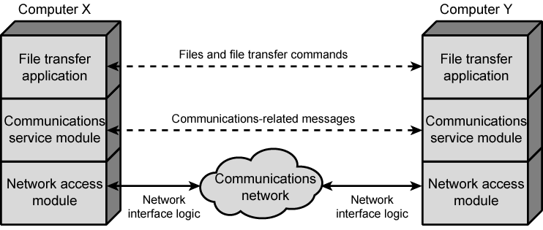
Simplified File Transfer Architecture

Slide 7
A Three Layer Model
Network Access Layer
Transport Layer
Application Layer

Slide 8
Network Access Layer
Exchange of data between the computer and the network
Sending computer provides address of destination
May invoke levels of service
Dependent on type of network used (LAN, packet switched etc.)

Slide 9
Transport Layer
Reliable data exchange
Independent of network being used
Independent of application

Slide 10
Application Layer
Support for different user applications
e.g. e-mail, file transfer

Slide 11
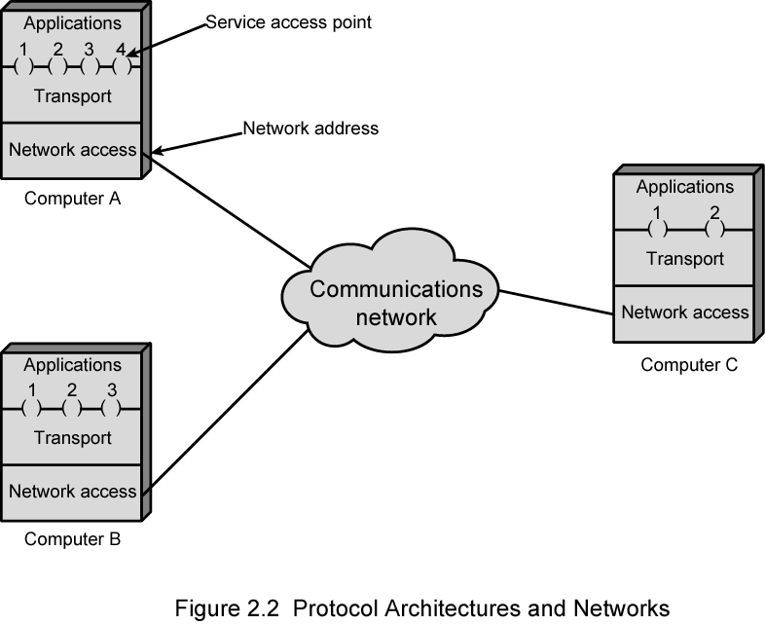
Protocol Architectures and Networks

Slide 12
Addressing Requirements
Two levels of addressing required
Each computer needs unique network address
Each application on a (multi-tasking) computer needs a unique address within the computer
The service access point or SAP
The port on TCP/IP stacks

Slide 13
Protocol Data Units (PDU)
At each layer, protocols are used to communicate
Control information is added to user data at each layer
Transport layer may fragment user data
Each fragment has a transport header
Destination SAP
Sequence number
Error detection code
This gives a transport protocol data unit

Slide 14
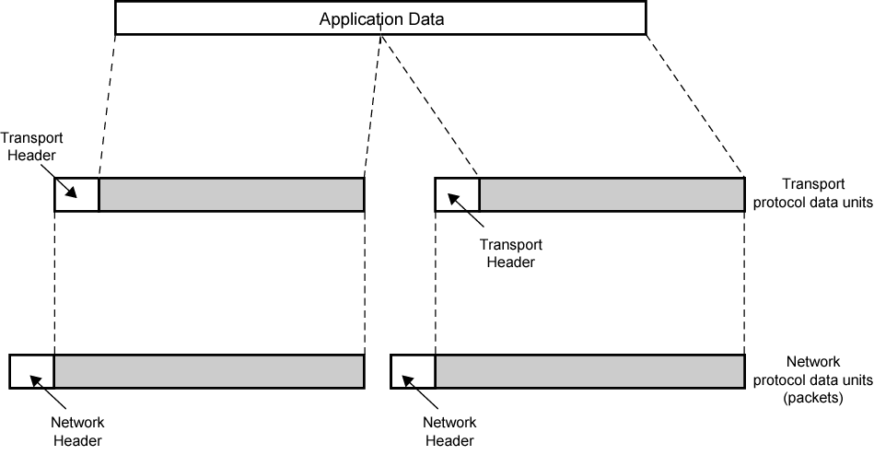
Protocol Data Units

Slide 15
Network PDU
Adds network header
network address for destination computer
Facilities requests

Slide 16
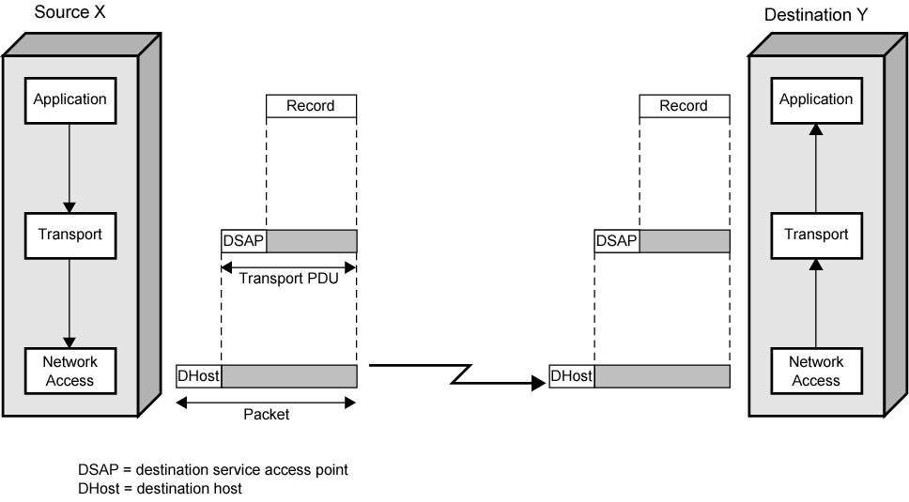
Operation of a Protocol Architecture

Slide 17
OSI
Open Systems Interconnection
Developed by the International Organization for Standardization (ISO)
Seven layers

Slide 18
OSI - The Model
A layer model
Each layer performs a subset of the required communication functions
Each layer relies on the next lower layer to perform more primitive functions
Each layer provides services to the next higher layer
Changes in one layer should not require changes in other layers

Slide 19
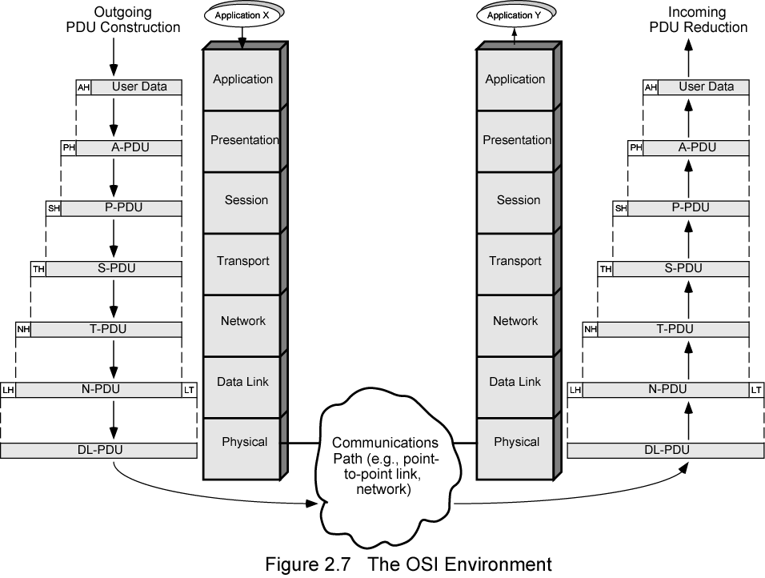
The OSI Environment
Notes:
In communication technology, trailer or footer refers to supplemental data placed at the end of a block of data being stored or transmitted, which may contain information for the handling of the data block, or just mark its end.

Slide 20
OSI Layers (1)
Physical
Physical interface between devices
Hub operates at the physical layer
Data Link
Means of activating, maintaining and deactivating a reliable link
Error detection and control
Higher layers may assume error free transmission
Switch operates at the data link layer

Slide 21
OSI Layers (2)
Network
Transport of information
Higher layers do not need to know about underlying technology
Not needed on direct links
Routers operate at the network layer
Important Protocols at this layer: IP
Transport
Exchange of data between end systems
Error free
In sequence
No losses
No duplicates
Quality of service
Important Protocols at this layer: TCP, UDP

Slide 22
OSI Layers (3)
Session
Control of dialogues between applications
Dialogue discipline
Grouping
Recovery
Presentation
Data formats and coding
Data compression
Encryption
Application
Means for applications to access OSI environment

Slide 23
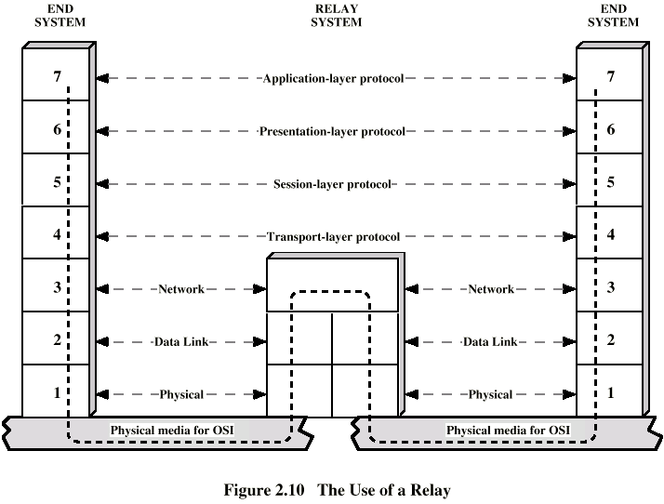
Use of a Relay

Slide 24
TCP/IP Protocol Architecture
Developed by the US Defense Advanced Research Project Agency (DARPA) for its packet switched network (ARPANET)
Used by the global Internet
No official model but a working one.
Application layer
Host to host or transport layer
Internet layer
Network access layer
Physical layer

Slide 25
Physical Layer
Physical interface between data transmission device (e.g. computer) and transmission medium or network
Characteristics of transmission medium
Signal levels
Data rates
etc.

Slide 26
Network Access Layer
Exchange of data between end system and network
Destination address provision
Invoking services like priority

Slide 27
Internet Layer (IP)
Systems may be attached to different networks
Routing functions across multiple networks
Implemented in end systems and routers

Slide 28
Transport Layer (TCP)
Reliable delivery of data
Ordering of delivery

Slide 29
Application Layer
Support for user applications
e.g. http, SMTP

Slide 30
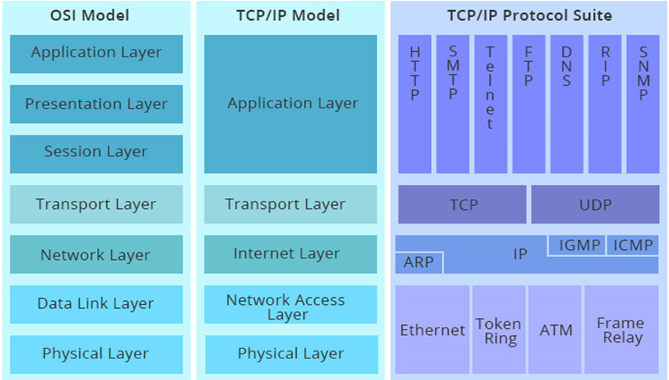
OSI v TCP/IP

Slide 31
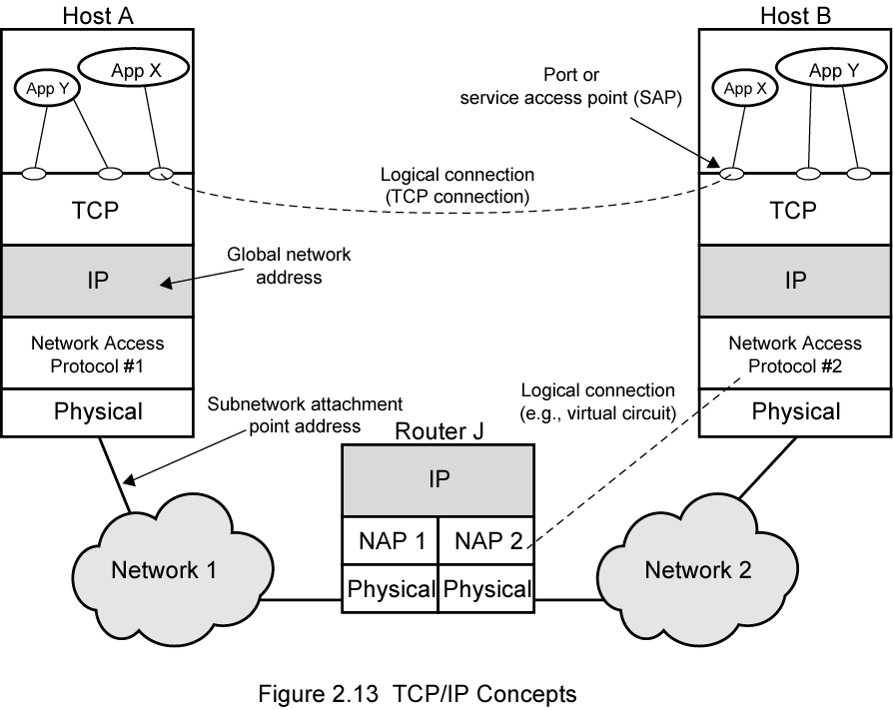
TCP/IP Concepts

Slide 32
Addressing level
Level in architecture at which entity is named
Unique address for each end system (computer) and router
Network level address
IP or internet address (TCP/IP)
Network service access point or NSAP (OSI)
Process within the system
Port number (TCP/IP)
Service access point or SAP (OSI)

Slide 33
Trace of Simple Operation
Process associated with port 1 in host A sends message to port 2 in host B
Process at A hands down message to TCP to send to port 2
TCP hands down to IP to send to host B
IP hands down to network layer (e.g. Ethernet) to send to router J
Generates a set of encapsulated PDUs

Slide 34
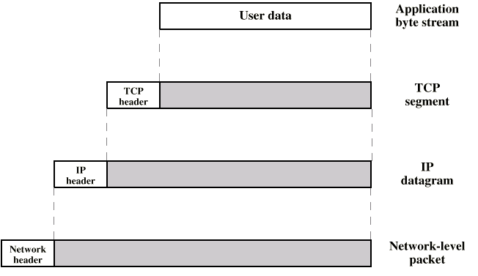
PDUs in TCP/IP

Slide 35
UDP(User Datagram Protocol)
Transport-level protocol
Does not guarantee delivery
Connectionless
Optional use of the checksum

Slide 36
TCP Header
Notes:
TCP segments include a header. Stallings DCC8e Figure 2.3a shows the header format for TCP, which is a minimum of 20 octets, or 160 bits. The Source Port and Destination Port fields identify the applications at the source and destination systems that are using this connection. The Sequence Number, Acknowledgment Number, and Window fields provide flow control and error control. The checksum is a 16-bit frame check sequence used to detect errors in the TCP segment. Chapter 20 provides more details.

Slide 37
UDP Header
Notes:
Because it is connectionless, UDP has very little to do. just adding a port addressing capability to IP. This is best seen by examining the UDP header, shown in Stallings DCC8e Figure 2.3b. The UDP header also includes a checksum to verify that no error occurs in the data; the use of the checksum is optional.

Slide 38
IP Header
Notes:
For decades, the keystone of the TCP/IP protocol architecture has been IP. Stallings DCC8e Figure 2.4a shows the IP header format, which is a minimum of 20 octets, or 160 bits. The header, together with the segment from the transport layer, forms an IP-level PDU referred to as an IP datagram or an IP packet. The header includes 32-bit source and destination addresses. The Header Checksum field is used to detect errors in the header to avoid misdelivery. The Protocol field indicates which higher-layer protocol is using IP. The ID, Flags, and Fragment Offset fields are used in the fragmentation and reassembly process. Chapter 18 provides more detail.

Slide 39
Example Header Information
Destination port
Sequence number
Checksum

Slide 40
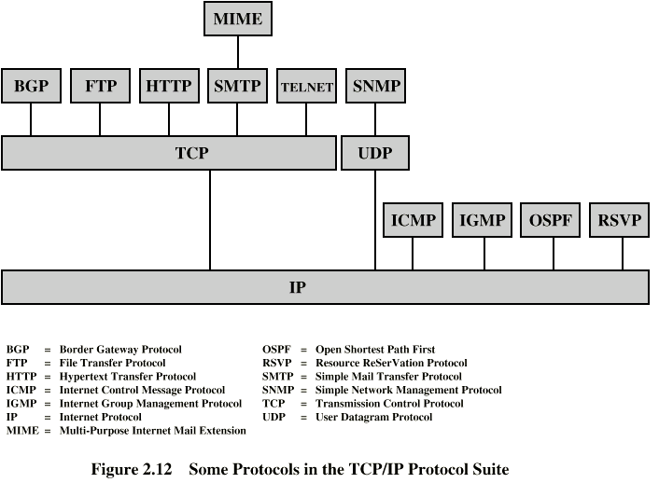
Some Protocols in TCP/IP Suite

Slide 41
End of chapter 2
Quiz of chapter 2 due

