Slide 1
ONION
Technical Name: Allium cepa
Family: Amaryllidaceae
Origin:
Afghanistan
Tajikistan
Uzbekistan
India

Slide 2
Uses
It is known as poor man food
Used when green stage and mature as bulbs
Also used in meat dishes, salad sand witches and soups
Its pungency due to a volatile oil (allyl Propyl disulphide)
Mature buds contain some
starch
Sugar
Protein
Vitamins A,B, C

Slide 3
Climate
It is cool season crop
Length of the day
Day length requirement of different varieties may differ
For bulb formation: high temperature and long photoperiod
Seed stalk: temp more important than day length

Slide 4
Soil:
Fertile soil with rich in humus
Well drained
pH 5.8-6.5
Fertilizer:
Fertilizer vary with
Soil type
Previous fertilizer application
Purpose for which crop grown
FYM: 40-50 t/ha
NPK: 120-60-60 kg/ha

Slide 5
Spacing:
Row to Row: 20 cm
Plant to Plant: 10 cm
Seed Rate:
For nursery
8-10 Kg/ha
Direct sowing:
25 Kg/ha
Bulb
1000-1200 kg/ha
They dibbled 15 cm apart in rows 45 cm apart

Slide 6
Irrigation
A seed bed usually irrigated immediately before transplanting
Irrigation stopped when tops mature and start falling
Varieties
Faisalabad early,
Pindi red
Ghotki
local white
Phulkara
Thanobola khan
Red Nasik
Desi red

Slide 7
Planting time
Seedlings raised between June and September from July to October
In plains of Pakistan for winter crops, seeds sown from middle of October to end of November
In December and January when seedlings reach the age of 8-10 weeks, they are transplanted
In the hills, seeds are sown from march to June

Slide 8
Harvesting
Green bunch onions harvested when diameter of a lead pencil and small bulb has formed
Mature bulbs can be pulled out easily by hand if soil is not hard
Yield
25-30 t/ha

Slide 9
Potato
Botanical Name: Solanum tuberosum L
Family: Solanaceae
Introduced into Europe in the 6 th century by the Spanish
Now it is cultivated through the word including Indo-Pakistan
It is also used as staple food crop

Slide 10
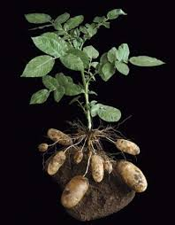
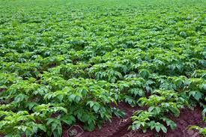
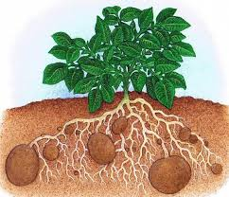
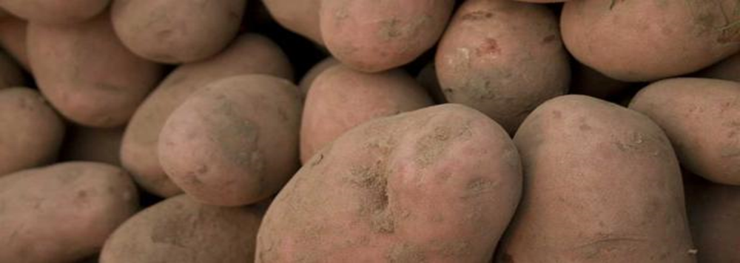

Slide 11
Uses:
Potatoes are used alone and mixed with
Meat
Chicken
vegetables
It also used in value addition Such as potato chips
It is rich source in
Starch
Protein
Minerals
Vitamins especially vit. C

Slide 12
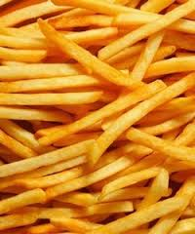
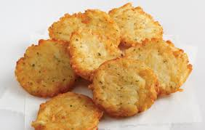
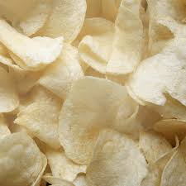

Slide 13
Climate
It is a cool season crop
Frost tolerant
Young plant grow well at a temperature 24 ⁰C
Tuber formation occurs at a temperature 20 ⁰C
Decreases with the rise in temperature
Stop tuber production at temperature 30 ⁰C

Slide 14
Soil
Potato developed best on deep, fertile and sandy to clay loams
Potato is a weak, shallow root system
However, soil compaction greatly reduced the potato yields
Aeration of the soil has great effect on tuber development

Slide 15
Fertilizers
FYM: 30 t/ha
N: 100 kg/ha
P: 100 kg/ha
K: 50 Kg/ha
Spacing:
Plant to Plant: 30 cm
Row to row : 60 cm

Slide 16
Seed rate
800-1000 kg/ha
Irrigation:
Need frequent irrigation
First irrigation should be given immediately after sowing
Thereafter at one week intervals
After tuber formation, the frequency of irrigation is decreased
Irrigation should be stopped a few days before harvesting

Slide 17
Harvesting:
The size of the tuber increases until the vine become dry
In Pakistan, potatoes are harvested by digging up the ridges with spade
Care should be taken that tubers not injured during the process
After harvesting crop should be kept in the shade.

Slide 18
Varieties
Prima
Alpha
Alladin
Baroka
Cardinal
Desiree
Ultimas
Multa
Lala Faisal
PARS-70
Yield:
20-25 t/ha

