Slide 1
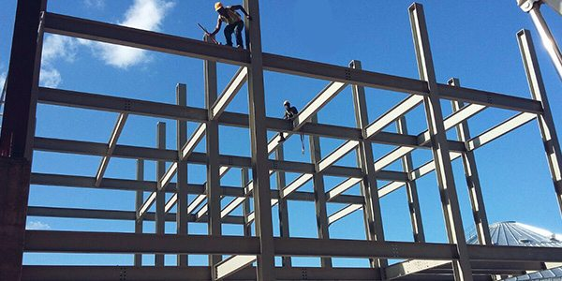
COLLEGE OF ENGINEERING AND TECHNOLOGY UNIVERSITY OF SARGODHA DESIGN OF STRUCTURES (CE-409) 01-Credit Hour
LECTURE-6
DESIGN OF RETAINING WALL STRUCTURES

Slide 2
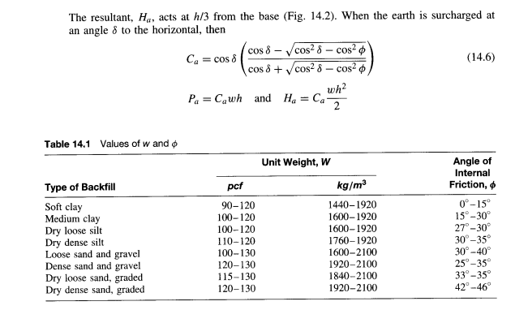

Slide 3
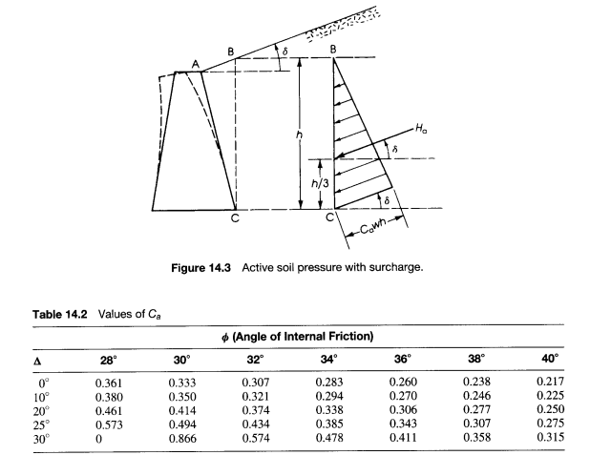

Slide 4
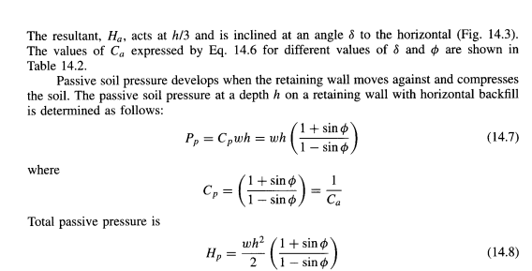

Slide 5
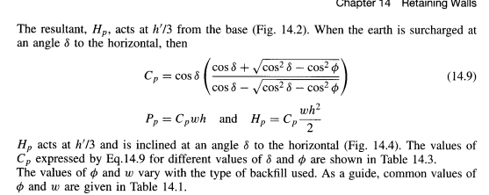

Slide 6
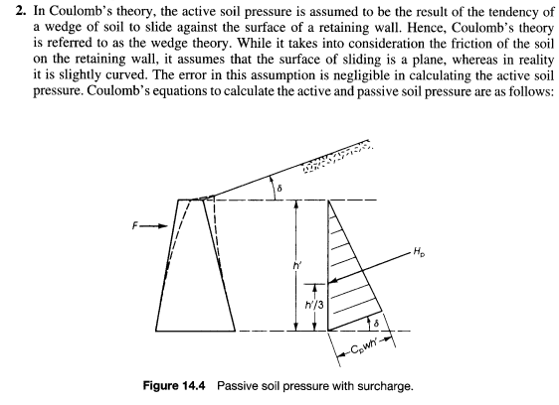

Slide 7
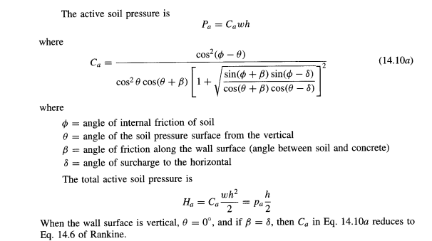

Slide 8
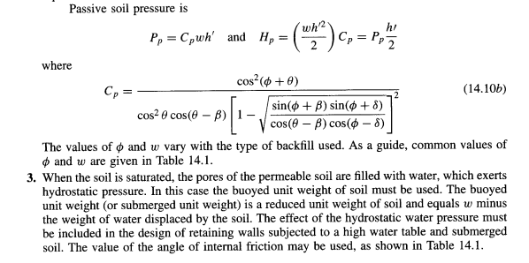

Slide 9
RETAINING WALLS
EFFECT OF SURCHARGE:
Different types of loads are often imposed on the surface of the backfill behind a retaining wall.
If the load is uniform, an equivalent height of soil, h_{s ,} may be assumed acting on the wall to account for the increased pressure.
For the wall shown in fig. 14.5, the horizontal pressure due to the surcharge is constant throughout the depth of the wall

Slide 10
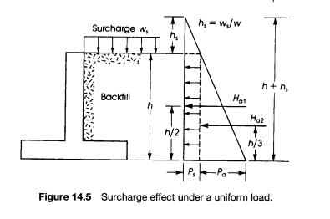

Slide 11
RETAINING WALLS
EFFECT OF SURCHARGE:

Slide 12
RETAINING WALLS
EFFECT OF SURCHARGE:
In case of a partial uniform load acting at a distance from the wall, only a portion of the total surcharge pressure affects the wall (Fig. 14.6).
It is a common practice to assume that the effective height of pressure due to partial surcharge is h’, measured from point B to the base of the retaining wall.
The line AB forms an angle of 45⁰ with the horizontal.
In case of a wheel load acting at a distance from the wall, the load is to be distributed over a specific area, which is usually defined by known specifications such as AASHTO and AREA.

Slide 13
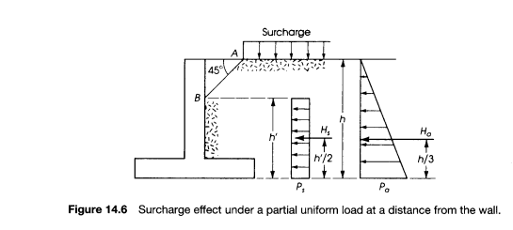

Slide 14
RETAINING WALLS
FRICTION ON THE RETAINING WALL BASE:
The horizontal component of all forces acting on a retaining wall tends to push the wall in a horizontal direction.
The retaining wall base must be wide enough to resist the sliding of the wall.
The coefficient of friction to be used is that of soil on concrete for coarse granular soils and the shear strength of cohesive soils.
The coefficients of friction µ that may be adopted for different types of soil are as follows:

Slide 15
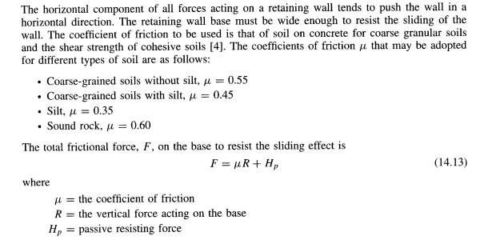
RETAINING WALLS

Slide 16
RETAINING WALLS

Slide 17
RETAINING WALLS
STABILITY AGAINST OVERTURNING:
The horizontal component of the active pressure, H_{a,} tends to overturn the retaining wall about the point zero on the toe as shown in figure-14.7.
The overturning moment is equal to M₀ = H_{a} h/3.
The weight of the concrete and soil tends to develop a balancing moment or rightening moment, to resist the overturning moment.
The balancing moment for the case of the wall shown in figure 14.7 is equal to

Slide 18
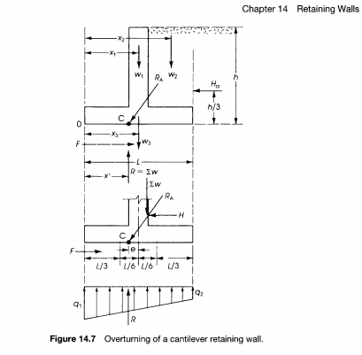
RETAINING WALLS
STABILITY AGAINST OVERTURNING:

Slide 19
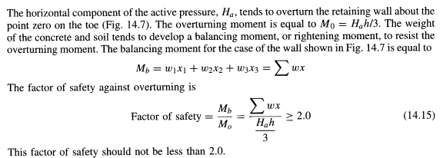
RETAINING WALLS
STABILITY AGAINST OVERTURNING:

Slide 20
RETAINING WALLS
STABILITY AGAINST OVERTURNING:
The resultant of all forces acting on the retaining wall, R_{A} , intersects the base at point C.
In general, point C does not coincide with the center of the base, L, thus causing eccentric loading on the footing.
It is desirable to keep point C within the middle third to get the whole footing under soil pressure.

Slide 21
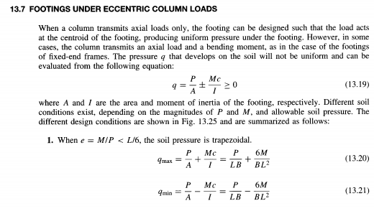
RETAINING WALLS
STABILITY AGAINST OVERTURNING:

Slide 22
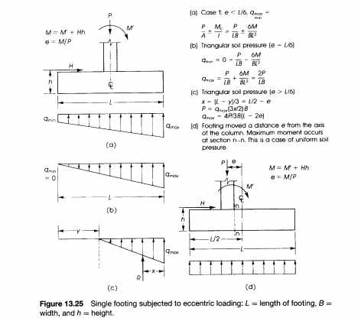
RETAINING WALLS
STABILITY AGAINST OVERTURNING:

Slide 23
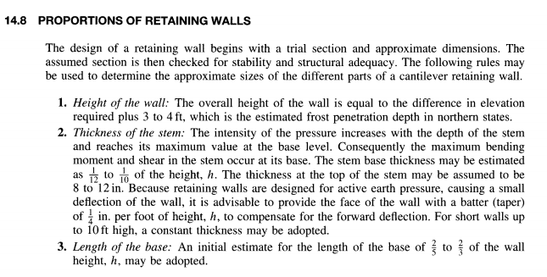
RETAINING WALLS

Slide 24
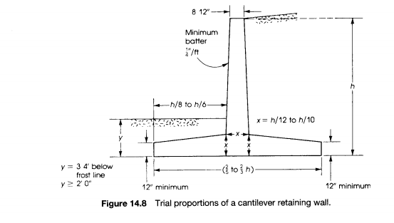
RETAINING WALLS

Slide 25
RETAINING WALLS

Slide 26
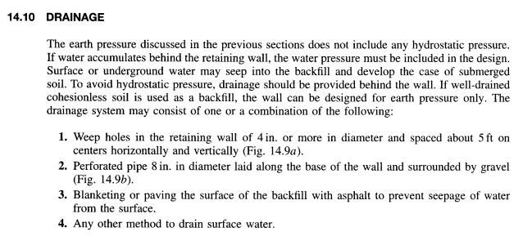
RETAINING WALLS

Slide 27
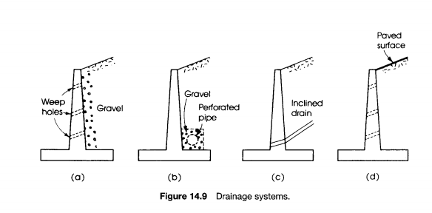
RETAINING WALLS

