Slide 2
FATS AND OILS
FST-403
B. Sc. (Hons). Food and Science and technology
INSTITUTE OF FOOD SCIENCE AND NUTRITION
UNIVERSITY OF SARGODHA, SARGODHA

Slide 3
LECTURE OUTLINE
Pretreatment of fats and oil
Selecting
Cleaning
Shelling
Flaking
Roasting

Slide 4
PRETREATMENT OF OILSEEDS
Oilseed pretreatment usually means the working procedures of detaching the impurities out of the oil material to make the oilseeds in the best condition before pressing in order to extract the most oil out.
It is the first and most vital step during the whole set of oil mill plant.
This is the part where the seeds are
procured,
cleaned,
flaked, and cooked
so that the oil extraction process can be carried out in a more efficient manner, so that the final output or the extracted oil is of the highest quality.

Slide 5
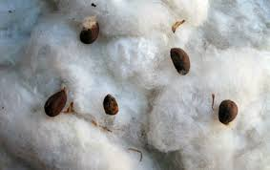
PRETREATMENT OF OILSEEDS
Extraneous material or impurities should first be removed from the harvested crop seed
These impurities here generally refer to the following items : The organic impurities: such as the stem leaf, cord, chemical fibers, and the other plants seeds
The inorganic impurities: such as soil, and metal, about oil-bearing impurities.

Slide 6
PRETREATMENT OF OILSEEDS
Oilseeds should be well pretreated and cleaned before pressing, and the quality of pretreatment affects the life performance, safety of machine directly as well as the oil output rate.
Unit operations for preparation of seeds for oil extraction vary slightly depending on the physical properties and oil content, however, most oilseeds go through the process of selecting/cleaning, shelling and separating, crushing and flaking, roasting.

Slide 7
PRETREATMENT OF OILSEEDS

Slide 8
PRETREATMENT OF OILSEEDS
Selecting/ Cleaning
Oilseeds need to be cleaned to remove plant stems, mud and sand, stones and metals, leaves and foreign material before being extracted. Oilseeds without careful selecting and can even lead to damage of the machine.
Foreign materials are typically separated out by a vibrating sieve, however, some oilseeds such as peanuts may contain stones which are similar in size to the seeds. Hence, they cannot be separated by screening. Seeds need to be separated from stones by destoner. Magnetic devices remove metal contaminants from oilseeds, and hullers are used to de-hull of oilseed shells like cottonseed and peanuts.

Slide 9
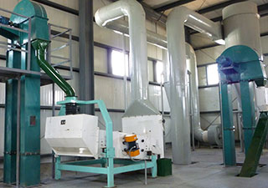
PRETREATMENT OF OILSEEDS
Seed cleaner

Slide 10
PRETREATMENT OF OILSEEDS
Shelling and Separating
Oil-bearing materials with shells such as groundnuts, sunflower seed, cotton seed, and tea seeds, should be separated from their outer husk or shell prior to the oil extraction process, and shells and kernels should be pressed separately.
Hulls will reduce the total oil yield by absorbing or retaining oil in the pressed oil cakes. What's more, wax and color compounds present in the hulls end up in the extracted oil, which are not desirable in edible oils and need to be removed during the refining process
The dehulling process is necessary and has got a series advantages, it increases oil production efficiency, capacity of the extraction equipment and reduces wear in the expeller, reduces fiber and increases protein content of the meal.

Slide 11
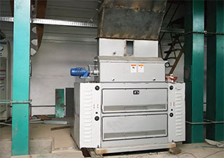
PRETREATMENT OF OILSEEDS
Dehuller

Slide 12
PRETREATMENT OF OILSEEDS
Crushing and Flaking
Oil output rate would be much higher after crushing and flaking. Most oilseeds are crushed to facilitate hull removal, heating, drying and flaking before oil extracting. For some seeds like rape seed, cotten germ, however, do not need the crushing process as they are already sufficiently small enough.
Crushers are used for oilseed size reduction. Oilseeds also can be flaked prior to solvent extraction. Flaking ruptures seed cellular structure and increases surface area for increased contact between solvent and seed during the solvent extraction process.

Slide 13
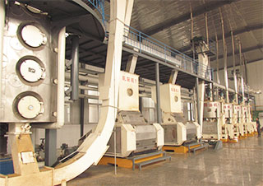
PRETREATMENT OF OILSEEDS
Crusher and Flaker

Slide 14
PRETREATMENT OF OILSEEDS
Roasting
The key factor of getting high oil output rate is roasting or cooking, so it is said “70% lies in roasting, and 30% lies in pressing”.
Water content and temperature of raw material should be controlled before pressing. It is suggested and requested that the user should master roasting technology in order to achieve idea economic benefits.
Roasting / Cooking also gives seeds proper elasticity for efficient pressing.

Slide 15
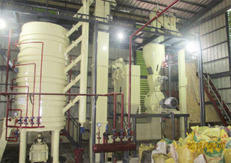
PRETREATMENT OF OILSEEDS
Roaster

Slide 16
PRETREATMENT OF OILSEEDS
Soybean Seeds: Pre treatment of soybean seeds

Slide 17
PRETREATMENT OF OILSEEDS
Pretreatmet of Canola Seeds:

Slide 18
PRETREATMENT OF OILSEEDS
Pretreatment of Sunflower Seeds:

Slide 19
Thank You ☺

