Slide 1
Chapter 9
Security

Slide 2
Security
Security is a measure of the system’s ability to protect data and information from unauthorized access while still providing access to people and systems that are authorized.
An action taken against a computer system with the intention of doing harm is called an attack and can take a number of forms.
It may be an unauthorized attempt to access data or services or to modify data, or it may be intended to deny services to legitimate users.

Slide 3
CIA
The simplest approach to characterizing has three characteristics :
Confidentiality, Integrity and Availability (CIA):
1. Confidentiality is the property that data or services are protected from unauthorized access. For example, a hacker cannot access your income tax returns on a government computer.
2. Integrity is the property that data or services are not subject to unauthorized manipulation. For example, your grade has not been changed since your instructor assigned it.
3. Availability is the property that the system will be available for legitimate use. For example, a denial-of-service attack won’t prevent you from ordering book from an online bookstore.

Slide 4
CIA
Other characteristics that are used to support CIA are these:
4. Authentication verifies the identities of the parties to a transaction and checks if they are truly who they claim to be. For example, when you get an email purporting to come from a bank, authentication guarantees that it actually comes from the bank.
5. Nonrepudiation guarantees that the sender of a message cannot later deny having sent the message, and that the recipient cannot deny having received the message. For example, you cannot deny ordering something from the Internet, or the merchant cannot disclaim getting your order.
6. Authorization grants a user the privileges to perform a task. For example, an online banking system authorizes a legitimate user to access his account.

Slide 5
Security General Scenario
One technique that is used in the security domain is threat modeling. An “attack tree,” similar to a fault tree discussed in Chapter 5, is used by security engineers to determine possible threats.
The root is a successful attack and the nodes are possible direct causes of that successful attack.
Children nodes decompose the direct causes, and so forth.
An attack is an attempt to break CIA, and the leaves of attack trees would be the stimulus in the scenario.
The response to the attack is to preserve CIA or deter attackers through monitoring of their activities

Slide 6
Example of Security General Scenario
Source of stimulus. The source of the attack may be either a human or another system. It may have been previously identified (either correctly or incorrectly) or may be currently unknown. A human attacker may be from outside the organization or from inside the organization.
Stimulus. The stimulus is an attack. We characterize this as an unauthorized attempt to display data, change or delete data, access system services, change the system’s behavior, or reduce availability.
Artifact. The target of the attack can be either the services of the system, the data within it, or the data produced or consumed by the system. Some attacks are made on particular components of the system known to be vulnerable.

Slide 7
Example of Security General Scenario
Environment. The attack can come when the system is either online or offline, either connected to or disconnected from a network, either behind a firewall or open to a network, fully operational, partially operational, or not operational.
Response. The system should ensure that transactions are carried out in a fashion such that data or services are protected from unauthorized access; data or services are not being manipulated without authorization; parties to a transaction are identified with assurance; the parties to the transaction cannot repudiate their involvements; and the data, resources, and system services will be available for legitimate use.

Slide 8
Example of Security General Scenario
Response measure. Measures of a system’s response include how much of a system is compromised when a particular component or data value is compromised, how much time passed before an attack was detected, how many attacks were resisted, how long it took to recover from a successful attack, and how much data was vulnerable to a particular attack.

Slide 9
Concrete Security Scenario
Figure 9.1 shows a sample concrete scenario: A disgruntled employee from a remote location attempts to modify the pay rate table during normal operations. The system maintains an audit trail, and the correct data is restored within a day

Slide 10
Concrete Security Scenario

Slide 12
Tactics for security
One method for thinking about how to achieve security in a system is to think about physical security.
Secure installations have limited access (e.g., by using security checkpoints), have means of detecting intruders (e.g., by requiring legitimate visitors to wear badges), have deterrence mechanisms such as armed guards, have reaction mechanisms such as automatic locking of doors, and have recovery mechanisms such as off-site backup.
These lead to our four categories of tactics: detect, resist, react, and recover.

Slide 13
Figure 9.2 The goal of security tactics

Slide 14
Detect Attacks
The detect attacks category consists of four tactics: detect intrusion, detect service denial, verify message integrity, and detect message delay.
Detect intrusion is the comparison of network traffic or service request patterns within a system to a set of signatures or known patterns of malicious behavior stored in a database. The signatures can be based on protocol, TCP flags, payload sizes, applications, source or destination address, or port number.
Detect service denial is the comparison of the pattern or signature of network traffic coming into a system to historic profiles of known denial-of-service attacks.

Slide 15
Detect Attacks
Verify message integrity. This tactic employs techniques such as checksums or hash values to verify the integrity of messages, resource files, deployment files, and configuration files. A checksum is a validation mechanism wherein the system maintains redundant information for configuration files and messages, and uses this redundant information to verify the configuration file or message when it is used. A hash value is a unique string generated by a hashing function whose input could be configuration files or messages. Even a slight change in the original files or messages results in a significant change in the hash value.
Detect message delay is intended to detect potential man-in-the-middle attacks, where a malicious party is intercepting (and possibly modifying) messages. By checking the time that it takes to deliver a message, it is possible to detect suspicious timing behavior, where the time it takes to deliver a message is highly variable

Slide 16
Resist Attacks
Identify actors. Identifying “actors” is really about identifying the source of any external input to the system. Users are typically identified through user IDs. Other systems may be “identified” through access codes, IP addresses, protocols, ports, and so on.
Authenticate actors. Authentication means ensuring that an actor (a user or a remote computer) is actually who or what it purports to be. Passwords, one-time passwords, digital certificates, and biometric identification provide a means for authentication.
Authorize actors. Authorization means ensuring that an authenticated actor has the rights to access and modify either data or services. This mechanism is usually enabled by providing some access control mechanisms within a system. Access control can be by an actor or by an actor class. Classes of actors can be defined by actor groups, by actor roles, or by lists of individuals.

Slide 17
Resist Attacks
Limit access. Limiting access involves controlling what and who may access which parts of a system. This may include limiting access to resources such as processors, memory, and network connections, which may be achieved by using process management, memory protection, blocking a host, closing a port, or rejecting a protocol. For example, a firewall is a single point of access to an organization’s intranet. A demilitarized zone (DMZ) is a subnet between the Internet and an intranet, protected by two firewalls: one facing the Internet and the other the intranet. A DMZ is used when an organization wants to let external users access services that should be publicly available outside the intranet. This way the number of open ports in the internal firewall can be minimized. This tactic also limits access for actors (by identifying, authenticating, and authorizing them).

Slide 18
Resist Attacks
Limit exposure. Limiting exposure refers to ultimately and indirectly reducing the probability of a successful attack, or restricting the amount of potential damage. This can be achieved by concealing facts about a system to be protected (“security by obscurity”) or by dividing and distributing critical resources so that the exploitation of a single weakness cannot fully compromise any resource (“don’t put all your eggs in one basket”). For example, a design decision to hide how many entry points a system has is a way of limiting exposure. A decision to distribute servers amongst several geographically dispersed data centers is also a way of limiting exposure.

Slide 19
Resist Attacks
Encrypt data. Data should be protected from unauthorized access. Confidentiality is usually achieved by applying some form of encryption to data and to communication. Encryption provides extra protection to persistently maintained data beyond that available from authorization. Communication links, on the other hand, may not have authorization controls. In such cases, encryption is the only protection for passing data over publicly accessible communication links. The link can be implemented by a virtual private network (VPN) or by a Secure Sockets Layer (SSL) for a web-based link. Encryption can be symmetric (both parties use the same key) or asymmetric (public and private keys).

Slide 20
Resist Attacks
Separate entities. Separating different entities within the system can be done through physical separation on different servers that are attached to different networks; the use of virtual machines (see Chapter 26 for a discussion of virtual machines); or an “air gap,” that is, by having no connection between different portions of a system. Finally, sensitive data is frequently separated from non sensitive data to reduce the attack possibilities from those who have access to non sensitive data.
Change default settings. Many systems have default settings assigned when the system is delivered. Forcing the user to change those settings will prevent attackers from gaining access to the system through settings that are, generally, publicly available.

Slide 21
React to Attacks
Several tactics are intended to respond to a potential attack:
Revoke access. If the system or a system administrator believes that an attack is underway, then access can be severely limited to sensitive resources, even for normally legitimate users and uses. For example, if your desktop has been compromised by a virus, your access to certain resources may be limited until the virus is removed from your system.
Lock computer. Repeated failed login attempts may indicate a potential attack. Many systems limit access from a particular computer if there are repeated failed attempts to access an account from that computer. Legitimate users may make mistakes in attempting to log in. Therefore, the limited access may only be for a certain time period.
Inform actors. Ongoing attacks may require action by operators, other personnel, or cooperating systems. Such personnel or systems—the set of relevant actors—must be notified when the system has detected an attack.

Slide 22
Recover from Attacks
Once a system has detected and attempted to resist an attack, it needs to recover. Part of recovery is restoration of services. For example, additional servers or network connections may be kept in reserve for such a purpose. Since a successful attack can be considered a kind of failure, the set of availability tactics (from Chapter 5) that deal with recovering from a failure can be brought to bear for this aspect of security as well.

Slide 23
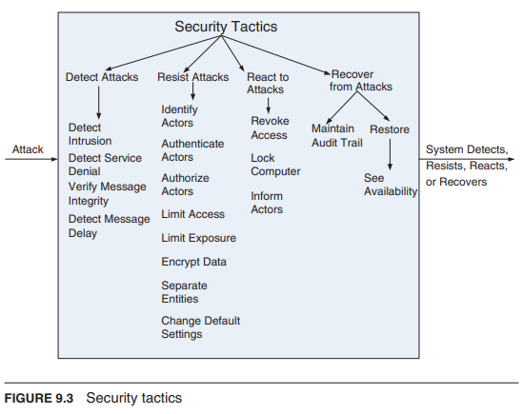
Security Tactics

Slide 24
A Design Checklist for Security

Slide 25
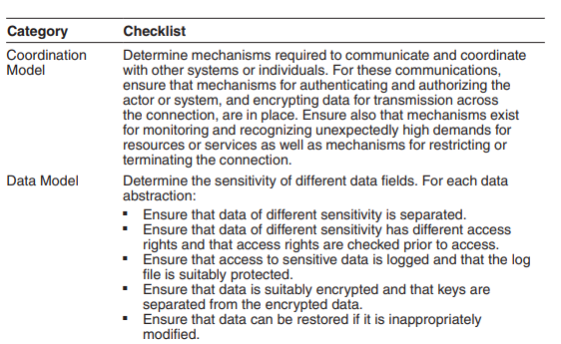
A Design Checklist for Security

Slide 26
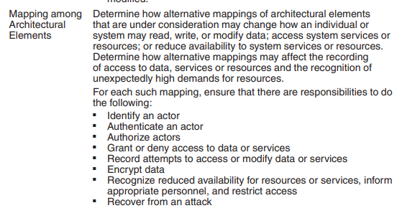
A Design Checklist for Security

Slide 27
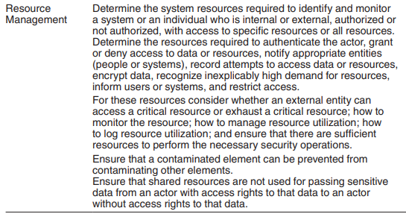
A Design Checklist for Security

Slide 28
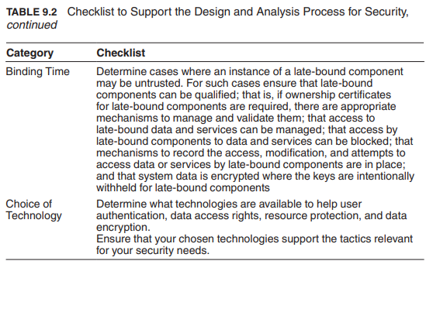
A Design Checklist for Security

