Slide 1
Polymers
Pharmaceutical Biotechnology
BS Biotechnology (8th Semester)
University of Sargodha

Slide 2
Polymers
In our daily life, we use lots of polymers like, Nylon, Teflon, Polyethylene, rubber.
Some are natural polymers while some are synthetic polymers.
Polymers make their way to medical and pharmaceutical industry in 20th century.
The key difference between early polymers and pharmaceutical polymers is biocompatibility.

Slide 3
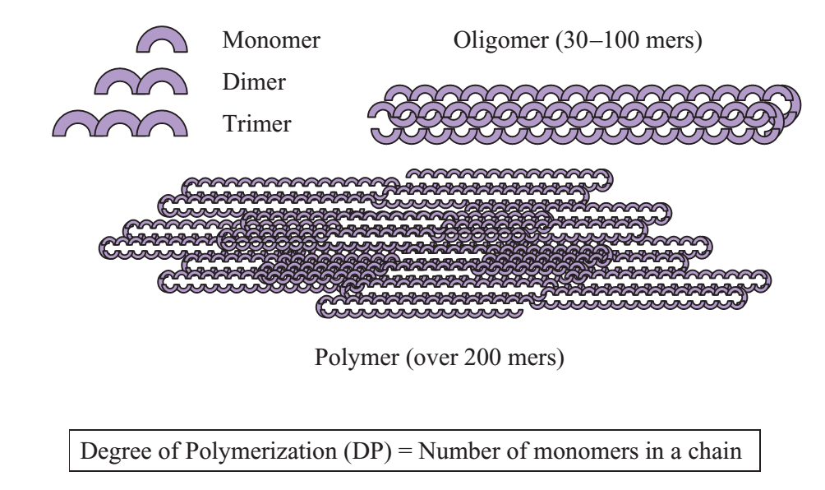
Polymers
The word “polymer” means “many parts.”
A polymer is a large molecule made up of many small repeating units.
Initially, polymers were referred as macromolecules. But later they were called as Polymers because of slight difference in the meanings of both terms (macromolecules and polymers).

Slide 4
Polymers
From a thermodynamic perspective, polymers cannot exist in the gaseous state because of their high molecular weight. They exist only as liquids or high solid materials.
Molecular weight of polymers can be adjusted according to their applications
E.g. silicone polymers are supplied as vacuum grease (low molecular weight) and as durable implants (very high molecular weight)

Slide 5
Polymers
The physio-chemical properties of polymers can be tailor-made by changing their molecular weight, structure or blending them with other polymers.
Blending is a process intended to achieve superior properties that are unattainable from a single polymer.
In pharmaceutical industry
the polymers are used to develop devices for controlling drug delivery or for replacing failing natural organs.
In oral delivery, polymers are used as coatings, binders, taste maskers, protective agents, drug carriers, and release controlling agents.
Transdermal patches use polymers as backings, adhesives, or drug carriers in matrix or membrane products.
In many drug products you may find at least one polymer that enhances product performance.

Slide 6
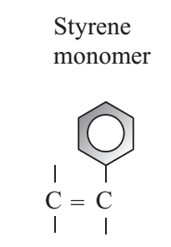
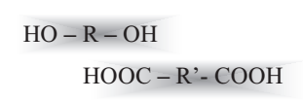
Polymer synthesis
The choice of polymer synthesis methods depends upon the structural perspectives of the monomer that will form the polymer.
Monomers can be
Olefinic (containing double bond)
Functional (containing functional group like hydroxyl, carboxyl or amines)

Slide 7
Methods of polymer synthesis
Addition Polymerization
Condensation Polymerization
Homogenous polymerization
Dispersion polymerization
Copolymers or Polymer blends
Interpenetrating Polymer Networks (IPNs)

Slide 8
Addition Polymerization
This is also known as free-radical polymerization or chain polymerization
Steps of addition polymerization
Initiation
Propagation
Termination
A radical generating ingredient can trigger the polymerization of monomers which have double bond.

Slide 9
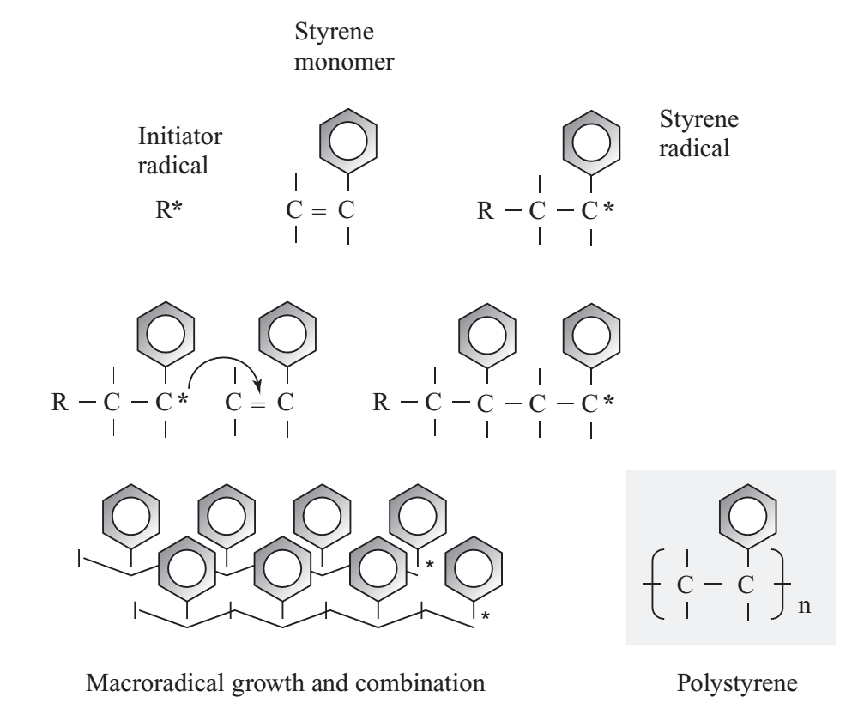
Addition Polymerization
Initiation
the radical is transferred to the monomer and a monomer radical is produced.
Propagation
The monomer radical is also able to attack another monomer and then another monomer, and so on and so forth.
Termination
Macroradicals can undergo another reaction with another macroradical or with another compound (e.g an impurity in reaction) which will terminate the macroradical.

Slide 10
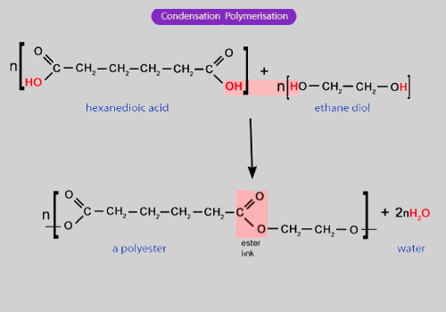
Condensation Polymerization
Also known as Step Polymerization
Two or more monomers carrying different reactive functional groups interact with each other to form polymer
Each monomer is bifunctional (in other words, it contains two reactive groups), the reaction product can grow by reacting with another monomer generating a macromonomer
Nylon is prepared via condensation polymerization of a diamine and diacid chloride.

Slide 11
Homogenous Polymerization
Also known as bulk polymerization
It occurs when no other materials except the monomer and initiator are used.
If the monomer is water soluble, then the polymer will also be water soluble. Similarly if monomer is oil-soluble then the polymer will also be oil-soluble.
Sometimes when an olefinic water-soluble monomer is polymerized in bulk, a water-swellable polymer is prepared due to the cross linking reaction.
During bulk polymerization heat is generated, due to this exothermic heat hydrogen molecule from the polymer backbone is removed which results in cross linking at defective sites and make a swellable polymer without the addition of cross linker. This type of polymer is called “popcorn” and this method is known as “popcorn polymerization”

Slide 12
Homogenous polymerization
If the molecule is very heat sensitive then this can leads to popcorn polymer even without the use of initiator.
This can also leads to sudden polymerization and huge exothermic heat.
This problem is solved by conducting polymerization in solution either water based or oil based.
The solution molecules reduce the interaction between the monomers and slows down the polymerization reaction which results in less heat.

Slide 13
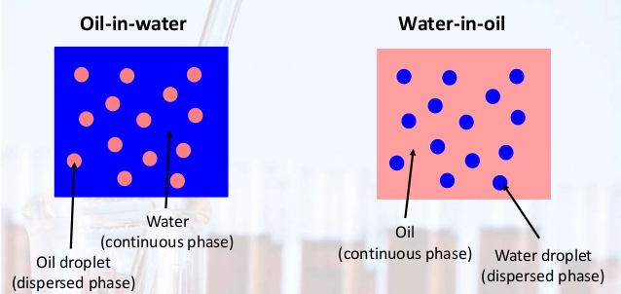
Dispersion Polymerization
Also known as heterogenous polymerization
Dispersion polymerization occurs in suspensions, emulsions, inverse suspensions, and inverse emulsions
The monomer can be water-soluble or oil-soluble.
For dispersion polymerization, monomer is dispersed in the continuous phase by using surfactant.
successful dispersion polymerization requires that the surfactant be soluble in the continuous phase

Slide 14
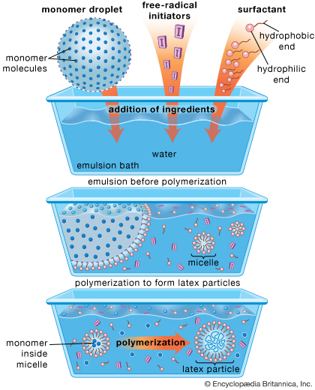

Slide 15
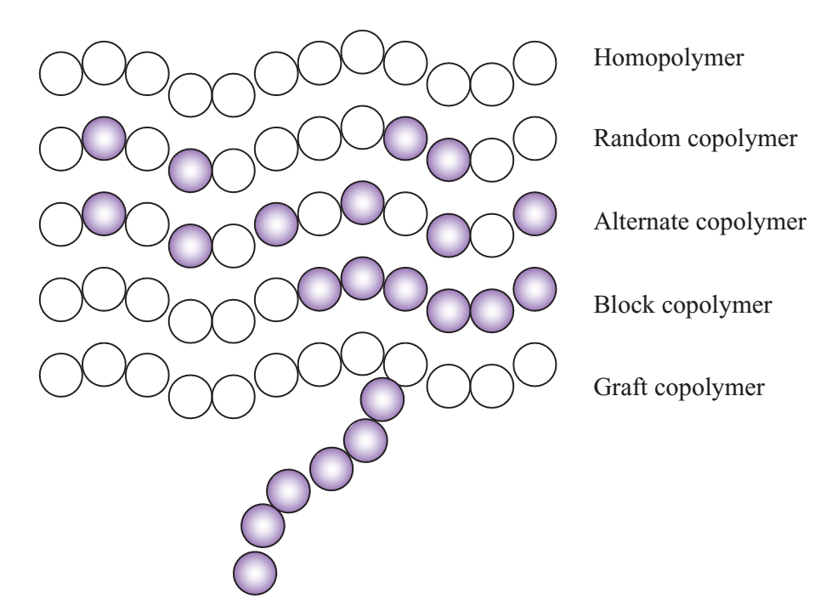
Copolymers and Polymer blends
If one polymer system cannot address the needs of a particular application, its properties need to be modified.
Copolymerization refers to a polymerization reaction in which more than one type of monomer is involved.

Slide 16
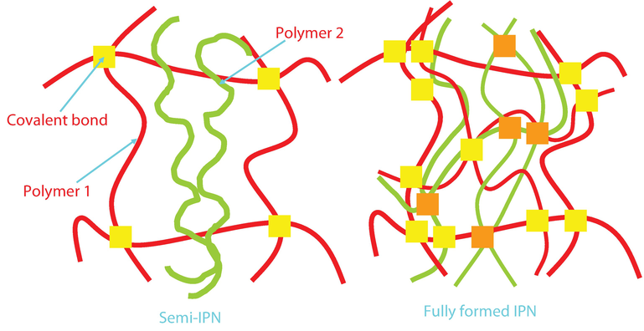
Interpenetrating polymer networks
Interpenetrating polymer networks (IPNs) are also composed of two or more polymer systems but they are not a simple physical blend.

Slide 17
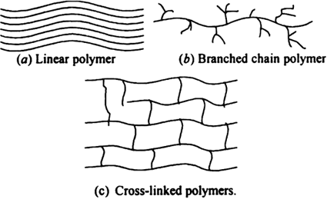
Properties of Polymers
Properties of the polymers depend upon the topology of the polymers.
Polymer can be
Linear
Branched
Cross-linked

Slide 18
Properties of Polymers
Crystalline and Amorphous polymer
If the structure is linear, polymer chains can pack together in a regular arrays
It will have low melting temperature because of the linear chains.
With increased temperature, the crystal cells (Crystallites) start to melt and the whole polymer mass suddenly melts at a certain temperature.
In many cases, the structure of a polymer is so irregular that crystal formation is thermodynamically infeasible
Amorphous structure is formed due to either rapid cooling of a polymer melt in which crystallization is prevented
Crystallinity in a given polymer depends on its topology, polymer molecular weight, intermolecular forces, pendant groups (bulky versus small groups), rate of cooling.

Slide 19
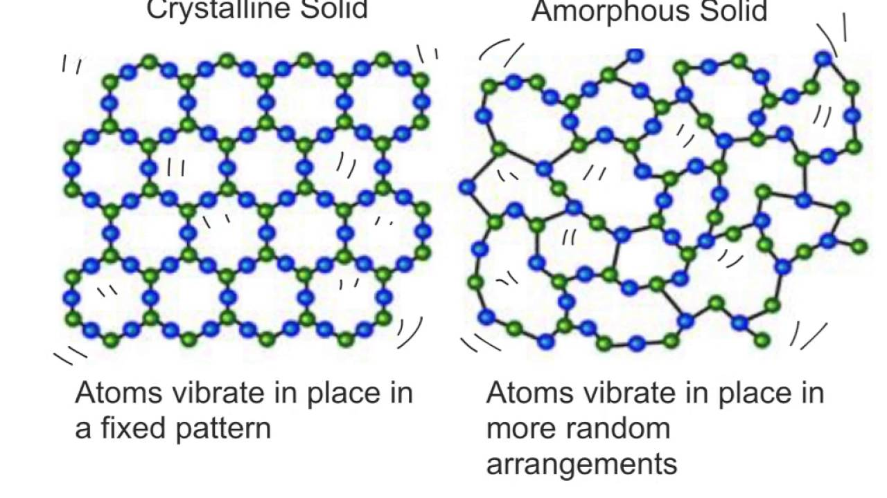
Polymer strength and stiffness increases with crystallinity as a result of increased intermolecular interactions
With an increase in crystallinity, the optical properties of a polymer are changed from transparent (amorphous) to opaque (semicrystalline).
From a pharmaceutical prospective, good barrier properties are needed when polymers are used as a packaging material or as a coating.
Crystallinity increases the barrier properties of the polymer. Small molecules like drugs or solvents usually cannot penetrate or diffuse through crystalline domains.
Diffusion and solubility are two important terms that are related to the level of crystallinity in a polymer.
Semi-crystalline

Slide 20
Thermal transitions
The volume of a polymer can change with temperature as first- or second order thermal transition.
When a crystal melts, the polymer volume increases significantly as the solid turns to a liquid.
the volume of an amorphous polymer gradually changes over a wide temperature range or so-called glass transition temperature.
T_{m}→ First order thermal transition
T_{g}→ Second order thermal transition

Slide 21
Glass Transition Temperature
Rigid glass state- soft flexible state
Temperature > Tg → polymers are rubbery and might flow
Temperature < Tg → amorphous polymers are hard, stiff, and glassy although they may not necessarily be brittle
Tg is an important factor for solid dosage forms
Tg of a polymer depend upon various factors
Length of Polymer chain
Side chain groups
Plymer chain flexibility
Polymer chain branching and cross linking
Processing rate

Slide 22
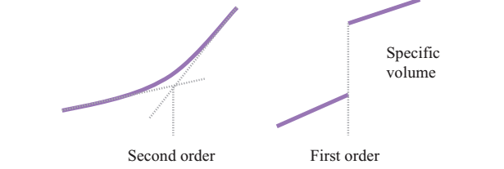
Glass transition vs. Melting
Glass Transition
Property of amorphous region
Below T_{g:} Disordered amorphous solid with immobile molecules
Above T_{g}: Disordered amorphous solid with portions of molecules can wiggle around
Melting
Property of crystalline region
Below T_{m}: ordered crystalline solid
Above T_{m}: Disordered melt

Slide 23
Molecular weight
Average Molecular weight- Fundamental characteristic of a polymer sample.
Controls the function of biomedical polymers
Pure sample contain molecules of differing only in degree of polymerization
There are different ways that molecular weights of a polymer can be expressed;
by the number of the chains
by the weight of the chains (the chain size)
or by viscosity
However, the two most common ways are number (Mn) and weight (Mw)

Slide 24
Application of Polymers in Pharmaceutical
Applications
tablet binders to bind the excipients of the tablet
drug protection
taste masking
controlled release of a given drug
targeted delivery
increase drug bioavailability and many more
Desirable polymer properties
film forming (coating)
Thickening (rheology modifier),
Gelling (controlled release)
Adhesion (binding)
pH-dependent solubility (controlled release)
solubility in organic solvents (taste masking)
barrier properties (protection and packaging).

Slide 25
Polymers and drug delivery
Pharmaceutical polymers are widely used in controlled release (e.g., extended, pulsatile, and targeted), enhanced stability, and improved bioavailability of drugs.
Delivery devices are systems in which a drug is dispersed within a polymer matrix and released by diffusion.
The rate of the drug release from a matrix product depends on the initial drug concentration and relaxation of the polymer chains, which overall displays a sustained release characteristic.

Slide 26
Polymers and drug delivery
Immediate release dosage forms
Modified release dosage forms
Extended release dosage forms
Gastroretentive dosage forms

Slide 27
General mechanism of drug release from polymer
Diffusion
Diffusion occurs when a drug or other active agent passes through
the polymer that forms the controlled‐release device.
Degradation
Biodegradable polymer degrades within the body as a result of natural biological processes, eliminating the need to remove a drug delivery system after release of the active agent has been completed
Swelling
They are initially dry and when placed in the body will absorb water or other body fluids and swell.
enabling the drug to diffuse through the swollen network into the external environment

Slide 28
Synthetic polymers
Synthetic polymers based on acrylic or methacrylic acids have found extensive applications in the drug delivery area to protect the drug or to release the drug in a controlled manner.
These are classified as cationic, anionic, and neutral (nonionic) polymers.
Despite the different solubility and swellability across the GI tract, the drug release from these matrices occurs through a diffusion process.

Slide 29
Biodegradable polymers
the drug can be released from a dosage form as a result of polymer erosion.
When a polymer starts to erode from its surface, the drug imbedded within the polymer matrix will be released at a rate depending on the erosion rate of the polymer.
If erosion happens in bulk, a much faster release is expected as an enormous number of hydrolysable sites are simultaneously cleaved up in water.

Slide 30
Swellable polymers
a drug may be released as a result of matrix swelling
A polymer in its swollen form is mechanically weak and can be eroded at different rates depending on the swelling feature of the matrix
A fast swelling hydrogel may undergo faster erosion and provide faster drug release compared with a slow swelling hydrogel.

