Slide 1
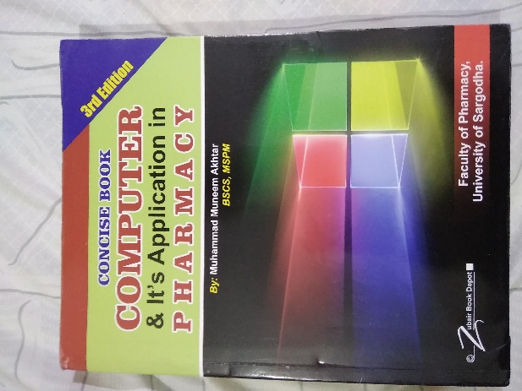
Data Input Methods
23
Recommended For
Pharmacy Student!
Part
Pharm-D (Doctor of Pharmacy),
DPT (Doctor of Physiotherapy) &
Pharmacy Technician.
Muhammad Munim Akhtar

Slide 2
Welcome to
Computer & its Application in Pharmacy with Munim Akhtar
Free online quality educational tutorials about Computer in Pharmacy

Slide 4
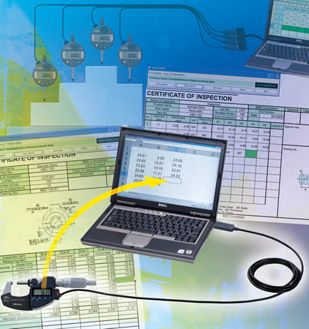
Data Input Methods

Slide 5
what is data capture/input
Data capture is the action or process of gathering data, especially from an automatic device, control system, or sensor.
Obtain data for a computer by manually is called manual data input.
Collecting documents to be typed in
Making measurements
Asking people to fill a questionnaires
Automated data capture means obtaining data directly by an input device without using a keyboard.
Using document readers (OMR, MICR, OCR)
Bar code readers
Scanning pictures
Using sensors, etc.

Slide 6
Different Input Methods
An input device which accepts data and sends it to the CPU:
Keyboard
Mouse
Document reader (OMR, OCR, MICR)
Light pens and touch screens
Sensors
Scanner
Joysticks and game controllers
Microphone, etc.

Slide 7
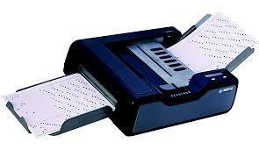
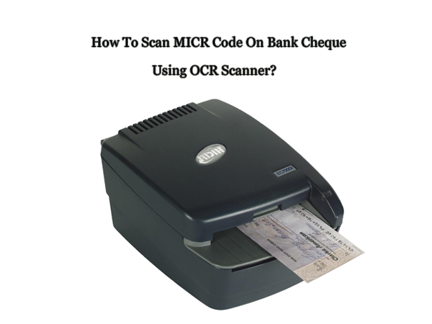
Document Readers
Optical Character Recognition (OCR)
Scanners read text and software recognises the letters from their shapes.
Magnetic Ink Character Recognition (MICR)
An MICR reader recognises characters formed from magnetic ink, used for bank cheques.
Optical Mark Readers (OMR)
OMR is a system of reading lines or marks which have been made inexactly the right positions on a document (School registers).

Slide 8
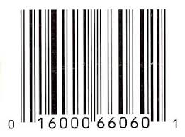
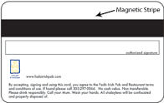
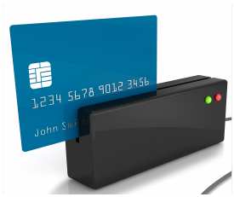
Bars and Stripes
Bar Codes
A bar code is a set of parallel lines that represent numbers, used for shop goods. The lines do not represent prices.
Magnetic Stripes
A magnetic stripe includes information to identify the ticket or the user. Examples:
credit cards; bank cards; switch cards; phone cards

Slide 9
Touch Screen
Touched-based systems include touch screens, buttons, and pen-based computing technology.
Touch screen technology has been very popular in restaurant or point-of-sale business applications.
Pen-based computing is popular for applications that require handwriting recognition.
Notes:
Recently, manufacturing companies have begun to use touch screens throughout the manufacturing shop floor as a means to capture data pertaining to such things as work orders, machine setup, material requisitions, employee attendance, and scheduling.
Pen-based computing is popular for applications that require handwriting recognition. You may have experienced this technology for capturing data when you were asked to sign for a special delivery package.
441-442

Slide 10
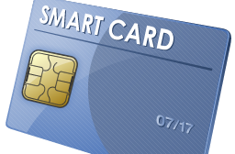
Smart Cards
Smart card technology has the ability to store a massive amount of information.
Smart cards are slightly thicker, than credit cards.
They also differ in that they contain a microprocessor, memory circuits, and a battery.
Smart cards are used on a daily basis by over 60%
e.g. NADAR Card
Notes:
Smart card applications are particularly promising in the area of health records where a persons blood type, vaccinations, and other past medical history can be made readily available. Other uses may include such applications as passport, financial information for point-of-sale transactions, pay-television, to name a few.
441

Slide 11
Biometric
Biometric systems consist of sensors that capture an individuals characteristic or digitizes the image pattern, and then compares the image to stored patterns for identification.
Biometric are popular because they offer the most accurate and reliable means for identification.
e.g. SIM verification system

Slide 12
What is Data Verification & data Validation

Slide 13
What is Data Verification?
Data verification is the process of checking that the data entered exactly matches the original source to find out if data is accurate. e.g., Double entry of data (such as when creating a password or email) to prevent incorrect data input.
Data verification is checking the data.
must: -
Check for spelling mistakes.
Check for data that has not been entered correctly.
Check that all data has been entered and nothing is missing.

Slide 14
What is Data Validation?
Data validation means checking the accuracy and quality of source data before using, importing or processing data.
The computer checks the data you enter.
The computer checks if the data is correct and makes sense.
e.g., A secondary school student is likely to be aged between 11 and 16. The computer can be programmed only to accept numbers between 11 and 16. This is a range check.

Slide 15
Validation types
Format check – e.g. two letters followed by two numbers – PR15 would be valid but PRX71 would not.
Presence check – Checking that the field contains any data.
Range check –checking that the data is between certain numbers or letters, e.g. A–E.
Size check – Checking data falls within a minimum or maximum number of characters.

Slide 16
Today quote:
“The purpose of our lives is to be happy “

Slide 17
?

