Slide 1
Dr. A. N. Khosla’s Theory (Potential Theory) (Main Points)
The flow of water is along the streamlines and hence susceptible of mathematical treatment.
Creep along the bottom can be prevented by providing u/s and d/s vertical cutoffs, one for each.
To stop the undermining at the downstream end provide a deep vertical cutoff and make sure that exit gradient is safe for the subsoil.
To safeguard against the undermining, the exit gradient is not allowed to exceed a certain safe limit as shown in the table
Kind of Subsoil | Factor of Safety | Safe Exit Gradient
Shingle | 4 to 5 | 0.25 to 0.20
Coarse Sand | 5 to 6 | 0.20 to 0.17
Fine Sand | 6 to 7 | 0.17 to 0.14

Slide 2
Khosla’s Theory (Conclusions)
The outer faces of the end sheet piles were much more effective than the inner ones and the horizontal length of the floor.
Intermediate piles will be ineffective, if smaller in length than the outer ones, and will be only effective for local distribution of the pressures.
Undermining starts at the tail end if the Hydraulic gradient at the exit is more than the critical gradient of the subsoil.
To prevent undermining it is essential to provide a reasonable deep vertical cutoff at the downstream.

Slide 3
Khosla’s Method of independent variables
He splits the complicated weir profiles into its elementary components which can be analytically solved.
Each component is treated independent of the others.
Pressure at the junction points of the floor and the piles, at the bottom line of the pile and at the bottom corners in case of depressed floors are read from the curves
These points are called key points

Slide 4
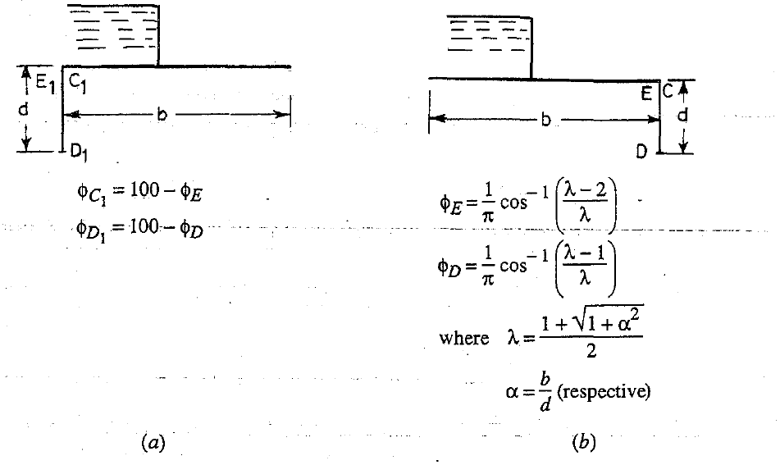
Khosla’s Method of independent variables

Slide 5
Khosla’s Method of independent variables

Slide 6
Exit Gradient
The Exit Gradient at the downstream end of an impervious floor length “b” and vertical cutoff “d” is given by:
$$G_{E}=\frac{H}{d}\frac{1}{π\sqrt{λ}}$$
Where H = Total Head
α= b/d
$$λ=\left[1+\frac{\sqrt{1+α^{2}}}{2}\right]$$
The exit gradient is said to critical if the upward disturbing force is just equal to the submerged weight of the soil grains.

Slide 7
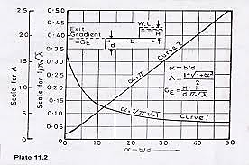
Khosla’s Safe Exit Gradient Curve

Slide 10
Correction for the floor thickness
E
C
E
C
E
C
E₁
C₁
E₁
C₁
E₁
D
D
D
$$φ_{E1}=φE−\frac{φE−φD}{d}×t$$
$$φ_{E1}=φE−\frac{φE−φD}{d}×t$$
$$φ_{C1}=φC+\frac{φD−φC}{d}×t$$
$$φ_{C1}=φC+\frac{φD−φC}{d}×t$$

