Slide 1
Spinal Cord Injury Management 4

Slide 2
Framework of physiotherapy management
Acute lesion
Neck muscle length

Slide 3
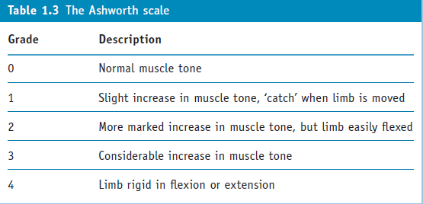

Slide 4
Successful rehabilitation is hard to define.
This chapter has tried to emphasize that rehabilitation must be patient centered.
The psychological impact of and responses to spinal cord injury need to be considered throughout rehabilitation and lifespan by all members of the interdisciplinary team.
‘The aims of the rehabilitation team should not only focus upon the acquisition of skills to enable a person to get out of bed in the morning, but to assist him in finding a reason for so doing’ (Treischmann 1988).

Slide 5
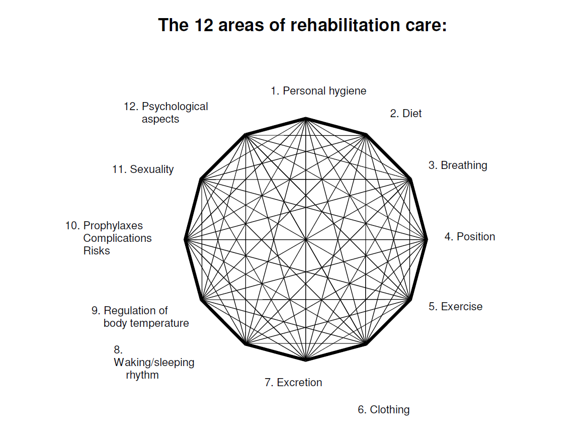

Slide 6
Immediate
6-8 weeks
10-12 weeks immobilization

Slide 7
Positioning
Fracture alignment
Pressure ulcer
Contracture

Slide 8
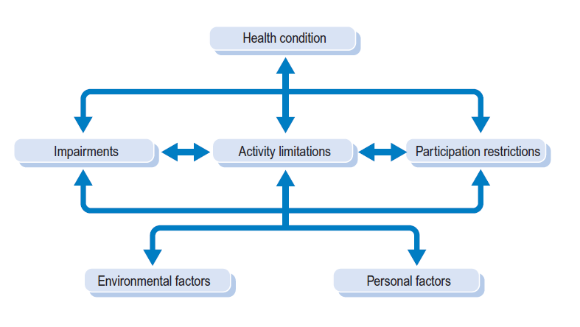

Slide 9
Steps

Slide 10
Setting goals for patient with complete SCI

Slide 11
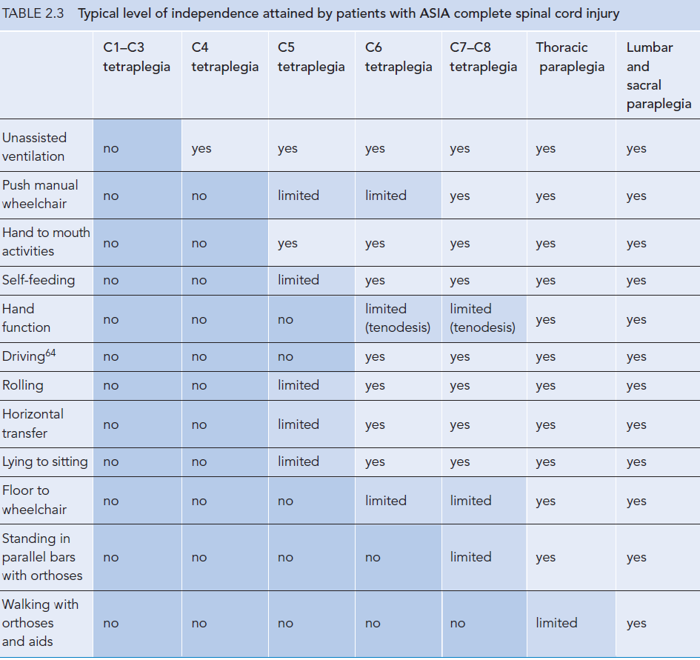

Slide 12
C1-C3
C2 fully dependent on ventilator
C3 have minimum diaphragm function

Slide 13
C4
Partial paralysis of diaphragm
Good strength in the rhomboid
Chin control wheel chair

Slide 14
C5
Partial paralysis of upper limb
Good strength of deltoid and biceps but poor in other muscles.
No triceps and hand function
Cannot perform gross task transfer
Can take hand to mouth or face
Splint hand
Keyboard with typing stick
Steering wheel with adaptation

Slide 15
C6
Difference between C5 and C6
Pectorals, serratus anterior, lattismus drosi and wrist extensors
Lift body weight and transfer
LD trunk stability
PM stability around shoulder and bed mobility
SA for scapular mobility
Potential to live independently
Manual WC but prefer motorized WC
Crude grasp or tenodesis grip

Slide 16
C7
Triceps
Wrist flexors and finger extensors
Triceps….bear weight through flexed elbow
Hold objects above head
Tenodesis grip

Slide 17
C8
Thumb and flexor activity
Grasp and release objects
Hand function better than tenodesis grip

Slide 18
T1
Near normal hand function
Some weakness in lumbricals and intrinsic muscles
Difficulty in unsupported sitting

Slide 19
Thoracic paraplegia
Wheel chair dependent
Walking aids
Lumbar and sacral paraplegia
Walk with or without devices

Slide 20
Biomechanical principal used in transferring
Elements of safe and efficient transfer
Mobility
Balance + Technique = Safe and efficient transfers
Strength
(age, gender and weight)

Slide 21
Lever
First lever
Weight
Fulcrum
Effort
Atlanto Axial joint
Initial stages of transfer
Lean backward on WC
Arm effort
Sacrum fulcrum
Leg weight

Slide 22
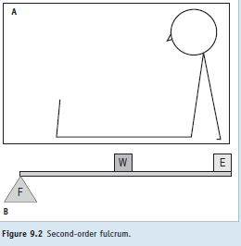
2nd order lever
Reverse transfer
On toes
Brachioradialais

Slide 23
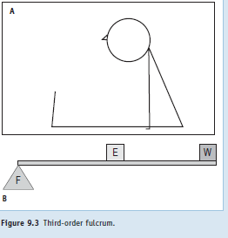
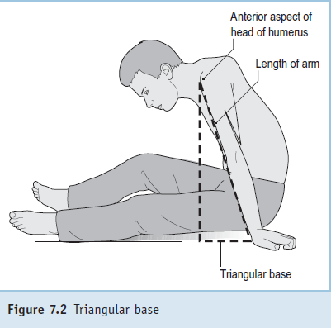
3rd order lever
biceps
Hamstring

Slide 24
Factors that make transferring easier
Low body weight
Upper limb strength
Joint flexibility and full forward mobility to achieve at least the vital triangle position
Good balance
Buttock clearance
Patient ability to solve problems
Daily practice
Placing one leg on the wheelchair footplate, which can offer greater trunk mobility for the transfer
Knowledgeable teaching by the physiotherapist.

Slide 25
Positioning
Upper limb Tetraplegia
Shoulder adducted , protracted
Elbow extended, if biceps overactive
Wrist 45 degree
Fingers flexed slightly
Thumb oppose…prevent monkey hand

Slide 26
Passive ?ROM
Forced passive movement against spasticity
Lower limb frog position while upper limb PROM
Heterotrophic ossification
45 degree abduction at hip….avoid medial side

Slide 27
SLR
Combined flexion of wrist and fingers avoided …trauma of extensors
Scapula
Length of
Rhomboids
Long head of triceps
Biceps

Slide 28
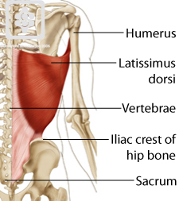
Lattismus dorsi
Serratius anterior

Slide 29
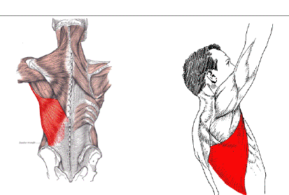

Slide 30
Neck Muscle Length
Quality of movement
Range of movement
Presence of resistance
Pain behavior

Slide 31
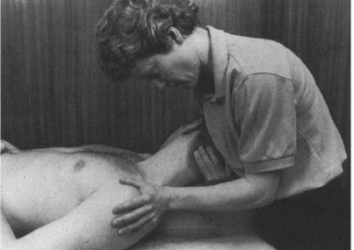
Levator scapulae
Contra lateral lateral flexion
Contra lateral rotation
Neck flexion
Shoulder depression

Slide 32
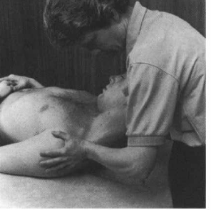
Upper trapezius
Contra lateral lateral flexion
Neck flexion
Shoulder depression

Slide 33
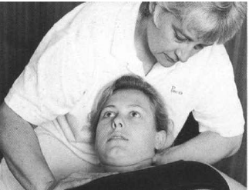
SCM
Chin tuck in
Contra lateral lateral flexion
Ipsilateral rotation
Clavicle is stabilized

Slide 34
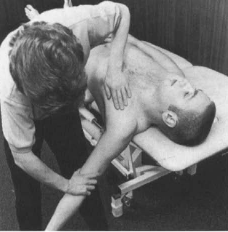
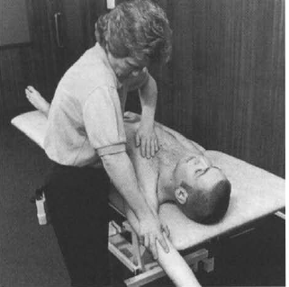
Pect major
Clavicular fibers
90 degree
Sternocosatl fibers
Full flexion

Slide 35
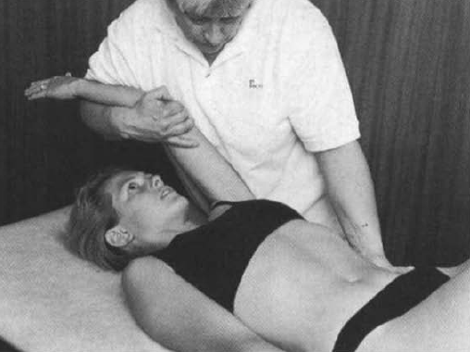
LD
Length
Action

