Slide 2
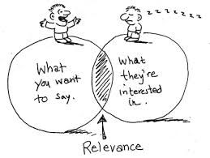

Slide 3
Preparing Useful Reports
Make your reports concise.
Make reports readable and understandable.
That means simple, not slang!
Put the most important points first.
Use graphics where possible.
Pay as much attention to the format of the report as to the content.

Slide 4
News paper writing
Compile all your facts.
Start with the lead
Give all the important details
Follow up main facts with additional information(After you've listed all the primary facts in your news article, include any additional information that might help the reader learn more, such as contact information, additional facts about the topic or people involved, or quotes from interviews. This additional information helps round out the article.)
Check facts before concluding
Remain unbiased
Conclude your article

Slide 5
News value
Timebased
Proximity
Consequence
Human interest

Slide 6
Writing for magazines
1-timeless
2-Select proper venue for your article and then to write the article directed at that audience
3-Feature articles sometimes even allow the writer to express personal thoughts and opinions on the topic.

