Slide 1
Pest of Maize and Sorghum
Dr. M. Asam Riaz
Assistant Professor
Entomology, College of Agriculture, University of Sargodha, Sargodha, Pakistan

Slide 2
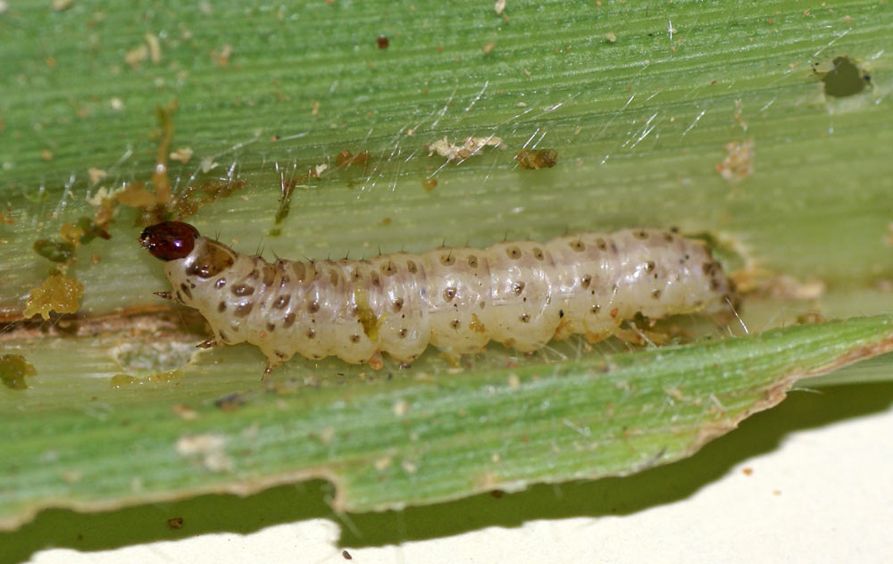
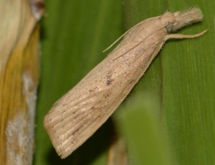
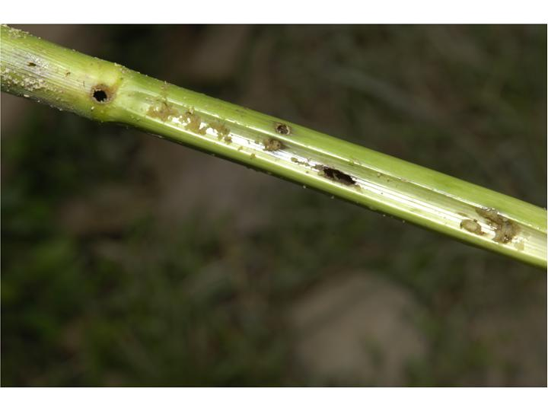
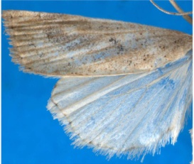
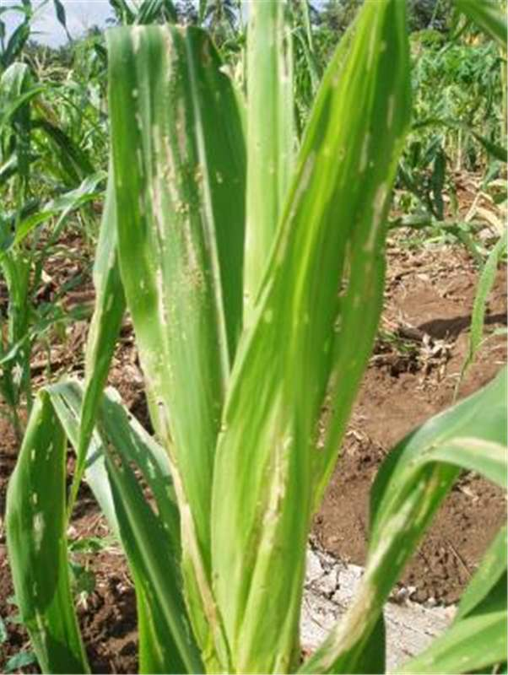
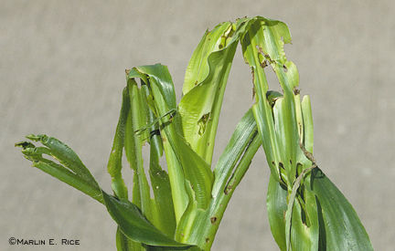
Insect pests of Maize & Sorghum Stem borer (Chilo partellus: Pyralidae: Lepidoptera)
Host plants: wild and cultivated grass species, including maize, sorghum, millets and rice
Active period: April to October
Identification (Spotted stem borer) and life cycle
Eggs: Clusters of 10-70 oval, scale like eggs laid on leaves near midribs.
Larvae: Creamy-white to yellowish-brown; 4 purple strips on dorsal side; Conspicuous dark-brown spots on dorsal side
hibernate as larvae; 1-2 weeks
Pupae: brown ; 7-10 days
Adult: Forewings are straw colour; row of black spot near outer margin
Damage:
Early stage crop is more susceptible.
Young larvae feed on growing tissue, inside the leaf whorl (leaving shot holes on leaves)
Producing ‘deadhearts’ and weakening stem with holes on them on internodal region.
Control:
Destruction of crop stubbles.
Use of light trap
Collect and destroy egg clusters
Biological control by Cotesia flavipes, Bracon spp.
Chemical control:
Imidacloprid 70WS 5 g/kg of seed
Granular insecticide to plant whorls e.g., Carbofuran 8-10kg/A
Triazophos 600 ml/A

Slide 3
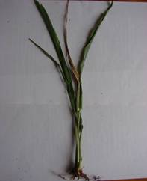
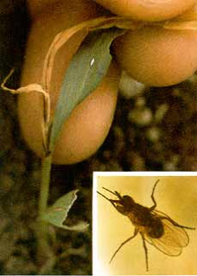
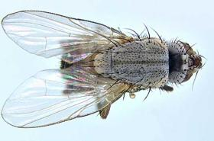
Insect pests of Maize & Sorghum Shoot fly (Atherigona soccata: Muscidae: Diptera)
Host plants: Sorghum, corn, millets, wheat, sarkanda, sudan grass
Active period: Feburary to October
Identification:
Eggs: elongated whitish in color laid singly on leave lowersides (30-40 eggs /female)
Larvae: yellowish brown in color; 6-10 days
Pupae: Pale white (turns brown later on)
Adult: small dark flies like house flies; pale grey; 1 month
Damage:
Maggots bore into the shoot of young plants, Central shoot dries (dead-heart).
Side tillers formation (which may be further attacked).
Control:
Pull-out and discard the infested plants
Higer seed rate
use of resistant cultivars;
Chemical control:
Imidacloprid (Confidor 70WS) 5 g/kg of seed
Cypermethrin 300-400 ml/A
Notes:
small dark fly; whitish eggs singly laid on leaf middle area.
Larvae yellow in color, make a clean cut at the base of the leaf inside the leaf whorls.
(1) monitoring adult shoot flies; (2) sequential sampling based on egg and dead heart counting; (3) cultural practices (sowing dates and plant densities, intercropping sorghum-cowpea); (4) use of resistant cultivars; (5) use of natural insecticide from the neem tree Azadirachta indica A. Juss. (Meliaceae); (6) effects of intercropping sorghum-cowpea on the natural enemies of the shoot fly; (7) spider fauna in pure sorghum and intercropped sorghum-cowpea; (8) parasitism of the shoot fly by a larval parasitoid, Neotrichoporoides nyemitawus Rohwer; and (9) the biology of an egg parasitoid, Trichogrammatoidea simmondsi Nagaraja. These nine approaches were divided into four main components: (1) monitoring populations, (2) cultural practices, (3) natural and chemical pesticides, and (4) biological control that could be integrated to control the shoot fly. Among these components, monitoring populations (egg sampling), cultural practices, and use of natural pesticides could be utilised at the farmer level.
The maggots bore into the shoot of young plants, central shoot dries (dead-heart).
Side tillers (which may be further attacked).

Slide 4
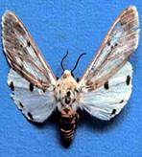
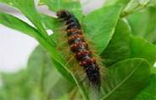
Insect pests of Maize & Sorghum Kutra moth (Amsacta moorei: Arctiidae: Lepidoptera)
Host plants: Polyphagous insect
Sorghum, corn, millets, sesamum, moth, mung
Identification: (also called red hairy catterpillars)
Adult: White forewings with scarlet reddish streaks on out margins and on the thorax and abdomen
Large black markings on hind wings
Eggs: yellow spherical eggs in clusters of few hundreds on leaf under sides,
Larvae: reddish brown hairy catterpillars
Life history:
Life cycle: 16-20 days
Larvae: 2-3 weeks
Pupation: 7 days (diapause as pupae in soil)
No. Of generations: 2-3
Damage:
Active period is June to August.
Kutra moth catterpillars feed on gorwingh shoot core
Large grown larvae eat agressively on all green matter.
Control:
Light traps for adult control
Pull-out and discard the infested plants with pest agrégations
Deep ploughting hoeing to kill pupae
10% Carbofuran

Slide 5
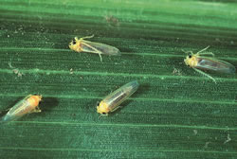
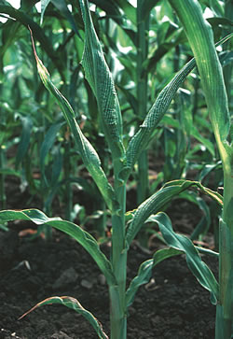
Insect pests of Maize & Sorghum Maize jassid (Zygina spp.: Cicadellidae: Homoptera)
Maize leafhoppers
Pest of maize, sorghum and millets crops
Adult/numph: Yellow and green-brigh
Desaping and deviatalizing the plants

