Slide 1
Resistive Circuits The circuits in which the resistors are connected in series or parallel or parallel-series combinations.

Slide 2
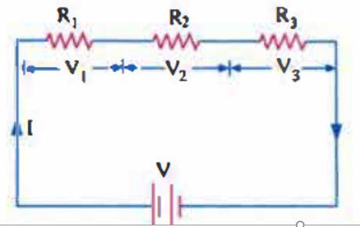
Series Circuit
The circuit in which the resistors are connected end-to-end in series with the battery.in other words the same current passes through each component. Consider three resistors R₁, R₂ and R₃ are connected in series with the battery as shown in fig. As the result same current I flow through each resistor
Then the voltage drop through each resistor are V₁= IR₁, V₁= IR₁ and V₂ = IR₂ and V₃ = IR₃. The sum of these voltage drops must be equal to the applied voltage. V = V₁ + V₂ + V₃

Slide 3
Total series resistance

Slide 4
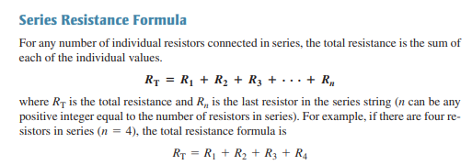
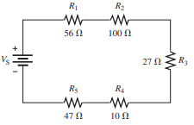
The total resistance of above circuit is

Slide 5
Example

Slide 6
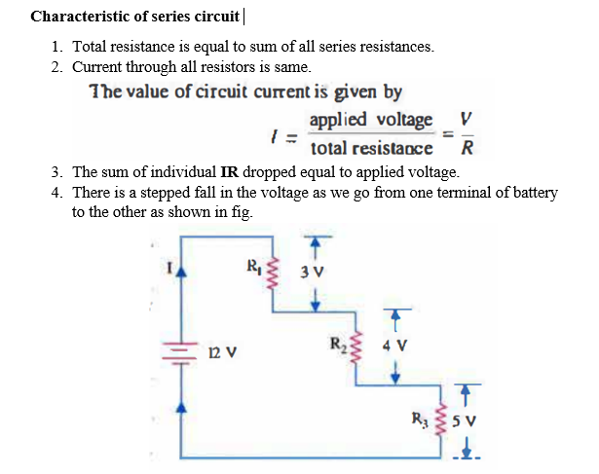

Slide 7
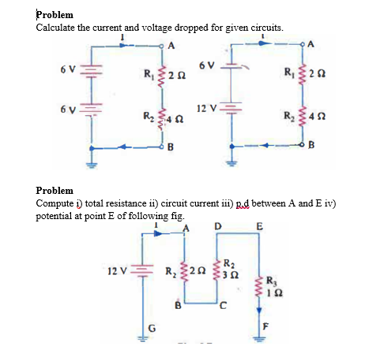

Slide 9
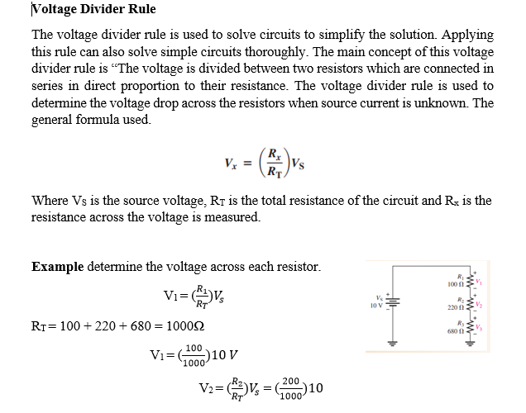

Slide 10
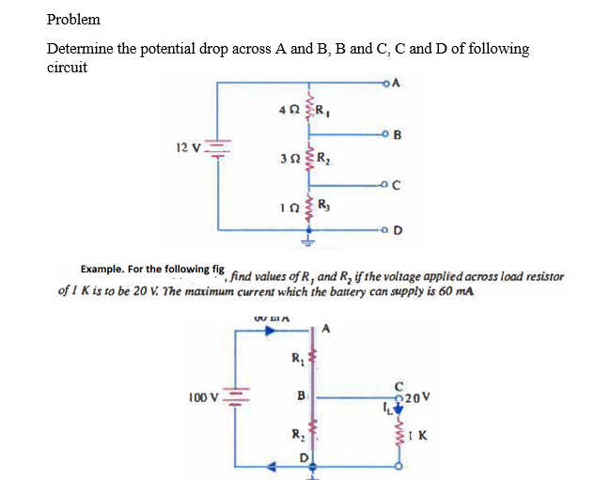

Slide 12
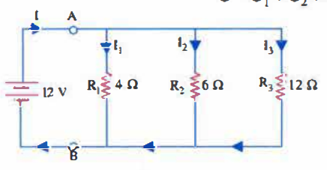
Example
Determine i) total resistance of the circuit ii) current through each branch iii) current supplied by battery.

