Slide 1
Low Head Diversion Dams (Barrages)
Engr. Muhammad Owais

Slide 2
WEIRS AND BARRAGES
A hydraulic structure constructed across a river is known as a dam, a weir or a barrage.
A weir is a structurally safe streamlined wall, built at a suitable site across a river. It is a low head-structure for the purpose of diverting river water.
A barrage is gated weir.

Slide 3
Purpose of Barrage
To divert required quantity of water from the river to the canals.
To raise the level of water supply.
To allow proper silt control.
To provide permanent head works for the canals in order to protect them during floods by providing complete closure.
To provide a better regulation than a weir.

Slide 4
Components of a Barrage
U/S (Up stream) floor
Concrete blocks
Stone-filling
U/S Apron (Pucca floor)
U/S Sheet pile
Intermediate Sheet Piles:
U/S Glacis:
D/S Glacis
Crest
D/S Apron
D/S sheet piles
Inverted Filter
Concrete blocks
Stone filling
D/S Flexible Protection

Slide 5
Components of a Barrage
U/S (Up stream) floor to lengthen the path of seepage and to protect the middle portion where the piers , gates, and bridge are to be found. Also to control the river water level so as to divert the required quantity of water at required level into the canal.
Concrete blocks, to raise the level of the supply so that it can command the area to be irrigated.
Stone-filling, to gain command economically when canal has to pass in expensive cutting
U/S Apron (Pucca floor) to reduce the fluctuations of the level of the river.

Slide 6
Components of a Barrage
U/S Sheet pile:
These are situated at the U/S end of the U/S concrete floor. The piles are driven into the soil beyond the maximum possible scour that may occur. The functions are:
To protect the barrage structure from the scour.
To reduce the uplift pressure on the barrage floor.
To hold the sand compacted and densified between two sheet piles in order to increase the bearing capacity.In recently built barrage such as Qadirabad and Chasma, upto 2 tons/ sq.ft. of bearing capacity has been obtained .

Slide 7
Components of a Barrage
Intermediate Sheet Piles:
These are situated at the end of U/S and D/S glacis. These serves as the Intermediate Sheet Piles. In the event of U/S or D/S sheet piles collapsing due to advancing scour or undermining, then these sheet piles give protection to main structure of the barrage i.e the piers carrying the gates, the road bridge and service bridge. The intermediate sheet piles also help lengthen the seepage path and reduce uplift pressure.

Slide 8
Components of a Barrage
U/S Glacis:
The U/S glacis have the necessary slope to join the U/S floor level with the highest point, the crest.
D/S Glacis:
This had a suitable shape and slope. This joins the crest to the D/S floor level (which may be at the river bed level or below), the hydraulic jump forms on the glacis since it is more stable than on the horizontal floor and this reduces the length of pucca work required at D/S.
Crest:
The crest is at the required height above the floor on which the gate rests in its closed position.

Slide 9
Components of a Barrage
D/S Apron:
The d/s floor is made of concrete and is constructed so as to contain the hydraulic jump. Thus it takes care of turbulence which would otherwise cause erosion. It is also provided with friction blocks of a suitable shape and at a distances determined by the hydraulic model experiments in order to increase friction and destroy residual kinetic energy.

Slide 10
Components of a Barrage
D/S sheet piles:
D/S sheet piles are placed at the end of the d/s concrete floor and their main function is to check the exit gradient. Their depth should be greater than the maximum possible scour.

Slide 11
Components of a Barrage
Inverted Filter:
An inverted filter is provided between the d/s sheet piles and the flexible protection . It would typically consist of 6" sand, 9"Coarse sand , 9” gravel. The filter material may vary with the size of the particles forming the river bed. It is protected by placing over it concrete blocks of sufficient wt. and size (ray 4'x2.75 'x4' used in the Kalabagh barrage). Silts (or jhiries) are left between the blocks to allow the water to escape. The silts are filled with sand. The length of the filter should be ( 2 x d / s ) depth of the sheet piles. Its primary function is to check the escape of fine soil particles in the seepage water. In the case of scour, it provides adequate cover for the d/s sheet piles against the steeping of the exit gradient.

Slide 12
Components of a Barrage
Concrete blocks - as discussed earlier.
Stone filling. Function is same as described earlier
D/S Flexible Protection:
A flexible apron is placed d/s of the filter and consists of boulders large enough not to be washed away by the highest likely water velocity. The protection provided is such as to cover one & half times depth of scour on the U/S side and 2 x depth of scour on the d/s side.

Slide 13
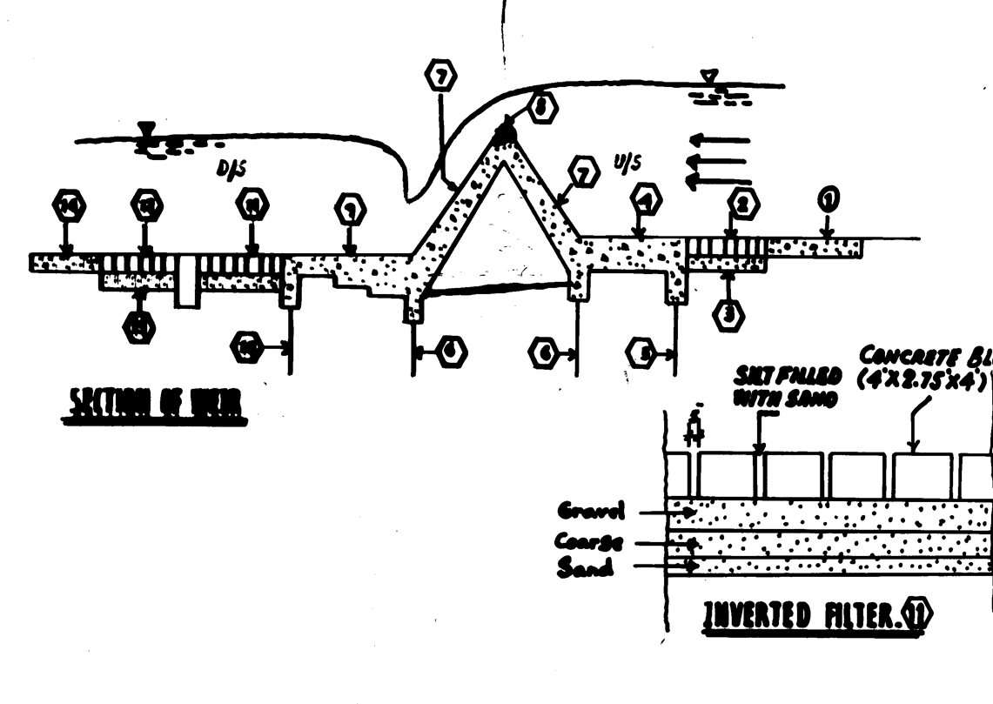

Slide 14
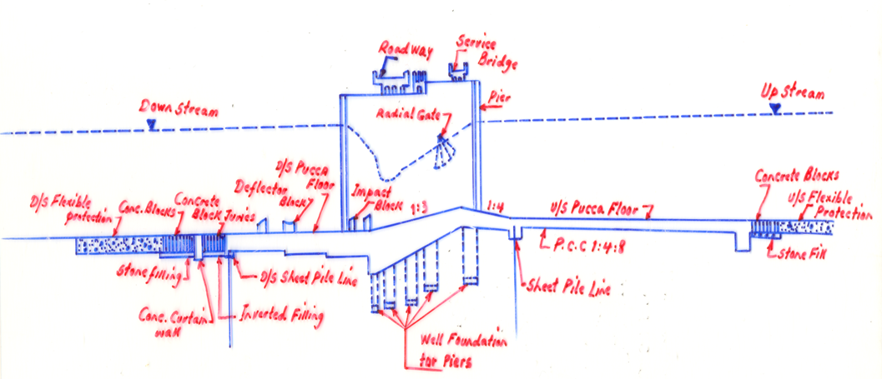

Slide 15
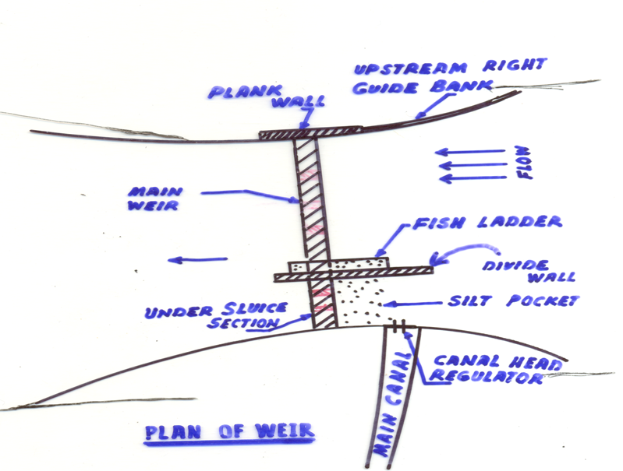

Slide 16
COMMENTS FROM PLAN
Undersluices: A number of bays at the extreme ends of the barrage adjacent to the canal regulator will have a lower crest level than the rest of the bays. The main function is to draw water by the formation of a deep channel in lower river flow and, secondly, to help control the flow of silt into the canal by reducing the water velocity by the formation of deep channel in front of the canal. Accumulated silt can be washed away easily by opening the undrsluice gates to high velocity currents generated by lower crest levels or a high differential head.

Slide 17
Divide Wall:
The divide wall separates undersluice bays from the normal bays. Its length on the U/S side has to be sufficient to keep the heavy turbulence at the nose of the wall well away from the protection of the sluices. Similarly, in the d/s side it should extend to cover the hydraulic jump and the resulting turbulence.
The main functions are:
To separate the undersluices from the normal bays to avoid the heavy turbulence which would otherwise occur due to a differential head in the two sections. This helps by creating a still pond in front of the canal off take thereby allowing better site control.
To generate a parallel flow and thereby avoid damage to the flexible protection area of the undersluice portion.

Slide 18
Fish Ladder:
It is constructed along the divide wall. It is a device designed to allow fish to negotiate the artificial barrier in either direction. In the fish ladder the optimum velocity is 6 to 8 ft/Sec, This can be obtained by creating a spatially varied flow as in the fish ladder at Marala, Qadirabad and Chashma barrages.

Slide 19
Guide Banks:
Guide banks are earthen embankment with stone pitching to guide the river through the barrage.
Marginal Bunds:
Marginal Bunds are flood embankments in continuation of the guide banks designed to contain the floods within the flood plain of the river. Both height and length vary according to the back-water effect produced by the barrage.

Slide 20
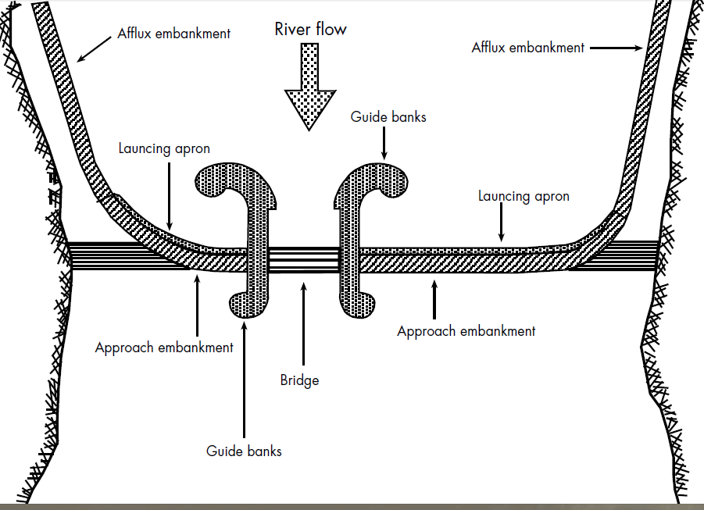

Slide 21
RETROGRESSION
Retrogression is a very important phenomenon which occurs after the construction of weir or barrage in a river flowing through alluvial soil. As a result of back-water effects and the increase in depths, the velocity of the water decreases resulting in the deposition of the sediment load. Therefore, the water overflowing the barrage having less silt, picks up silt from the d/s bed. This results in the lowering of the d/s river bed for a few miles. This is known as retrogression.

Slide 22
RETROGRESSION
Retrogression may occur for the first few years and bed levels often recover their previous level. The phenomenon is temporary because the river regime ice. its slope, adapts to the new conditions of flow created by the barrage within a few years and then the water flowing over the weir has a normal silt load. The d/s cycle than reverses due to the greater depth, silt is then deposited and the d/s retrogressed bed recovers to the point of equilibrium. Retrogression value is minimum for a flood discharge and maximum for a low discharge. The values vary from 2 feet to 8.5 feet.

Slide 23
ACCRETION:
Accretion is the reverse of retrogression and normally occurs u/s although may also occur d/s after the retrogression cycle is complete. There is no accurate method of calculating the values of retrogression and accretion but the values that have been recorded at various barrages may serve as guidelines.

Slide 24
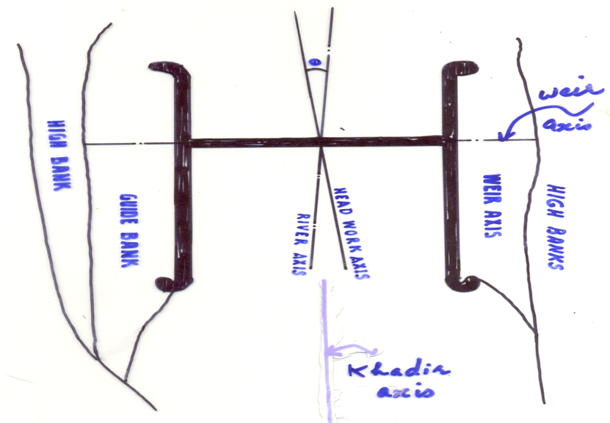

Slide 25
Definitions
Khadir:
The Khadir is the flood plain of the river.
Khadir Axis:
The Khadir axis is a line passing through the centre of the river course, between the two high bands upto the backwater effect.
Weir Axis:
The weir axis is a line along which the crest off the weir is laid.

Slide 26
Definitions
River Axis:
The river axis is a line parallel to the Khadir axis at the centre of the weir axis between the abutments.
Headworks Axis:
The Headworks axis is a line perpendicular to the weir axis at the centre of the weir abutments.

Slide 27
SITE SELECTION OF BARRAGE
The following consideration should be kept in mind when deciding on the site for a barrage.
The site must have a good command over the are to be irrigated, and must also be not too far distant to avoid long feeder channels.
The width of the river at the site should preferably be the minimum with a well defined and stable river approach.

Slide 28
SITE SELECTION OF BARRAGE
A good land approach to the site will reduce the expense of transportation and, therefore, the cost of the barrage.
Easy diversion of the river after construction.
Existence of central approach of the river to the barrage after diversion. This is essential for proper silt control.
If it is intended to convert the existing inundation canals into perennial canals, site selection is limited by the position of the head regulator and the alignment of the existing inundation canals.
A rock foundation is the best but in alluvial plains the bed is invariably sandy.

Slide 29
Consideration for Layout of Barrage:
The common practice in Pakistan was to build the barrage on dry land in a bye river and after completion to divert the river through it. This gave an oblique approach and created problems. The irrigation Research Institute, Lahore on the basis extensive hydraulic model experiments for each individual case suggests.
Where the angle between the headwork axis and the river axis exceeds 10º the problems arises of concentration of flow on one side and island formation (due to heavy silting)within the guide banks on the other side, as at Islam, Sidhnai and Ballokee barrages.

Slide 30
Consideration for Layout of Barrage:
If the river axis is to the right of the headwork axis the concentration of flow is generally on the left side with the consequent tendency to form an island on the right and vice versa.
When a barrage is located below the confluence of two rivers, it should be located sufficiently far below the confluence and consideration must be given as to which of the two rivers dominate the confluence.

Slide 31
Consideration for Layout of Barrage:
The barrage should be located as far as is possible in the center of the flood plain. Asymmetry of location increases the likelihood of shoals forming and calls for expensive training works.
The most suitable site for a barrage when constructed on dry land, is blow the outer side of the convex band, which is followed by straight reach off the river.

Slide 32
UNDERMINING OF WEIRS
When the seepage velocity in the microscopic flow channels in the sub-soil under the apron is such that the seepage force at the exit point becomes greater than the submerged weight and friction off the soil, very fine soil particles become displaced. This can be observed as muddy water emerging from the soil surface. With this continuing process and a subsoil consisting of fine particles surrounding larger particles, the removal of the fine particles causes unequal settlement of the subsoil, and ultimately the collapse of the structure due to piping. This is called the piping phenomenon.

Slide 33
Bligh’s Creep Theory
Bligh discovered the concept of line of creep along which the seepage water follows the path of least resistance , and this line is under the profile of the structure.
The head loss up to any point is in the ratio of the length to that point to the total creep.
Head loss up to G is=(BC+CD+DE+EF+FG)/ (BC+CD+DE+EF+FG+GH+HI+IJ+JK+KL+LM)
Uplift at G= total H- Head loss up to G

Slide 34
Bligh’s Creep Theory
Bligh discovered that piping occurs along the line of creep. It can be avoided if the average hydraulic gradient H/L, (Where H is total head during flow and 'L' is total creep length does not exceed l/C. Where 'C' is a constant which depends upon the type of porous material.
A number of structures were built according to Bligh's creep theory. Some of them were successful while others failed and further investigations were required to find a more sound and scientific basis for weir design . The SUKKUR BARRAGE was the last to be built on the basis of Bligh's creep theory. It is still standing today because it happened to be a safe structure by later design requirements.

Slide 35
Barrage profile
ΔH
B
D
E
G
H
K
L
M2
M
C
F
J
M1

Slide 36
Lane's weighted Creep theory
Lane (1935) found that the drop in head from head water to tail water depends on the weighted creep length. The weight creep length was defined as the sum of all the vertical distances plus 1/2 of the horizontal creep distance. The horizontal creep distance includes all the faces inclined at an angle less than 45º. The weighted creep ratio is the ratio of the weighted creep length to the head difference between the head water and the tail water.

Slide 37
Lane's weighted Creep theory
According to this theory, in computing creep length, greater weight should be given to vertical cut-off than to horizontal floors. The reasons are:
1.In practice, the contact between the vertical and steeply sloping surface is likely to be closer than that along horizontal or slightly sloping surfaces.
2.The soil beneath the structure may settle and leave empty spaces which will be aggravated by piping with vertical surfaces the voids will be filled due to earth pressure.

Slide 38
Lane's weighted Creep theory
Vertical cut-off are more effective against horizontal stratification, and check the free flow through the layers of sow permeability.
According to Lane's weighted creep theory, the weighted creep length is given as
Lw = 0.5S+V
Where S = the sum of all the horizontal contacts and of all the sloping contacts less than 45⁰.
V = the sum of all the vertical contacts plus the sloping contact greater than 45⁰.
To ensure safety against piping the average hydraulic gradient H/Lw must not exceed 1/C,

Slide 39
Material | C(Lane's Value) | C(Bligh's value)

