Slide 1
Rural Sociology ^{BS Sociology} Semester: 7th ^{Lecture No. 06} ^{Instructor: Mumtaz Hussain} University of Sargodha Sb Campus ^{Bhakkar}

Slide 2
Introduction to Village:
A village is a small settlement usually found in a rural setting.
A village is a small settlement usually found in a rural setting. It is generally larger than a "hamlet" but smaller than a "town". Some geographers specifically define a village as having between 500 and 2,500 inhabitants.
In most parts of the world, villages are settlements of people clustered around a central point. A central point is most often a church, marketplace, or public space. A public space can be a open space (sometimes called a village green), or developed square (sometimes called a plaza or piazza). This type of village organization is called a nucleated settlement.

Slide 3
Continue..
Some villages are linear settlements. They are not clustered around a central public space, but around a line. This line can be natural, such as a river bank or seashore. (Fishing villages are often linear settlements.) Linear settlements can also develop around a transportation route, such as a railroad line.
Villages in the Past
In the past, rural villagers usually engaged in a primary activity such as farming or fishing. In the United Kingdom, a "pit village" is a settlement whose primary activity is mining. In many underdeveloped nations, these primary activities are still the focus of rural village life.
The Industrial Revolution of the late 18th and early 19th centuries forever changed village life. The Industrial Revolution, defined as transition from animal-based labor to machines that manufacture goods, vastly increased productivity. As this happened, countless small villages grew into cities and towns.

Slide 4
Continue..
The Industrial Revolution of the late 18th and early 19th centuries forever changed village life. The Industrial Revolution, defined as transition from animal-based labor to machines that manufacture goods, vastly increased productivity. As this happened, countless small villages grew into cities and towns.
In this process, called urbanization, nucleated settlements built up around factories, not churches or community centers. This trend began on the island of Great Britain and eventually spread around the world.

Slide 5
Village Life Today
Agricultural villages remain the predominant form of rural settlement throughout most of the world. (In much of North America and Australia, however, the most common form of rural settlement is the isolated farmstead.)
Most villages in developed countries are no longer oriented toward primary activities. Cultural changes, globalization, and other factors have encouraged residents to seek other occupations, or, in some cases, to migrate. Perhaps the most radical change in village life came to Russia during the Soviet period.

Slide 6
Continue..
In the 1920s, Russia was an agricultural nation, with more than 75 million people living in villages. Russia quickly became an industrial nation, with the government supporting a manufacturing-based economy that was mostly located in cities. By the end of the Soviet Union in 1989, fewer than 40 million Russians lived in villages.
Some urban residents moved to villages and commute to jobs in larger cities and towns. This phenomenon is referred to as "urban flight" or "suburban colonization." Villages or suburbs not only grow larger, but gain political power.

Slide 7
Continue..
Conflict between village or suburban residents and inner-city residents over resources and priorities often define political debates in urban areas such as Mexico City, Mexico.

Slide 13
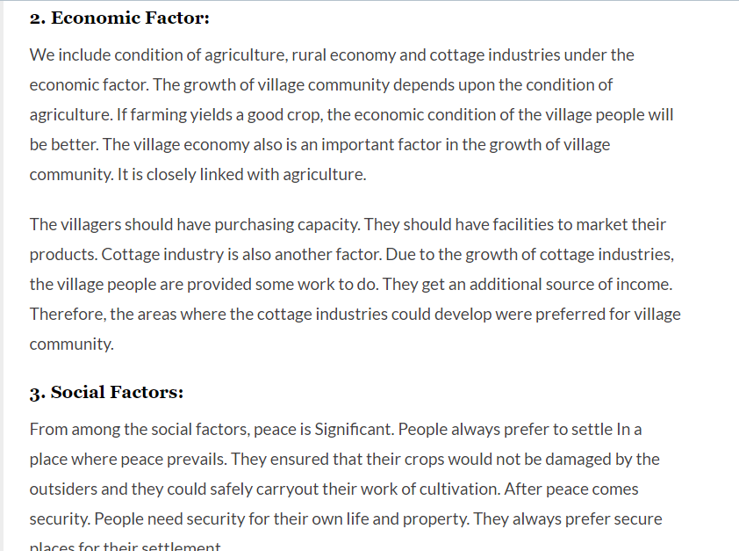

Slide 14
Thank You

