Slide 1
EXOTIC PLANTS IN SOCIAL FORESTRY

Slide 2
EXOTIC PLANTS
“EXOTIC” term as a reference to species that are not only able to survive but also able to reproduce outside their habitats where they evolved or spread naturally (United States Environmental Protection Agency, 2003)
Plants growing in an area different to their natural habitat or species growing in area where they do not naturally occur.
Zobel and Talbert, 1984
Webster and Mcetchnie (1980)
Wright (1976)
Morandini (1964)

Slide 3
EXOTIC PLANTS
The term “Exotic” is also used as synonymous of:
Introduced
Foreign
Non-native
Naturalized
Immigrant
Non-indigenous
Arrived by human activity, either deliberate or accidental
One of the difference between the terms exotic species and invasive species is that exotic species is associated with a benefit (i.e. conservation or profits) while invasive is relate to species that have been introduced and become a pest in its new location.

Slide 4
Benefits of Using Exotic Species
Used as an alternative to local indigenous tree species
Fast growing rate (In the tropics, exotic species could grow 5 to 10 times more wood than native species)
Exotic species used in forestry plantations can grow in sites with limited edaphological conditions (pH, nutrient availability, moisture content etc.)
Exotic species can adapt to different environmental conditions
Reduces the pressure over native species

Slide 5
Risks of Using Exotic Species
If the provenances and seed sources of the exotic species are not the most appropriate, the plantation could result in a disaster
Associated with new pests and diseases and affect native species;
Ecologists and politicians are against the use or modification of natural forests and their biodiversity
Some ecologists point out that “once established, some exotic species have the ability to displace or replace native plant and animal species, disrupt nutrient and fire cycles, and cause changes in the pattern of plant succession” (Jeff Lovich, 2003)

Slide 6
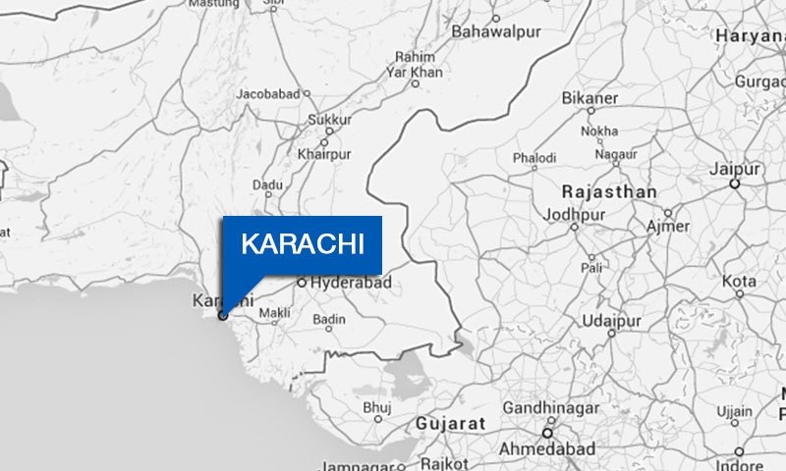
‘Stop Planting Exotic Trees’
KARACHI:
Stop growing exotic species and make the plantation more diverse, suggested Dr. Zafar Iqbal Shams, during his lecture on urban forestry held at the Garden Centre on Saturday
Organized by the Horticulture Society of Pakistan
Dr. Shams, said that it was important to
know the definition of a tree that go to a
certain height and develop a canopy

Slide 7
‘Stop Planting Exotic Trees’
Findings of Dr. Zafar Iqbal Shams
“Besides being an exotic species with harmful effects on the environment, the conocarpus (a North American species) grown extensively in the city is a shrub and not a tree”
Sharing findings of his study that showed a comparison between the composition and diversity of plantation existed in 1993 and 2013 along the 15-kilometre-long Corridor-1 (starting from Merewether Tower and ending at Sohrab Goth) and prepared a plant inventory on the request of Karachi Mass Transit Project officials in 1993
He revisited the data in 2013 and found that plant diversity had greatly reduced with an increased number of exotic species

Slide 8
‘Stop Planting Exotic Trees’
“The species diversity index had declined from 8.74 in 1999 to 1.4 to 2013. This is dangerous as a single plant infected with a disease could affect all trees and you would lose all your investment”
The urban forestry rule states that:
Not more than 10pc trees of any species should be planted
Not more than 20pc trees of any genus should be planted
Not more than 30pc trees of any family should be planted
On native species versus exotic species, he said that the study also showed that the corridor heavily comprised conocarpus species (84pc). Earlier in 1993, there was not only a better composition of native and exotic species, but there were more trees and less shrubs as well.

Slide 9
‘Stop Planting Exotic Trees’
Recommendations by Dr. Zafar Iqbal Shams
Plantation of local ficus species as easy to grow and requires little water
Moringa, native to parts of Africa and Asia (locally called sohanjana), a miracle tree with immense health benefits and should be planted in the city
Rich in calcium and protein
Its leaves could be used for making herbal tea
Seed oil could be used to have a glowing look
(Published in Dawn, August 30th, 2015)

Slide 10
EXOTIC TREE SPECIES IN SOCIAL FORESTRY OF PAKISTAN
Dalbergia sissoo – Rosewood Tree (Nepal)
Eucalyptus camaldulensis – Red Gum (Australia)
Conocarpus lanceolatus – Ethiopian Teak (Sudan)
Populus deltoides – Poplar (North America)
Acacia tortilis – Umbrella Thorn (Africa)
Paulownia chinensis – (China)
Prosopis juliflora – Mesquite (West Indies)
Jacaranda ovalifolia – Nila Gul Mohar (America)
Tamarindus indica – Tamarind (Africa)

Slide 11
Some Exotic Ornamental Trees Grown in Pakistan
Delonix regia – Gold Mohur (Malagasy)
Peltophorum pterocarpum – Golden Shower (Philippines)
Callistemon viminalis – Bottle brush (Australia)
Grevillea robusta – Silver Oak (Australia)
Heterophragma adenophyllum – Mostan Phul (Burma)

Slide 12
EXAMPLE
CHOICE OF EXOTIC AND INDIGENOUS TREE SPECIES FOR PLANTING ON FARMLANDS
The study was conducted at Chichawatni irrigated plantation (1989 to 2000)
For suggesting the appropriate indigenous and exotic tree species on farmlands
Indigenous tree species included in this study:
Bombax ceiba
Melia azedarach
Albizzia procera
Exotic tree species included in this study:
Populus deltoides
Eucalyptus camaldulensis

Slide 13
EXAMPLE
EXPERIMENT
Each tree species was planted at a spacing of 3m x 2m
Tree height and diameter at breast height (DBH) were measure of each species at the end of the eleventh year
Total volume of all tree species was calculated by using their plant height and DBH in equations provided in the local volume tables
RESULTS
The diameter and height of E. camaldulensis was greater than all other tree species but the volume of both E. camaldulensis and A. procera was also better than all other species
D. sissoo and M. azedarach had lower diameter, height and volume than all other tree species.

Slide 14
Final Thoughts
The establishment of fast growing exotic plantations is one of the best alternatives to produce the raw material needed to supply the increasing demand of the emergent economies
Features as fast growth, wider adaptability, higher response to intensive silviculture management and for instance higher profitability, makes of exotic species the ideal material to be used in the establishment of new forest plantations

