Slide 1
Indus Valley Civilization

Slide 2
Art
The Indus Valley civilisation left no temples or tombs like the Pyramids of Egypt, and no great statues of kings or gods. Indus Valley people made small figures of people and animals using metal and clay

Slide 3
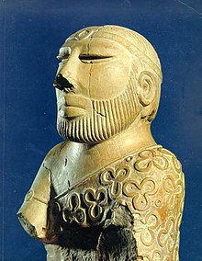
Statues
Only a few small statues survive. One is the Priest-King, with his beard, and his patterned robe.

Slide 4
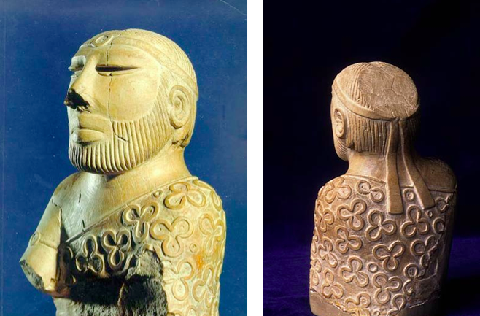

Slide 5
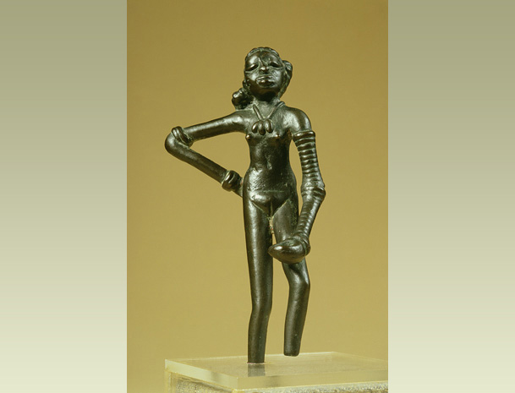
Another figure is a 'dancing girl' in bronze, only 11 cm high. This shows that Indus Valley people liked to dance. The dancing girl wears very little, but has lots of bangles on her arms. Her hair is in a plait

Slide 6
Small clay Figures
Small clay figures were thrown into rubbish pits. Perhaps they were good luck charms, or used in once and then thrown away?

Slide 7
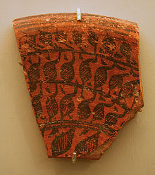
Pots
At home, Indus Valley people used bowls, dishes, cups, and vases made of terracotta. They had metal dishes made from copper, silver and bronze

Slide 8
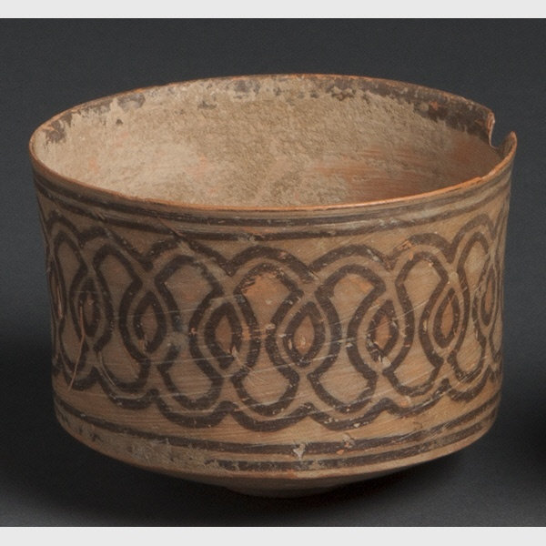
Most Indus Valley pots are plain, but some pots were decorated, usually in red and black. Potters added bands, patterns of leaves and flowers, and shapes like fish scales. A few pots were coloured blue, red, green and yellow.

Slide 9
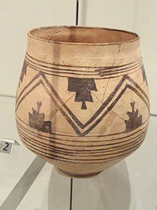
Clay pots were shaped on a potter's wheel. The potter put a lump of wet clay on a wooden disc (the wheel), and made the wheel spin. As the clay spun on the wheel, the potter shaped the pot by hand. The finished pot went into a hot oven to 'fire'or harden it. A cheap pot might be left in the hot sun to dry.

Slide 10
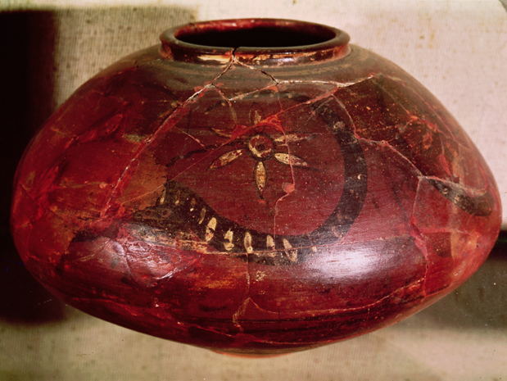

Slide 11
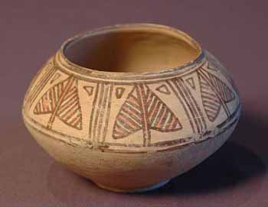

Slide 13
JEWELLERY
Archaeologists have found evidencethat Indus Valley people wore lots of jewellery, especially beads, necklaces, ear-rings and ear-studs, amulets, bangles and brooches.
Some Indus bracelets look like doughnuts, painted grey or black.

Slide 14
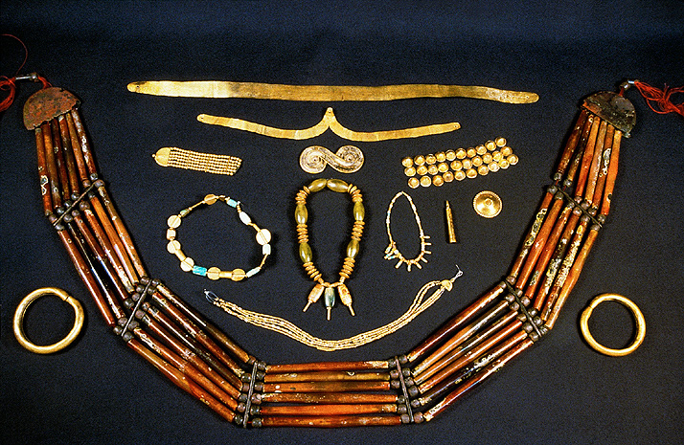

Slide 15
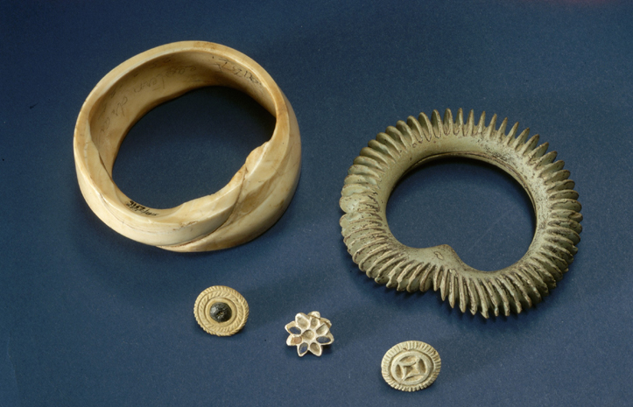

Slide 16
At Harappa, archaeologists found the grave of a man, who was buried wearing a necklace of more than 300 soapstone beads. People also liked bangles made from conch shells. Shell bangles are still made in India today

Slide 17
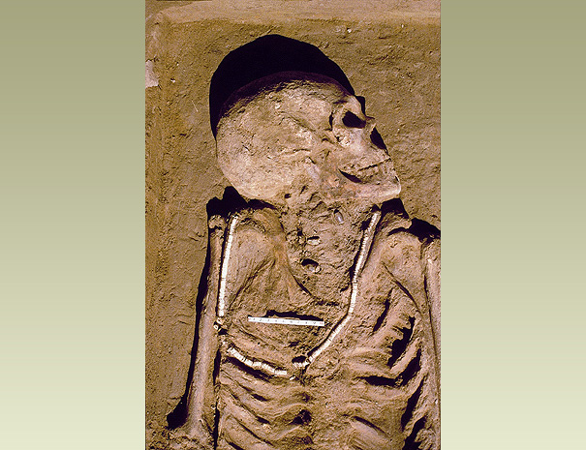

Slide 18
Red beads were made by heating carnelian stones in an oven. The heat turned the stone from brown to red. After it had cooled, the stone was chipped to shape the bead. Using a stone drill, the bead-maker drilled a hole for the string. Finally, the bead was polished smooth and shiny.

