Slide 1
Emergent General Medical Conditions

Slide 2
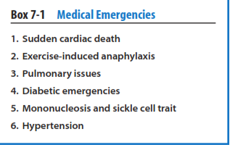
Sudden Death
Majority of cases of sudden death are related to undiagnosed cardiac conditions, pulmonary problems, hyperthermia , drug abuse , blunt chest trauma, sarcoidosis , and exercise-induced anaphylaxis, among others, have also been reported as causes

Slide 3
Hypertrophic cardiomyopathy
Hypertrophic cardiomyopathy is a congenital condition with an incidence of about 1 in 500 persons in the general population. Hypertrophic cardiomyopathy is associated with impaired diastolic filling , decreased ventricular compliance, and impaired ventricular emptying resulting from hypertrophy of the interventricular septum and left ventricle. Electrocardiograms demonstrate ventricular hypertrophy and marked symmetrical T-wave inversion and can be an effective screening test, but an echocardiogram is a better test.

Slide 4
Arrhythmogenic right ventricular dysplasia
A genetic condition characterized by replacement of the myocardium by fat and fibrous tissue . The prevalence in the general population is estimated at 1:5000,but in certain regions of Italy the incidence is as high as 0.4 to 0.8%.The disease is diagnosed in patients younger than 40 years 80% of the time. There is a genetic predisposition, although the true prevalence of the disease is unknown. The areas of fibrosis result in right ventricular arrhythmias during exercise. In Italy, it has been shown to be the most common disease leading to exercise induced cardiac death in athletes.

Slide 5
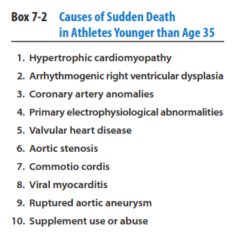

Slide 6
Coronary artery anomalies
Cause of sudden death in young athletes, although they are less frequently diagnosed than hypertrophic cardiomyopathy and arrhythmogenic right ventricular dysplasia.
The majority of the recorded cases occurred in junior high school and high school athletes, with basketball and soccer being the most common sports of occurrence.
The majority will die without prior symptoms, but syncope and chest pain will occur in a minority of cases and clearly should be evaluated with an angiogram because echocardiogram and electrocardiogram findings will not typically be present.
Stress test results are positive in a minority of the athletes in these cases.

Slide 7
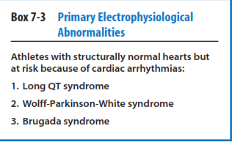
represent a group of athletes with structurally normal hearts but who are at increased risk of dying from cardiac arrhythmias

Slide 8
Long QT syndrome
Long QT syndrome can be acquired or inherited. It was initially thought that there were two inherited forms: autosomal dominant, the most common, and an autosomal recessive form associated with congenital deafness.
The acquired forms are most frequently related to medication use or electrolyte imbalances—in particular, potassium and magnesium.
The common feature of long QT syndrome is prolongation of cardiac repolarization . Competitive sports are discouraged for patients with this syndrome, but recreational activities are considered acceptable

Slide 9
WolffParkinson-White (WPW) syndrome
WPW syndrome is a congenital cardiac abnormality in which the ventricle of the heart receives electrical stimulation from accessory pathways from the atrium. These pathways can result in “pre-excitation,” a cardiac abnormality in which the ventricular myocardium receives electrical activation from the atrium prior to the normal conduction from the atrioventricular (AV) node. WPW syndrome has been associated with syncope and has been considered a potential cause of sudden death in athletes.
The diagnosis can be made on electrocardiogram..

Slide 10
WolffParkinson-White (WPW) syndrome
Atrial fibrillation occurs in 10% to 30% of patients with WPW and may be a risk factor for sudden death, although no specific predictor of sudden death has been found.
Treatment is to ablate accessory pathways from the atrium to the ventricle

Slide 11
Brugada syndrome
A high risk for sudden death in young and otherwise-healthy adults. It is a genetic disease characterized by abnormal electrocardiogram findings and is fatal due to ventricular fibrillation.
It has a high prevalence in Japan but a much lower prevalence in Europe and the United States.
Males appear at higher risk of sudden death.
At present , the most accepted treatment is placement of an intracardiac defibrillator

Slide 12
Valvular heart disease
Mitral valve prolapse has a low incidence of sudden cardiac death, especially if significant mitral regurgitation, ventricular ectopy, and a positive family history of sudden death are not present.
The condition affects 5% of the general population and is considered the most common cardiac valve disorder.
The diagnosis is made on physical examination, with auscultation of a mid systolic to late systolic click. Most physicians adopt a permissive attitude toward participation in sports

Slide 13
Aortic stenosis
Easily diagnosed on a pre-participation physical examination, with identification of the presence of a harsh systolic murmur that increases on squatting and decreases with Valsalva maneuver.
Patients with mild aortic stenosis may participate in all competitive sports, but patients with moderate stenosis may participate in only low-intensity sports, and patients with severe stenosis are generally excluded from sports participation.

Slide 14
Commotio cordis
It is most common in children and adolescents ,with a mean age of occurrence of 13 years.
Blow must be directly over the heart and occur within 15 to 30 microseconds of the T-wave peak, which is the vulnerable phase of cardiac repolarization.

Slide 15
Viral myocarditis
Viral myocarditis with or without left ventricular dysfunction is associated with cardiac arrhythmias and sudden death. These patients typically present with chest discomfort and dyspnea , in addition to a variety of symptoms associated with viral infections. Although coxsackie viruses have been thought to be responsible for most of these infections, a variety of viruses are now considered to cause this condition.
Diagnosis can be difficult, with a variety of studies, including myocardial biopsy, and polymerase chain reaction/reverse transcriptase-polymerase studies failing to demonstrate an infectious agent in some cases.

Slide 16
Kawasaki disease
It is a rare childhood illness that affects the blood vessels can harm the coronary arteries,
which carry blood to the heart muscle The disease is most common in children ages 1 to 2 years and is less common in children older than age 8.

Slide 17
Use of supplements such as ephedra or drugs such as anabolic steroids or Theses deaths are thought to be largely inferential because of the time between ingestion and the episode of sudden death.
Cocaine use is associated with a wide range of arrhythmias

Slide 18
Exercise-Induced Anaphylaxis
Exercise-induced anaphylaxis is a rare form of physical allergy that occurs during physical activity.
It has become increasingly recognized in the past 30 years as more people participate in sports. Three major types of the condition are described:
(1) Cholinergic urticaria ,
(2) Classic exercise induced anaphylaxis
(3) Variant type exercise-induced anaphylaxis.
These may occur separately or together..

Slide 19
Cholinergic urticaria
Cholinergic urticaria is a skin condition manifested by small (2–5 mm) punctate papules surrounded by an erythematous base usually occurring about 6 minutes into exercise.Lesions come on in response to exercise, warming, or emotional stress and generally begin on the chest and neck but may occur anywhere on the body. Increased lacrimation, salivation, and diarrhea may occur from cholinergic stimulation, and if the inciting stress persists, hives and angioedema may occur but vascular collapse is uncommon. Symptoms typically resolve in 2 to 4 hours. Onset typically occurs between 10 and 30 years of age.Diagnosis of exercise-induced urticaria can be made with the results of a methacholine skin test challenge. This Test is designed to see if the patient’s bronchial tubes are unusually sensitive to a drug called methacholine.

Slide 20
Classic exercise induced anaphylaxis
It is most commonly precipitated by running, but a variety of activities have been associated with its occurrence. Symptoms last from 30 minutes to 4 hours after cessation of activity. Symptoms are not consistently reproducible, even in a laboratory situation.
These patients present with systemic symptoms often in a sequence beginning with fatigue , generalized warmth , pruritus,and erythema that progresses to an urticarial eruption.
Transient periods of lost consciousness occur in some patients, and a completely developed attack includes choking, stridor, and gastrointestinal colic,with nausea and vomiting.

Slide 21
Skin manifestations will include hives ( erythematous lesions) 10 to 15 mm in size. The diagnosis is most commonly made by history , but passive warming may help differentiate cholinergic urticaria from exercise-induced anaphylaxis,
Exercise challenge testing under controlled conditions also is used. Exercise challenge testing can be difficult because of variability of symptom occurrence.

Slide 22
Variant type exercise-induced anaphylaxis.
It is the least common form of exercise-induced anaphylaxis. It is characterized by punctuate urticaria (2–4 mm) associated with exercise-induced vascular collapse.
It is precipitated only by exercise and not by vascular warming.
Choking and stridor resulting from upper airway edema occur in some patients with exercise-induced anaphylaxis, but changes in pulmonary function are uncommon.

Slide 23
Treatment of exercise-induced anaphylaxis
Treatment of exercise-induced anaphylaxis consists of subcutaneous epinephrine, intravenous (IV) fluid, oxygen, antihistamines, and airway maintenance. Once the athlete is stabilized, prophylactic use of antihistamines and anticholinergic medications and a search for precipitating causes should be initiated. Exercising with a partner, quick availability of an autoinjector of epinephrine (such as an EpiPen ), and patient education are highly advisable; patient education about the disease will also help to reduce the rate of recurrences. In the literature, only one death has been attributed to this disorder.

Slide 24
Asthma
Asthma is a chronic inflammatory disorder of the airways associated with hyperresponsiveness of the inflammatory system, reversible airflow limitation, and respiratory symptoms. It is the most common chronic lung disease. The prevalence of asthma is highest among African Americans and those living in low-income households.
Signs and symptoms of an asthma attack include progressive increase in shortness of breath,coughing,wheezing,or chest tightness and a decrease in peak expiratory flow rate.

Slide 25
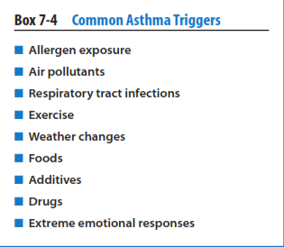
Asthma triggers cause exacerbations by inducing airway inflammation, provoking acute bronchospasm.

Slide 26
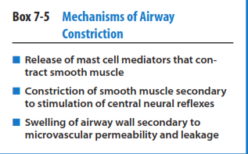
Allergen-induced bronchoconstriction results from the release from airway mast cells of mediators, including histamine, prostaglandins, and leukotrienes, that contract the smooth muscle.

Slide 27
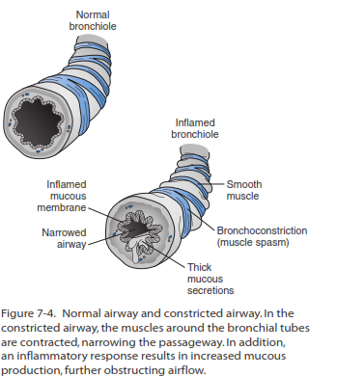

Slide 28
Progression of asthmatic attack
Two different scenarios are involved in the progression of an asthma attack.
In first scenario when airway inflammation is predominant, patients show a progressive (over many hours, days, or even weeks) clinical and functional deterioration.
This type of asthma progression is between 80% and 90% of all adults with acute asthma who present to the emergency department

Slide 29
In the second scenario, bronchospasm is predominant and patients present with a sudden-onset asthma attack.
It is characterized by rapid development of airway obstruction in less than 3 to 6 hours after the onset of the attack.
These patients show a more rapid and complete response to treatment.

Slide 30
An important sign that an athlete’s asthma is worsening is use of a quick relief rescue inhaler more than twice a week because of symptoms.
Severe symptoms include pulsus paradoxus (a decrease in systolic blood pressure by at least 12 mmHg during inspiration), use of accessory muscles of inspiration (sternocleidomastoid muscles), diaphoresis, and inability to lie supine because of breathlessness.
If an athlete presents with any of these symptoms, it is the athletic trainer’s responsibility to quickly assess the severity of the attack

Slide 31
Particular attention should be given to the athlete’s general appearance .Those with the most severe conditions will be sitting upright. The use of accessory muscles can also be used as an indicator of severe obstruction. The presence of sternocleidomastoid retractions or suprasternal retractions correlates well with severe impairment in lung function.
Respiratory rate (RR) >30 breaths per minute, tachycardia >120 beats per minute, or pulsus paradoxus >12 mm Hg have also been described as vital signs of acute severe asthma

Slide 32
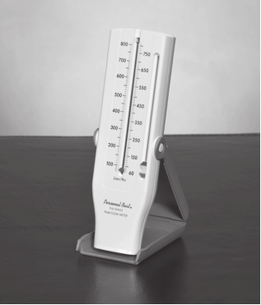
Athletic trainers and team physicians should be aware of an asthmatic athlete’s personal best peak expiratory flow readings.

Slide 33
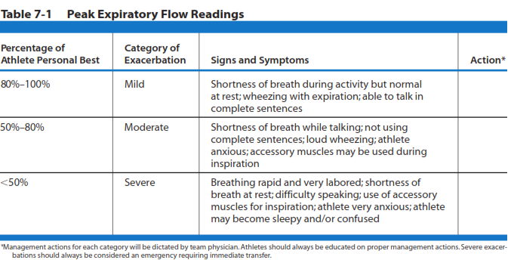

Slide 34
The primary goals of therapy for acute asthma are the rapid reversal of airflow obstruction and the correction, if necessary, of severe hypercapnia or hypoxemia.
Inhaled short-acting beta-2 agonists are the mainstay of emergent treatment of acute asthma exacerbations. Albuterol is the most widely used short-acting beta-2 agonist in the acute setting.
Their onset of action is rapid,and their side effects are well tolerated. Albuterol has an onset of action of 5 minutes and duration of action of 6 hours. Other used drugs are metaproterenol, terbutaline, and fenoterol.

Slide 35
Long-acting beta-2 agonists cannot be recommended for emergency treatment because of their longer onset time for effectiveness.
The inhaled route has a faster onset and fewer adverse effects and is more effective than systemic routes (IV, oral medication in pill form, injection).
Medication to be delivered by metered dose inhaler (MDI) with spacer or by nebulizer

Slide 36
Each beta-2 agonist treatment with an MDI and spacer takes 1 to 2 minutes as compared with 15 to 20 minutes for each treatment with a nebulizer.
It seems reasonable to conclude that the MDI plus spacer is the most efficient way to deliver high doses of bronchodilators to a patient with acute severe asthma.
Nebulizers generate a relatively large particle size in which up to 90% of the medication remains in the machine or is lost to the atmosphere from the expiratory port.

Slide 37
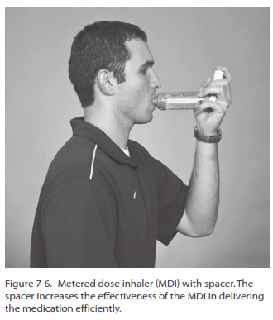

Slide 38
Side effects of beta-2 agonists are dose dependent and can occur with all routes of administration.Inhaled administration is associated with the least frequency of side effects. Receptors on vascular smooth muscle result in tachycardia and tachyarrhythmia.
Those on skeletal muscle generate tremor and hypokalemia (as a result of potassium entry into muscle cells).
Lastly, cells involved in lipid and carbohydrate metabolism cause an increase in blood-free fatty acids, insulin, glucose, and pyruvate. The most common side effect seen after administration of beta-2 agonists is a fine tremor.

Slide 39
The usual dosing is 2 to 4 puffs delivered every 15 to 20 minutes for a total maximum of 3 doses. Bronchodilation can be achieved by high doses (6–12 puffs) of a beta-2 agonist by MDI with a spacer.
The athlete’s peak flow should be measured just before and a few minutes following administration of each dosing.
Current guidelines encourage institution of systemic corticosteroids as soon as insufficient improvement with beta agonist bronchodilators is identified. Patients in this category include those with the following: (1) less than 10% improvement in peak flow rates after the first dose of inhaled beta agonists, (2) an asthma attack that has developed despite daily or alternate day oral corticosteroids, and (3) a peak flow rate less than 70% of personal best after the initial hour of treatment.

Slide 40
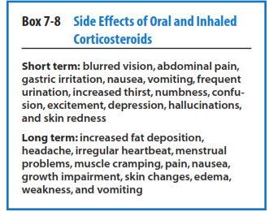
Prednisone , the most common oral corticosteroid .The most common initial dose range given for teenagers and adults in an acute asthma exacerbation is 5 to 60 mg.

Slide 41
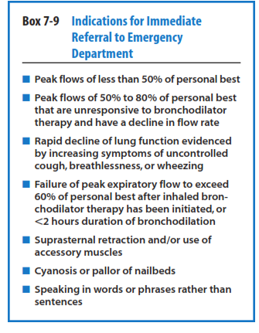

Slide 42
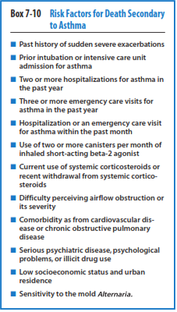

Slide 43
Diabetes mellitus
Diabetes mellitusis a group of metabolic disorders resulting from defects in insulin secretion,action,or both.It is generally divided into four separate groups: (1) absolute insulin deficiency; (2) impaired insulin secretion and peripheral insulin resistance; (3) secondary to metabolic disorders, drugs, or other diseases; and (4) gestational diabetes.
Historically, about 80% of patients have impaired insulin secretion and peripheral insulin resistance (type 2 diabetes), and about 15% have insulin deficiency (type 1 diabetes)

Slide 44
In children, only 2% to 3% of all diabetes was a result of impaired insulin secretion.
In the past 10 years, a 10-fold increase in the incidence of impaired insulin secretion has been reported in children. These children are predisposed to diabetes by being obese, leading a sedentary lifestyle,and eating a high-fat and low-fiber diet—risk factors not generally associated with athletics.
However, a genetic predisposition exists for some individuals. The average age of onset of these children is 12 to 14 years of age, and women are more often affected than men.

Slide 45
The development of type 2 diabetes, and many adolescents will not have undergone screening, so the athletic trainer may see these patients before the diagnosis is established and may have to manage the initial difficulties with hypoglycemia, hyperglycemia, dehydration, and electrolyte imbalances with exercise when the disease first occurs. These athletes will often present with hyperglycemia; dehydration; and, in most cases, electrolyte imbalances. In almost all cases, they will require transport to an emergency room. Both the team physician and athletic trainer will want these athletes to be transferred to an emergency room for proper laboratory work, including glucose, electrolyte,blood urea nitrogen,and complete blood count levels. Appropriate management of uncontrolled diabetes requires transfer.

Slide 46
For all athletes with diabetes,the main risk of exercise is hypoglycemia.
Paying attention to meal planning , providing carbohydrates during practices , and monitoring of glucose levels can prevent episodes.
When episodes of hypoglycemia occur, having a ready source of carbohydrate minimizes complications.
Athletes who do not adequately dose themselves with insulin are at risk of developing hyperglycemia, and potentially diabetic ketoacidosis, provoking a medical emergency. Hyperglycemia predisposes the athlete to osmotic diuresis (increase of urination rate ) and dehydration

Slide 47
Diabetic ketoacidosis is a serious complication of diabetes that occurs when your body produces high levels of blood acids called ketones. Without enough insulin, your body begins to break down fat as fuel. This process produces a buildup of acids in the bloodstream called ketones, eventually leading to diabetic ketoacidosis if untreated. Diabetic ketoacidosis is a medical emergency and requires hospital admission for appropriate management. Clinically, diabetic ketoacidosis is most often seen in type 1 diabetes and often develops over a day or two.It often presents with polydipsia and polyuria and is associated with abdominal pain, nausea, and vomiting. Weight loss, weakness,and drowsiness are less frequent symptoms..

Slide 48
The management of diabetic ketoacidosis requires fluid and electrolyte therapy; insulin therapy.
The most common complications include cerebral edema, pulmonary edema, electrolyte imbalances, hyperchloremic metabolic acidosis(a decrease in plasma bicarbonate concentration, and an increase in plasma chloride concentration ) vascular thrombosis, and renal failure.
Any athlete with suspected diabetic ketoacidosis requires immediate transport to an emergency room.

Slide 49
Hyperglycemic hyperosmolar state is the other extreme in the spectrum of diabetic decompensation.
Insulin deficiency results in hyperglycemia but not in ketone body production, and hyperglycemia and dehydration result. Higher mortality rate.
The hyperglycemic hyperosmolar state is more often seen in older patients with type 2 diabetes and often develops over weeks.
Management with insulin, fluids, and frequent monitoring is similar to diabetic ketoacidosis

Slide 50
Mononucleosis
An abnormally high monocytes in the blood, The Epstein-Barr virus is the infectious agent in mononucleosis. Although most Epstein-Barr infections are asymptomatic, mononucleosis syndrome is most commonly seen in adolescents and young adults. Infectious mononucleosis is characterized by a prolonged incubation period of 30 to 50 days and an extremely wide array of clinical manifestations, with nearly every organ system in the body potentially being involved. Diagnosis of mononucleosis syndrome is usually made clinically by the presence of sore throat, fever, headache, lymphadenopathy, and malaise, associated with a complete blood count demonstrating a lymphocytosis and the presence of atypical lymphocytes making up greater than 10% of the total white blood cell count

Slide 51
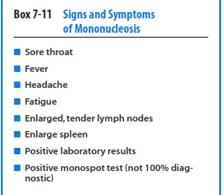
The heterophil antibody test, also known as the monospot, is positive in about 90% of older children and young adults with the syndrome,
but the test is positive in only 60% at 2 weeks and 90% at 4 weeks after symptoms are note.
Test is specific for heterophile antibodies produced by the human immune system in response to EBV infection.

Slide 52
mononucleosis is associated with spontaneous rupture of the spleen, diagnosis be made quickly .
In some cases,serologic testing should be performed.
The majority ofsplenic ruptures occur between day 4 and 21 of symptoms; holding the athlete until spleen size is normal is recommended.

Slide 53
Sickle Cell Trait
Sickle cell trait means having one gene for a condition called sickle cell disease (SCD).
sickle cell trait is generally considered benign, it has been associated with an increased risk of sudden death during exercise. Risk factors for athletes with sickle trait include heat, dehydration, altitude, and asthma. There is also increased risk of splenic infarction and rhabdomyolysis(rapid destruction of skeletal muscle resulting in leakage into the urine of the muscle protein myoglobin).Although screening is not recommended and high-level athletic activity is clearly possible, athletes with a history of collapse with exercise and sickle cell trait should be well hydrated and well monitored. Players may complain of cramp like pain in the legs and/or back.

Slide 54
Hypertension
Pre hypertension : Systolic blood pressure (SBP) 120 to 139 or diastolic blood pressure (DBP) 80 to 89.
Stage I HTN: SBP 140 to 159 or DBP 90 to 99
Stage II HTN: SBP 160 or DBP 100
The sports medicine community needs to be aware of a potentially life-threatening spectrum of clinical presentations where uncontrolled BP can lead to progressive target organ dysfunction (TOD) known as hypertensive crises.

Slide 55
Hypertensive Emergency -;
Hypertensive emergencies represent severe HTN with acute impairment of the central nervous system (CNS),cardiovascular system,or the renal system.These are considered target organ systems because they are most directly affected by changes in BP. To prevent permanent damage to target organs, the BP should be lowered aggressively over minutes to hours.
Hypertensive Urgency-;
Hypertensive urgency is defined as a severe elevation of BP without evidence of progressive TOD.These patients require BP control over several days to weeks.

Slide 56
20 mm Hg systolic or 10 mm diastolic increase in BP, the mortality rate from both ischemic heart disease and stroke doubles.
Clinical Evaluation-;
History-;
Chest pain: myocardial ischemia or infarction
Back pain: aortic dissection
Dyspnea: pulmonary edema,congestive heart failure Neurological symptoms: headache, nausea, vomiting, visual disturbances, altered level of consciousness (hypertensive encephalopathy), seizures

Slide 57
Physical Examination
Vitals: levels 180/120 mm Hg usually associated with hypertensive crises.
• BP should be measured in both the supine position and the standing position
• BP should also be measured in both arms
(a significant difference suggests an aortic dissection)
■ Cardiovascular: evaluate for the presence of heart failure •Jugular venous distension
• Crackles
■ Abdomen: abdominal masses or bruits

Slide 58
Treatment
Oral medicines,such as nifedipine,in an effort to lower BP rapidly before discharge.This is not indicated and may be dangerous.
Target organ hypoperfusion may result leading to ischemia and infarction. MAP should be reduced by no more than 20% to 25% in the first hour of treatment.If the patient remains stable,the BP should then be lowered to 160/100 to 110 in the next 2 to 6 hours.
Continuous infusion of a short-acting IV antihypertensive agent

Slide 59
■ CNS • Level of consciousness
• Visual fields
• Focal neurological signs
■ Ear,nose,and throat: presence of new retinal hemorrhages,exudates,or papilledema suggests a hypertensive emergency

