Slide 1
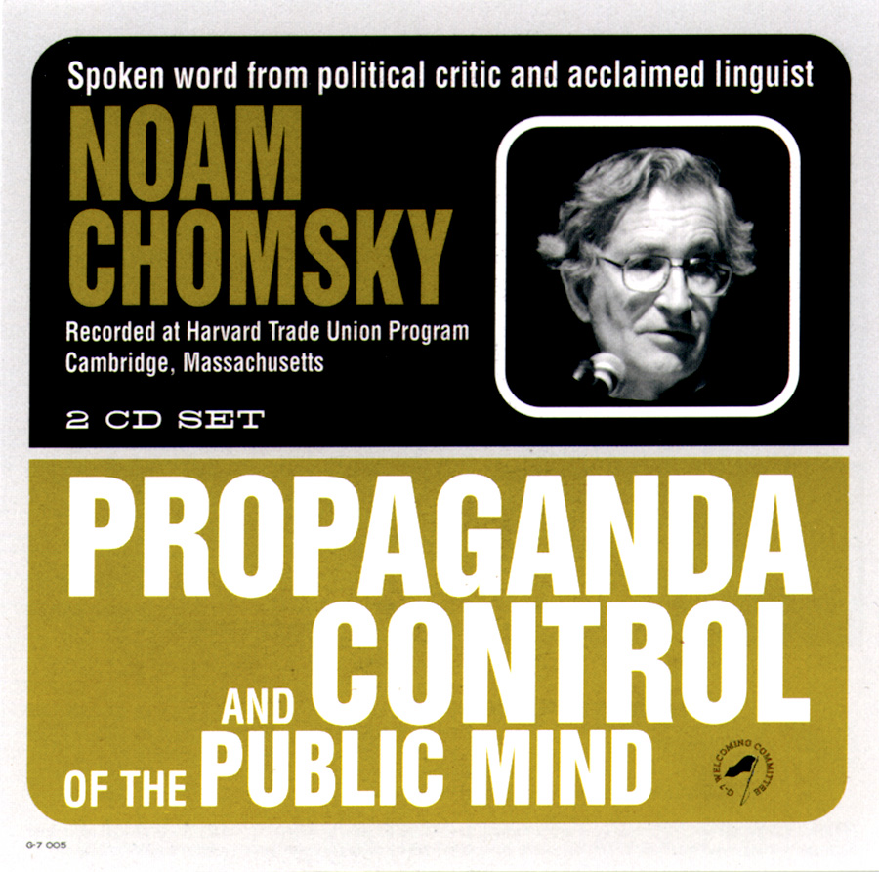
PROPAGANDA MODEL By Noam Chomsky & Edward S. Herman

Slide 2
Objectives
Introduction of Noam Chomsky
Introduction of the book
History of the model
Filters of the model
Applications of the model

Slide 3
Who is Noam Chomsky?
Linguistic, cognitive scientist, philosopher, logician, historian, political activist and social critic.

Slide 4
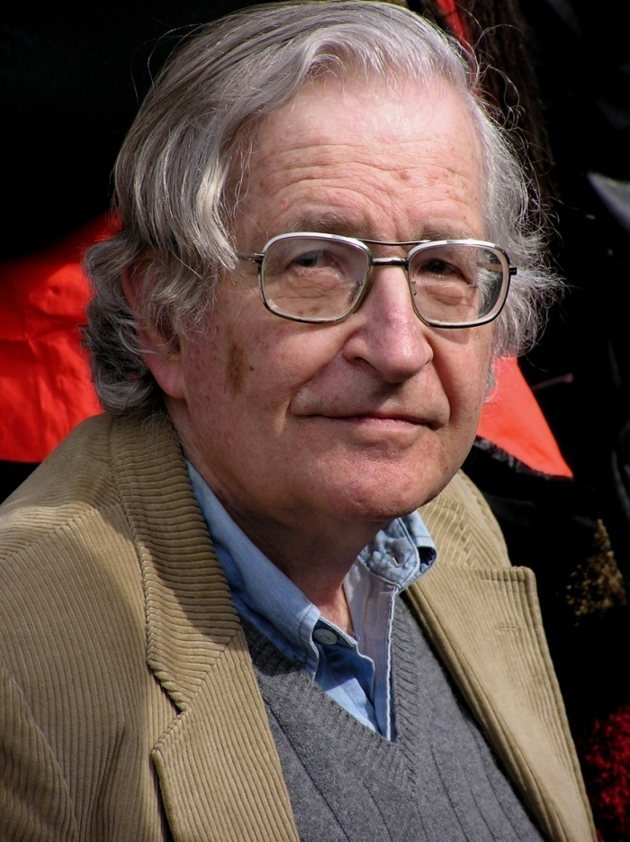
Early Life
Middle class family
Editorial on rise of Fascism in Europe
Development of Political Views
Authorities are questionable

Slide 5
Works
Current Issues in Linguistics Theory – 1964
Manufacturing Consent: The Political economy of the Mass Media - 1988
9/11: Was there an Alternative? – 2002
Miscellaneous
“FATHER OF MODERN LINGUISTICS”

Slide 6
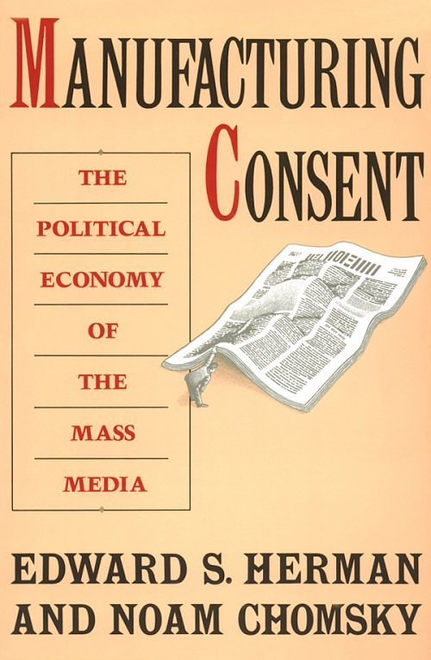
How mass media work?
How media do propaganda?
How they affect the public?

Slide 7
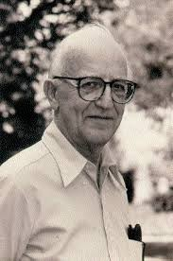
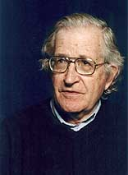
Media
The media “are effective and powerful ideological institutions that carry out a system-supportive propaganda function, by reliance on market forces, internalized assumptions, and self-censorship, and without overt coercion" through propaganda model.

Slide 8
History of the Propaganda Model
Manufacturing Consent: The Political Economy of the Mass Media
Walter Lipmann’s Public Opinion
Introduction of filters
Manufacturing Consent: Noam Chomsky and the Media
Documentary
Life history, model and politics
New Version of the book
Updating fifth filter
Application of the model

Slide 9
FILTERS
Size, ownership and profit orientation of the mass media
Funding
Sourcing
Flak
Anti-Communism

Slide 10
Size, Ownership and Profit Orientation of the Mass Media
Competition under capitalism
Elites posses the power
Business oriented and subjective approach
In the US, 1,500 daily newspapers, 11,000 magazines, 9,000 radio and 1,500 TV stations, 2,400 book publishers, and 7 movie studios over 25,000 media groups controlled by 24 media giants.

Slide 11
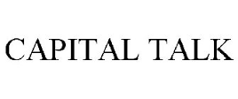
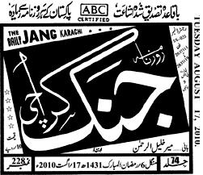
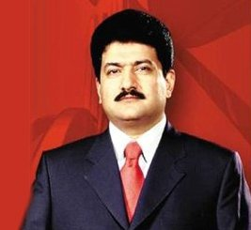
Independent Media Corporation

Slide 12
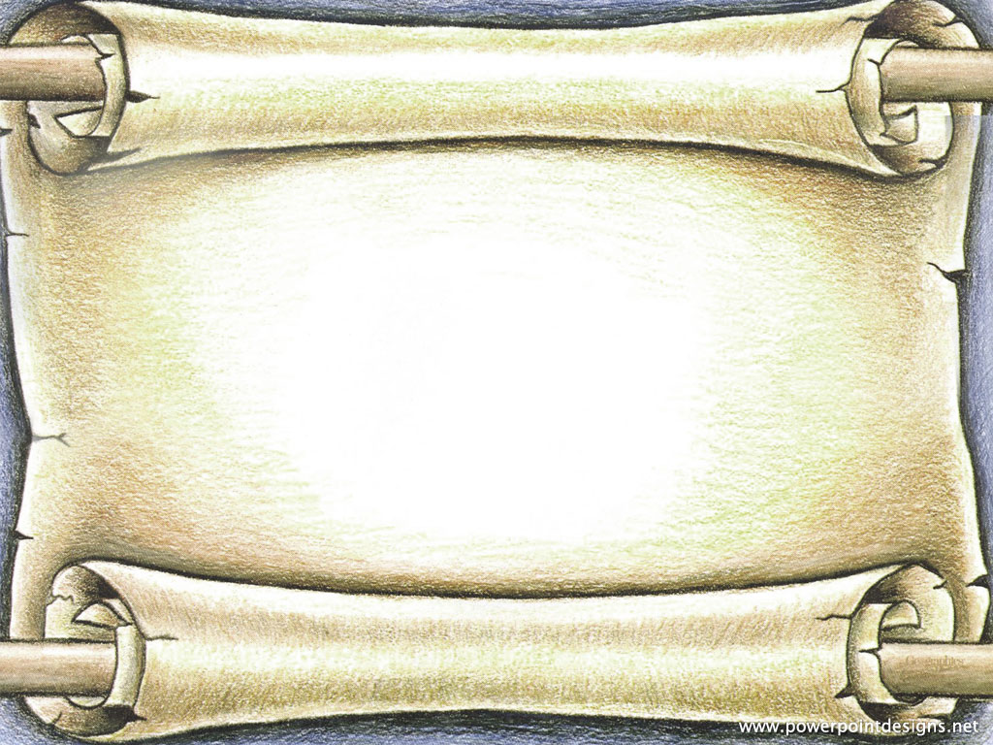
Funding
Importance of advertisements
Advertiser facilitates media and consumers
Effect on advertising revenue and rating
In the US, Link between NBC and environmental problem.

Slide 13
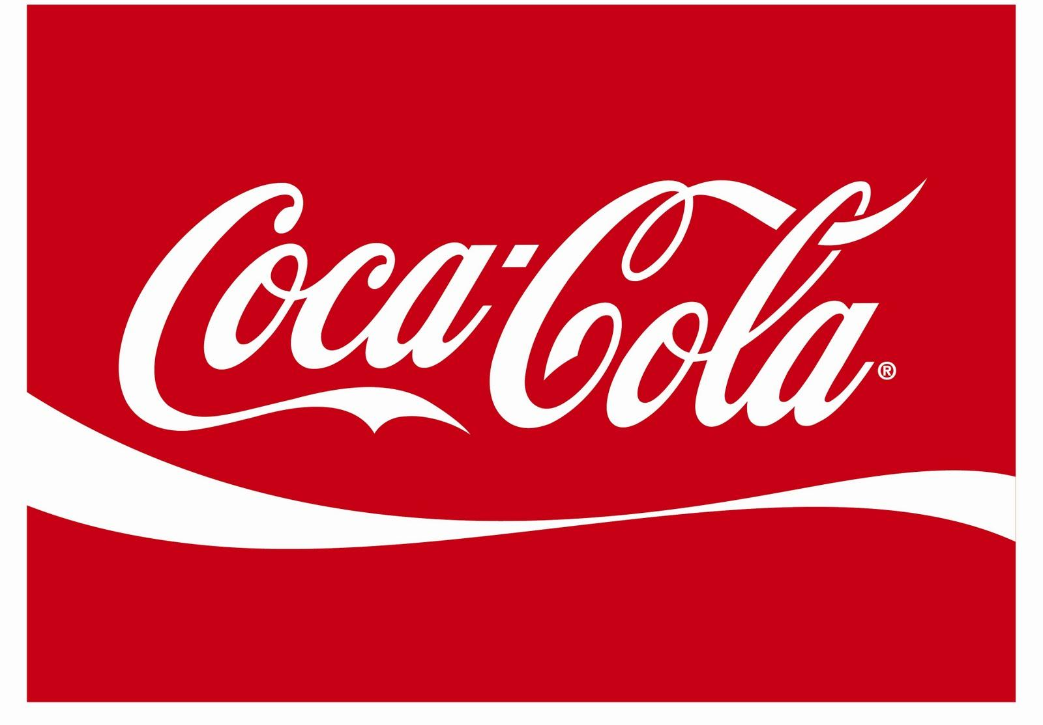
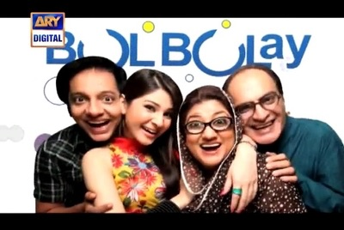

Slide 14
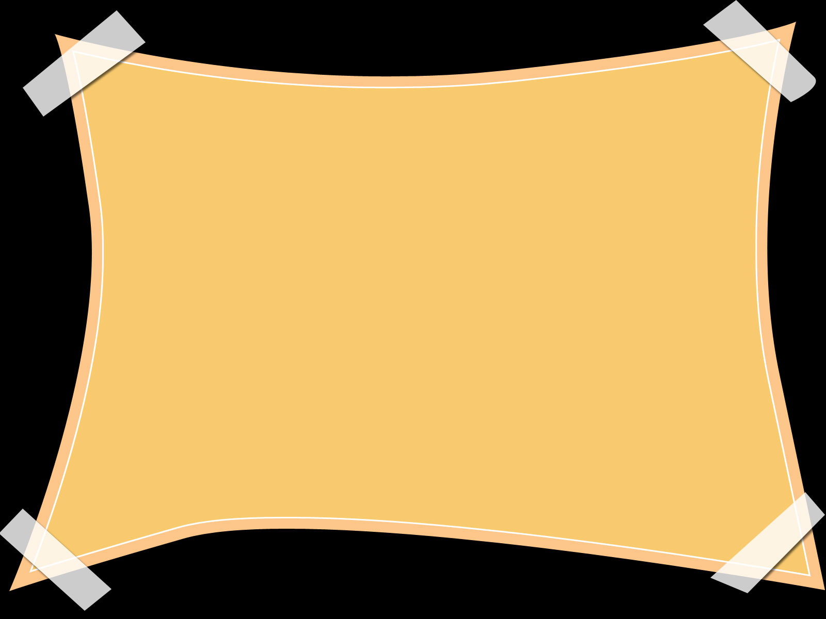
Source
Significance of Source
famous personality or figure
Relations with source
In the US, The White House, the Pentagon and the State Department in Washington D.C.

Slide 15
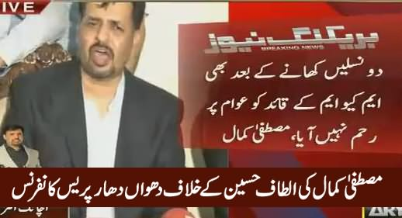
Press Conference
by
Mustafa Kamal

Slide 16
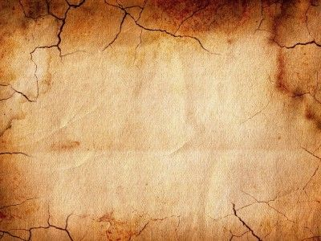
Flak
Bombardment of negative responses
Reputation of media outlet
Pressure groups
petition, sanction, complaints etc
Check on news

Slide 17
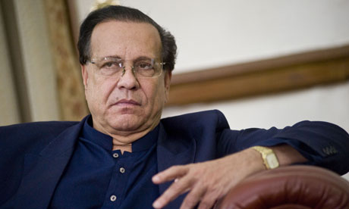
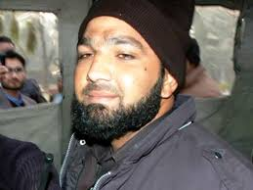
Salman Taseer’s Murder
Mumtaz Qadri Hanged

Slide 18
Anti-Communism
Fear of communism
Communism, the greatest evil
Post 9/11 political environment

Slide 19
Communism
9/11
War on Terror

Slide 20
Applications
Media’s performance regarding NAFTA, subsequent Mexican crises and meltdown of 1994-1995
Difference of opinion between citizens and businessmen
No coverage by mainstream media
Mexico locked-in
Ignoring labor conditions

Slide 21
2. Drug Wars
Health insurance controversy
Media remained uncritical
Benefits

Slide 22
Conclusion
Corporate media
Manipulate the minds
Interests are met
Profit is gained
In search of news

