Slide 1
Mobility and Dispersion Of Elements Under different Geochemical Environments

Slide 2
contents
Mobility, Geochemical Mobility and Geochemical Dispersion
Geochemical Environments
Geochemical Mobility
Geochemical Dispersion
Dispersion of elements in Primary and Secondary Environments
Carbon Cycle

Slide 3
Mobility
The Capacity for elements, ions and the molecules to move from one compartment of soil to another is called as Mobility.
Geochemical Mobility
The Mobility of elements to control their transport and their availability to take part in the Geochemical reactions.
Geochemical Dispersion
The movement of elements below the Earth Surface by Metamorphic and magmatic resulting in the formation of Igneous and Metamorphic Rocks is called as Geochemical Dispersion.

Slide 4
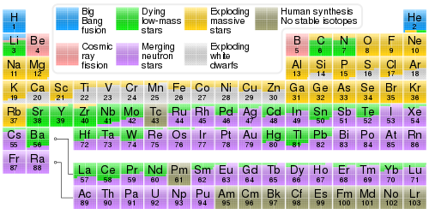

Slide 5
Geochemical Environments
Earth is a dynamic system in which materials move from one place to another and change in composition by a variety of geological process like melting , crystallization, erosion, dissolution, precipitation etc…
Geochemical environment of the earth can be broadly classified into 2 Types. 1.Deep seated environment
2. surficial environment
The Deep seated environments extends downwards from the lower levels of circulating meteoric water to the deepest level at which normal rocks can be formed. It is an environment of high temperature and pressure, restricted circulation of fluids, and relatively low free oxygen content.
The Surficial environment is characterized by the process of weathering, erosion, and sedimentation at the surface of the earth. It is characterized by low temperatures, nearly constant low pressure, free movement of solutions, and abundant free oxygen, water, and CO2.

Slide 6
Geochemical Mobility
Fundamentally, the response of an element to dispersion process is governed by its mobility, that is the ease with which it may be move in any given environment .
Mobility depends upon the mechanical properties and factors such as the viscosity of magmas and solutions, size, shape and density of clastic grains.
Prime factors are the changes in relative stability of the various coexisting fluid (mobile) and crystalline (immobile) phases that result from changes in the environmental condition.
In crystallization of magmas ,the constituents that can not be accommodated in the lattice structures of stable rock forming minerals are concentrated in mobile residual fluid.
At high P-T the hydrous minerals of sedimentary rocks becomes unstable and water is released to become principal constituent of the mobile phase.

Slide 7
Geochemical Mobility
The occurrence of an element as a characteristic constituents of deposits formed from fluids of various kinds, either vapor, supercritical solutions or normal aqueous solutions may also be an indication of their mobility.
Elements of complex pegmatites, hydrothermal vein deposits, juvenile water, and gaseous state.
Relatively Mobile | Major Elements | Minor Elements
Very Mobile | S, Cl | B, Iodine
Moderately Mobile | Ca, Mg, k | Zn, Ba, U
Moderately Immobile | Si, Mn | Ni, Co, Cu, Pb
Very Immobile | Fe, Al, Ti | Cr, Rare Earth Elements

Slide 8
Geochemical Dispersion
Any material on the earth is constantly subjected to transformation as process through different environment in the geochemical cycle.
The process in which atoms and particles move to new locations and geochemical environment is referred to as geochemical dispersion.
Geochemical dispersion may occur by mechanical process or even chemical and biological factors .
The response of an elements to dispersion depends on its mobility that is how easily it can be dispersed .
Geochemical dispersion is generally identified by Geochemical Models which provide the elements associations, Geochemical anomalies ,exploration procedures , analysis and interpretations.

Slide 9
Geochemical Dispersion
Dispersion may be either deep-seated or surficial, according to the geochemical environment, in which it occurs, and primary or secondary, according to whether it occurs during the formation of the ore deposit or during a later stage.
There are two types of dispersions.
1. Primary dispersion - occurs in the deep-seated environment.
2. Secondary dispersion – occurs in the surficial environment.
Primary dispersion includes all processes leading to emplacement of elements during the formation of an ore deposit, no matter how the orebody was formed.
Secondary dispersion applies to the redistribution of the primary patterns by any later process, usually in the surface environment.

Slide 10
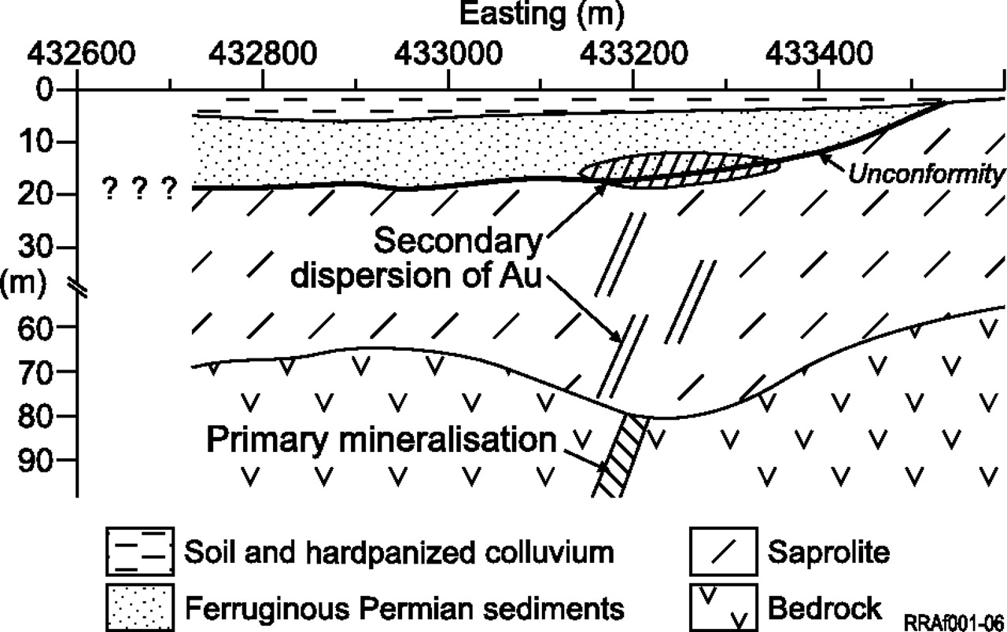

Slide 11
Dispersion of elements in primary and secondary environments
Elements are dispersed into the Primary and Secondary environments according to the following Contents.
Uranium….
Uranium is the most abundant element by weight in the earth and earth’s crust. It is a lithophile element
1. Primary environment: high mobile; concentrates in late phases (granites, hydrothermal veins).
2. Secondary environment: highly mobile in oxidizing environment, especially in alkaline Earth metals.
Thorium….
Thorium is mainly lithophile element. It occurs principally in necessary minerals of igneous rocks.
1.Primary environment: high mobile; concentrates in late phases (granites, hydrothermal veins).
2. Secondary environment: only as clastic and detrital mineral phases in the heavy fractions of the soils, sediments etc.

Slide 12
Dispersion of elements in primary and secondary environments
Zinc…………..
Zinc is a chalcophile element. It occurs in clay and organic matters.
1.Primary environment: in most igneous rocks Zn substitute in mineral structures; Zn ore deposits in igneous rocks are usually found associated with felsic rock.
2. Secondary environment: high in oxidizing environments.
Lead…….
Pb is mainly chalcophile element. Pb has low mobility, restricted by tendency for the presence of insoluble organic matter.
Other Elements are also dispersed into these environments like Nickle, Vanadium, Cobalt, Copper, Chromium and Arsenic.

Slide 13
Geochemical cycle
The movement of earth materials from one environment to another can be conveniently visualized in terms of a closed cycle referred to as the geo chemical cycle .
The geochemical cycle starting on the right hand side of the diagram and moving clockwise direction .
Sedimentary rocks are metamorphosed as they are subjected to increasing temperature, pressure. When erosion brings the resulting suite of rocks into the surficial environment again, the component elements are relative solubility in water. redistributed by weathering agencies . A new series of sedimentary rocks is then deposited ,and the cycle is closed . The geochemical cycle therefore includes both deep seated process of metamorphism and igneous differentiation and the surficial process of weathering, erosion, transportation and sedimentation

Slide 14
