Slide 2
Key Contents:
Stomata
Structure of Stomata
Opening and Closing of Stomata
Factor affecting stomatal movement
Types of guard cells
Arrangement of stomata
Water regulation in Stomata

Slide 3
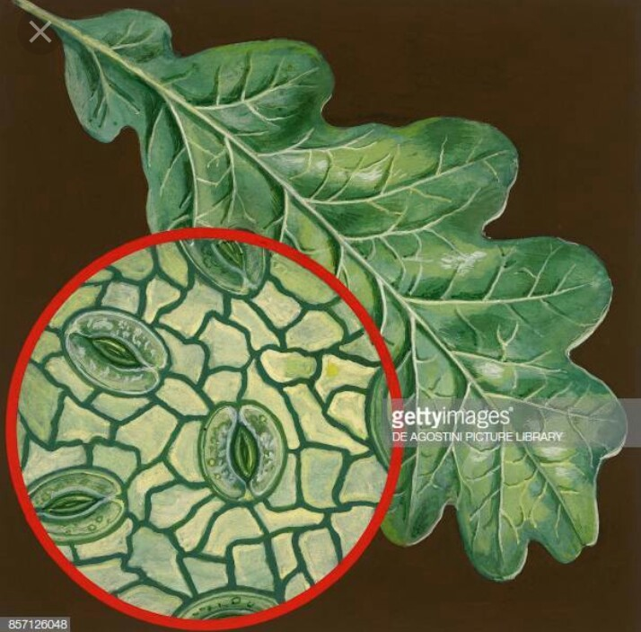
What is stomata?
Stomata are pores in a plants skin through which water and gases are exchanged between the plants and atmosphere.

Slide 4
Structure of Stomata:
They constitutes three parts
Cell pore
Guard cell
Subsidiary cell

Slide 5
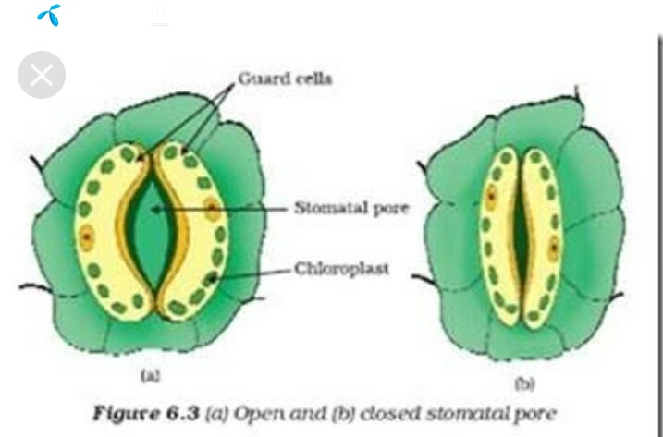
Cell pore:
Pore present on leaf
Help in gasseous exchange
Transpiration occur by this

Slide 6
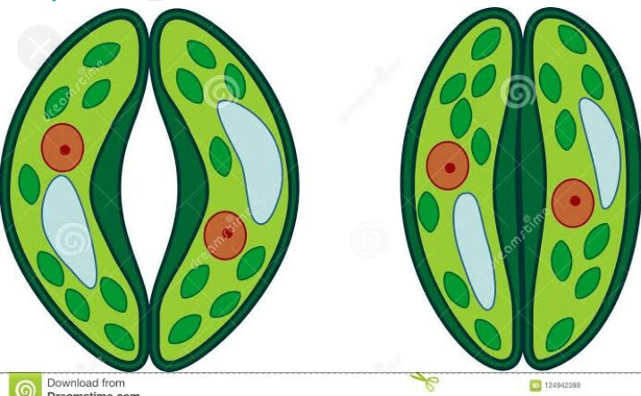
Guard cell:
Specialized cell surrounds stomatal pore
Always present in pair
Helping stomata in opening and closing

Slide 7
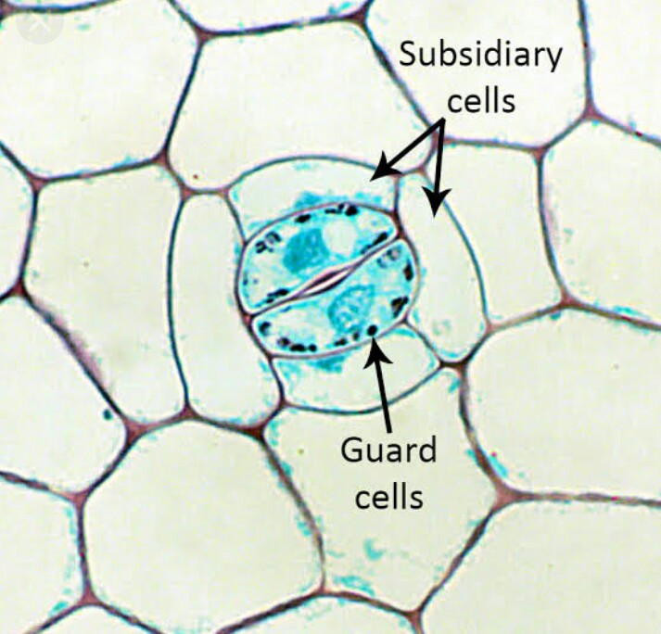
Subsidiary cell:
These are type of epidermal cell which are associated with guard cell.
They are morphologically different from guard cell also called Accessory cell.

Slide 8
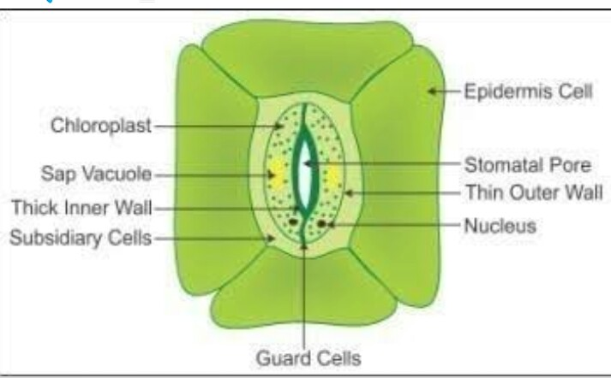
Stomatal Apparatus:
Stomatal pore, guard cell and subsidiary cell togather called stomatal apparatus.

Slide 9
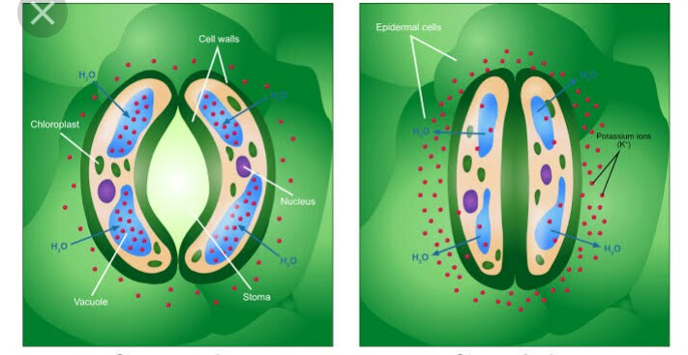
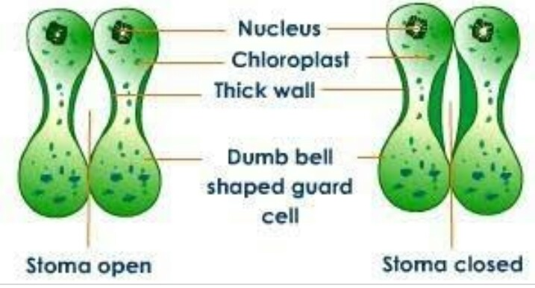
Types of guard cell
In dicot leaf=kidney shape.
In monocot leaf=dum bell shape.

Slide 10
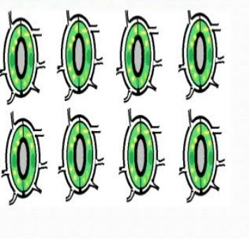
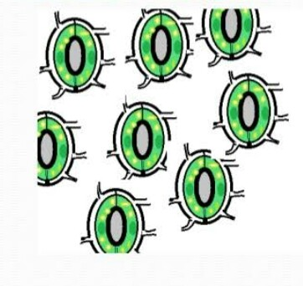
Arrangment of stomata:
In monocot=parallel
In dicot=irragular

Slide 11
Opening and closing of stomata:
Opening and closing of stomata takes place due to change in turgor pressure of Guard cells.
During the day time water from subsidiary cells enter into guard cells making the guard cells fully turgid and stomata opens.
During night time water from guard cells enters the subsidiary cells and as a result guard cells become flaccid due to decrease in turgor pressure and the stomata close.

Slide 12
Opening of stomata during day time:
Opening of stomata depends upon following conditions:
Presence of light.
Decrease in starch content of guard cells.
Increase concentration of malic acid in guard cells.
Influx of k+ ions in guard cells.
Efflux of H+ from guard cells.

Slide 13
Con……
Low co2 concentration in or around guard cells.
High pH in guard cells.
High turgor pressure in guard cells due to endosmosis.

Slide 14
Closing of stomata in the absence of light:
Closing of stomata depends on following conditions:
Absence of light.
Decreased concentration of malic acid in guard cells.
Efflux of k+ ions from guard cells.
Acid medium of the cell sap in guard cells.

Slide 15
Con…….
Increase concentration of co2 in or around the guard cells.
Presence of plant growth inhibiting harmone abscissic acid.

Slide 16
Factor affecting stomatal movement:
Light.
Temprature.
Co2
Water content

Slide 17
Light
Stomata of most plant open in the day and close at night ,while CAM plant are just the opposite.
Stomata opening are sensitive to red light and blue light, blue light is more effective, it stimulates opening by a blue light receptor : zeaxanthin.

Slide 18
Con……
Blue light has direct effect on stomatal opening.
At low fluence rate ,blue light causes stomatal opening, but not red light.
At high fluence rate ,stomatal opening under blue light is consistently higher than under red light.

Slide 19
Temprature :
Stomata open with rise in temperature and close at lower temperature as light and temperature are directly related.
Higher temperature also cause stomatal closure.

Slide 20
Co2:
Low co2 concentration promotes stomatal opening,while high co2 concentraion inhibits stomatal opening.
Co2 conc. decreases =>stomata open=>to uptake more co2
Co2 conc.increases =>stomata close

Slide 21
Water regulation in stomata:
Water is responsible for causing changes in the turgor of the guard cells.Guard cells become flaccid on losing water and stomata close.
When guard cells become fully turgid with water then stomata open.
At night, no photosynthesis,
Stomata close, preventing unnecessary lose of water.

Slide 22
Con…
Sunny morning ,photosynthesis is demanding supply of water is abundant.
Hydro passive closure:
Water loss from the guard cells exceeds the rate of movement into the guard cells=>decreases in the tugidity of guard cells=>stomata closure.

Slide 23
Hydro active closure:
ABA (abscisic acid)referred to as an anti transpirant.
Plant sense water deficit =>ABA is released into the apoplast and then transferred to the guard cells=>stomata close=>ABA conc.is increased =>more stomata close.

