Slide 1
Sociology ^{BBA} Semester: 3rd ^{Lecture No. 13} ^{Instructor: Mumtaz Hussain} University of Sargodha Sb Campus ^{Bhakkar}

Slide 4
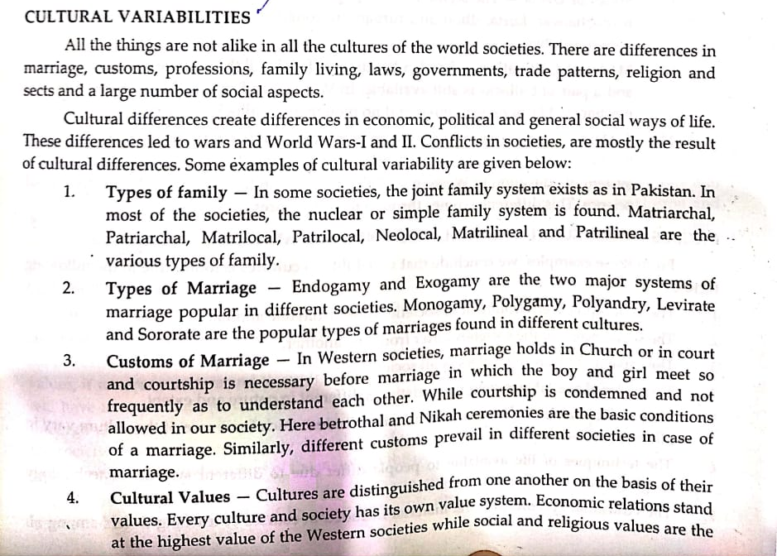

Slide 5
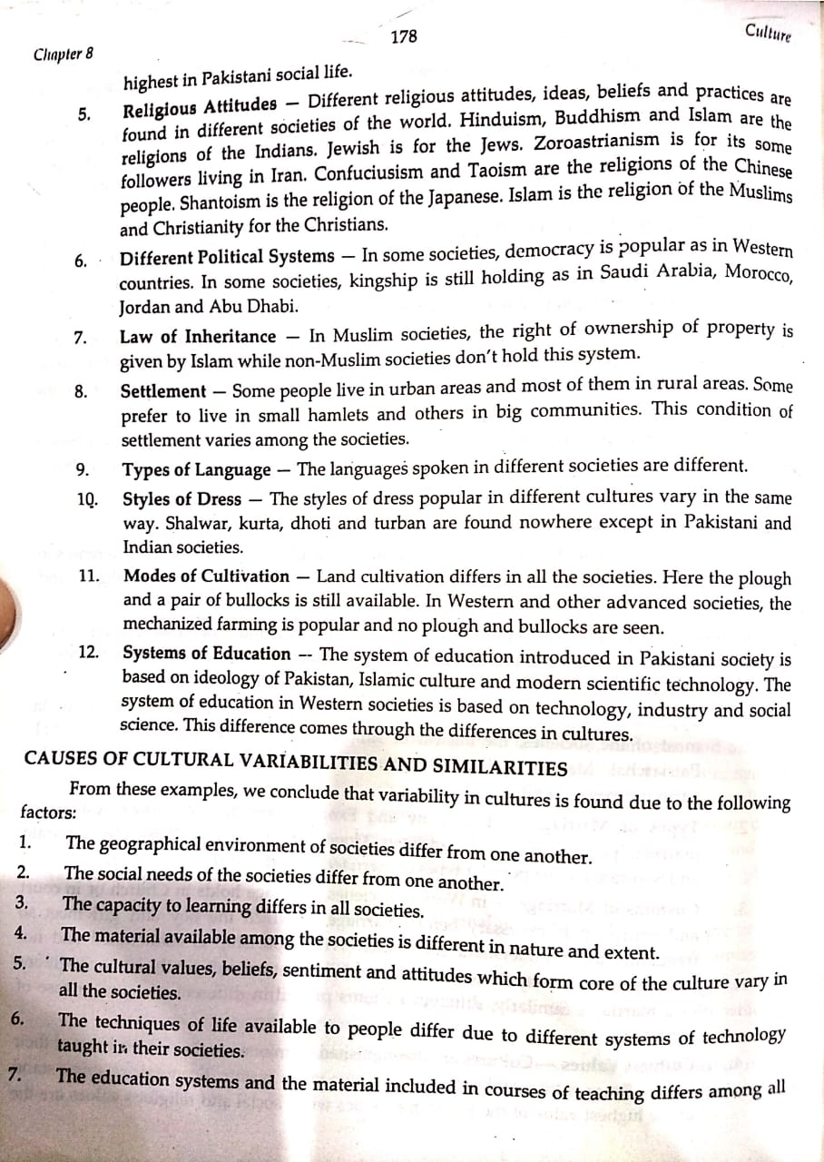

Slide 12
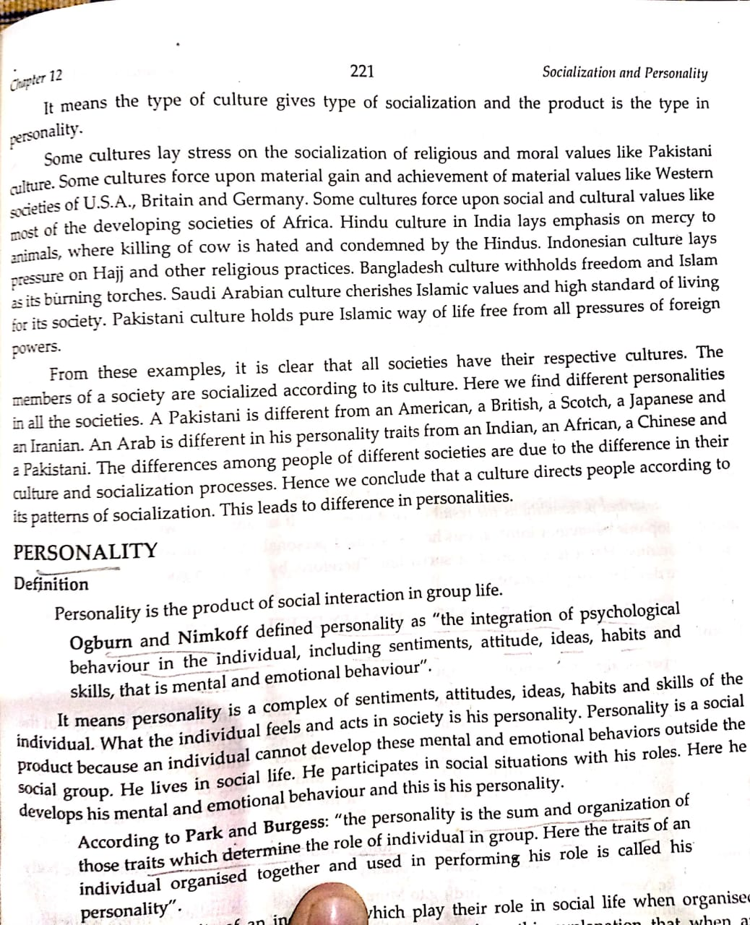

Slide 15
Thank You

