Slide 1
Code of Ethics

Slide 2
Definition
A code of ethics is a guide of principles designed to help professionals conduct business honestly and with integrity. A code of ethics document may outline the mission and values of the business or organization, how professionals are supposed to approach problems, the ethical principles based on the organization's core values, and the standards to which the professional is held.

Slide 3
Functions of ethics codes
Inspiration
Identifying values & ideals to which CPs should aspire
to inspire public trust & respect for the profession
Education
Several educational functions
Inform & educate new members of the profession about values & standards
Inform public policy makers, clients, users & general public about profession’s ideals, obligations & responsibilities
Code of ethics – powerful educational tools

Slide 4
Guidance
Ethical principles, values, imperatives & standards of good practice spelled out in ethics codes
Helpful guides for CPs as they exercise their judgment in decision making.
Accountability
Reveal to clients & users alike the level of responsibility & care that they should expect, as well as standards that they should demand

Slide 5
Enforcement
Identify ethically unacceptable behavior,
codes of ethics enable professional organizations to encourage & even to enforce standards of good practice
Compliance with responsible norms

Slide 6
What a code of Ethics is Not
Not laws
Codes of professional ethics are not laws passed by legislative bodies
Not complete ethical frameworks or algorithms
Not complete ethical frameworks to cover every possible ethical question that might arise about computing
Conflict between one value or principle with other value or principle is possible

Slide 7
No exhaustive checklists
No code of ethics can provide complete ethical framework – so it is not a checklist
Checklists - useful tool as it suggest topics that often need ethical consideration
Risk to overlook some important ethical question, not included in checklist

Slide 8
Variety of format
Different roles
Member’s role
As human being & member of society
As CP providing services & products
As a leader in professional organizations
Different groups/individuals
To society
To organization
To peers
To staff
To the profession
To one’s self

Slide 9
General principles (Australian computer society ACS, )
Be honest, forthright & impartial
Loyally serve the community
Advance human welfare
Consider & respect people’s privacy
British Computer Society (BCS)
Have regard to the public health, safety, environment
Have regard to the legitimate rights of third parties
Conduct your professional activities without discriminations
Reject any offer of bribery or inducement;

Slide 10
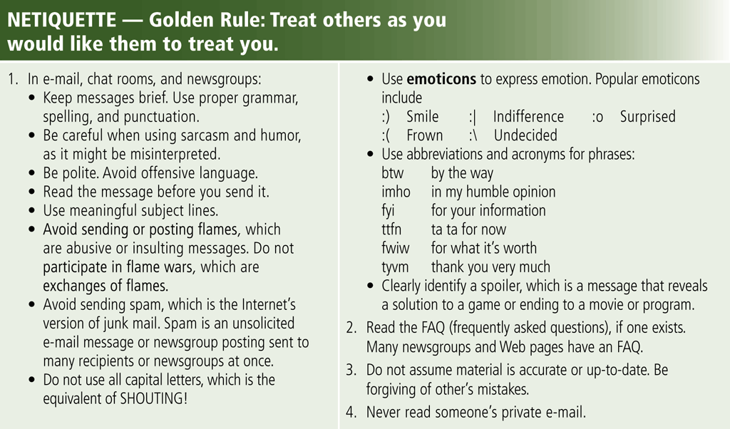
Netiquette
Netiquette is the code of acceptable Internet behavior
Page 81
Figure 2-23

