Slide 1
Introduction to Computer (Comp-201)
System Unit
Components of System Unit

Slide 2
System Unit
System Unit is a case that contains electronic components of the computer used to process data.
Made of metal or plastic to protects the internal components from damage.
All computers have a system unit. It is available in variety of shapes & sizes.

Slide 3
System Unit
System unit of a desktop computer stands vertically (tower model).
In laptop computers, keyboard and pointing devices are built on the top of the system unit.
System unit of a tablet is behind the screen.

Slide 4
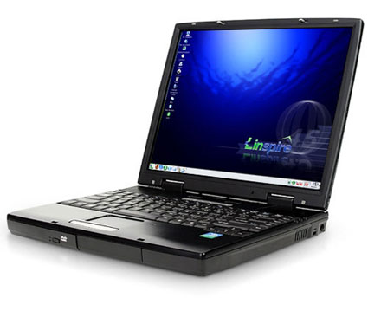
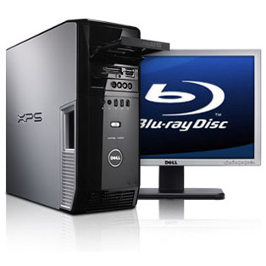
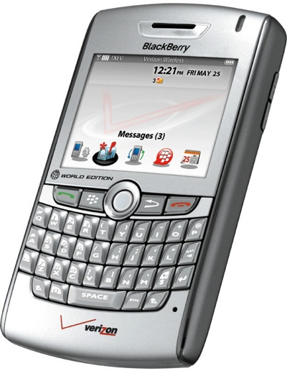
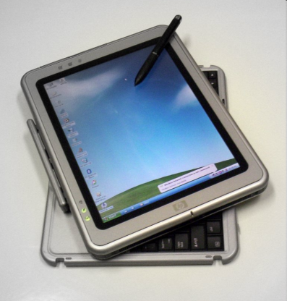
System Unit
System unit
System unit
System unit

Slide 5
Components of System unit
Mother Board
Central Processing Unit
Memory
Ports
Buses
Bays
Power Supply and Battery

Slide 6
Motherboard
Motherboard
Is also known as system board or main board.
Is a communication medium for the entire computer system.
All components of the computer are connected to the motherboard.
It also enables the user to attach different devices to it such as keyboard, printer and scanner.

Slide 7
Motherboard

Slide 8
Central Processing Unit (CPU)
CPU also known as processor is the brain of a computer.
All computers must have a CPU, as a computer cannot work without it.
CPU is located on the motherboard and carries most of the work of a computer.
CPU
Performs all operations on data according to the given instructions.
Executes instructions and tells other parts of computer what to do.

Slide 9
Central Processing Unit (CPU)
All functions of processor usually are on a single chip in personal computers.
A single-core processor is a processor with a single core on a chip.
A multi-core processor has two or more cores on a single chip. Two most common multi-core processors are
Dual-core Processor: two separate cores on a single chip
Quad-core Processor: four separate cores on a single chip
Notes:
Core is actual processing unit that reads and executes instructions.

Slide 10
Central Processing Unit (CPU)
CPU consists of two main units
Arithmetic and Logic Unit (ALU)
Control Unit
These components work together to perform processing operations.

Slide 11
Central Processing Unit (CPU)
ALU is the part of CPU where actual execution of instructions takes place.
All arithmetic and logical operations are performed in ALU.
ALU consists of two units
Arithmetic Unit
Logic Unit

Slide 12
Central Processing Unit (CPU)
Arithmetic unit of ALU performs basic arithmetic functions such as addition, subtraction, multiplication and division.
Logic Unit of ALU performs logical operations like comparing two data items to find which data item is greater to, equal to or less than the other.

Slide 13
Central Processing Unit (CPU)
Control unit is the component of CPU that acts like a supervisor of the computer.
It controls and coordinates all activities of a computer system by issuing necessary commands to different components of computer.

Slide 14
Central Processing Unit (CPU)
Important operations performed by control unit are
It fetches instructions from the main memory.
It interprets the instructions to find what operation is to be performed.
It controls the execution of instructions.

Slide 15
Central Processing Unit (CPU)

Slide 16
Machine Cycle
CPU uses the machine cycle to process each instruction. Four steps of machine cycle are
Fetch: Instruction fetch is a process of getting an instruction from the memory to execute it. It is performed by the control unit.
Decode: The control unit decodes the instruction. This process examines the nature of instruction to determine what further operations should be taken. CU directs to move the required data from memory to ALU.

Slide 17
Machine Cycle
Execute: After decoding the instruction and getting the required data, CPU finally executes that instruction. The instructions are executed by ALU.
Storing: the process of writing the result to the memory is called storing.
These four operations collectively called a machine cycle or instruction cycle.

Slide 18
Instruction Set
A set of all instructions that can be performed by a CPU is called instruction set. The instruction set consists of four types of instructions
Arithmetic Instruction: The instructions used to perform arithmetic operations are called arithmetic instructions. Different arithmetic operations are addition, subtraction, multiplication and division.
Logical Instruction: The instructions used to perform logical operations are called logical instructions. A logical operations is the comparison of two data values e.g. greater than, equal to and less than.
Both these instructions are executed by ALU.

Slide 19
Instruction Set
Data Transfer Instruction: The instructions used to transfer data from one component to another component are called data transfer instructions.
Control Transfer Instruction: The instructions used to change the execution sequence of instructions of a program are called control transfer instructions. These instructions transfer the execution control to a certain part of program instead of next instruction.
These instructions are executed by CU.

Slide 20
System Clock
The processor relies on a small quartz crystal circuit called the system clock to control the timing of all computer operations.
Just as your heart beats at a regular rate to keep your body functioning, the system clock generates regular electronic pulses, or ticks, that set the operating pace of components of the system unit.
Each tick equates to a clock cycle.
In the past, processors used one or more clock cycles to execute each instruction.
Processors today often are superscalar, which means they can execute more than one instruction per clock cycle.

Slide 21
System Clock
The pace of the system clock, called the clock speed, is measured by the number of ticks per second.
Current personal computer processors have clock speeds in the gigahertz range. Giga is a prefix that stands for billion, and a hertz is one cycle per second.
Thus, one gigahertz (GHz) equals one billion ticks of the system clock per second.
A computer that operates at 3 GHz has 3 billion (Giga) clock cycles in one second (hertz).
The faster the clock speed, the more instructions the processor can execute per second.

Slide 22
Registers
A processor contains small, high-speed storage locations, called registers, which temporarily hold data and instructions.
Registers are part of the processor, not part of memory or a permanent storage device.
Processors have many different types of registers, each with a specific storage function.

Slide 23
Registers
Register functions include
storing the location from where an instruction was fetched
storing an instruction while the control unit decodes it
storing data while the ALU computes it
storing the results of a calculation.

Slide 24
Registers
Some registers are
Instruction register is used to store the fetched instruction.
Address Register is used to store the memory address being used by the CPU (data, next instruction)
Storage register store data retrieved from main memory prior to processing.
Accumulative Register store the results of arithmetic & logic operations
Program Counter is used to store the address of next instruction to be fetched for execution.

Slide 25
Pipelining
Pipelining is a technique in which CPU fetches the next instruction before it completes the machine cycle for the first instruction.
Modern computers use pipelining to process multiple instructions at the same time.
It results in the faster processing and increases the performance of computer.

Slide 26
Pipelining
Without pipelining, the processor fetches, decodes, executes and stores only one instruction at a time.
CPU waits until an instruction completes its all four stages and then executes the next instruction.

Slide 27
Pipelining

Slide 28
Processor Cooling
Proper cooling for processor is very important as excessive heat can cause problems or even damage a processor.
The computer provides cooling system for the processor.
Heat sink, cooling fans and liquid cooling system are used to keep safe the processor from overheating.

Slide 29
Q/A

