Slide 1
Phonetics and Phonology
English vowel sounds.
Classification of vowel sounds.

Slide 2
What is a vowel sound?
It is a sound in which
there is a continuous vibration of the vocal chords and
the airstream is allowed to escape from the mouth in an unobstructed manner, without any interruption.

Slide 3
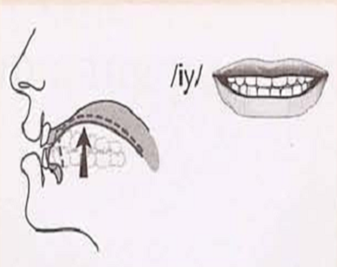
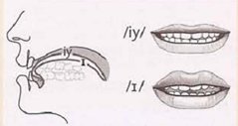
Vowel symbols (IPA)
/i:/ like in meet, beat
/ɪ/ like in sick, big

Slide 4
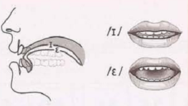
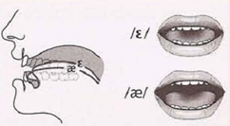
/Ɛ/ or /e/ like in bed, head
/ӕ/ like in bad, cat

Slide 5
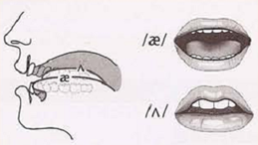
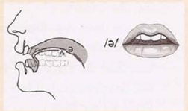
/ʌ/ like in cut, come (stressed syllable)
/ə/ like in about, sofa (unstressed syllable)

Slide 6
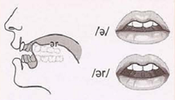
/ɝ/ like in fur, murder
(stressed syllable)
/ɚ/ like in murder, mother (unstressed syllable)

Slide 7
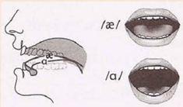
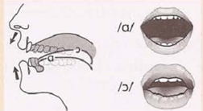
/a:/ like in father
/ɒ/ like in got
/ɔ:/ like in hoard

Slide 8
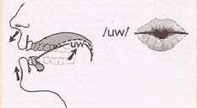
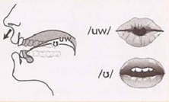
/u:/ like in too, soon
/Ʊ/ like in foot, could

Slide 9
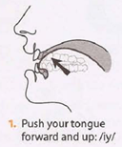
Classification of English vowels
1- Part of the tongue involved:
According to the horizontal position
of the tongue, they can be:
Front vowels: The front of the tongue is raised in the direction of the hard palate.

Slide 10
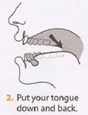
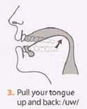
Back vowels: The back of the tongue is raised in the direction of the soft palate.
Central vowels: They are intermediate between front and back vowels.

Slide 11
2- Position of the tongue:
High vowels: when the front or back of the tongue is raised.
Low vowels: when the front or back of the tongue is neutral.

Slide 12
3- According to the vertical position of the mouth, they can be:
Close vowels: when the mouth is relatively closed.
Half Close vowels: when the mouth is approximately half-way.
Open vowels: when the mouth is relatively open.

Slide 13
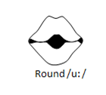
4- According to the lips position, they can be:
Round vowels: They are result of a position where the corners of the lips are brought towards each other and the lips are pushed forwards.

Slide 14
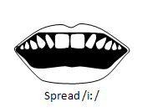
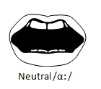
Spread vowels: In this position the lips are moved away from each other (i.e. when we smile)
Neutral vowels: They are result of a position where the lips are not noticeably rounded or spread.

Slide 15
5- According to the duration of the sound, they can be:
Long vowels
Short vowels

Slide 16
Vowel Chart

Slide 17
Thank You!

