Slide 1
Asphyxia & Drowning
Lesson 3 (Specific Pathological Signs)
Dr Nadir Ali

Slide 2
Specific Pathological Changes/Signs
These signs indicate the specific type of asphyxia

Slide 3
Levels Of Interference To The Supply Of Oxygen To Lungs

Slide 4
1.Specific Findings of suffocation
Bruise (mouth, nose, cheeks, lips & mucosal surfaces).
Distribution of Lividity.
Abrasion around nose/mouth.
Rupture of lips.
Fracture of nasal bone/teeth.
Tape/cloth may be found in smothering and gagging respectively.

Slide 5
Suffocation

Slide 6
Suffocation

Slide 7
Suffocation

Slide 8
Suffocation

Slide 9
2. Specific Findings of Throttling
Disc-like fingertip bruises.
Nail Marks (abrasions from assailant or victim).
Bruising of neck and underlying soft tissues.
Fracture of Hyoid bone or Thyroid cartilage are common.

Slide 10
Throttling

Slide 11
Throttling

Slide 12
Throttling

Slide 13
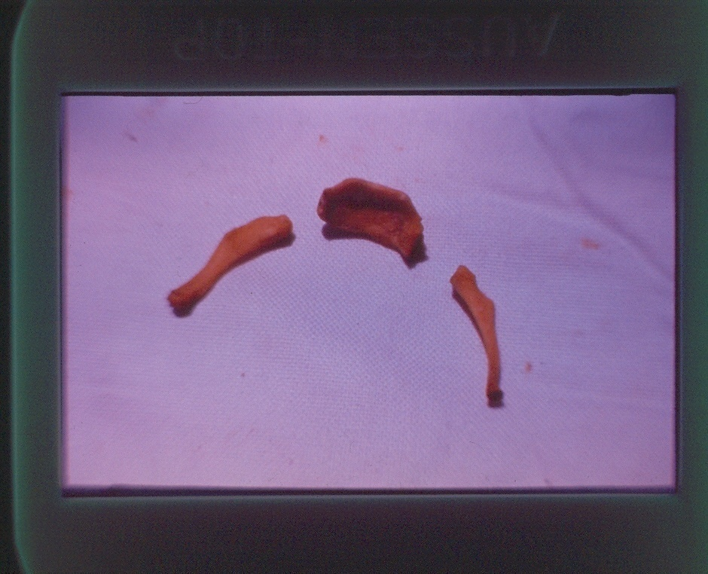
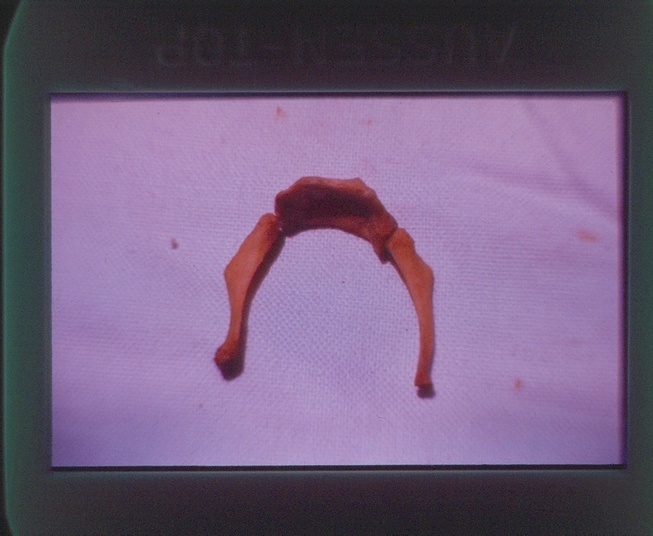
Hyoid Bone

Slide 14
3) Specific Findings of Garroting
1. Ligature mark
It is generally in the midline of the neck and is continuous all around the neck horizontally.
Soft Ligature e.g., Dupatta leaves a diffuse mark while
hard Ligature e.g., wire or rope, leaves a more defined, deeper mark.

Slide 15
3) Specific Findings of Garroting
2. Finger mark abrasions in attempt to relieve the constriction.
3. Bruising of the soft tissue.
4. Fracture of Hyoid bone may occur.

Slide 16
Ligature Strangulation

Slide 17
Ligature Strangulation

Slide 18
Ligature Strangulation

Slide 19
4) Specific Findings of Hanging
:
LIGATURE MARK is in upper part of the neck, usually depressed below the skin surface.
Usually running obliquely upwards towards the point of suspension and may be missing near the peak.

Slide 20
However, if a running knot is used, the ligature mark may be horizontal all around the neck and can be confused with that of Garotting.
Usually no evidence of injury surrounding the ligature mark is present.
Patches of lividity may be found above the ligature mark.

Slide 21
2) Soft tissue injuries may be present.
Fracture of hyoid bone and thyroid cartilage are uncommon.
Distribution of Post Mortem staining may be characteristic (Stocking & Glove distribution).
Fracture of cervical vertebra in case of sudden drop.

Slide 22
HANGING

Slide 23
Hanging

Slide 24
Hanging

Slide 25
No | Features | Hanging | Strangulation
1. | Manner of death | Mostly suicidal | Mostly homicidal
2. | Ligature Length Application Knot | Long Single turn On the back of neck | Short More than 01 turn In front of neck
3. | Ligature mark Site Direction Extent Knot imprint Depth of the groove | High up in the neck Oblique Incomplete At the occiput or side of the face Decreases towards the knot | Middle of the neck Horizontal Complete In front of neck if present Uniform

Slide 26
No | Features | Hanging | Strangulation
4. | Others Nail marks Cyanosis Facial congestion Petechael haemorrhage Saliva Bleeding from nose and mouth Fracture dislocation of cervical vertebrae | Absent Mild or absent May be present Scanty Running out of the angle of the mouth Rare Common in judicial hanging | Usually present. Intense. Marked. Numerous. Usually absent but if present, is blood mixed. Common. Rare

Slide 27
5.Specific Finding of Traumatic Asphyxia
No external injury may be visible. However, bruises on the chest may be present.
Soft tissue damage (respiratory muscles).
Rib fractures.
Lung tear / laceration.
A clear cut demarcation line between the areas above the level of pressure (congested area) and the one below (normal area).

Slide 28
No | Features | Hanging | Strangulation
1. | Manner of death | Mostly suicidal | Mostly homicidal
2. | Ligature Length Application Knot | Long Single turn On the back of neck | Short More than 01 turn In front of neck
3. | Ligature mark Site Direction Extent Knot imprint Depth of the groove | High up in the neck Oblique Incomplete At the occiput or side of the face Decreases towards the knot | Middle of the neck Horizontal Complete In front of neck if present Uniform

Slide 29
No | Features | Hanging | Strangulation
4. | Others Nail marks Cyanosis Facial congestion Petechael haemorrhage Saliva Bleeding from nose and mouth Fracture dislocation of cervical vertebrae | Absent Mild or absent May be present Scanty Running out of the angle of the mouth Rare Common in judicial hanging | Usually present. Intense. Marked. Numerous. Usually absent but if present, is blood mixed. Common. Rare

Slide 30
Specific Finding of Traumatic Asphyxia
No external injury may be visible. However, bruises on the chest may be present.
Soft tissue damage (respiratory muscles).
Rib fractures.
Lung tear / laceration.
A clear cut demarcation line between the areas above the level of pressure (congested area) and the one below (normal area).

Slide 31
Traumatic Asphyxia

Slide 32
Traumatic Asphyxia

