Slide 1
Week No. 1
Introduction

Slide 2
Welcome
URCE – 5191 GRAMMAR
The course aims at developing grammatical competence of the learners to use grammatical structure in context in order to make the experience of learning English more meaningful.
The objectives of the course are to
i) Reinforce the basics of grammar
ii) Understand the basic meaningful units of language
iii) Introduce the functional aspects of grammar categories
iv) Comprehend language use

Slide 3
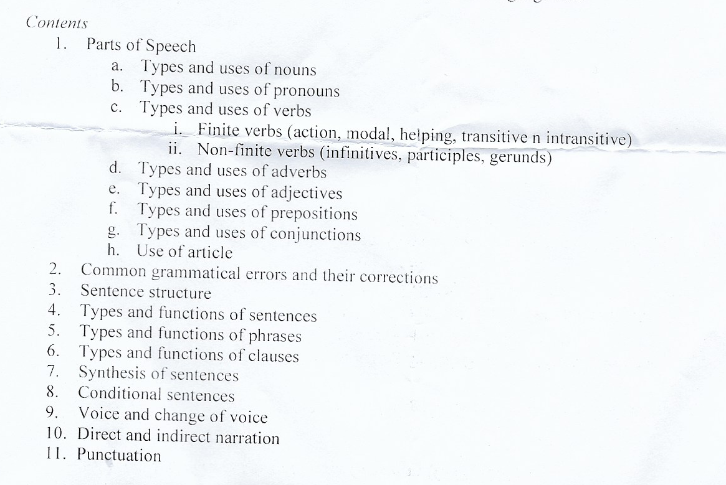

Slide 4
Recommended Books

Slide 5
Parts of speech
There are eight parts of speech in the English language: noun, pronoun, verb, adjective, adverb, preposition, conjunction, and interjection.
The part of speech indicates how the word functions in meaning as well as grammatically within the sentence.

Slide 6
Parts of speech
An individual word can function as more than one part of speech when used in different circumstances.
Understanding parts of speech is essential for determining the correct definition of a word when using the dictionary.

Slide 7
Nouns

Slide 8
What is a noun?
Noun is a word that represent human, animal, thing, place, action, emotion etc. Noun can be both visible and invisible.

Slide 9
Types of nouns
There’re 9 types of noun which are :
Common Nouns - Collective Nouns
Proper Nouns - Abstract Nouns
Countable Nouns - Concrete Nouns
Uncountable Nouns - Predicate Nouns
Compound Nouns

Slide 10
Nouns

Slide 11
Common Nouns
Common Nouns are use to represent things those are common in nature for example :
People : Man, Woman, Male, Female, Boy, Girl
Animals : Ant, Elephant, Bird, Cat, Dog
Things : Table, Chair, Desk, Television, Door
Places : Building, Park, Stadium, School, Company
Emotion : Fear, Love, Hate
Time : Minute, Hour, Year
Nouns
Common Nouns

Slide 12
Proper Nouns
Proper Nouns are similar to Common Nouns but more specific for example :
Proper Nouns always start with
“Capital Letter”
People : Thompson, Joseph, John, Jane, Jason
Animals : Name of animal
Things : IKEA office furniture, Toyota, Honda
Places : KMUTT. , Bangkok, Thailand, Australia
Time : January, Saturday, Christmas
Nouns
Proper Nouns

Slide 13
Proper Nouns
Rules of Proper Nouns :
- There is no article in front of proper nouns except The Jones (Jone’s family) and The Jones must be written in plural form. The United States the word “States” is in plural form.
- Another exception like The Pacific Ocean, The Sahara, The Vatican, The White House.
Nouns
Proper Nouns

Slide 14
Countable Nouns
Countable Noun is noun that you can count them in number. It can have shape or no shape.
Shape : Dog, Chair, Table, Student, Door
No Shape : Day, Month, Year, Journey
Activity : Job, Assignment
Nouns

Slide 15
Countable Nouns
Q: Countable Nouns, Singular or plural ?
A: Countable Nouns have 2 forms
Singular : Dog, Country, Day, Year
Plural : Dogs, Countries, Days, Years
Nouns

Slide 16
Countable Nouns
For Singular Countable Nouns. They must have determiner or article in front of them.
I want an orange.
Where is the book ?
Do you want to watch this movie ?
Nouns
Countable Nouns

Slide 17
Countable Nouns
For Plural Countable Nouns. The determiner or article is depend on the situation.
I like to water the flowers.
Cats are adorable pets.
I want those books on the table.
Nouns
Countable Nouns

Slide 18
Uncountable Nouns
Uncountable Noun is noun that you can’t count them in number directly. It can be a very small thing and a very big thing.
Activity = Swimming, Eating
Other = News, Money, Mail, Work, Gossip, Education, Weather, Research, Traffic, Breakfast, Permission
Nouns

Slide 19
Uncountable Nouns
Q: Uncountable Nouns, Singular or plural ?
A: Uncountable Nouns have 2 forms
Most of uncountable nouns must be written in singular form and without article.
I have bread and butter for my breakfast.
We cannot live without air and water.
Nouns

Slide 20
Uncountable Nouns
If uncountable nouns act as the subject of the sentence. It must be follow by the singular Verb to be.
Butter is one of diary product.
Butter and cheese are made from milk.
Nouns

Slide 21
Singular to Plural
- Countable Nouns can be both singular and plural.
95% of uncountable nouns are in singular form but there’re still some exception that uncountable nouns can be plural.
For Example :
Wine – Uncountable Noun
Wines –
Water – Uncountable Noun
Waters -
Nouns
Singular to Plural

Slide 22
Uncountable Nouns
Q: How can we count the uncountable nouns ?
A: Simply add “the container” in front of uncountable nouns
A cup of coffee.
Two glasses of water.
A tablespoon of sugar.
A set of furniture.
Nouns
Uncountable Nouns

Slide 23
Uncountable Nouns
Some of the nouns can be countable and uncountable for example :
Glass :
Please give me a glass of water.
That container is made of glass.
Where are my glasses ?
Nouns
Uncountable Nouns

Slide 24
Uncountable Nouns
Some of the nouns can be countable and uncountable for example :
Paper :
I read two papers every morning.
This flowers are made of paper.
Show me your paper.
Nouns

Slide 25
Uncountable Nouns
Personality
Fish
Abuse
Anger
Afternoon
Fear
Culture
Glass
Faith
Fruit
Paper
Nature
Adulthood
Power
Time
Food
Metal
Paper
Film
Fiction
Passion
History
Theater
Age
Hair
Love
People
Appearance
Childhood
Nouns
Uncountable Nouns

Slide 26
Types of nouns
Compound nouns
A compound noun is a noun that is made up of two or more words. Most compound nouns in English are formed by nouns modified by other nouns or adjectives
Nouns
Compound Nouns

Slide 27
Types of nouns
Noun + Noun = Bed + Room = Bedroom
Verb + Noun = Swimming + Pool = Swimming Pool
Preposition + Noun = Under + Ground = Underground
Noun + Verb = Hair + Cut = Haircut
Nouns
Compound Nouns

Slide 28
Types of nouns
There’re 3 ways to write a compound noun.
Write 2 words together.
- Toothpaste, Bedroom, Blackboard
Write 2 words separate by hyphen.
- Six-Pack, Mother-in-law
Write 2 word separately
- Swimming pool, Full moon, Tool box.
Nouns
Compound Nouns

Slide 29
Collective Nouns
A collective noun is noun that use to name something that form in group or in collection.
Structure :
Collective noun + of + common noun
Nouns
Collective Nouns

Slide 30
Collective Nouns
They are names of collections or the word that use for define a groups of objects.
People = A crowd of people
Animals = A swamp of bees
Places = A union of countries
Things = A network of computers
Nouns
Collective Nouns

Slide 31
Types of nouns
Usually examples for collective nouns are :
Our class took a field trip to the natural history museum.
The herd of bison ran across the prairie, leaving a massive dust cloud in its wake.
We waited anxiously for the jury to come to a verdict.
This year’s basketball team includes three players who are over six feet tall.
Nouns
Collective Nouns

Slide 32
Collective Nouns
Napoleon’s army was finally defeated at Waterloo.
The town council has approved plans to create a new park.
He comes from a huge family: he’s the oldest of eleven kids.
The rock group has been on tour for months.
Everyone in the audience applauded loudly when Elvis appeared on stage.
Nouns
Collective Nouns

Slide 33
Abstract Nouns
This type of noun is very special. You can sense them. You can’t see, hear, smell or even touching.
Abstract Nouns from Verb
Decision – To decide
Thought – To think
Imagination – To imagine
Speech - To speak
Growth - To grow
Nouns
Abstract Nouns

Slide 34
Abstract Nouns
This type of noun is very special. You can sense them. You can’t see, hear, smell or even touching.
Abstract Nouns from Adjective
Beauty - Beautiful
Poverty - Poor
Vacancy - Vacant
Happiness - Happy
Wisdom - Wise
Nouns
Abstract Nouns

Slide 35
Abstract Nouns
This type of noun is very special. You can sense them. You can’t see, hear, smell or even touching.
Abstract Nouns from Nouns
Friendship - Friend
Childhood - Child
Nouns
Abstract Nouns

Slide 36
Concrete Nouns
Concrete Noun is opposite to abstract noun. Actually Concrete noun is similar to Common noun.
Nouns
Concrete Nouns

Slide 37
Predicate Nouns
Predicate noun is noun that follow “verb to be”. It use to define the subject.
He is a mathematician. (Mathematician is predicate noun)
We are engineers. (Engineers is predicate noun)
She is a Prime Minster.
Nouns
Concrete Nouns

Slide 38
Positions of nouns
Noun has 2 position in the sentences.
First of all noun can be written at the beginning of the sentences.
Example :
- Adele is a very popular singer. (Adele is a proper noun and act as a subject for this sentence)
Nouns
Position of Nouns

Slide 39
Positions of nouns
Noun can also written at the end of the sentences.
Example :
John loves Jane very much. (Jane is a proper noun and act as an object for this sentence.)
Nouns
Position of Nouns

Slide 40
Positions of nouns
Noun can also written at the end of the sentences and act as a complement.
Example :
My name is Adam. (Adam is a subject complement. Adam makes verb to be complete)
His parents name him Harry. (Harry is an object complement. Harry perform a modifier of him)
Nouns
Position of Nouns

Slide 41
Singular to Plural
There’re 5 rules to change nouns from singular to plural.
Add ‘S’ after nouns.
Apple = Apples
Computer = Computers
Table = Tables
Desk = Desks
Book = Books
Nouns
Singular to Plural

Slide 42
Singular to Plural
There’re 5 rules to change nouns from singular to plural.
2. Add ‘es’ for the words that end with s, ss, sh, ch, x, z, o.
Glass = Glasses
Bus = Buses
Dish = Dishes
Box = Boxes
Tomato = Tomatoes
Potato = Potatoes
Nouns
Singular to Plural

Slide 43
Singular to Plural
There’re 5 rules to change nouns from singular to plural.
2.1 Exception for words that end with ‘O’.
Auto = Autos
Studio = Studios
Piano = Pianos
Photo = Photos
Tobacco = Tobaccos
Bamboo = Bamboos
Nouns
Singular to Plural

Slide 44
Singular to Plural
There’re 5 rules to change nouns from singular to plural.
2.2 Some words that end with ‘O’ can add ‘S’ or ‘es’.
Cargo = Cargos = Cargoes
Mango = Mangos = Mangoes
Mosquito = Mosquitos = Mosquitoes
Buffalo = Buffalos = Buffaloes
Motto = Mottos = Mottoes
Zero = Zeros = Zeroes
Nouns
Singular to Plural

Slide 45
Singular to Plural
There’re 5 rules to change nouns from singular to plural.
3. Words that end with ‘y’ if in front of ‘Y’ is consonant change ‘y’ to ‘i’ and add ‘es’.
Army = Armies
Family = Families
Lady = Ladies
Baby = Babies
Library = Libraries
Nouns
Singular to Plural

Slide 46
Singular to Plural
There’re 5 rules to change nouns from singular to plural.
3.1 Words that end with ‘y’ if in front of ‘Y’ is vowel. You can directly add ‘s’ at the end of the word.
Toy = Toys
Boy = Boys
Key = Keys
Day = Days
Monkey = Monkeys
Valley = Valleys
Nouns
Singular to Plural

Slide 47
Singular to Plural
There’re 5 rules to change nouns from singular to plural.
4. Words that end with ‘f’ or ‘fe’ change them into ‘V’ and add ‘es’
Calf = Calves
Thief = Thieves
Knife = Knives
Half = Halves
Wolf = Wolves
Life = Lives
Wife = Wives
Nouns
Singular to Plural

Slide 48
Singular to Plural
There’re 5 rules to change nouns from singular to plural.
4.1 These words that end with ‘f’ that can directly add ‘s’ at the end of the word.
Belief = Beliefs
Chef = Chefs
Cliff = Cliffs
Safe = Safes
Dwarf = Dwarfs
Gulf = Gulfs
Nouns
Singular to Plural

Slide 49
Singular to Plural
There’re 5 rules to change nouns from singular to plural.
4.2 These words that end with ‘f’ that can add ‘S’ or ‘es’.
Scarf = Scarfs = Scarves
Staff = Staffs = Staves
Roof = Roofs = Rooves
Wharf = Wharfs = Wharves
Nouns
Singular to Plural

Slide 50
Singular to Plural
There’re 5 rules to change nouns from singular to plural.
5. Change form
Goose = Geese Woman = Women
Louse = Lice Ox = Oxen
Mouse = Mice Child = Children
Foot = Feet
Tooth = Teeth
Man = Men
Nouns
Singular to Plural

Slide 51
Exception of singular and plural
Some words that are the same as they are in singular and plural
Aircraft Deer Herring
Carp Bison Salmon
Fish Shellfish Mackerel
Sheep Barracks Trout
- Species Corps Series
Nouns
Singular to Plural

Slide 52
Exception of singular and plural
2. Some words are written in plural form but use them as singular form
Economics Civics Works
Mathematics Mumps Ashes
Physics Teens Measles
Sciences Twenties Tactics
Statics Thirties Means
News Headquarters
Nouns
Singular to Plural

Slide 53
Exception of singular and plural
3. Some words are written in plural form and use as plural
Arms Pajamas Credentials
Assets Scissors Thanks
Biceps Drawers Shorts
Clothes Eyeglasses Wages
Contents Spectacles Goods
Jeans Binoculars Sandals
Remains Earnings Trousers, Pants
Nouns
Singular to Plural

Slide 54
Exception of singular and plural
4. Some words are written in singular form and use as plural
People Majority
Police Minority
Poultry Youth
Cattle Swine
Nouns
Singular to Plural

Slide 55
Advice (คำแนะนำ) Advices (รายงาน)
Air (อากาศ) Air (การวางท่าหยิ่ง)
Color (สี) Colors (ธงชาติ)
Compass (เข็มทิศ) Compasses (วงเวียน)
Content (ความพอใจ) Contents (สารบัญ)
Copper (ทองแดง) Coppers (เหรียญทองแดง)
Custom (ธรรมเนียม) Customs (ศุลกากร)
Draught (กระแสลม) Draughts (หมากรุกฝรั่ง)
Dump (ที่ทิ้งขยะ) Dumps (ความหดหู่)
Effect (ผลกระทบ) Effects (ทรัพย์สิน)
Force (อิทธิพล) Forces (กองทัพ)
Good (ดี) Goods (สินค้า)
Ground (ดิน) Grounds (เหตุผล)
Iron (เหล็ก) Irons (โซ่ตรวน)
Manner (วิธี อาการ) Manners (มารยาท)
Minute (นาที) Minutes (รายงานการประชุม)
Physic (ยา) Physics (วิชาฟิสิกส์)
Quarter (หนึ่งในสี่) Quarters (ที่อยู่อาศัย)
Return (การกลับ) Returns (ผลกำไร)
Sand (ทราย) Sands (หาดทราย)
Spirit (จิตวิญญาณ) Spirits (เหล้า ปีศาจ)
Water (น้ำ) Waters (แหล่งน้ำ)
Work (งาน) Works (โรงงาน)
Exception of singular and plural
5. Some words have different meaning when they are in singular and plural
Nouns
Singular to Plural

Slide 56
Exceptional forms of nouns
There’re several nouns that form from suffix which are
…ment = Arrangement, Refreshment, Employment, Replacement
…ness = Happiness, Sadness, Darkness, Kindness, Weakness
…ity = Possibility, Purity, Majority, Seniority
…ance = Importance, Resistance
…ence = Silence, Absence, Dependence
Nouns

Slide 57
Exceptional forms of nouns
There’re several nouns that form from suffix which are
…ship = Relationship, Friendship, Membership
…hood = Childhood, Motherhood
Nouns

Slide 58
Exercises :
From the presentation, How many types of nouns are there ?
Joseph, Peter, Jason, Honda, Toyota are the examples of what types of noun ?
An army of solders, the word “army” represent what types of noun ?
The type of noun is opposite to “Abstract Noun” ?
Nouns

Slide 59
Exercises :
5. Write down the meaning of these words in
Copper = __________ Coppers = __________
Good = __________ Goods = __________
Force = __________ Forces = __________
Sand = __________ Sands = __________
Water = __________ Waters = __________
Work = __________ Works = __________
Minute = __________ Minutes = __________
Compass = _________ Compasses = ________
Nouns

Slide 60
Exercises :
6. Change these words into plural form :
girl - ………. potato - ………... child - ……….. pencil - ………. deer - ……….. baby - ……….. rice - ………… door - ……….. sheep - ………… pen - ……….. cherry - ….. toy - ………….. fox - ………… tooth - ……….. wish - ……….. fish - ……….. knife - …………. day - …………. leaf - …………. thief - …………
Nouns

Slide 61
Exercises :
7. Complete these words with given suffix.
-ment, -ness, -ity, -ance, -ence, -ship, -hood
Manage = __________ Friend = __________
Happy = __________ Child = __________
Personal = __________ Replace = __________
Possible = __________ Kind = __________
Silent = __________ Major = __________
Sad = __________ Senior = __________
Dark = __________ Different = __________
Nouns

