Slide 1
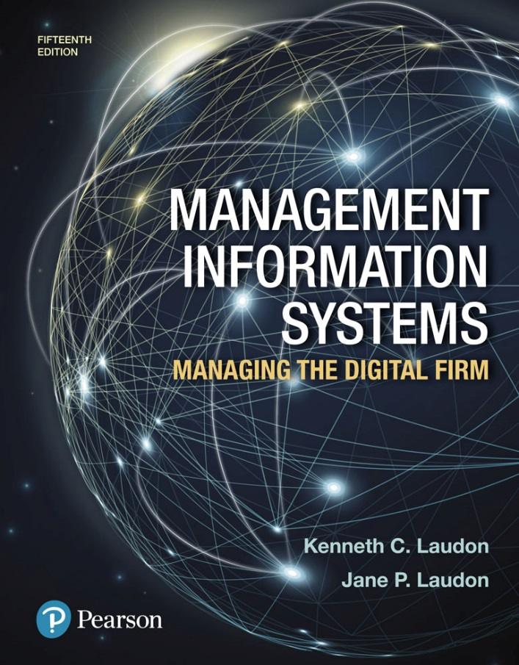
Management Information Systems: Managing the Digital Firm
Fifteenth edition
Chapter 1
Information Systems in Business Today

Slide 2
Learning Objectives
1-1 How are information systems transforming business, and why are they so essential for running and managing a business today?
1-2 What is an information system? How does it work? What are its management, organization, and technology components? Why are complementary assets essential for ensuring that information systems provide genuine value for organizations?
1-3 What academic disciplines are used to study information systems, and how does each contribute to an understanding of information systems?
Notes:
Students may not know exactly what is meant by globalization, or may have an incomplete understanding of the term. You might ask students what they think it means. Potential answers could include: reduction of economic and cultural advantages of developed countries, increased number of companies with operations in multiple countries worldwide, and increased reliance on imports and exports of goods (and jobs). Globalization will be discussed in later slides as well.

Slide 3
Video Cases
Case 1: Business in the Cloud: Facebook and eBay Data Centers
Case 2: UPS Global Operations with the DIAD
Instructional Video: Tour IBM’s Raleigh Data Center

Slide 4
The Grocery Store of the Future: Look at Kroger (1 of 2)
Problem
Limited facility capacity
High customer expectations
Solutions
Information systems to improve checkout experience
Temperature sensors
Online ordering service
Mobile shopping app

Slide 5
The Grocery Store of the Future: Look at Kroger (2 of 2)
Kroger uses QueVision to cut customer wait time in checkout lines
Demonstrates IT’s role in increasing value and revenue in any business
Illustrates the potential for technology to improve customer experience

Slide 6
How Information Systems Are Transforming Business
Mobile digital platform
Systems used to improve customer experience, respond to customer demand, reduce inventories, and more
Growing online newspaper readership
Expanding e-commerce and Internet advertising
New federal security and accounting laws
Notes:
New federal security and accounting laws that require companies to store e-mail for 5 years have spurred the growth of digital information, which is increasing at a rate of 5 exabytes annually. Students may be surprised to learn that 5 exabytes of data is equivalent to 37,000 Libraries of Congress. Ask the students to think about what difference it makes to the world economy, or the U.S. economy, if global operations become much less expensive? What are the challenges to American suppliers of goods and services, and to labor?

Slide 7
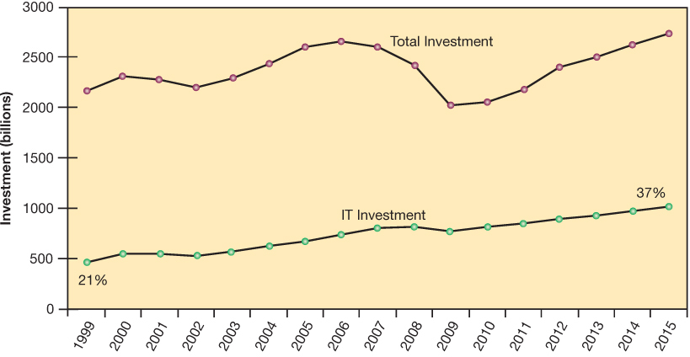
Figure 1.1: Information Technology Capital Investment
Notes:
Figure 1.1, Page 6.
Information technology capital investment, defined as hardware, software, and communications equipment, grew from 21 to 37 percent of all invested capital between 1999 and 2015.
Source: Based on data in U.S. Department of Commerce, Bureau of Economic Analysis, National Income and Product Accounts,
Table 5.3.6. Real Private Fixed Investment by Type, Chained Dollars (2016).
Emphasize to students that total investment is more than one trillion dollars in 2012, and that more than 540 billion dollars of that was invested in information technology. You could ask them why it is that the percentage of total investment devoted to IT has increased so much since 1980. Other kinds of capital investment are machinery and buildings. Why would firms increase IT investment faster than machinery and buildings? The answer is capital substitution: the price of IT capital has been falling exponentially, whereas the price of machine and buildings has been growing at slightly more than the rate of inflation. Wherever possible, firms would much rather invest in more IT than machinery or buildings because the returns on the investment are greater.

Slide 8
What’s New In Management Information Systems (1 of 2)
Technology
Cloud computing
Big data and the Internet of Things (IoT)
Mobile digital platform
Management
Online collaboration and social networking software
Business intelligence
Virtual meetings

Slide 9
What’s New In Management Information Systems (2 of 2)
Organizations
Social business
Telework
Co-creation of business value

Slide 10
Interactive Session: Management: The Mobile Pocket Office (1 of 2)
Class Discussion
What kinds of applications are described here? What business functions do they support? How do they improve operational efficiency and decision making?
Identify the problems that businesses in this case study solved by using mobile digital devices.
Notes:
Ask students whether or not the smartphones that are changing business have had a similar effect on their own lives. Have iPhones dramatically changed they way they do things or created new possibilities?

Slide 11
Interactive Session: Management: The Mobile Pocket Office (2 of 2)
Class Discussion (cont.)
What kinds of businesses are most likely to benefit from equipping their employees with mobile digital devices such as iPhones and iPads?
One company deploying iPhones has said, “The iPhone is not a game changer, it's an industry changer. It changes the way that you can interact with your customers” and “with your suppliers.” Discuss the implications of this statement.

Slide 12
Globalization Challenges and Opportunities: A Flattened World
Internet has drastically reduced costs of operating on global scale
Increases in foreign trade, outsourcing
Presents both challenges and opportunities

Slide 13
The Emerging Digital Firm
In a fully digital firm:
Significant business relationships are digitally enabled and mediated
Core business processes are accomplished through digital networks
Key corporate assets are managed digitally
Digital firms offer greater flexibility in organization and management
Time shifting, space shifting
Notes:
Time shifting and space shifting are connected to globalization. You could ask students to explain why a digital firm is more likely to benefit from globalization than a traditional firm. One answer is that by allowing business to be conducted at any time (time shifting) and any place (space shifting), digital firms are ideally suited for global operations which take place in remote locations and very different time zones.

Slide 14
Strategic Business Objectives of Information Systems (1 of 2)
Growing interdependence between:
Ability to use information technology and
Ability to implement corporate strategies and achieve corporate goals
Notes:
In the opening case, the UPS Interactive Session later in the chapter, and with many of the Interactive Sessions and opening cases in the book, it will be useful to ask students to explain how various information systems succeeded or failed in achieving the six strategic business objectives. You might ask the students to think about some other business objectives and think about how IT might help firms achieve them. For instance, speed to market is very important to firms introducing new products. How can IT help achieve that objective?

Slide 15
Strategic Business Objectives of Information Systems (2 of 2)
Firms invest heavily in information systems to achieve six strategic business objectives:
Operational excellence
New products, services, and business models
Customer and supplier intimacy
Improved decision making
Competitive advantage
Survival

Slide 16
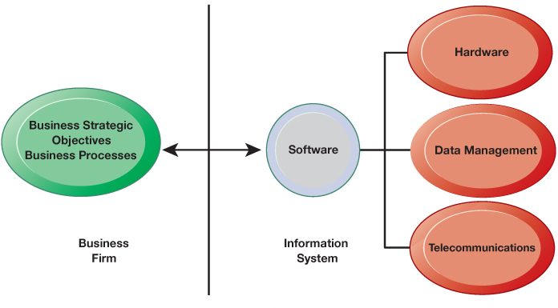
Figure 1.2: The Interdependence Between Organizations and Information Systems
Notes:
Figure 1.2, Page 13.
In contemporary systems, there is a growing interdependence between a firm’s information systems and its business capabilities. Changes in strategy, rules, and business processes increasingly require changes in hardware, software, databases, and telecommunications. Often, what the organization would like to do depends on what its systems will permit it to do.
The basic point of this graphic is that in order to achieve its business objectives, a firm will need a significant investment in IT. Going the other direction (from right to left), having a significant IT platform can lead to changes in business objectives and strategies. Emphasize the two-way nature of this relationship. Businesses rely on information systems to help them achieve their goals; a business without adequate information systems will inevitably fall short. But information systems are also products of the businesses that use them. Businesses shape their information systems and information systems shape businesses.

Slide 17
Operational Intelligence
Improvement of efficiency to attain higher profitability
Information systems, technology an important tool in achieving greater efficiency and productivity
Walmart’s Retail Link system links suppliers to stores for superior replenishment system
Notes:
Walmart is the most efficient retailer in the industry and exemplifies operational excellence. You could ask students to name other businesses that they believe exhibit a high level of operational excellence. Do customers perceive operational excellence? Does it make a difference for customer purchasing? What websites strike students as really excellent in terms of customer service? If you have a podium computer, you might want to visit the Walmart site and the Amazon site to compare them in terms of ease of use.

Slide 18
New Products, Services, and Business Models
Business model: describes how company produces, delivers, and sells product or service to create wealth
Information systems and technology a major enabling tool for new products, services, business models
Examples: Apple’s iPad, Google’s Android OS, and Netflix
Notes:
You could ask students to name other new products or business models that they’ve encountered and how they might relate to new information systems or new technology. One way to encourage participation is ask students to help you list on the blackboard some really interesting recent digital product innovations. Discussing “green technologies” such as wind, solar, and hybrid vehicles is always fun. In this context, what role will IT be playing in the development of these technologies?

Slide 19
Customer and Supplier Intimacy
Serving customers well leads them to return, increasing revenue and profits
Example: High-end hotels that use computers to track customer preferences and then monitor and customize the environment
Intimacy with suppliers allows them to provide vital inputs, which lowers costs
Example: JCPenney’s information system which links sales records to contract manufacturer
Notes:
You could ask students what types of companies might rely more on customer and supplier intimacy more than others and which companies they feel have served them exceptionally well. Ask the students to identify online sites that achieve a high degree of customer intimacy. Sites to visit would include Netflix, Amazon, and other sites which have recommender systems to suggest purchase ideas to consumers.

Slide 20
Improved Decision Making
Without accurate information:
Managers must use forecasts, best guesses, luck
Results in:
Overproduction, underproduction
Misallocation of resources
Poor response times
Poor outcomes raise costs, lose customers
Example: Verizon’s web-based digital dashboard to provide managers with real-time data on customer complaints, network performance, line outages, and so on
Notes:
You could ask students if they have ever been recipients of exceptional service from a company made possible by improved decision making and whether or not information systems contributed to that level of service. For example, perhaps they had a power outage and it took a very short (or very long) time for the utility company to correct the error.

Slide 21
Competitive Advantage
Delivering better performance
Charging less for superior products
Responding to customers and suppliers in real time
Examples: Apple, Walmart, UPS
Notes:
Emphasize that achieving any of the previous four business objectives represents the achievement of a competitive advantage as well.

Slide 22
Survival
Information technologies as necessity of business
Industry-level changes
Example: Citibank’s introduction of ATMs
Governmental regulations requiring record-keeping
Examples: Toxic Substances Control Act, Sarbanes-Oxley Act
Dodd-Frank Act
Notes:
Ask students if they can name any examples of companies that failed to survive due to unwillingness or inability to update their information systems. The Sarbanes-Oxley Act (2002) requires that public firms keep all data, including e-mail, on record for 5 years. The Dodd-Frank Act (2010) requires financial services firms to develop extensive new compliance reports. You could ask students if they appreciate why information systems would be useful toward meeting the standards imposed by these new federal statutes.

Slide 23
What Is an Information System? (1 of 3)
Information system
Set of interrelated components
Collect, process, store, and distribute information
Support decision making, coordination, and control
Information vs. data
Data are streams of raw facts
Information is data shaped into meaningful form
Notes:
These are some basic background understandings needed for the course. A system refers to a set of components that work together (hopefully). Can students think of systems other than information systems? The point of an information system is to make sense out all the confusing data in the environment, and put the data into some kind of order. Information is an ordered set of data that you can understand and act on. If the students want to get a sense of raw data, show them a stock ticker on a financial website, such as Yahoo/finance. Ask them to tell you what it means? Then show them the current value of the Dow Jones Industrial Index and the S&P 500, and its daily trend (or for that matter switch to a one year view of either of these indexes). Looking at the indexes students can quickly get a grasp of whether the market is up or down, and they could act on that information.

Slide 24
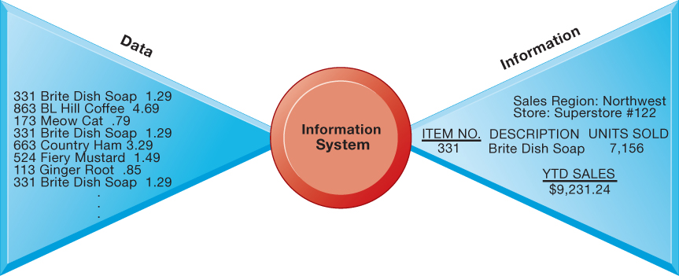
Figure 1.3: Data and Information
Notes:
Figure 1.3, Page 17.
Raw data from a supermarket checkout counter can be processed and organized to produce meaningful information, such as the total unit sales of dish detergent or the total sales revenue from dish detergent for a specific store or sales territory.
Emphasize the distinction between information and data. You could, for example, ask several students to list their ages and write the numbers on one side of the board—then you could calculate the average age of those students on the other side, oldest student, youngest student, and so forth, to illustrate the difference between raw data and meaningful information.

Slide 25
What Is an Information System? (2 of 3)
Three activities of information systems produce information organizations need
Input: Captures raw data from organization or external environment
Processing: Converts raw data into meaningful form
Output: Transfers processed information to people or activities that use it
Notes:
Use an example similar to the one given in the previous slide to illustrate the three activities involved in the function of an information system. Continuing with that example, the process of asking students their age would represent input, calculating the average age and determining the oldest and youngest age would represent processing, and writing that information on the board would represent output.

Slide 26
What Is an Information System? (3 of 3)
Feedback
Output is returned to appropriate members of organization to help evaluate or correct input stage
Computer/computer program vs. information system
Computers and software are technical foundation and tools, similar to the material and tools used to build a house
Notes:
Explain to students how the “house” analogy works: assuming that a successful information system is like a completed “house”, computers and software represent only the tools and materials used to build the house. Tools and materials don’t just suddenly become a completed house—outside (human) input is required. Systems need to be designed to fit the firms and the humans who work with the systems.

Slide 27
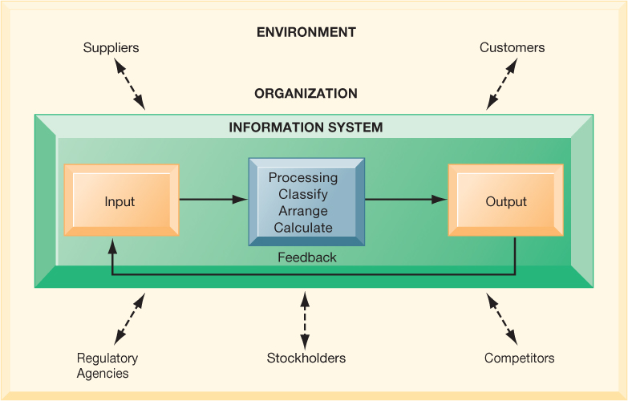
Figure 1.4: Functions of an Information System
Notes:
Figure 1.4, Page 17.
An information system contains information about an organization and its surrounding environment. Three basic activities—input, processing, and output—produce the information organizations need. Feedback is output returned to appropriate people or activities in the organization to evaluate and refine the input. Environmental actors, such as customers, suppliers, competitors, stockholders, and regulatory agencies, interact with the organization and its information systems.
The point of this diagram is first of all to highlight the three basic activities of information systems, so that students can understand what an information system is doing at its most fundamental level. But the diagram also puts information systems into the context of organizations (firms), and then puts the firm into its respective environment composed of shareholders, higher level authorities (government), competitors, suppliers, and customers. Suddenly, students should see that information systems play a central role mediating and interacting with all these players. Hence, systems play a key role in the operations and survival of the firm.
You could also explain this diagram by relating it back to the opening case, as the book does. The two types of input into the Synergy system are manually entered data as well as video. The system processes that data and creates the output, video, and statistics about specific types of players and plays.

Slide 28
Dimensions of Information Systems
Organizations
Management
Technology

Slide 29
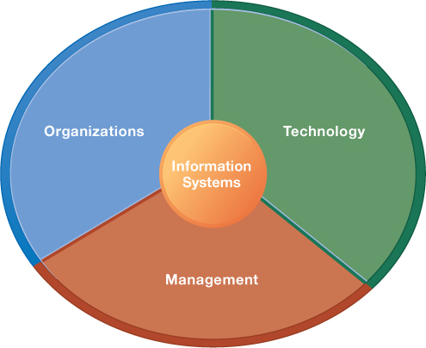
Figure 1.5: Information Systems Are More Than Computers
Notes:
Figure 1.5, Page 19.
Using information systems effectively requires an understanding of the organization, management, and information technology shaping the systems. An information system creates value for the firm as an organizational and management solution to challenges posed by the environment.
These three themes (management, organizations, and technology) will reappear throughout the book. Understanding the interaction among these factors and information systems is known as information system literacy. Knowing how to optimize the relationship between technology, organizations, and management is the purpose of this book and course.

Slide 30
Dimensions of Information Systems: Organizations (1 of 2)
Hierarchy of authority, responsibility
Senior management
Middle management
Operational management
Knowledge workers
Data workers
Production or service workers
Notes:
Pages 18 and 19 in the text provide more specific details on each level of this hierarchy. You can ask students to talk about an organization where they currently work, or have worked in the past. What was their contact with senior management, middle management, and operational (supervisory) management? Many younger students will have had little or no contact with senior and middle management. Older students most likely will have experience. You might need to provide more description about exactly what senior managers do for the firm (and middle managers).

Slide 31
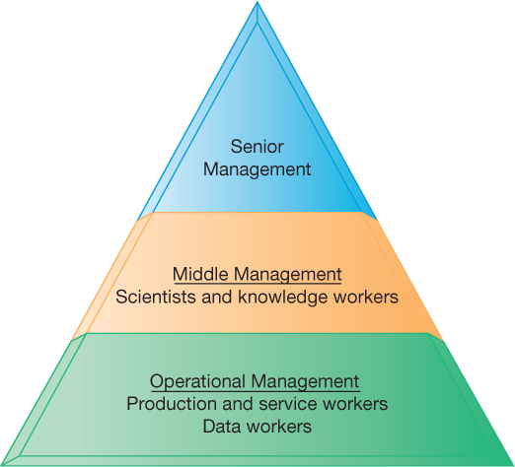
Figure 1.6: Levels in a Firm
Notes:
Figure 1.6, Page 20.
Business organizations are hierarchies consisting of three principal levels: senior management, middle management, and operational management. Information systems serve each of these levels. Scientists and knowledge workers often work with middle management.
Ask students to think about how information systems would factor into the day-to-day jobs of each of the three types of workers in the pyramid.

Slide 32
Dimensions of Information Systems: Organizations (2 of 2)
Separation of business functions
Sales and marketing
Human resources
Finance and accounting
Manufacturing and production
Unique business processes
Unique business culture
Organizational politics
Notes:
The point of this slide is to let students know there are many organizational factors that will shape information systems. A common observation is that “Every business is different.” Does this mean every business will have different information systems? Every business has its unique culture and politics. Systems reflect these business cultures.
For an example of how information systems shed light on a firm’s unique business processes and culture, you might describe the UPS Interactive Session later in the chapter. The company’s package tracking systems exemplify their commitment to customer service and putting the customer first.

Slide 33
Dimensions of Information Systems: Management
Managers set organizational strategy for responding to business challenges
In addition, managers must act creatively
Creation of new products and services
Occasionally re-creating the organization
Notes:
How might information systems assist managers in the development of new products and services? What is meant by re-creating the organization? Why do organizations need to be continually re-created? The answer is that they quickly become obsolete unless they continue to change. Ask students to help you list some organizations that have recently failed, or are about to fail.

Slide 34
Dimensions of Information Systems: Technology
Computer hardware and software
Data management technology
Networking and telecommunications technology
Networks, the Internet, intranets and extranets, World Wide Web
IT infrastructure: provides platform that system is built on
Notes:
Information technology is at the heart of information systems. Although organization and management are important too, it’s the technology that enables the systems and the organizations and managers who use the technology.
The distinction between the Internet and intranets and extranets has to do with their scope. Intranets are private networks used by corporations and extranets are similar except that they are directed at external users (such as customers and suppliers). In contrast, the Internet connects millions of different networks across the globe. Students may not immediately understand this distinction.

Slide 35
Interactive Session: Technology: UPS Competes Globally with Information Technology
Class Discussion
What are the inputs, processing, and outputs of UPS's package tracking system?
What technologies are used by UPS? How are these technologies related to UPS's business strategy?
What strategic business objectives do UPS's information systems address?
What would happen if UPS's information systems were not available?
Notes:
UPS is a good example of a company that successfully uses information systems to enhance their business.
Discuss the Delivery Information Acquisition Device (DIAD) and its various uses. Why is it an excellent example of an information system affected by a firm’s business and vice versa? Do students think UPS does a good job with its information systems? What might they improve?

Slide 36
Dimensions of UPS Tracking System
Organizational
Procedures for tracking packages and managing inventory and provide information
Management
Monitoring service levels and costs
Technology
Handheld computers, bar-code scanners, networks, desktop computers, and so on
Notes:
Discuss what the consequences would be if any one of the three dimensions of information systems were lacking at UPS. With poor technology, good management and organizational procedures would not significantly increase efficiency; without good organizational procedures, even the highest-quality technology wouldn’t prevent frequent errors and data loss; and without good management, the company would not make appropriate decisions about how to use the technology and what procedures to use.

Slide 37
It Isn’t Just Technology: A Business Perspective on Information Systems (1 of 3)
Information system is instrument for creating value
Investments in information technology will result in superior returns
Productivity increases
Revenue increases
Superior long-term strategic positioning
Notes:
You could ask students to consider how this view of information systems might contrast with the sociotechnical view or other views. You could also ask them to consider the circumstances under which information systems might not result in increased productivity and revenue.

Slide 38
It Isn’t Just Technology: A Business Perspective on Information Systems (2 of 3)
Business information value chain
Raw data acquired and transformed through stages that add value to that information
Value of information system determined in part by extent to which it leads to better decisions, greater efficiency, and higher profits
Business perspective
Calls attention to organizational and managerial nature of information systems
Notes:
During this and the next slide, emphasize that the end result of the business information value chain will always be profitability.
Questions for students: What aspects of the business perspective might be lacking? Are there other perspectives that might provide a different picture? (sociotechnical)

Slide 39
It Isn’t Just Technology: A Business Perspective on Information Systems (3 of 3)
Investing in information technology does not guarantee good returns
There is considerable variation in the returns firms receive from systems investments
Factors
Adopting the right business model
Investing in complementary assets (organizational and management capital)
Notes:
Connect this slide to the previous slide. Many firms make significant investments in IT for very little benefit to the bottom line. Discuss why companies experience a wide variety of outcomes in their efforts to invest in IT. Consider the factors we use in this book: organizational and management factors.

Slide 40
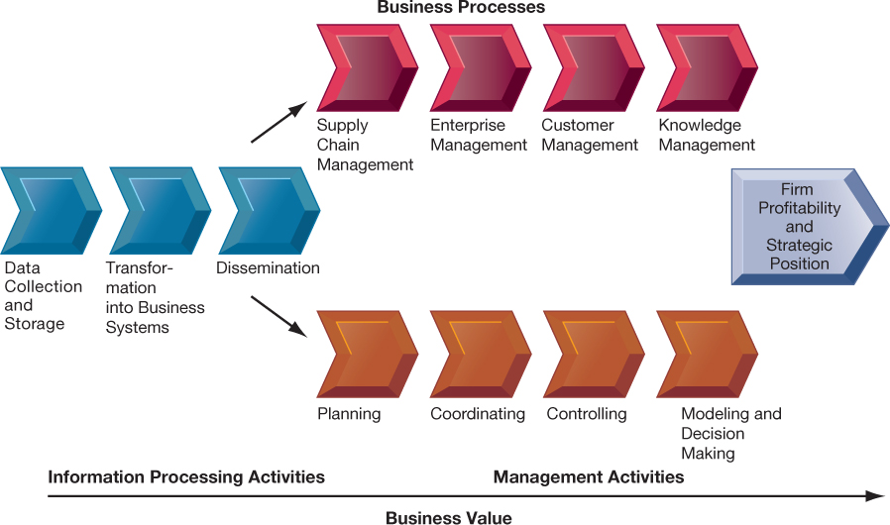
Figure 1.7: The Business Information Value Chain
Notes:
Figure 1.7, Page 26.
From a business perspective, information systems are part of a series of value-adding activities for acquiring, transforming,
and distributing information that managers can use to improve decision making, enhance organizational
performance, and, ultimately, increase firm profitability.
The information value chain is one way to visualize the relationship among information activities, business processes, and management activities. You could also ask students if they could imagine any reason to create an information system besides profitability or strategic positioning (it’s not likely that they will think of one, which will prove the point). One reason to create a system that is not primarily profit-oriented is to meet the information reporting requirements of government and other authorities.

Slide 41
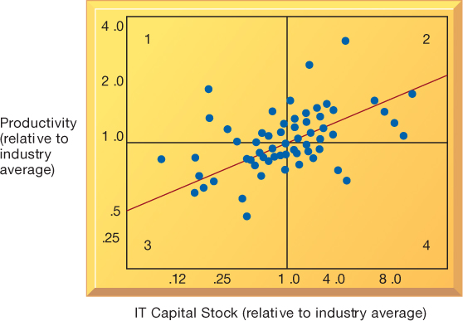
Figure 1.8: Variation in Returns on Information Technology
Notes:
Figure 1.8, Page 27.
Although, on average, investments in information technology produce returns far above those returned by other investments, there is considerable variation across firms.
Source: Based on Brynjolfsson and Hitt (2000).
Emphasize that each quadrant of the graph represents a different type of firm.
Quadrant 1 represents firms that invest much less in IT but still receive strong returns.
Quadrant 2 represents firms that invest a great deal in IT and receive a great deal in returns.
Quadrant 3 represents firms that invest much less in IT and receive poor returns.
Quadrant 4 represents firms that invest a great deal in IT but receive poor returns.
Ask students where they want their firms to show up? The purpose of the course and book is to show students how to end up in top quadrant (2).

Slide 42
Complementary Assets: Organizational Capital and the Right Business Model (1 of 2)
Assets required to derive value from a primary investment
Firms supporting technology investments with investment in complementary assets receive superior returns
Example: Invest in technology and the people to make it work properly
Notes:
The example used in the book for complementary assets is for automobile companies: these companies rely on investments in highways, other roads, gas stations, repair facilities, and so on to maximize the value of their primary investment. Ask students to provide a different example of another company’s or industries complementary assets.

Slide 43
Complementary Assets: Organizational Capital and the Right Business Model (2 of 2)
Complementary assets
Examples of organizational assets
Appropriate business model
Efficient business processes
Examples of managerial assets
Incentives for management innovation
Teamwork and collaborative work environments
Examples of social assets
The Internet and telecommunications infrastructure
Technology standards
Notes:
Emphasize that firms that make significant investment in complementary assets tend to derive greater benefit from information technology investment than those that do not. Consideration of complementary assets should be a part of any firm’s broader view of how to create and implement their information systems. Stress to students that managers must consider dimensions such as complementary assets in order to derive benefit from information systems and be successful.

Slide 44
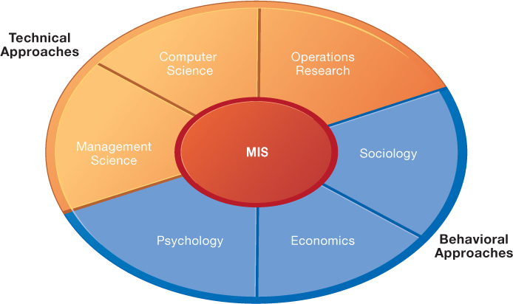
Figure 1.9: Contemporary Approaches to Information Systems
Notes:
Figure 1.9, Page 29.
The study of information systems deals with issues and insights contributed from technical and behavioral disciplines.
Ask students which of the two major types of approaches, behavioral and technical, they find to be most appropriate or accurate. Why do they feel this way? Emphasize that the technical approach does not ignore behavior and the behavioral approach does not ignore technology, but that they are indeed two distinct approaches.

Slide 45
Technical Approach
Emphasizes mathematically based models
Computer science, management science, operations research
Notes:
You might ask the students whether they think it’s possible to adopt only one of the two approaches to information systems and be successful. Then emphasize that the most accurate position is that there is no single approach that can truly capture the full scope and importance of information systems by itself.

Slide 46
Behavioral Approach
Behavioral issues (strategic business integration, implementation, etc.)
Psychology, economics, sociology

Slide 47
Approach of This Text: Sociotechnical Systems (1 of 2)
Management information systems
Combines computer science, management science, operations research, and practical orientation with behavioral issues
Four main actors
Suppliers of hardware and software
Business firms
Managers and employees
Firm’s environment (legal, social, cultural context)
Notes:
Ask students to describe some of the relationships between the four main actors. For example, business firms look to acquire the components of their information systems from suppliers of hardware and software. The firm’s environment may dictate the type of software a company uses as well as the kind of employees that work there.

Slide 48
Approach of This Text: Sociotechnical Systems (2 of 2)
Sociotechnical view
Optimal organizational performance achieved by jointly optimizing both social and technical systems used in production
Helps avoid purely technological approach
Notes:
The sociotechnical systems perspective was also discussed briefly in slide 3, which you could revisit to give students a refresher. The critical aspect of this view is the balance between technological and social/behavioral concerns. Sometimes a lesser form of technology may be the best option because it is more suited to the personal needs of the individual, for example.

Slide 49
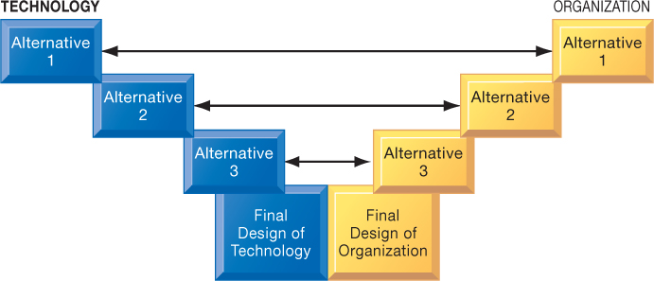
Figure 1.10: A Sociotechnical Perspective on Information Systems
Notes:
Figure 1.10, page 31.
In a sociotechnical perspective, the performance of a system is optimized when both the technology and the organization mutually adjust to one another until a satisfactory fit is obtained.
This graphic illustrates the interplay between technology and the organization. The two continue to grow closer together until an approach satisfying both perspectives is reached. Ensure that students understand that the two sides do not always need to form an equal compromise. Sometimes highly advanced technology may be more acceptable than at other times. As they will see with packaged software solutions and enterprise systems, firms are often required to change greatly in order to make the software applications work.

