Slide 1
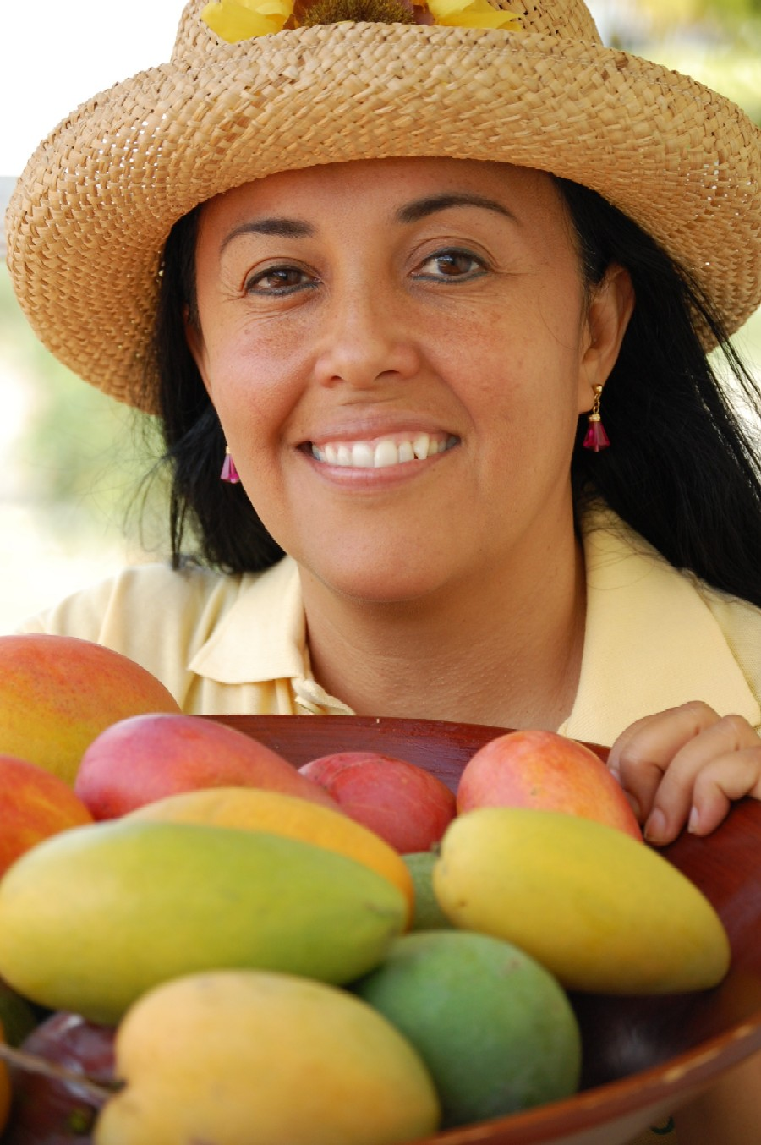
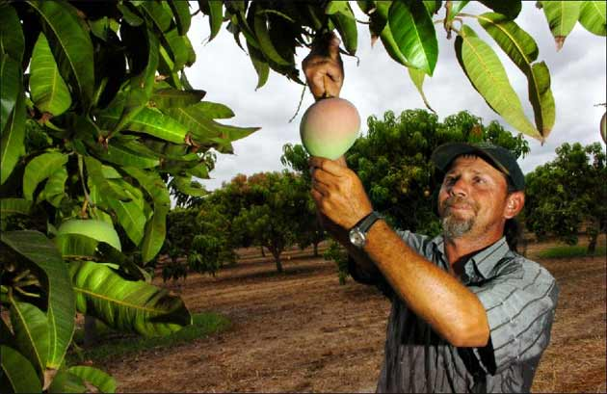

Slide 2
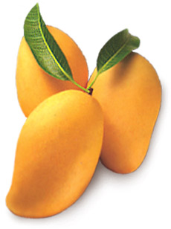
Area (000 ha)
Production (000 Tonnes)
Total : 1727.9

Slide 3
Major Mango Growing Regions
Punjab | Sindh | KPK | Balochistan
Multan | Mir pur Khas | Peshawer | Qalat
Bahawalpur | Hyderabad | D. I. Khan
Muzzaffargarh | Thatta | Mardan
Rahim yar Khan

Slide 4
Botany
Family Anacardiaceae
Genus Mangifera
Botanical name Mangifera indica
Origin southern Asia

Slide 5
Mangifera produced 40 spp
Few produce edible fruits such
M. odorata Griff
M. foetida Lour
M. sylvatica Roxb
M. Lagenifera Griff
M. langar
M. similis
All other spp produced inferior quality fruits

Slide 6
Tree Characters
An impressive size tree (25 meters)
Evergreen and erect
But few are prostrate (Flat or horizontal)
Live long 300 year in INDIA (Lakh Bagh)
Leaves
Tree don't grow continuously
Producing various colored leaves when young
Young leaves are reddish, wine-colored or pale
Leaves of mango spirally on a shoot
A general phylotaxy 3/8 is observed

Slide 7
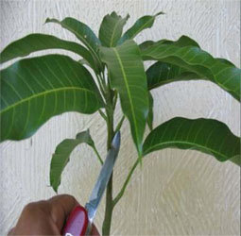
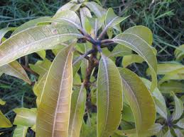

Slide 8
In mango growing regions of Pakistan flushes appear Feb-Oct
First flush are from terminal buds on flowering shoots of preceding year
Second from later buds on shoot that setting little or no fruit
Third flush may grow from lateral buds on shoot that have ripened a crop
Fourth from lateral buds on shoots greatly weakened by a crop

Slide 9
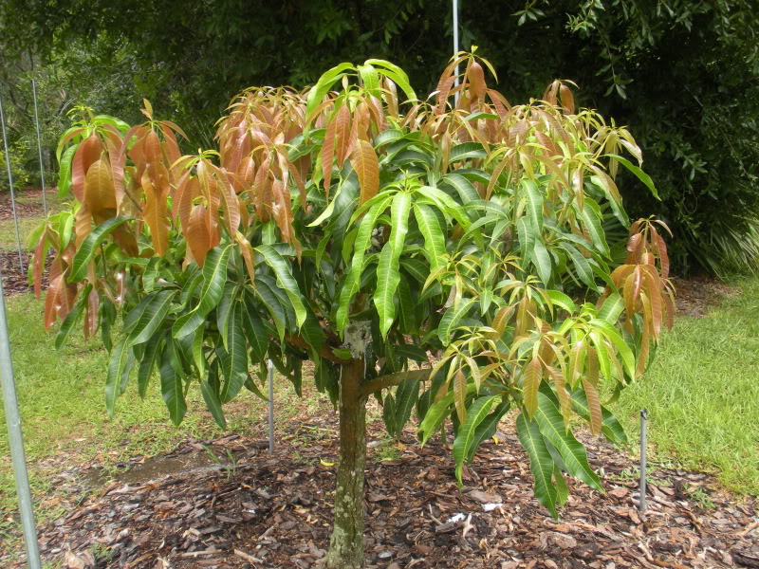

Slide 10
April flush: 37% bear inflorescence
May flush: 29%
June flush: 20%
July flush: 12%
August flush 7%

Slide 11
Flowers
Flower bud differentiate in Sep- Oct
Blooming start from Feb- until mid April
Early variety Early Gold bloom continuously through December to March
Flowers are born terminally on 30-50 cm
Carry 500-1500 flowers or in some cases have 7000 flowers
Small, yellowish or pinkish in color

Slide 12
Male 67-90%
Hermaphrodite 10-30%
Staminate flowers contain only one
While 5-6 abortive stamens called staminodes
Fertile stamen is longer, with dark-red anther filled with pollen
Perfect flowers have small ovary
Style is lateral
stigma is simple and small
Sepal 4-5
Petals 5

Slide 13
Fruit:
Large drupe
Epicarp:
Mesocarp
Endocarp
Weight vary from cultivar to cultivars from plum to 2 kg
Skin is smooth and thick
Yellow or greenish
Some cv.s have red blush on yellow skin
Fruit will ready for harvesting with in 13 to 20 weeks

Slide 14
Climate
Fruit of Tropical region
Excessive rains – tend to produce continuous growth flushes
Fruit induction – low temperature stress or drought period is important (Sub-tropical climate)
That’s why per-hectare yield is more in Punjab than Sindh
Suitable temperature range is 15 to 40ºC
During flowering – freedom from rain, cloudiness and frost is important
During ripening – dry hot conditions improve fruit quality

Slide 15
Soil Requirements
Can be grown on wide range of soils types
Deep well – drained sandy loam soils give best results
The sub-soil should be free from hardpan, sticky clay and water logged conditions
Suitable soil pH range: 5.5 – 8.7

Slide 16
Propagation
Propagated by both sexual and asexual methods
Sexually propagated mangoes are called seedlings/ Desi Mangoes
Sexual propagation is now restricted to raise rootstock
Raising of Rootstocks
Sowing of fresh mango stones – July – August
Seedlings are shifted to bed in August – September
Seedlings remain there for one year

Slide 17
Attain suitable height and thickness – propagated asexually by side grafting
Shifted to earthen pots – grafted by inarching (Approach grafting)

Slide 18
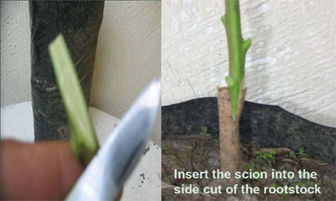

Slide 19
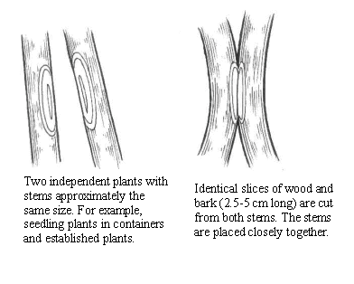
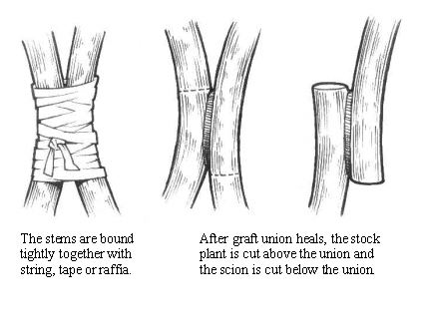
Approach Grafting (Inarching)

Slide 20
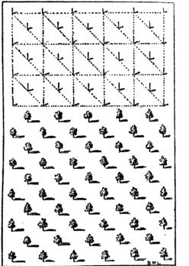
Layout
Usually planted in square system with fillers in the centre of squares (Quincunx System)
Planting distance depends
Soil
Variety
Climate
System of orchard management
Dusheri and Anwar Ratool – 11 m
Sindhiri, Langra , Samar Bahisht – 15 m
Pre – dug pits ---- March and September

Slide 21
Transplanting and Bearing
Transplanting
In spring: Feb/March
In Autumn:Sept/Oct
Time to start of bearing: 4-5 years
Time to full bearing: 6-7 years
Normal economic bearing life: 30-50 years
Time of flowering: Feb/Mar

Slide 22
Irrigation
Arid and semi arid regions irrigation is essential for good harvest
Fortnightly irrigation after fruit set until the monsoon rains
This will help to prevent fruit drop
Also help to improve fruit size and quality
Heavy irrigation just before blooming result in vigorous bloom

Slide 23
Fertilizers
Age of Plant | FYM | Urea | DAP | SoP
Digging Hole for Plantation |  | 15 – 20 g
1st - 2nd Year |  | 200 g | 100 g | 100 g
3rd – 4th year | 15 – 20 kg | 440 – 600 g | 300 – 500 g | 200 – 300 g
5th – 9th year | 40 – 50 kg | 1.5 – 2 kg | 1 – 1.5 kg | 750 g – 1 kg
> 10 year | 80 – 100 kg | 3 – 4 kg | 1.5 – 2 kg | 1.5 – 2 kg

Slide 24
Pruning
Mango usually assumes a graceful dome shape shading the main trunk.
No pruning is practiced however, annually after fruit harvest diseased, dried, broken branches and those touching the ground should be pruned off.
To rejuvenate the orchard after every 3-4 years it is advisable that 15-20% of old wood should be removed.

Slide 25
Important Commercial Varieties
Sindh: Sindhri, Gulabkhas, Baganpalli, Collector, Neelum
Punjab: Malda, Langra, Duseri, Anwar Ratol, Samer Bahisht, Fajri Kalan and Sensation, Langra and
NWFP: Langra and Samer Bahisht
Baluchistan: Sindhri and Banganpalli

Slide 26
Special Problems /Disorders
Malformation
Serious threat
Affects both vegetative parts and inflorescence
Branches show stunted (under developed) growth with small and bunchy leaves
Also called Bunchy Top
cause is not yet known but, viruses, fungi, mites and deficiency of elements
Mostly male flowers
Good management can reduce this problem to some extent

Slide 28
Alternate Bearing
A disorder in which fruit trees produce heavy crop in one year and low in the next year
May be physiological due to imbalance in the C:N ratio
Also presumed as a genetic disorder
Totapari
Romani
Fazli
Neelum

Slide 29
Insects of mango
Mango Hopper
Mango mealybug

Slide 30
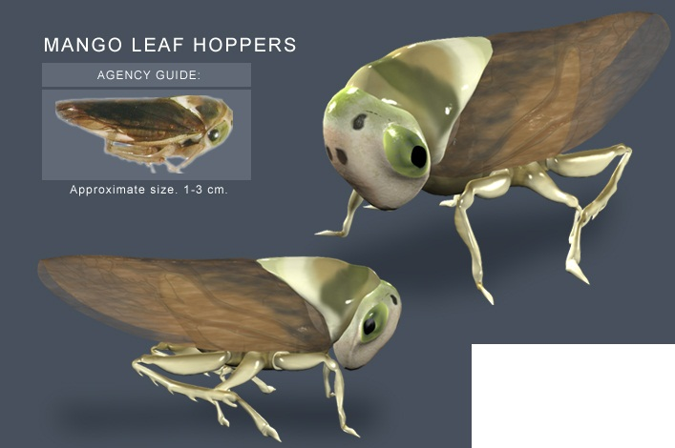
Insects
The factor affecting are environmental, physiological, genetics
Management: Heavy manuring during off-year + Delayed Harvesting
Fruit thinning during on-year + Early harvesting during on-year
Mango hopper:
Jumping insect which creates a noise on leaves
Very serious threat to mango
Damage is so great that it may barren the whole orchard
Suck the sap from the leaves and panicles
Control: Thinning of plantation for good light reduces its population
Spray of insecticides during first 15 days of blooming is effective
Pre-blossoming spray – Mid December – Late January provide complete control

Slide 31
Known as am ka tela
Jumping insect
Creates noise on leaves when the population is great
Very serious threat to mango
Spray insecticides first 15 days of blooming is useful
Imidacloprid (0.3%), Endosulfan (0.5%), and Cypermethrin (0.4%), and natural Neem oil (3%)

Slide 32
Mango mealy bug
Heavy losses to tree and crop
Nymphs of the female insects suck sap from the panicles and leaves
Crawl up the tree during Feb and feed there until May
Then climb down when temperature high
Shelter in cracks in the soil and die there
Female filled with eggs and hatch next year
Control:
Distraction of eggs during Nov-Dec by putting slippery and sticky bands on the main stem to stop their crawling on the tree
Chemical control: ameeda chloprids 50-80g/100 ml water
Triaezophos 250ml/100 ml water

Slide 33
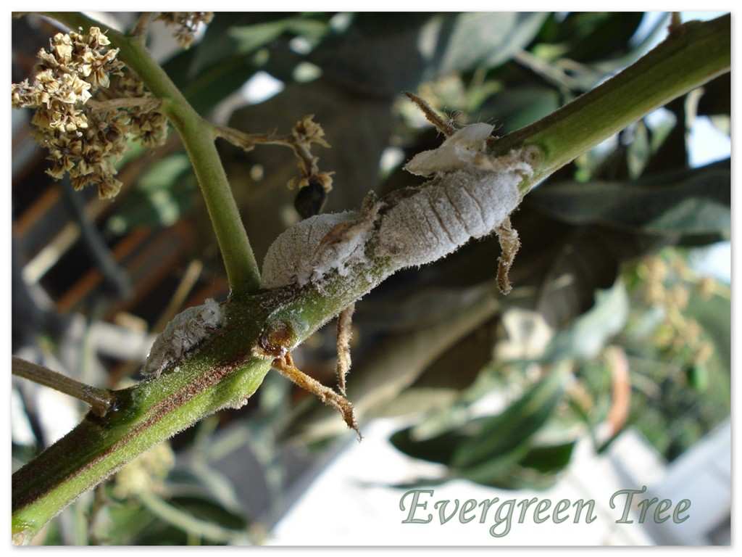
Mango Mealy Bug
It is another major pest of mango and is widely distributed
Nymphs and adults suck the plant sap and reduce the vigour of the plant.
The female, after copulation, crawl down the tree in the month of April-May and enter in the cracks in the soil for laying eggs in large numbers encased in white egg sacs.
Just after hatching, the minute newly hatched pink to brown coloured nymphs crawl up the tree. After climbing up the tree they start sucking the sap of tender plant parts.
They are considered more important because they infest the crop during the flowering season and if the control measures are not taken timely , the crop may be destroyed completely.
Control : Polythene (400 gauge) bands of 25 cm width fastened around the tree trunk have been found effective barrier to stop the ascent of nymphs to the trees. The band should be fastened well in advance before the hatching of eggs, i.e., around November - December.

Slide 34
Powdery Mildew
Spreads rapidly during warm, humid weather
Prevalence of such weather during blossoming cause heavy crop loss
Attacks the inflorescence – looks purplish with a sprinkling of white fungus
Panicles dry out and flower drop completely without setting any crop
Control; Bordeaux mixture before or during flowering

Slide 37
Anthracnose
Fungal disease
Common on Samar bahisht
Damage to the twigs, leaves, panicles and fruit
Severity increases with higher rain and humidity
Leaves, flowers and young fruit will drop
Controlled by copper based fungicides

Slide 39
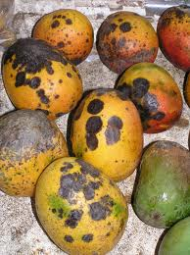
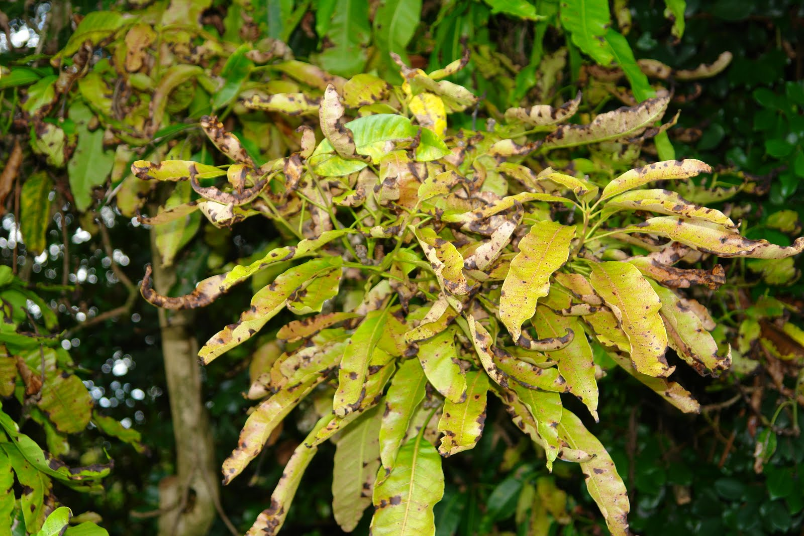
Anthracnose
Common and widespread fungal disease
Mostly in Samar Bahisht
Severe damage – leaves, twigs, panicles and fruit
Severity increases with excessive rains and humidity with shedding of leaves, flowers and young fruit
Fruit can’t be shipped because it rots soon after picking
Copper based fungisides

Slide 40
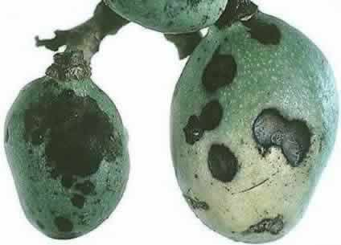

Slide 42
Dr. Saeed Ahmad

