Slide 1
X-RAYS

Slide 2
INTRODUCTION.
X-rays are types of electromagnetic radiation probably most well-known for their ability to see through a person&apos;s skin and reveal images of the bones beneath it. Advances in technology have led to more powerful and focused X-ray beams as well as ever greater applications of these light waves, from imaging biological cells and structural components of materials like cement to killing cancer cells.

Slide 3
TYPES
X-rays are roughly classified into soft X-rays and hard X-rays. Soft X-rays have relatively short wavelengths of about 10 nanometers (a nanometer is one-billionth of a meter), and so they fall in the range of the electromagnetic (EM) spectrum between ultraviolet (UV) light and gamma-rays. Hard X-rays have wavelengths of about 100 picometers (a picometer is one-trillionth of a meter). These electromagnetic waves occupy the same region of the EM spectrum as gamma-rays. The only difference between them is their source: X-rays are produced by accelerating electrons, whereas gamma-rays are produced by atomic nuclei in one of four nuclear reactions.

Slide 4
HISTORY
X-rays were discovered in 1895 by Wilhelm Conrad Röentgen, a professor at Würzburg University in Germany. According to the Nondestructive Resource Center&apos;s "History of Radiography," Röentgen noticed crystals near a high-voltage cathode-ray tube exhibiting a fluorescent glow, even when he shielded them with dark paper. Some form of energy was being produced by the tube that was penetrating the paper and causing the crystals to glow. Röentgen called the unknown energy "X-radiation." For this discovery, Röentgen was awarded the very first Nobel Prize in physics, in 1901.

Slide 5
SOURCES AND THEIR EFFECTS.
X-rays can be produced on Earth by sending a high-energy beam of electrons smashing into an atom like copper or gallium, according to Kelly Gaffney, director of the Stanford Synchrotron Radiation Lightsource. When the beam hits the atom, the electrons in the inner shell, called the s-shell, get jostled, and sometimes flung out of their orbit. Without that electron, or electrons, the atom becomes unstable, and so for the atom to "relax" or go back to equilibrium, Gaffney said, an electron in the so-called 1p shell drops in to fill the gap. The result? An X-ray gets released.

Slide 6
Synchrotron radiation was seen for the first time at General Electric in the United States in 1947, according to the European Synchrotron Radiation Facility. This radiation was considered a nuisance because it caused the particles to lose energy, but it was later recognized in the 1960s as light with exceptional properties that overcame the shortcomings of X-ray tubes.

Slide 7
"Because the electrons are relativistic [or moving at near light-speed], when they give off light, it ends up being focused in the forward direction," Gaffney said. "This means you get not just the right color of light X-rays and not just a lot of them because you have a lot of electrons stored, they&apos;re also preferentially emitted in the forward direction."

Slide 8
X-RAY IMAGING
Due to their ability to penetrate certain materials, X-rays are used for several nondestructive evaluation and testing applications, particularly for identifying flaws or cracks in structural components. According to the NDT Resource Center, "Radiation is directed through a part and onto [a] film or other detector. The resulting shadowgraph shows the internal features" and whether the part is sound. This is the same technique used in doctors&apos; and dentists&apos; offices to create X-ray images of bones and teeth, respectively

Slide 9
X-rays are also essential for transportation security inspections of cargo, luggage and passengers. Electronic imaging detectors allow for real-time visualization of the content of packages and other passenger items. The original use of X-rays was for imaging bones, which were easily distinguishable from soft tissues on the film that was available at that time. However, more accurate focusing systems and more sensitive detection methods, such as improved photographic films and electronic imaging sensors, have made it possible to distinguish increasingly fine detail and subtle differences in tissue density, while using much lower exposure levels.

Slide 10
Additionally, computed tomography (CT) combines multiple X-ray images into a 3D model of a region of interest. Similar to CT, synchrotron tomography can reveal three-dimensional images of interior structures of objects like engineering components, according to the Helmholtz Center for Materials and Energy.

Slide 11
X-RAY THERAPY
Radiation therapy uses high-energy radiation to kill cancer cells by damaging their DNA. Since the treatment can also damage normal cells, the National Cancer Institute recommends that treatment be carefully planned to minimize side effects.

Slide 12
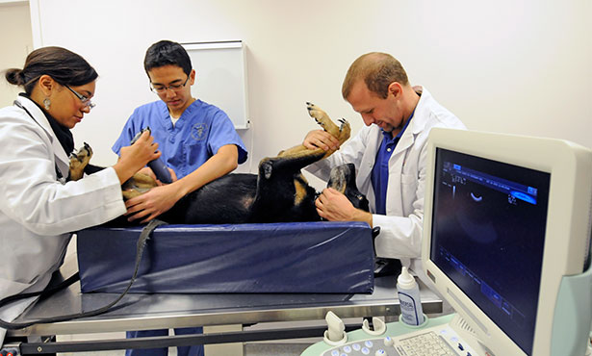
ultrasonography

Slide 13
contents
Introduction
Principle
Uses
Echocardiography
Imaging Tests of the Liver and Gallbladder
Imaging Tests of the Urinary Tract
Advantages
Disadvantages
Ultrasonographic image of fetus
3D Imaging technology
Ultrasound frequencies

Slide 14
introduction

Slide 15
introduction
Ultrasonography uses high-frequency sound (ultrasound) waves to produce images of internal organs and other tissues. A device called a transducer converts electrical current into sound waves, which are sent into the body’s tissues. Sound waves bounce off structures in the body and are reflected back to the transducer, which converts the waves into electrical signals. A computer converts the pattern of electrical signals into an image, which is displayed on a monitor and recorded as a digital computer image. No x-rays are used, so there is no radiation exposure during an ultrasonography.

Slide 16
Principle

Slide 17
uses
Ultrasonography is effectively used to image internal organs in the abdomen, pelvis, and chest. However, because sound waves are blocked by gas (for example, in the lungs or intestine) and by bone, ultrasonography of internal organs requires special skills. People who have been specifically trained to do ultrasound examinations are called sonographers.
Gallbladder and biliary tract: For example, to detect gallstones and blockages in the bile ducts

Slide 18
uses
Liver, spleen, and pancreas: For example, to detect tumors and other disorders
Urinary tract: For example, to distinguish benign cysts from solid masses (which may be cancer) in the kidneys or to detect blockages such as stones or other structural abnormalities in the kidneys, ureters, or bladder
Female reproductive organs: For example, to detect tumors and inflammation in the ovaries, fallopian tubes, or uterus
Pregnancy: For example, to evaluate the growth and development of the fetus and to detect abnormalities of the placenta (such as a misplaced placenta, called placenta previa)

Slide 19
uses
Heart: For example, to detect abnormalities in the way the heart beats, structural abnormalities such as defective heart valves, and abnormal enlargement of the heart’s chambers or walls (ultrasonography of the heart is called echocardiography)
Blood vessels: For example, to detect dilated and narrowed blood vessels

Slide 20
Echocardiography
Echocardiography can be used to detect whether the heart muscle is moving normally and how much blood the heart is pumping out with each beat. This procedure can also detect abnormalities in the heart's structure, such as defective heart valves, birth defects (such as holes in the walls between the heart's chambers), and enlargement of the heart's walls or chambers, as occurs in people with high blood pressure, heart failure, or impairment of the heart's muscular walls (cardiomyopathy).

Slide 21
Imaging Tests of the Liver and Gallbladder
Ultrasonography uses sound waves to provide images of the liver, gallbladder, and bile ducts.
ultrasonography is better for detecting structural abnormalities affecting just certain parts of the liver, such as tumors, than for abnormalities that affect the entire liver uniformly, such as cirrhosis (severe scarring of the liver) or fatty liver (excess fat in the liver). It is the least expensive and safest technique for creating images of the gallbladder and bile ducts.

Slide 22
Imaging Tests of the Liver and Gallbladder
can readily detect gallstones in the gallbladder. Ultrasonography of the abdomen can distinguish whether jaundice (a yellowish discoloration of the skin and the whites of the eyes) is caused by obstructed bile ducts or by malfunctioning liver cells. If ultrasonography shows bile ducts that are dilated (widened), the cause is typically obstruction.

Slide 23
Imaging Tests of the Urinary Tract
Ultrasonography is commonly used to obtain images of urinary tract stones and swellings and masses (lumps) in the urinary tract, such as in the kidneys, bladder, scrotum and testes, penis, and urethra. Ultrasonography can also be used to look for blockages in the kidneys or bladder

Slide 24
Ultrasound frequencies
2.5 MHz: deep abdomen, obstetric and gynaecological imaging
3.5 MHz: general abdomen, obstetric and gynaecological imaging
5.0 MHz: vascular, breast, pelvic imaging
7.5 MHz: breast, thyroid
10.0 MHz: breast, thyroid, superficial veins, superficial masses, musculoskeletal imaging.
15.0 MHz: superficial structures, musculoskeletal imaging.

Slide 25
advantages
They are generally painless and do not require needles, shots or cuts.
Patients aren't exposed to ionizing radiation, making the procedure safer than diagnostic techniques such as X-rays and CT scans. In fact, there are no known harmful effects when used as directed by your health care provider.
Ultrasound captures images of soft tissues that don't show up well on X-rays.
Ultrasounds are widely accessible and less expensive than other methods.

Slide 26
disavantages
Insertion of the transducer into the body may cause some discomfort. Rarely, when a transducer is inserted, tissue is damaged, causing bleeding or infection.
Bone or gas can block ultrasonography. Thus, using it to obtain images of certain structures (those behind bone or gas) is difficult.

Slide 27
Ultrasonographic image of fetus

Slide 28
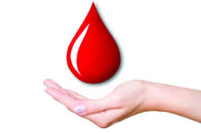
BLOOD COLLECTION
by
DIFFERENT SPECIES

Slide 29
Terms:
Anticoagulants are medicines that help prevent blood clots. (Heparin)
Clot normally takes about 25 to 30 seconds. It may take longer if you take blood thinners.
plasma
The colourless fluid part of blood which contains clotting factors as well as other proteins, glucose etc .

Slide 30
SAFTY PRECAUTIONS :
Have the blood taken by a well trained and experienced phlebotomist.
Make sure they wash their hands and use alcohol gel
They should wear gloves, which is mainly for their protection, but they may identify the vein without gloves, which is safe if their hands are clean.
Make sure they use a clean, freshly unwrapped needle and if using a vacutainer, use a fresh needle holder. They will use fresh items if this is done by a safe practitioner.

Slide 31
Why Blood Collection is to be Done??
A blood culture is a test that checks for foreign invaders like bacteria, yeast, and other microorganisms in your blood. Having these pathogens in your bloodstream can be a sign of a blood infection, a condition known as bacteremia. A positive blood culture means that you have bacteria in your blood.

Slide 32
General Blood Tests
Cholesterol and lipid tests
Blood glucose test
ELISA test
Calcium blood test
The D-dimer test is a blood test used to help check for or monitor blood clotting problems.
ESR test ( Erythrosits sedimentation rate)
INR test
An international normalised ratio (INR) test measures the time taken for your blood to clot.

Slide 33
An enzyme-linked immunosorbent assay, also called ELISA or EIA, is a test that detects and measures antibodies in your blood. This test can be used to determine if you have antibodies related to certain infectious conditions.

Slide 34
BLOOD TESTS FOR GOATS
Caprine Arthritis Encephalitis (CAE) is a member of the small ruminant lentiviruses which may lead to chronic disease of the joints. Not all goats that become infected will develop clinic disease, therefore it is important to test goats routinely for infection.
BioPRYN Blood Pregnancy Test
Johne's Tests

Slide 35
Sheep Testing
1. BioPRYN Blood Pregnancy Test
2. Johne's Disease Tests
3. Glucose
A doe can be tested for pregnancy at 30 days or later post breeding or buck removal.

Slide 36
BLOOD TESTS FOR CATTLE
1 . BOVINE LEUKOSIS
2 . BIO-PRYN PREGNANCY TEST
3. Thalaria
4. Babasia
Ticks mites

Slide 37
BLOOD TESTS FOR HORSE
1.Red Blood-Cell Count (RBC) (((4.2 to 5.4 million/uL)))
2.White Blood-Cell Count (WBC) ((4,500 to 11,000 WBC /uL ))
3.Fibrinogen
Normal range 1.5 to 3.5 g/L,
4.Blood Urea Nitrogen (BUN)
5.Glucose

Slide 38
BLOOD TESTS FOR DOG
1. Electrolytes
2.Glucose
3.Blood Urea Nitrogen (BUN)
4.Heartworm Test

Slide 39
BLOOD TESTS FOR CAT
1. BUN
2. Glucose
3. Electrolytes
4. T4
Thyroxine (T4) is usually monitored in cats as they get older. A high T4 might indicate the development of hyperthyroidism, a commonly diagnosed condition in cats, including increased appetite, weight loss, eating non-food items or wanting more human food, and increased vomiting.

Slide 40
CBC or HB test
A CBC, or complete blood count,
Red blood cell (RBC) counts,
RBCs carry oxygen, iron, and other nutrients around the body.
White blood cell (WBC) counts,
. WBCs help fight inflammation, infection, cancer cells, and parasitic intruders.
Platelet counts
. Platelets control blood clotting.

Slide 41
CHICKENS
Blood is collected from chickens for two purposes:
1. To obtain serum which will be tested for Newcastle disease virus antibodies,
2. To obtain red blood cells, the blood is collected into anticoagulant.

Slide 42
TECHNIQUE :
Handle the chickens gently.
Collect the blood samples quickly.
Take care not to damage the vein. Damaged veins will result in haematomas being formed.
Minimize the loss of blood. This minimizes trauma to the chickens and stress to their owners.

Slide 43
CATTLE :
From coccygeal vein of the tail-head,
Jugular vein of the neck.
Methods :
With the classic needle and syringe, and exiting the contents of the syringe into a vaccutainer tube,
with a double-pointed needle that draws blood into a vaccutainer tube, no syringe required.

Slide 44
To make things simpler, the classic needle and syringe is coupled with obtaining a blood sample from the tail-head, and the double-pointed needle holder is coupled with taking blood from the jugular vein.
Take a rubber-capped test tube (called a "vacutainer tube") and insert the needle into the top of the cap. The vacuum-sealed tube will vacate the contents of the syringe without you needing to apply pressure to the plunger. Remove the needle when all contents have been vacated.

Slide 45
Insert the needle directly into the vein, perpendicular to the angle of the tail.
((It is easier to put the needle in perpendicular to the tail because it reduces the needle slipping and missing the vein completely. All needles are tapered at the end, not pointed like a spear. The greater the angle the needle was inserted (i.e., more parallel to the neck), the chance of the needle slipping and missing the vein completely increases.))
Use a short needle: an 1-inch, 18-gauge . And as mentioned, only insert the needle slightly over half-way in, never all the way.
The syringe should not be more than 5 cc; (but, there's nothing wrong with having a 10 cc syringe), just note that you don't need to fill it up completely with blood.

Slide 46
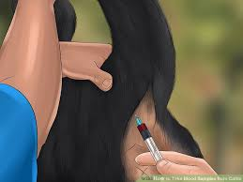
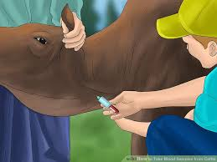
coccygeal vein
Jugular vein

Slide 47
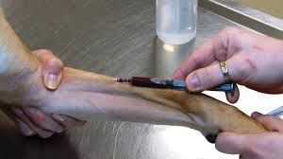
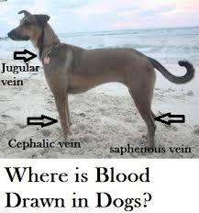
Cephalic vein

Slide 48
A 22G needle works for most blood draws. In larger breed dogs, an 18 G needle will be better and the blood sample will be obtained much more quickly.

Slide 49
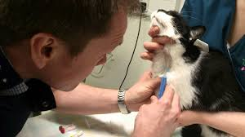
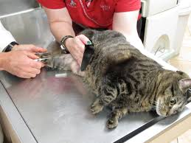
(22 G or a 25 G needle),
Jugular Vein
Cephalic Vein

Slide 50
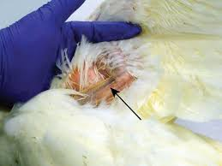
Brachial vein
2.5 mL syringes
25 gauge needles for small chickens
23 gauge needles for larger chickens

Slide 51
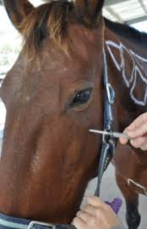
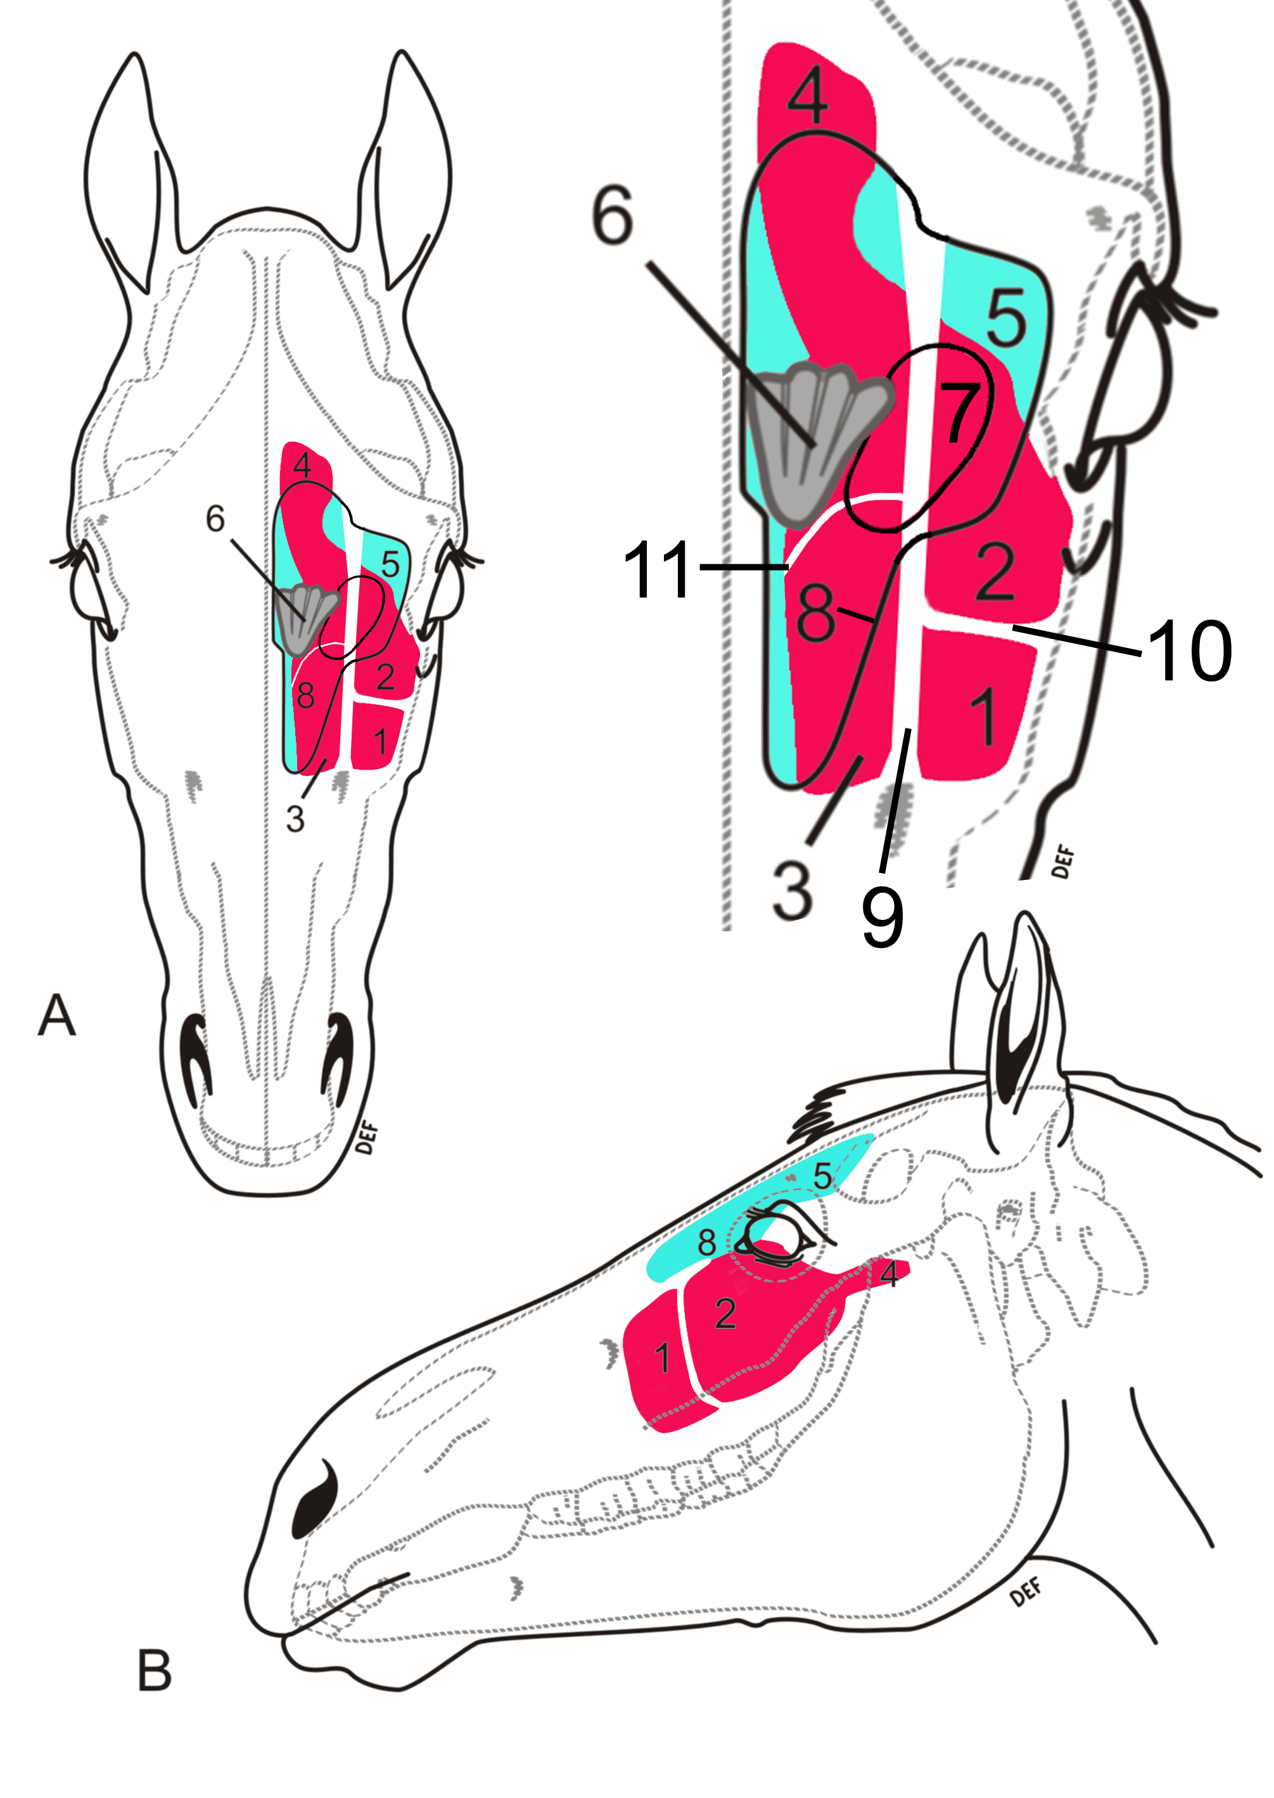
(18 to 20 gauge is best),
Facial Sinus
Jugular Vein

Slide 52
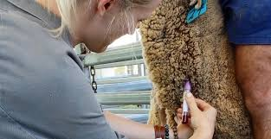
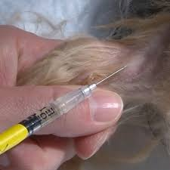
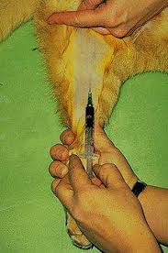
Jugular vein
Saphenous vein
Cephalic vein
((Using a 6 cc syringe, 20-gauge ))

Slide 53
Blood sample processing and storage:
Whole Blood •
Collect whole blood into 1 lavender top tube containing EDTA, and allow another tube to clot for collection of serum. • Add up to 500 μL of whole blood (from EDTA tube) directly into 2 vials, one containing 500 μL Trizol and one containing 500 μL VTM (= maximum final ratio of 1:1) and mix each vial well.
Serum •
After clotting is complete, use a plastic pipette to take 1 ml of serum and transfer into 2 cryovial tubes, 0.5 ml each. • If a centrifuge is available, centrifuge samples for 15 minutes and then collect 1 ml serum and transfer into 2 cryovial tubes, 0.5 ml each. • Label the cryovial tubes with the same label information used on vacutainer tube. • You can harvest additional serum for serum bank as appropriate. • Freeze all samples in liquid nitrogen immediately in the field and transfer to -80°C freezer once back in the lab.

Slide 54
Samples should be refrigerated to 4°C immediately after collection. They can also be shipped in refrigerated packaging at 4°C. At that temperature they are stable for 7 days. If it is anticipated that analysis can not occur within 7 days, samples should be frozen immediately at -70°C (-20°C is not sufficient).
When kept at -65°C or below, red blood cells can be stored for up to 10 years. Platelets can be stored at 20°C - 24°C for up to 5 days with constant agitation. Plasma that is frozen at temperatures of -18°C or below within 8 hours of collection, platelets can be stored for up to 1 year

Slide 55
For decades, the Food and Drug Administration has limited storage of refrigerated red blood cells to 42 days. But it has been clear for some time that stored blood degrades in various ways long before that six-week limit, and some research suggests that the changes may be harmful to patients who receive older blood.

Slide 56
Samples should be refrigerated to 4°C immediately after collection. They can also be shipped in refrigerated packaging at 4°C. At that temperature they are stable for 7 days. If it is anticipated that analysis can not occur within 7 days, samples should be frozen immediately at -70°C (-20°C is not sufficient).
When kept at -65°C or below, red blood cells can be stored for up to 10 years. Platelets can be stored at 20°C - 24°C for up to 5 days with constant agitation. Plasma that is frozen at temperatures of -18°C or below within 8 hours of collection, platelets can be stored for up to 1 year

Slide 57
Serum
A liquid which separates out when blood coagulates.
SERUM
Please check individual specimen requirements for restrictions. When using a serum separator tube, follow these instructions:
Perform venipuncture as with any other blood collection device.
Invert the tube gently no more than eight times. Further inversion may cause alterations in sample integrity.
Do not remove the stopper at any time. Do not centrifuge immediately after drawing blood. Allow the blood to clot in an upright position for at least 30 minutes but not longer than 1 hour before centrifugation.
Perform venipuncture as with any other blood collection device.
Centrifuge for at least 15 minutes at 2200-2500 RPM within one hour of collection.
Transfer the serum to a plastic screw-cap vial for transport to the laboratory.

Slide 58
PLASMA
Plasma contains fibrinogen and other clotting factors when separated from the red blood cells. Evacuated tubes used to collect plasma specimens contain anticoagulant and, frequently, a preservative. The additive in each tube is specified on the label and tube stoppers are color coded according to the additive present. Consult the individual test specimen requirements to determine the correct additive/tube to use. Indicate that the specimen is plasma on the plastic screw-cap vial for transport and test requisition.
Centrifugation: When plasma is required, or when not using a serum gel separator tube, follow these instructions:
Draw 12 mL of whole blood for each 5 mL of serum or plasma needed. Collect in an appropriate collection tube.
Centrifuge for at least 15 minutes at 2200-2500 RPM.
Pipette the serum or plasma into a clean plastic screw-cap vial and attach the label. Do not transfer red cells to the vial. Screw cap on firmly to prevent leakage.

Slide 59
How to separate serum and plasma from blood
Serum is the liquid fraction of whole blood that is collected after the blood is allowed to clot. The clot is removed by centrifugation and the resulting supernatant, designated serum, is carefully removed using a Pasteur pipette. Plasma is produced when whole blood is collected in tubes that are treated with an anticoagulant. The blood does not clot in the plasma tube. The cells are removed by centrifugation.

Slide 60
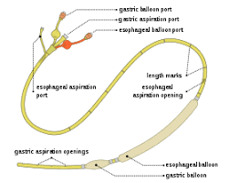
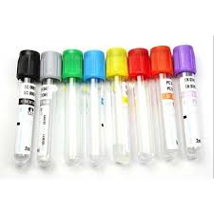
Blood collection devices
Sengstaken–Blakemore tube
vacutainer

Slide 61
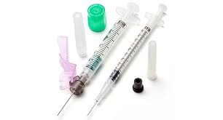
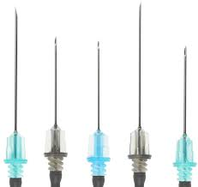
Syrings
Needles

Slide 62
Vacutainer
can be defined as a proprietary blood collection tube with a vacuum to facilitate blood collection

Slide 63
Blue-Top Tube - Sodium Citrate (NaCitrate): This tube is primarily used for coagulation studies (PT and PTT). Complete filling of this tube is essential to obtain accurate results.
Lavender-Top Tube - EDTA: EDTA .
Its primary use is for the CBC .

Slide 64
Red-Top Tube - This tube has no anticoagulant and is used for many chemistry tests, drug levels, and blood bank procedures.
Navy Blue-Top Tube - There are two general types - one with K2 EDTA and one with no anti-coagulant. This tube is used primarily for trace metal analysis.
Serum Separator Tube (SST®) - This tube contains a clot activator and serum gel separator. It has no anticoagulant and is used for many chemistry tests.

Slide 65
Green-Top Tube - This tube contains sodium heparin and is used for collection of heparinized plasma or whole blood for special tests.
Grey-Top Tube - Potassium Oxalate. This tube is used primarily for glucose tolerance testing.
Yellow-Top Tube - (acid citrate dextrose) Solution A or B: used for whole blood determinations

Slide 66
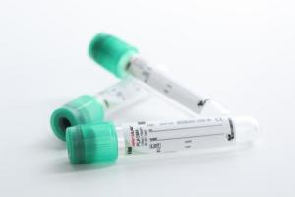
Plasma Tube

