Slide 1
Software Testing & Quality Engineering
Chapter 6
Quality Management System
Linda Westfall Quality Press

Slide 2
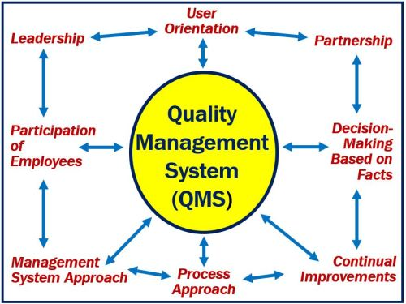
Objectives
Quality Goals and Objectives
Customers and other stakeholders
Planning
Outsourcing

Slide 3
Quality Management System
A Quality Management System is a collection of policies, procedures, plans, resources, processes, practices, and the specification of responsibilities and authority of an organization designed to achieve product and service quality levels, customer satisfaction and company objectives.

Slide 4
Quality Management System - contd
QMS can be viewed in three parts.
Strategic planning
Deployment of the strategy
Information systems for monitoring, analyzing and improving the deployments.
The difference between strategic planning and deployment is:
Strategic planning means deciding what to do.
Deployment means using the best methods to carry out the strategic plan.

Slide 5
1 - Strategic Planning
Identify and define top management’s responsibility for the QMS, including establishing policies and objectives, setting organization-wide goals, and supporting quality initiatives.
Strategic planning usually begins with an analysis phase.
The strengths and weaknesses of the organization are assessed and forecasts are generated to predict how market opportunities and competitive threats will change during the time period covered by the study.
This analysis is sometimes called a SWOT (the acronym for strengths, weaknesses, opportunities, and threats) study.
Ideally, strategic planning for quality will address each aspect of the SWOT analysis.
Notes:
1 Strengths are Leveraged for competitive advantage.
2 Weaknesses are addressed through appropriate measures like trainings or process improvement process.
3 Opportunities are identified through various marketing research techniques (market size, growth rate, customer expectations, desires, perceptions). It should lead to new product development efforts.
4 Threats Business environment should be assessed. Threats can come from direct competitors offering substitute products/services, suppliers of critical proprietary components & distributors etc.
PEST

Slide 6
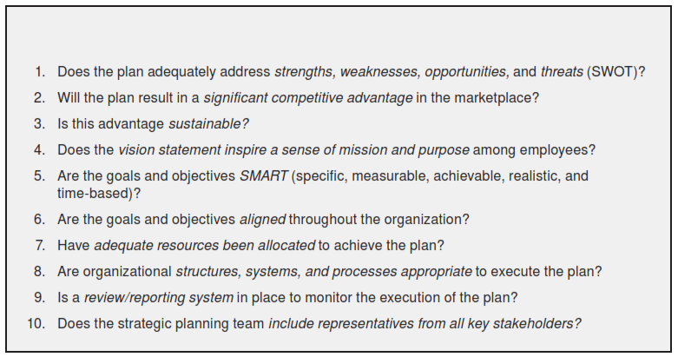
1 - Strategic Planning - Contd
After the SWOT analysis is complete, the organization can develop strategic quality plans. To discern the effectiveness of strategic quality plans, management should employ a series of sequentially ordered effectiveness tests.
Notes:
Gym: Body maintenance, Fitness, Strong, Health
Losing weight – gaining muscles – Gaining height
Losing weight by 10 kgs in 4 months by putting effort of 2 hours daily and taking specified diet.
S = Specific
M = Measureable
A = Achievable
R = Realistic
T = Time – based.

Slide 7
2. Deployment Techniques
Define, describe, and use various deployment tools in support of the QMS: benchmarking, stakeholder identification and analysis, performance measurement tools, and project management tools such as PERT charts, Gantt charts, critical path method (CPM), resource allocation, and so on.
Quality improvement does not just happen. It must be planned, supported, and monitored.
Planning requires ways to identify the specific initiatives to be taken on, while support and monitoring require methods for tracking and communicating progress.

Slide 8
2. Deployment Techniques - Contd
Policy deployment : Policies provide direction to guide and determine present and future decisions. They indicate the principles to be followed or what is to be done but not specifically how it is to occur. A documented and deployed quality policy provides.
A written guide to managerial action, lending stability to the organization.
Consideration of quality problems and their effects
A basis for auditing practices against policy
Deployed policies cascade throughout the organization, directly impacting each functional area and indirectly affecting events, activities, and outcomes depending on those functions. If policies do not have this effect, they are not fulfilling their purpose. Each function and person impacted by the organization’s policy must align their objectives and procedures to support the policy.
Notes:
To ensure consistency and understanding throughout the organization, policies need to be
Integrated with the strategic plan, then
Deployed through appropriate initiatives and performance checks.
Projects must be justified and scheduled.
Performance must be measured and reported.
An organization’s policies should be actionable.
Some situations may call for temporary adaptation of the policy to meet unanticipated needs.

Slide 9
2. Deployment Techniques - Contd
Goals and Objectives: Goals must fulfill the SMART principle.
An example of the hierarchical relationships between strategy, a goal, objectives, and action plans follows:
Organization strategy: Continually build and retain a loyal customer base.
Organizational goal: Deliver all products to all customers 100 percent on time.
Organizational objective: Given current capacity, improve delivery dates of all future customer orders from 35 percent to 75 percent on-time delivery by February 2010 and to 100 percent by August 2010.
Functional objectives: The quality department will assign a quality engineer to convene a cross-functional process improvement team by November 1, 2009. The team will utilize lean manufacturing techniques to reduce cycle time and will continue its efforts until the production process has achieved 100 percent on-time delivery performance.
Action plans: Detailed plans state how, when, and by whom the objective will be achieved. Action plans may resemble mini project plans or may be more complex project planning documents as needs dictate. In either case, action plans influence planning and scheduling.

Slide 10
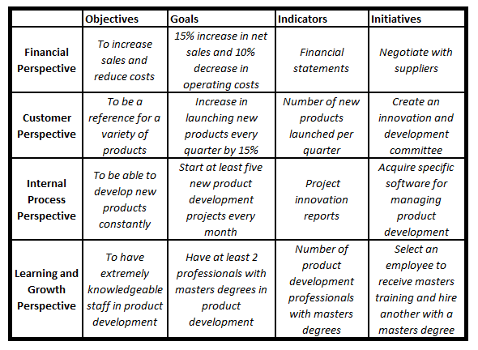
Performance measurement tools
Balanced Score Card. (BSC)
Traditional reporting framework typically only look at the financial perspectives.
BSC however proposes four perspectives for performance measurement.
1- Financial Fundamentals 2- Business Processes
3- Customer 4- Learnig and growth
In a typical scorecard, the objective is listed along with associated measures, targets for performance, and initiatives that will drive the organization to achieve the objective.
Notes:
Financial measures include traditional indicators such as cash flow, sales, and return on investment. Business processes include manufacturing measures such as yield and rework. It can also include support activities such as order processing. Customer measures may include trends in customer satisfaction or average wait times on telephone hot lines. The learning and growth perspective recognizes the human element in an organization and looks at softer measures such as participation in employee suggestion programs and training.

Slide 11
Performance measurement tools
Dashboards: is a visual display of key business indicators. It may include various charts, numbers or information required for a quick review. The elements in a dashboard should be linked to the strategic objectives

Slide 12
Customers and Stakeholders
Congruence between policy and results is evaluated through audits that periodically check for conformance. The stakeholders need to be clearly identified and their differing needs must be met. If adaptation of a policy must occur, it must remain within the original intent if the policy is to remain credible to the stakeholders. Frequent feedback from all stakeholders helps to quickly identify and correct any disparity. Stakeholders include the following:
Stockholders, the owners of the company
The executive group, including the board of directors and the top tier of managers.
Employees other than top management
Suppliers and customers
The community at large
Notes:
Stockholders: their role is passive and their needs are financial in nature. Expect company to maintain credibility in market, and growth in market share.
The executive group: Must acknowledge that they are there for other stakeholders. Lot depends on their decisions.
Employees: The quality depends on how well the employees are recruited, trained and supervised.
Suppliers and customers: Supplier must adhere the contractual requirements and will ask for prompt payments. Customers are the paramount stakeholders.
The community: Communities, neighbors, environmental regulators, law enforcement agencies, chambers of commerce, legislatures, and similar bodies often are indirect stakeholders. Individually their impact is relatively slight but if a major issue arises, the concerns of a community can have an overwhelming influence.

Slide 13
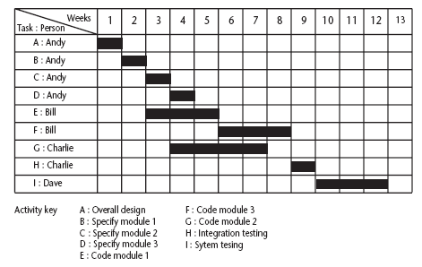
Planning and scheduling
Plan your work, work your plan.
Work planning requires a clear understanding of the overall goal and the objectives.
The planning process must also take into account how the initiative relates to other projects (e.g. sharing of resources) and therefore often requires input from or participation by multiple stakeholders.
Notes:
Formal : MS Project – MS Excel
Task 1 Design
Sub task 1
Sub task 2
Task 2 (Finish to Start) Sub task 1

Slide 14
Outsourcing
Sublet the task
Pros Negative
Flawless performance Because you depend, you lack control.
Budget Optimization Developers, testing team not sitting together
Code and testing simultaneously Time zone difference, work schedules
Can be problem. Time saving Emergency scenarios you cant sync.
Skip the hiring process Risk factor (high)
Notes:
Cost benefit analysis :

