Slide 1
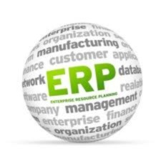
Enterprise Resource Planning -ERP
1

Slide 2
What is ERP?
2
Definition:

ENTERPRISE RESOURCE PLANNING(ERP) is a cross-
functional enterprise system driven by an integrated suite
of software modules that supports the basic internal business processes of a company
Notes:
Information systems that cross the boundaries of traditional business functions in order to reengineer and improve vital business processes all across the enterprise. The new product development process in a manufacturing company

Slide 3
What is ERP?
3

The practice of consolidating an enterprise’s
planning, manufacturing, sales and marketing efforts into one management system.

Combines all databases across departments into a
single database that can be accessed by all employees.

ERP automates the tasks involved in performing a
business process.

Slide 4
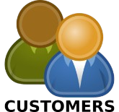
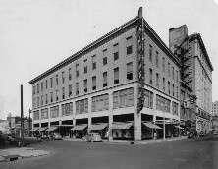
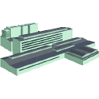
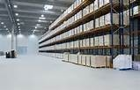
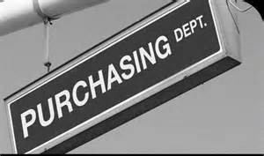
Before ERP example
4
Order parts
Check for parts
Ship parts.
We ordered parts
Call back “not in stock”
Sales dept. Demographic Files
Sends report
Ship parts.
Vendor
Ship parts.
Accounting dept. Accounting Files
Warehouse
“we ordered parts”
Inventory Files
Place order
“we need parts”
Sends report
Purchasing dept. Purchasing Files

Slide 5
Typical Business Process :
Key observation
5

A typical enterprise has many Departments/ Business units(BU).
These Departments/ BU continuously communicate and exchange data with each other.


The success of any organization lie’s in effective communication and data exchange within the Departments/ BU as well as associated third party such as Vendors, Outsourcers and Costumers.

Also known as Decentralized System.

Slide 6
Problems with Decentralized
System
6

Numerous disparate information system are developed individually over the time.
Integrating the data becomes time and money consuming. Inconsistences and duplication of data.



High inventory, material and human resource cost.

Slide 7
Centralized System : ERP example
7
Order parts
Sales Dept.
Accounting
Inventory data
Financial data
exchenge
Purchasing data
Database
Books Inventory
Order is placed
Vendor
Purchasing Dept.
Ship parts
Warehouse
Invoice Accounting

Slide 8
Centralized System :
Key observation
8

Data is maintained at a central location and is shared with various Departments.
Departments have access information/ data of the other Departments/ BU/


Slide 9
Benefits of Centralized
System
9

Eliminates the duplication, discontinuity and redundancy in data.
Provides information across departments in real time. Provides control over various business processes.



Increase Productivity, better inventory management, promotes quality, reduced material cost, boosts profits.
 Better Customers interaction, increased throughput,
improves customer services.

Slide 10
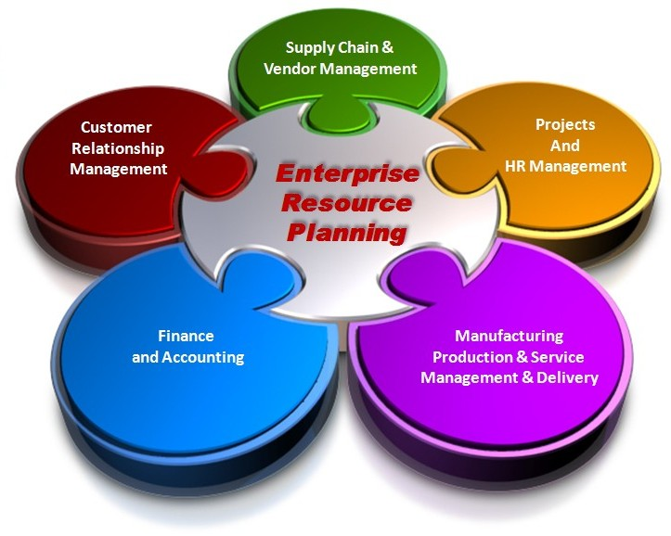
ERP Application Components
10
Source : https://www.linkedin.com/pulse/20140926221018-366028342-10-emerging-trends-in-erp

Slide 11
ERP Components
11

Financial Management
At the core of ERP are the financial modules,
including general ledger, accounts receivable, accounts payable, billing and fixed asset management. If your organization is considering the move to an ERP system to support expansion into global markets, make sure that multiple currencies and languages are supported, as well as regulatory compliance in the U.S. and in foreign countries.
Other functionality in the financial management modules will include budgets, cash-flow, expense and tax reporting. The evaluation team should focus on areas that are most important to support the strategic plans for your organization.

Slide 12
ERP Components
12

Business Intelligence
Business Intelligence (BI) has become a standard component of most ERP packages. In general, BI tools allow users to share and analyse the data collected across the enterprise and centralized in the ERP database. BI can come in the form of dashboards, automated reporting and analysis tools used to monitor the organizational business performance. BI supports informed decision making by everyone, from executives to line managers and accountants.

Slide 13
ERP Components
13

Supply Chain Management
Supply Chain Management (SCM), sometimes referred to as logistics, improves the flow of materials through an organization by managing planning, scheduling, procurement, and fulfillment, to maximize customer satisfaction and profitability. Sub modules in SCM often include production scheduling, demand management, distribution management, inventory management, warehouse management, procurement and order management..

Slide 14
ERP Components
14

Human Resource Management
Human resource management ERP modules should enhance the employee experience – from initial recruitment to time tracking. Â Sub modules can include payroll, performance management, time tracking, benefits, compensation and workforce planning. Self-service tools that allow managers and employees to enter time and attendance, choose benefits and manage PTO are available in many ERP solutions.
Notes:
Payroll is the process of paying a company's employees, which can include the tracking of hours worked, the calculation of employee's pay, and the distribution of payments via direct deposit directly to their account or by check
personal time off (PTO)

Slide 15
ERP Components
15

Manufacturing Operations
Manufacturing modules make manufacturing operations more efficient through product configuration, job costing and bill of materials management. ERP manufacturing modules often include Capacity Requirements Planning, Materials Requirements Planning, forecasting, Master
Production Scheduling, work-order management and shop- floor control
Integration
Key to the value of an ERP package is the integration

between modules, so that all of the core business functions are connected. Information should flow across the organization so that BI reports on organization-wide results.
Notes:
Job costing is defined as a method of recording the costs of a manufacturing job, rather than process. With job costing systems, a project manager or accountant can keep track of the cost of each job, maintaining data which is often more relevant to the operations of the business.
A bill of materials (BOM) is a comprehensive inventory of the raw materials, assemblies, subassemblies, parts and components, as well as the quantities of each, needed to manufacture a product. In a nutshell, it is the complete list of all the items that are required to build a product.
Shop Floor Control (SFC) is a software system of methods and tools that are used to track, schedule and report on the progress of work in a manufacturing plant. Shop Floor Control systems generally evaluate the portion of an order or operation that has been completed.

Slide 16
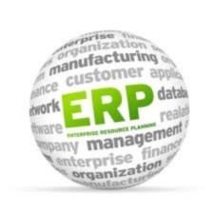
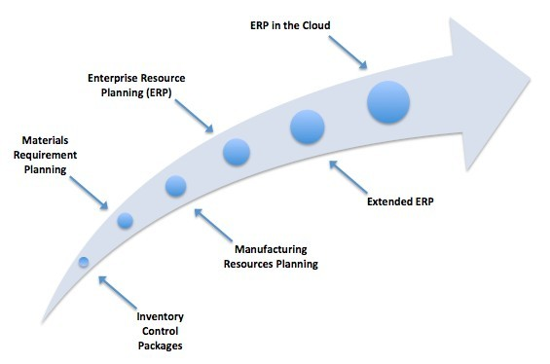
ERP Evolution
16
From manufacturing co-ordination to enterprise wide backend solutions.

Slide 17
ERP Evolution
17

Inventory Management & Control-1960’s
Inventory Management and control is the combination of
information technology and business processes of maintaining the appropriate level of stock in a warehouse. The activities of inventory management include identifying inventory requirements, setting targets, providing replenishment techniques and options, monitoring item usages, reconciling the inventory balances, and reporting inventory status.
Notes:
restoration of a stock or supply to a former level or condition.
To reconcile inventory, compare the inventory counts in the company's records to the actual amounts on the warehouse shelves, figure out why there are differences between the two amounts, and adjust the records to reflect this analysis

Slide 18
ERP Evolution
18

Material Requirement Planning (MRP)-1970’s
Materials Requirement Planning (MRP) utilizes software
applications for scheduling production processes. MRP generates schedules for the operations and raw material purchases based on the production requirements of finished goods, the structure of the production system, the
current inventories levels and the lot sizing procedure for each operation
Manufacturing Requirements Planning (MRP II)-1980’s Manufacturing Requirements Planning or MRP

utilizes software applications for coordinating manufacturing processes, from product planning, parts purchasing, inventory control to product distribution.

Slide 19
ERP Evolution
19

Enterprise Resource Planning (ERP)-1990’s
Enterprise Resource Planning or ERP uses multi-module application software for improving the performance of the internal business processes. ERP systems often integrates business activities across functional departments, from product planning, parts purchasing, inventory control, product distribution, fulfillment, to order tracking. ERP software systems may include application modules for supporting marketing, finance, accounting and human resources.

Slide 20
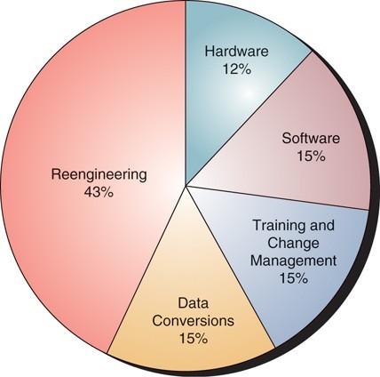
Costs of ERP
21

Slide 21
ERP Project and Time
23

Real transformational ERP efforts will usually run between 1 to 3 years, on average.

Short implementations (3 to 6 months):


small companies,
implementation limited to a small area of the company, or

the company only used the financial pieces of the ERP system.

The important thing is not to focus on how long it will take but to understand why you need ERP and how you will use it to improve your business.

Slide 22
Hidden Costs of ERP
24


Training
Integration and testing



Data conversion Data analysis Consultants



Replacing best and brightest staff after implementation Implementation teams can never stop
Waiting for ROI

Post-ERP depression
Notes:
http://www.axisgp.com/2010/11/what-does-erp-really-cost/

Slide 23
Benefits of ERP Systems
25

Improving integration, flexibility



Fewer errors
Improved speed and efficiency
More complete access to information



Lower total costs in the complete supply chain Shorten throughput times
Sustained involvement and commitment of the top management

Slide 24
Benefits of ERP Systems
26
 Reduce stock to a minimum



Enlarge product assortment Improve product quality
Provide more reliable delivery dates and higher service to the customer

Efficiently coordinate global demand, supply and production
Notes:
Product assortment, sometimes referred to as merchandise mix, refers to the variety of products that a retailer stocks and sells. It's made up of two key components: 1. Product breadth, which is the variety of product lines in a store. Product breadth is all about how wide and diverse an assortment is

Slide 25
ERP Implementation
27

Biggest IT project that most companies ever handle,


Changes the entire company, and.
It is essential that all the key players understand the scope of the

project.
This is an IT-Related Project.


Slide 26
28 ERP Implementation
Phases
4 Major Phases:



Concept/initiation Development Implementation

Closeout/Operation and maintenance
Notes:
is that implementation is the process of moving an idea from concept to reality in business, engineering and other fields, implementation refers to the building process rather than the design process while development is (uncountable) the process of developing; growth, directed change.
Development deals with Individual object development as per the design/business requirements. Implementation deals integrated with individual development objects

Slide 27
Risks with ERP
Implementation
29



Expensive (can costs 100 thousands to millions of dollars) Time-consuming (can take months to years)
Great risk for the organization


Transfer of Knowledge Acceptance with the company

Slide 28
Causes of ERP Failures
30
Business mangers and IT professionals underestimate the complexity of the planning, development, and training needed
Failure to involve affected employees in the planning and development phases
Trying to do too much too fast in the conversion process
Failure to do enough data conversion and testing

Slide 29
Conclusion
31

The benefits of a properly selected and implemented ERP system can be significant.

An average, 25 to 30% reduction on inventory costs; 25% reduction on raw material costs.

Lead-time for customers, production time, and production costs can be reduced.

BUT cost of implementing can be quite high and risks are great.

Slide 30
Best Practices of ERP Implementation
32
Change Management
Extensive Education and Training
Data Clean up and Data Integrity
Implementation is viewed as an ongoing process

Slide 31
Best Practices of ERP Implementation
33

Change Management

Changes in business procedures, responsibilities,
work load.¹
As a result, ERP implementations are times of

high stress, long hours, and uncertainty.¹ Mid-level managers must²
 facilitate continual feedback from employees,

provide honest answers to their questions, and
help resolve their problems.
Sources:
Yakovlev, I.V., “An ERP Implementation and Business Process Reengineering at a Small University”, Educause Quarterly, Number 2, 2002;
Umble, M. Michael, “Avoiding ERP Implementation Failure”, Industrial Management, Jan/Feb 2002.

Slide 32
Best Practices of ERP Implementation
34

Extensive Education and Training
 General education about the ERP system
for everyone.
 Massive amount of end users training before and during implementation.
Follow-up training after the implementation.
10 to 15% of total ERP implementation budget for training will give an organization an 80% chance of a successful implementation.
Source: Umble, M. Michael, “Avoiding ERP Implementation Failure”, Industrial Management, Jan/Feb 2002.
Notes:
he act of following up. an action or thing that serves to increase the effectiveness of a previous one, as a second or subsequent letter, phone call, or visit

Slide 33
Best Practices of ERP Implementation
35

Data Clean up and Data Integrity



Clean-up data before cut-over.¹
“Near enough is no longer good enough.”²
To command trust, the data in the system must be sufficiently available and accurate.³

Eliminate the old systems, including all informal systems.³
Sources:
http://www.bpic.co.uk/checklst.htm, viewed November 5, 2002;
http://www.projectperfect.com.au/info_erp_imp.htm, viewed November 5, 2002;
M. Michael Umble, “Avoiding ERP Implementation Failure”, Industrial Management, Jan/Feb 2002.

Slide 34
Best Practices of ERP Implementation
36

Implementation is viewed as an ongoing process

Ongoing need for training and software support after implementation.
Ongoing need to keep in contact with all system users and monitor the use of the new system.


Ongoing process of learning and adaptation that continually evolves over time.
Source: Umble, M. Michael, “Avoiding ERP Implementation Failure”, Industrial Management, Jan/Feb 2002.

Slide 35
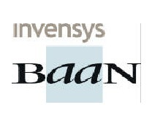
Main ERP vendors
37

Slide 36
Thank You!
38

