Slide 1
Giant chromosomes

Slide 2
Giant chromosomes
Chromosomes are generally decondensed during interphase, so that their structure is difficult to discern.
Notable exceptions are the specialized
lampbrush chromosomes of vertebrate oocytes and
polytene chromosomes of insect giant secretory cells.

Slide 3
Contd..
Studies of these two types of interphase chromosomes suggest that each long DNA molecule in a chromosome is divided into a large number of discrete domains that are folded differently ( euchromatin and heterochromatin ) .

Slide 4
Contd..
In both lampbrush and polytene chromosomes the regions that are actively synthesizing RNA are least condensed.
About 10% of the DNA in interphase vertebrate cells is in a relatively uncondensed conformation that correlates with DNA transcription in these regions.

Slide 5
Contd..
These chromosomes are very long and thick (upto 200 times their size during mitotic metaphase in the case of Drosophila)
Hence they are known as Giant chromosomes
Such "active chromatin" is biochemically distinct from the more condensed inactive regions of chromatin

Slide 6
Lamp brush chromosomes
The amphibian oocyte (germ cells in the ovary) has certain periods of very active RNA synthesis.
During the diplotene stage, certain chromosomes stretch out large loops of DNA, causing the chromosome to resemble a lamp brush
These chromosomes show RNA synthesis and form unusual chromatin loops

Slide 7
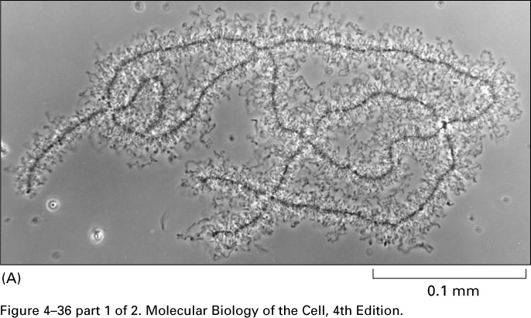
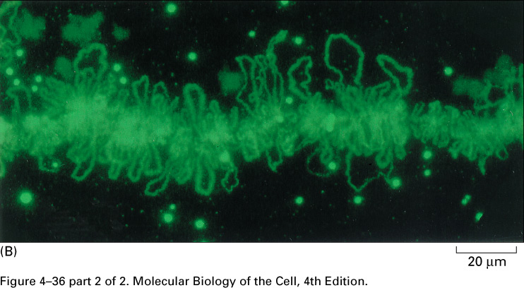
Lampbrush chromosomes (amphibian oocyte)

Slide 8
Contd...
Loops consist of transcriptionally active DNA which can synthesize large amount of mRNA, necessary for the synthesis of yolk
Lampbrush chromosomes in are unusually large compared with their mitotic chromosomes, about 400–800 μm long as opposed to at the most 15–20 μm during later stages of meiosis
These are visible under the light microscope as the so-called lampbrush chromosomes.

Slide 9
Contd..
Lampbrush chromosomes are greatly extended chromosome bivalents during the diplotene phase of meiosis in oocytes of certain amphibians.
This stage can last several months.
A meiotic bivalent of two pairs of sister chromatids can be seen under the light miscrocope
They are held together at points of chiasma formation.
The loops of a paired chromosome form mirror-image structures

Slide 11
Contd..
The paired chromosomes of oocytes in meiosis consist of numerous chromatin loops arranged along an axis. Chiasma formation is visible at various locations.
Each segment of a lampbrush chromosome consists of a series of chromatin loops, originating from an axis. There, a condensed structure, the chromomere, is visible
Each loop corresponds to a particular unit of unfolded chromatin, which has unraveled and is transcriptionally active.

Slide 12
Contd..
Transcription occurs either along the whole loop or at parts of a loop.
The chromatin loops of a chromosome are paired, mirror-image structures each corresponds to the loop of a sister chromatid.
The chromomere at the base of the loops consists of dense chromatin of the two sister chromatids
At the beginning of meiosis, when DNA replication is complete, the homologous pairs lie immediately next to each other and form characteristic structures composed of four chromatids
Lampbrush chromosomes are distinguished by an especially high rate of RNA transcription.

Slide 14
Polytene Chromosomes
Many of the cells of certain fly larvae grow to an enormous size through multiple cycles of DNA synthesis without cell division.
In several types of secretory cells of fly larvae, all the homologous chromosome copies are held side by side, creating a single giant polytene chromosome.
Polytene chromosome have a distinct pattern of chromosome banding readily visible under the light microscope.

Slide 15
Contd..
These chromosomes, first observed in cells of insect salivary glands of Drosophila .
Found in salivary glands and other tissues of flies
Seen in the nucleus during interphase
Show linear series of alternating bands and interbands, distinctive banding for each chromosome in a given species

Slide 16
Contd..
A polytene chromosome results from ten cycles of replication without division into daughter chromosomes.
Thus,there are about 1024 identical chromatid strands, which lie strictly side by side.
Contain five long and one short arm radiating from a central point called chromocentre. formed by the fusion of centromeres of all the eight chromosomes found in the cell.

Slide 17
Contd...
Of the 6 arms, the short arm represents the fused IV chromosome and the longest represents the fused sex chromosomes.
About 80% of the DNA in polytene chromosomes is located in bands, and about 15% in interbands.

Slide 18
Contd..
The chromatin in the darkly stained band is condensed to a much greater degree than the chromatin in the interbands.
Intensely stained chromosomal segments correspond to a high degree of packing and are genetically inactive (heterochromatin)

Slide 19
Contd..
Less tightly packed segments stain less distinctly and correspond to segments with genetic activity (euchromatin).
Polytene chromosomes form structures that correlate with the functional state
During the larval development of drosophila, a series of expansions (puffs) appear in temporal stages in the polytene chromosomes.

Slide 20
Contd..
Chromosome puffs are decondensed, expanded segments that represent active chromosomal regions, i.e., regions that are being transcribed.
The location and duration of the puffs reflect different stages of larval development
The incorporation of radioactively labeled RNA has been used to demonstrate that RNA synthesis, a sign of gene activity (transcription), occurs in these regions

