Slide 1
CHICKEN POX
(Varicella)

Slide 3
INTRODUCTION
It is a common childhood exanthum caused by human Herpes virus Varicella zoster virus (VZV)
After chicken pox immunity is life long
When a person recovers from chicken pox, the virus remains in the dorsal root(sensory) ganglion cell in a latent state for decades
As immunity decreases in late adulthood, the virus may reactivate (10-15% of cases) and cause the dermatomal exanthum called Herpes zoster or Singles

Slide 4
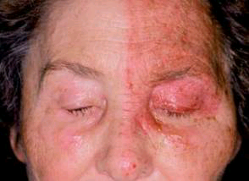

Slide 5
PATHOGENISIS
VZV is one of the human Herpes viruses.
It is a DNA virus
Incubation period is usually 14-15 days (ranges 10-20 days)
Initial site of infection is conjunctivae or URT
The virus then replicate for about 4-6 days at local site in head or neck
Then virus is transmitted throughout the body( primary viremia)
Notes:
The period between infection and appearence of rash

Slide 6
Cont...
Virus is released in large amount 1 week later after a second replication( 2ndry viremia) and invades the cutaneous tissues
When virus leave the capillaries and enter the epidermis, vesicles of chickenpox appear on skin

Slide 7
TRANSMISSION
Chickenpox is transmitted by droplets in respiratory secretions
Air current from an infected child to susceptible child carry these water droplets
Varicella is contagious from 24-48 hr before rash appear and while un-crusted vesicles are present which is usually 3-7 days

Slide 8
CLINICAL FEATURES
The characteristic feature of chickenpox is vesicle
Exanthum develop over 2-6 days.
Usually it begin along the hairline on the face
Rash begin as red macules that progresses to tiny vesicle with surrounding erythema (dew drops on rose petal
Then form pustules, become crusted,scabbed over and leave no scar
Then rash appear in successive crop over trunk and extremities

Slide 9
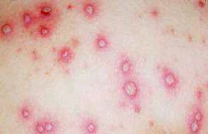

Slide 10
Cont...
In 1st week there are lesions in different stages of development (upto 5 crops of lesion may be seen)
Prodrome is mild with malaise and low grade fever
Temprature rises when pox appears
Temprature is above 102 F
Secondary cases (having an infected sibling) have a more severe disease

Slide 11
Cont..
Child become afebrile by the end of 1st week
Cutaneous lesions start crusting and become dry and fall off
Infant have more severe disease but due to persistant maternal antibody,chickenpox in 1st few months may be mild
Children on high dose steriod therapy are at greater risk of fatal chickenpox

Slide 12
COMPLICATIONS
Bacterial infection: of vesicular lesion is most frequent complication
Infecting organism are Group A streptococcus and staphylococcus (common)
Less common but more serious bacterial infections are toxic shock syndrome, sepsis,cellulitis,erysipelas, cutaneous abcesses,impetigo and suppurative lymphadenitis

Slide 13
Cont..
Viral sequalae : involve all systems
Most common is pnemonitis,
hepatitis,
arthritis,
pericarditis,
glomarulonephritis,
orchitis
Encephlitis (< 0.1% of cases)
usually in 1st week of illness
Notes:
It pesents as cerebritis with ataxia and resolve completely

Slide 14
Cont..
Purpura fulminans: large ecchymosis that appear on leg and may progress to haemorrhagic gangrene
Reyes Syndrome: protacted vomiting and change in sensorium with history of salisylate abuse

Slide 15
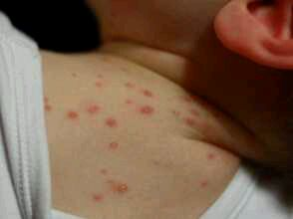
Perinatal varicella infection
If mother of a new born develops varicella 6 days before and 2 days after delivery,the baby will get severe and fatal disease
In such a newborn varicella zoster immune globulin and antiviral therapy should be given

Slide 16
DIAGNOSIS
Clinical examination ( characteristic rash)
WBC counts are normal to low.
Leucocytosis suggest secondary bacterial infection
On CXR, in varicella pnemonia,there are numerous bilateral nodular densities and hyperinflation
Virus can be identified by obtaining samples of vesicle for inoculation in cell culture

Slide 17
Cont..
Most reliable method for testing VZV humoral immunity are fluorescent antibody to membrane antigen(FAMA) and ELISA

Slide 18
D/D
Coxsackie virus infection: there are few lesions and no crusting
Impetigo: few lesions, perioral and peripheral lesions and no classic vesicle, lesions respond to antimicrobials
Papular urticaria: history of insect bite and rash is non vesicular
Scabies: burrows and no typical vesicles

Slide 19
TREATMENT
Chickenpox in a healthy child is not usually serious disease
Maintenance of hydration is important
Fever is treated with paracetamol.
Aspirins should not be given to avoid the risk of Reyes syndrome
Calamine lotion for pruritis
Diphenhydramine syrup to relieve discomfort of itching
Hygienic measures like nail trimmed and clean skin

Slide 20
Cont..
Antibiotics for secondary skin infection
For immunocompromised child or child with corticosteriods therapy VZIG should be given
There is no beneficial effect of VZIG after 4th day post exposure
In such cases acyclovir is given for 7 days
IV acyclovir block viral replication within 24-48 hrs ( S/creatinine every 3rd day)
Disease can be prevented by varicella vaccine not recommended under 1 yr of age
One dose of 0.5 ml is recommended after 1 yr of age

Slide 21
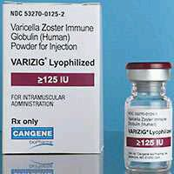
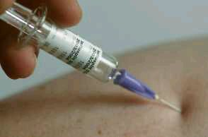
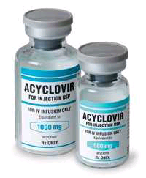

Slide 22
PROGNOSIS
Mortality rate in children is about 1:50,000 and in infant 1:13,000

