Slide 1
D e s i g n o f a i r c o n d i t i o n i n g d u c t s

Slide 2
Earlier the use of air-conditioning for
comfort purpose was considered a luxurious
but now-a-day, it has been a necessity in
extreme climatic conditions, such as
extreme cold and hot in western countries.
Window air conditioners are preferred for
office rooms while large centralized units
are installed for conditioning the
auditorium, hospitals etc.

Slide 3
A i r c o n d i t i o n i n g d u c t s
T h e p u r p o s e o f a i r c o n d i t i o n i n g
d u c t w o r k i s t o d e l i v e r a i r f r o m
t h e f a n t o t h e d i f f u s e r s w h i c h
d i s t r i b u t e t h e a i r t o t h e r o o m .
A i r M o v e s T h r o u g h t h e
D u c t w o r k i n R e s p o n s e t o a
P r e s s u r e D i f f e r e n c e C r e a t e d b y
t h e F a n

Slide 4
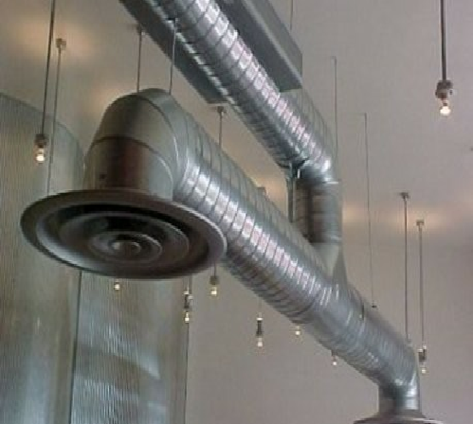
D u c t w o r k C o n s i d e r a t i o n s
S h a p e
S i z e
A s p e c t r a t i o
V e l o c i t y
S t a t i c P r e s s u r e

Slide 5
M a t e r i a l s
S h e e t m e t a l ( b y
g a u g e )
G a l v a n i z e d I r o n
A l u m i n u m
F l e x i b l e
■
I n s u l a t e d
T u b e ( s o c k s )
■
01
01
01
02
02
03
04
04
05
05
05
06

Slide 6
S h a p e a n d S i z e
Rectangular
Round
Oval

Slide 7
R e c t a n g u l a r
W
L o w e r a s p e c t r a t i o s
■
M o r e e n e r g y e f f i c i e n t
U s e l e s s d u c t w o r k
D
■
V e l o c i t y a n d A r e a h a v e
a n i n v e r s e r e l a t i o n s h i p
t o t h e C F M ( C F M = V x
A )
V e l o c i t y a n d P r e s s u r e
D r o p h a v e a d i r e c t
r e l a t i o n s h i p
1 to 1
Aspect ratio = W / D

Slide 8
A i r D i s t r i b u t i o n S y s t e m s
T h r e e T y p e s
S e r v i c e s
■
A b o v e C e i l i n g
D i s p l a c e m e n t
U n d e r f l o o r
S u p p l y a i r
R e t u r n a i r
V e n t i l a t i o n a i r
R e l i e f a i r
E x h a u s t a i r
■
■
■
■
■
■
■

Slide 9
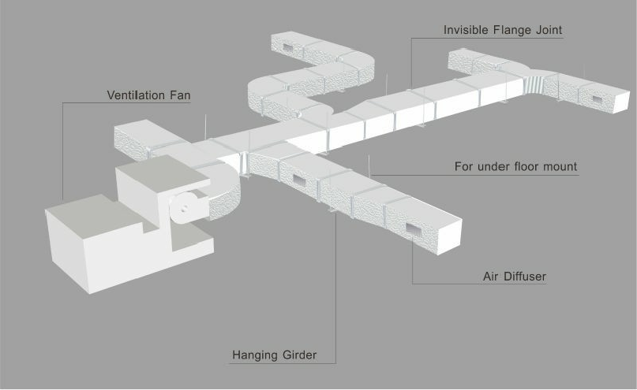
A b o v e C e i l i n g
D i s t r i b u t i o n S y s t e m
horizontal
horizontal
return
return
heat
heat pump
pump
duct
duct
return air
return air
grille
grille
supply
supply
duct
diffuser
duct
diffuser

Slide 10
O t h e r D e s i g n
C o n s i d e r a t i o n s
Thermal mass
Natural light
Solar shading
Control strategies
Life safety issues
Infiltration
Mixed Air
conditions
Energy in the air
Comfort level of
the air
The amount of
water in the air

Slide 11
D I S P L A C E M E N T
P R I N C I P L E S
•Conditioned air moves upward past the
persons breathing zone.
•This invisible plume continues an upward
movement toward the ceiling.
•A person will breathe lower contaminant
levels vs. a mixing design.

Slide 12
D i s p l a c e m e n t
Advantages/Disadvantages
Advantages
Moderate supply
Disadvantages
■
air temperature
Low velocity
■
Higher initial
■
cost
Less well
■
Air delivered to
the comfort zone
■
without mixing
Accommodate
understood
Too quiet
■
■
more outside air
for same energy
cost
Very quiet
■

