Slide 1
SOIL EROSION

Slide 2
Soil Erosion: Erosion is the loss of soil from the land. Or it is the process in which the top fertile layer of the soil is lost. Wind and water are constantly eroding the soil. Erosion occurs when soil is transported from one location by wind and water and moved to a new location such as rivers and soil lacks.

Slide 3
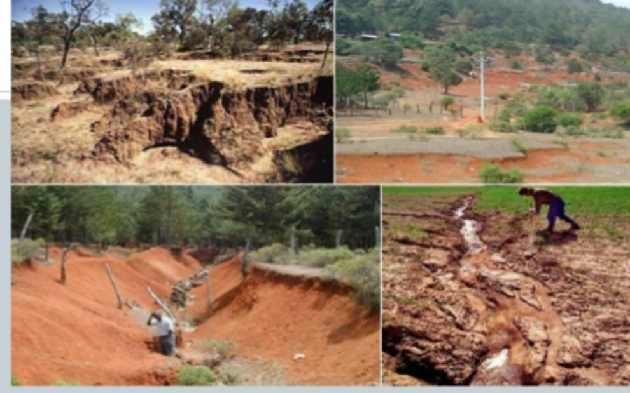
Soil erosion is a natural process occurs slowly enough that new soil can be made to replace it.

Slide 4
Soil Erosion Problems:
Soil is the most precious gift of nature -Prime resource-for food, fodder etc.
Soil mismanaged-less resource for food, fodder etc. Soil mismanaged less productivity

Slide 6
Causes of Soil Erosion: Natural factors Human factors Human factors in soil erosion: Deforestation Over grazing Construction activities Mining activities Defective methods of farming .

Slide 7
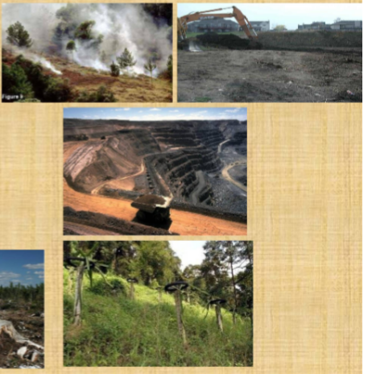

Slide 8
Types of soil erosion: Geological Erosion: It is a normal process, representing erosion of land in natural environment. It is caused by effect of Rainfall Run off Wind Topography

Slide 9
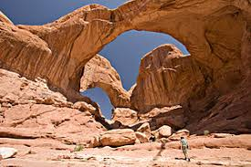

Slide 10
Accelerated Erosion: Accelerated erosion is due to man made activities, which have brought about changes in natural environment and soil condition. The activities includes Land preparation for raising crops. Land use patterns for building houses, industries, hill cutting, deforestation, lack of soil conservation.

Slide 11
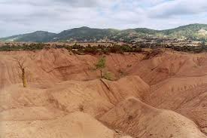

Slide 12
Wind Erosion: It is primary responsible for creation and maintenance of desert areas. Finer soil particles from top soil along with organic matter and nutrients are easily detachable and removed by wind velocity.

Slide 13
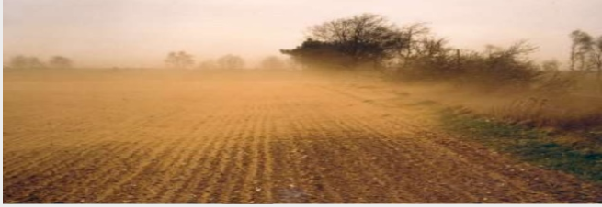

Slide 14
Water Erosion: The impact of rain drops causes splash erosion . Run off water causes scraping and transport of soil particles leading to sheet erosion and gully erosion . Flood water causes erosion of River banks and sides of reservoir, lakes and oceans.

Slide 15
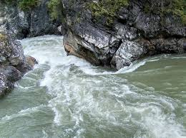

Slide 16
Sheet Erosion: Sheet erosion is the movement of soil by rain drops splash and runoff water. It typically occurs evenly over a uniform slope and goes unnoticed until most of the productive topsoil has been lost.

Slide 17
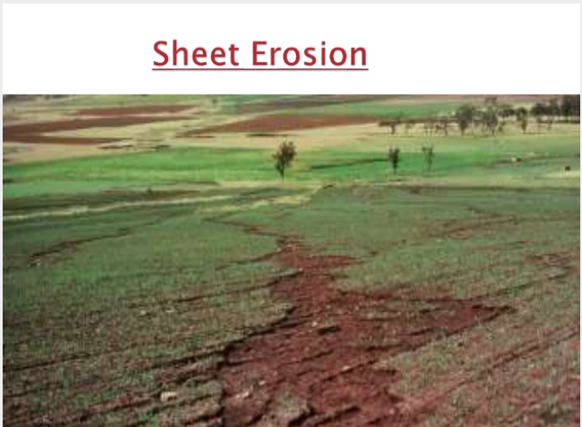

Slide 18
Rill Erosion: In general the sheet flow is carried out by very small definable channels called interrill. Detachment and transport of soil particles by concentrated flow of water; Predominant form of concentrated flow of water, Predominant form of erosion.

Slide 19
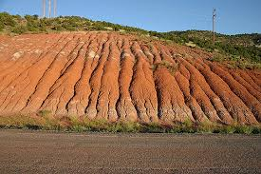

Slide 20
Problems of Soil Erosion : Loss in agricultural production Loss of nutrients Reduction of infiltration rates Flood may occur in rivers Decrease in useful life of reservoir Survival of wild life Land degradation Desertification

Slide 21
Effects of soil erosion: Loss of top soil: Obviously it is the biggest effect of soil erosion. Because it is very fertile layer and when it is removed, this can cause serious harm to farmer’s crops and the ability of the land to work.

Slide 22
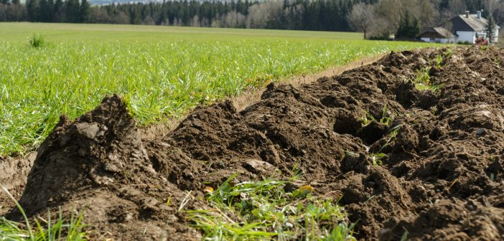

Slide 23
Soil Compaction: When soil under the top soil become compact and stiff, it reduces the ability for water to in filtrate in these deeper levels, which increase the risk of more serious erosion.

Slide 24
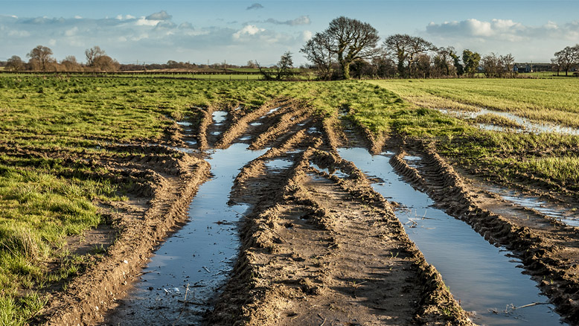

Slide 25
Reduced organic and fertile organic matter: As mentioned , removing top soil that is heavy in organic matter will reduce the ability for the land to regenerate new flora and crops.

Slide 26
Issues with plant reproduction: When soil is eroded in active crop land, wind in particular makes lighter soil properties such as new seeds and seedlings to be buried or destroyed.

Slide 27
Soil acidity level: When the structure of soil becomes compromised, and organic matter is generally reduced, there is higher chance of increase of soil acidity, which will significally impact the ability for plants and crops to grow.

Slide 28
Solutions to prevent soil erosion: Vegetation Contour Farming Build retaining walls Wind breakers Conservation tillage Mulching

Slide 29
Vegetation: The simplest and most natural way to prevent erosion. Plants establish root systems, which stabilizes soil and prevent soil erosion.

Slide 30
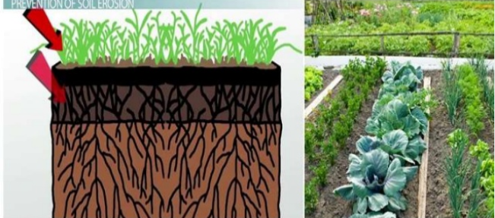

Slide 31
Soil stabilization: The plant root system bind the soil at the surface. Increase strength of the soil. Soil erosion by run off water and wind is decrease.

Slide 32
Contour Farming: Contour farming or Contour ploughing or Contour bunding is the farming practice of level rows around a hill, as opposed to farming up and down on the hill. It reduce; Amount and Velocity of water moving across the soil surface or hill surface.

Slide 34
Build retaining walls: A retaining wall is a structure that keeps soil, rock and water in place so that it won’t be wasted away from the rain. The retaining wall is to one of the purposes prevent soil that is eroded by wind, rain and flowing water, but in most likely to be due to the wind and rain.

Slide 36
Wind breakers: Field windbreaks are linear planting of trees designed to reduce wind speed in open fields, preventing soil erosion and protecting crops from wind damage. Field windbreaks are typically planted in multiple rows perpendicular to prevailing winds.

Slide 37
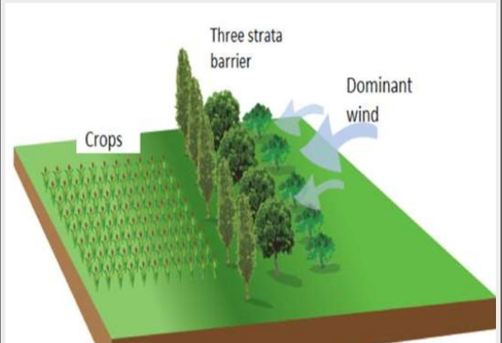

Slide 38
Windbreaks Reduce soil erosion from wind. Increased relative humidity. Reduce evaporation. Increased soil moisture. Protects crops from wind damage.

Slide 39
Conservation tillage: Conservation tillage is the method of soil cultivation that leaves of the previous year’s crop residue on fields before and after planting the next crop to residue soil erosion and runoff , as well as other benefits such as carbon store in soil.

Slide 40
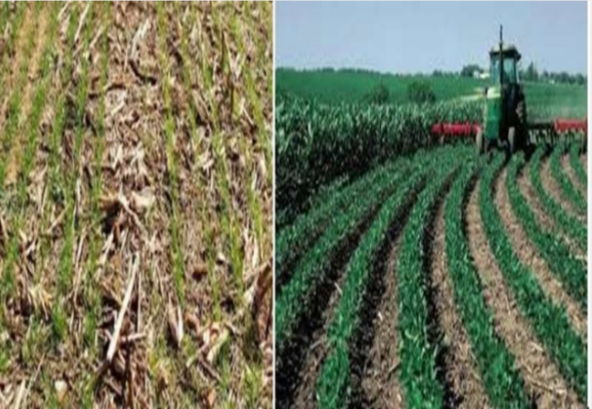

Slide 41
Mulching: In a mulching a material placed on the soil surface to maintain moisture, reduce weed growth, reduce soil erosion and improve soil conditions. Mulching can help to improve crop yield and optimize water use reduce oil and water erosion.

