Slide 1
PROCESSING TISSUES FOR HISTOTECHNOLOGY

Slide 2
PROCESSING TISSUES FOR HISTOTECHNOLOGY
INTRODUCTION
A series of processes are done on a tissue before a microscopic examination
Fixation
Dehydration
Clearing
Embedding
Cutting
Staining

Slide 3
PROCESSING TISSUES FOR HISTOTECHNOLOGY
PRESERVATION OF TISSUES
The aim of ideal fixation is to preserve the tissue in as lifelike manner as possible
Only the very rapid freezing of small pieces of tissues in iso-pentane in liquid nitrogen (-160℃) will actually achieve this purpose

Slide 4
PROCESSING TISSUES FOR HISTOTECHNOLOGY
DEFINITION OF FIXATION
This is the process by which the constituents of the cells, and therefore of the tissues, are fixed in a physical, and partly also in a chemical, state so that they will withstand subsequent treatment with various reagents.

Slide 5
PROCESSING TISSUES FOR HISTOTECHNOLOGY
FIXATION
Ideally a fixative should
Penetrate the tissue quickly
Be rapid in action
Be isotonic
Cause a minimum loss and minimum physical and chemical alteration of tissue and its components
Be cheap, stable and safe to handle
It should not bind with staining chemicals

Slide 6
PROCESSING TISSUES FOR HISTOTECHNOLOGY
EFFECTS OF FIXATIVES ON TISSUES
Most fixatives produce tissue hardening
Certain fixatives act as mordants for stains e.g., mercuric fixatives
They usually increase the optical differentiation of cell and tissue components
They render the cells insensitive to hypo- and hypertonic solutions
Microorganisms also get fixed and prevent decomposition

Slide 7
PROCESSING TISSUES FOR HISTOTECHNOLOGY
THE IDEAL FIXATIVE
1- Prevent autolysis and bacterial decomposition
2- Preserve tissue in their natural state and fix all components
3- Makes the cellular components insoluble to liquids encountered in the tissue processing
4- Preserves tissue volume
5- Avoid excessive hardness of fixed tissue
6- Allow enhanced staining of tissues
7- Be nontoxic and non-allergenic

Slide 8
PROCESSING TISSUES FOR HISTOTECHNOLOGY
GENERAL PRINCIPLES IN HANDLING AND FIXATION OF SPECIMENS
1- Amount of fixing fluid
It should be 10-20 times the volume of specimen
2- Surgical specimens
These should be placed in an adequate amount of fixative as soon as possible after removal
3- Autopsy material
Autopsy examination should be performed as soon after death as possible. Slices of organs taken at autopsy should be thin to facilitate fixation.

Slide 9
PROCESSING TISSUES FOR HISTOTECHNOLOGY
ROUTINE FIXATIVES
Formaldehyde ; Formalin
Metallic Fixatives ; include, Mercury fixatives, Chromate fixatives
Picric Acid Fixatives
Alcohol Fixatives

Slide 10
PROCESSING TISSUES FOR HISTOTECHNOLOGY
Formaldehyde ; Formalin
Commercial formaldehyde is a saturated solution of formaldehyde (H.CHO) gas in water, 40% gas by weight.
A mixture of 10mL formalin with 90mL of water and saline is known a 10 % formalin
Formation of para-formaldehyde
Formation of formic acid

Slide 11
PROCESSING TISSUES FOR HISTOTECHNOLOGY
Nature of Formalin Action
The aldehyde group in formalin permits many reactions with tissue components especially polymerization action.
Resulting in alteration in cell physio-chemistry
Reactivity of tissues towards certain histochemical stains alters
Such changes can be altered by washing the specimen with water or by putting the specimen in formalin for about 6-24 hours

Slide 12
PROCESSING TISSUES FOR HISTOTECHNOLOGY
Formalin fixation and temperature
A block of average tissue (not fatty) upto 4mm thick will be adequately fixed in 10-20 times its volume of buffered neutral formalin in about 8 hours at room temperature
Time can be shortened 25-40% if the fixative’s temperature is raised to 45℃

Slide 13
PROCESSING TISSUES FOR HISTOTECHNOLOGY
Advantages of formalin
Its cheap, easy to prepare and is relatively stable
No special preliminary procedure is done before staining
Frozen sections can be done more easily after formalin fixation
Staining of fat can be easily done after its use
Tissue enzyme study can be done
Tissue penetration is well. Rendering them neither much hard nor brittle
Natural tissue color can be restored with no great difficulty
It’s the best fixative for CNS

Slide 14
PROCESSING TISSUES FOR HISTOTECHNOLOGY
Disadvantages of Formalin
Dermatitis of hands
Its fumes cause irritation to the nostrils
Asthma in allergic individuals
The National Institute for Occupational Safety and Health (NIOSH)recommends that no worker be exposed to more than 1 part per million (ppm)of formaldehyde for any 30 minute period.
Reduction in pulmonary ventilating capacity is seen in industrial exposures.
It forms dark-brown artifact pigment granules in spleen

Slide 15
PROCESSING TISSUES FOR HISTOTECHNOLOGY
REMOVAL OF FORMALIN PIGMENT
Its relatively simple and is achieved by either of the following methods
Kardasewitsch’s Method.
1. Bring sections down to water
2.Place the sections for 5 minutes to 3 hours, depending on amount of pigment, in a mixture of
70% ethyl alcohol 100 ml
28% ammonia water 1 or 2 ml
3. Wash thoroughly in water

Slide 16
PROCESSING TISSUES FOR HISTOTECHNOLOGY
Lillie's Method.
After bringing down to water, place the sections for 1 to 5 minutes in a mixture of
Acetone 50 ml
3 vol hydrogen peroxide 50 ml
28% ammonia water 1 ml
This should be followed by washing in 70% alcohol and then in running water.
Picric Acid.
Place sections (after bringing to water) in a saturated alcoholic solution of picric acid for 5 minutes to 2 hours. Then wash for 10 to 15 minutes in running tap water.

Slide 17
PROCESSING TISSUES FOR HISTOTECHNOLOGY
Routine Formalin Fixatives
Traditionally formol-saline (usually buffered) has been the most commonly used fixative in pathology.
10% Formol-Saline
Water (preferably distilled) 900 mL
Sodium chloride 8.5 g
Formalin 100 mL
For better results, however, one should use buffered neutral formalin as recommended by Lillie.
10% Buffered Neutral Formalin Water (distilled) 900 mL
NaH₂PO4 (anhydrous) 3.5 g Na₂HPO4. (anhydrous) 6.5 g Formalin 100mL

Slide 18
PROCESSING TISSUES FOR HISTOTECHNOLOGY
For the hydrated salts the quantities are:
NaH₂PO4 .H₂0 4.02 g
Na₂HPO4· 12H₂0 16.37g/L
Storage of specimens in 10% buffered formalin is suitable for most routine purposes, but the use of 70% ethyl alcohol or 10 to 20% diethylene glycol in water is considered better because, even with buffered formalin, there is gradual loss in basophilic staining of the cytoplasm and nucleus, together with loss in reactivity of myelin to the Weigert iron hematoxylin method.

Slide 19
PROCESSING TISSUES FOR HISTOTECHNOLOGY
Formalin and Lipids
It is largely inert towards lipids
It fixes some complex and unsaturated lipids
Neutral fats remain unaltered
Formol-mercuric chloride is better
Chromation after use of calcium cobalt will cause even more lipids to be retained in liquid paraffin sections
Due to its polymerizing action, formalin tends to reduce the PAS positivity of reactive mucin

Slide 20
PROCESSING TISSUES FOR HISTOTECHNOLOGY
Secondary Fixation (postmordanting)
Some laboratories use this technique for special purposes e.g., metachromasy, trichrome staining, and for the chromaffin reaction.
Secondary fixation.
Blocks that have been in formalin for 1 to 4 hours are placed for 4 to 6 hours in Helly’s fulid, or preferably, for 4 to 16 hours in formol-mercuric chloide.
Mercuric chloride 30 g
Distilled water 900 ml
Formalin 100 ml

Slide 21
PROCESSING TISSUES FOR HISTOTECHNOLOGY
Metallic Fixatives
1- Mercury Fixatives
2- Chromate Fixatives

Slide 22
PROCESSING TISSUES FOR HISTOTECHNOLOGY
MERCURY FIXATIVES
Formulas of Mercuric Salt Fixatives ZENKER'S
Mercuric chloride (HgCI₂) 50 g
Potassium dichromate 25 g
Sodium sulfate (often omitted) 10 g
Distilled water 1000 mL
Add 50 mL (5 mL/dL stock) of glacial acetic acid just before use.
After treatment with Zenker's fixative the potassium dichromate deposit should be removed by washing the tissue in running water for at least an hour (preferably overnight) before dehydration and the removal of the mercuric deposit. The tissue blocks are then placed in 70% ethanol.

Slide 23
PROCESSING TISSUES FOR HISTOTECHNOLOGY
SCHAUDlNN'S "SUBLIMATED ALCOHOL"
Mercuric chloride 3 g
Distilled water 50 mL
Dissolve the HgCl₂ in the water by shaking, and then add 25 mL of absolute ethyl alcohol. This is probably the most useful fixative for making smears of loose cells on a slide, following which they are less likely to detach during staining than with any other fixative.

Slide 24
PROCESSING TISSUES FOR HISTOTECHNOLOGY
Chromate fixatives
2.5% Potassium dichromate (K₂Cr₂0₇), aqueous 100 mL Sodium sulfate (optional) 1 g Add, just before using, Formalin solution 10 mL
Regaud's (Moller's) Fluid
3% Potassium dichromate 80 mL Add, just before using Formalin 20 mL

Slide 25
PROCESSING TISSUES FOR HISTOTECHNOLOGY
PICRIC ACID FIXATIVES
Brasil’s Alcoholic Picro-Fromol Fixative
The following is a modified Brasil formula
Formalin 2040 mL
Picric acid (BDH: 50% water) 80g
Ethanol or isopropyl alcohol 6000 mL
Trichlro-acetic acid 65 g

Slide 26
PROCESSING TISSUES FOR HISTOTECHNOLOGY
ALCOHOLIC FIXATION
It denatures and precipitates protein
Methyl alcohol 80-100% is an excellent fixative for smears
In concentrations below 80% it is of causes lysis of cells
Ethyl alcohol is used for fixation of enzymes
Unless used at 0℃ or cooler it causes severe shrinkage
They are contraindicated when lipids are to be studied

Slide 27
PROCESSING TISSUES FOR HISTOTECHNOLOGY
SPECIAL FACTORS AFFECTING FIXATION
Size and thickness of piece of tissue
Tissues covered by or containing mucus are fixed slowly and poorly e.g, pseudomucinous cyst
The same applies to blood containing organs like lungs
Fatty and lipomatous tissue fix slowly. So, the blocks should be thin
Moderate heat (37 to 56℃) will accelerate fixation
Fixation is also accelerated by agitation

Slide 28
PROCESSING TISSUES FOR HISTOTECHNOLOGY
COMPATIBILITY AND INCOMPATIBILITY OF FIXATIVES AND STAINS
Few fixatives permit the use of all stains
One and the same fixative may act as mordant for one group of dyes and an inhibitor for another set of stains
With some fixatives must be thoroughly washed from the tissues before many stains may be used

Slide 29
PROCESSING TISSUES FOR HISTOTECHNOLOGY
SOFTENING HARD TISSUES
Some tissues like cervix, fibroids, some hyperkeratotic skin lesions, and finger nails
Lendrum’s method is used for softening such tissues before processing
Benzene or chloroform instead of xylene will reduce hardness

Slide 30
PROCESSING TISSUES FOR HISTOTECHNOLOGY
DECALCIFICATION
The cutting of thin sections by ordinary methods is impossible in the case of bone, teeth, also many calcified pathological lesions seen in tuberculous foci or calcified atheromas
Acids are used in which bone salts are dissolved
All such acids damage the ground substance of the bone
So 2-4 mm thick blocks are fixed in a buffered neutral formalin for 2-4 days or in Zenker’s solution for 15-24 hours
It will render the nucleic acid resistant to hydrolytic action of acids

Slide 31
PROCESSING TISSUES FOR HISTOTECHNOLOGY
DECALCIFICATION
Heat will accelerate the process of demineralization but it will also increase the destructive action of acid on matrix
Effect of agitation is little in acid solution
Use of partial or complete vacuum is same

Slide 32
PROCESSING TISSUES FOR HISTOTECHNOLOGY
DECALCIFICATION
Usually 2 types of acids are used for decalcification purposes
1- Nitric acid
2- Formic acid
The volume of decalcifying solution should be at least 1 oz per g of tissue
It should be changed once or twice a day until decalcification is completed
The bone block should rest on a gauze platform supported by a glass rod in the middle of the fluid in glass jar

Slide 33
PROCESSING TISSUES FOR HISTOTECHNOLOGY
DECALCIFICATION
TESTS FOR COMPLETION OF DECALCIFICATION
By touch, pliability, and resistance to finger nail
By needling, by x-ray, or by chemical testing of decalcifying fluid
Chemical testing
In a clean test tube place decalcifying fluid for 3-12 hours
Alkalinize the litmus paper by carefully adding ammonia water
Add 0.5ml saturated ammonium oxalate, mix and let it stand for 15-30 minutes

Slide 34
PROCESSING TISSUES FOR HISTOTECHNOLOGY
DECALCIFICATION
If fluid remains clear, decalcification is completed
If cloudiness appears, it means decalcification is not complete

Slide 35
PROCESSING TISSUES FOR HISTOTECHNOLOGY
PARAFFIN SECTIONS OF ASPIRATED BONE MARROW
It is usually obtained by aspiration needle
Sternal puncture is done
Smears are done as soon as possible from freshly obtained marrow
The left over is placed in 50-100mL of fixative

Slide 36
PROCESSING TISSUES FOR HISTOTECHNOLOGY
FIXATIVE FOR ASPIRATED BONE MARROW
Formaldehyde (40) % 200ml
Glacial acetic acid 165ml
Sodium sulfate 60gm
Distilled water 1000ml

Slide 37
PROCESSING TISSUES FOR HISTOTECHNOLOGY
PROCESSING OF ASPIRATED FRAGMENTS
Place the aspirated fragments in 50-100 ml of fixative. Mix by inversion or by figure-of-8 motion. Allow to fix for 30-60 minutes
Pour off the bulk of the supernatant fixative and place the remainder, together with the marrow fragments, in a petri dish on a black background
Using Pasteur pipette select all the white marrow fragments and place in a test tube. As soon as the fragments have settled, aspirate the remainder of the fixative with the pipette

Slide 38
PROCESSING TISSUES FOR HISTOTECHNOLOGY
Fill the tube to within ½ cm of top with 50% ethyl alcohol. Stopper and mix by inversion. Let stand 20 minutes; pipette off the supernatant
Replace with 70% alcohol . Let stand 20 minutes; pipette off the supernatant
Replace with 90% alcohol for 15 minutes
Replace with absolute alcohol for 15-20 minutes
Replace with fresh absolute alcohol for 15-20 minutes
Replace alcohol xylol. Stand 1 hour
Replace with fresh xylol. Let it stand for 1-2 hours

Slide 39
PROCESSING TISSUES FOR HISTOTECHNOLOGY
Pipette off the xylol. Place the tube in wax oven and fill with molten wax. Let it stand for 1 hour in the oven
Replace with fresh wax and allow to remain in the wax oven for 1-2 hours more
Replace with fresh embedding wax; remove from the oven and allow to set
Immerse for 5 minutes in cold tap water to harden
Carefully break the tube, removing all fragments of glass. Mount the block ready for sectioning

Slide 40
PROCESSING TISSUES FOR HISTOTECHNOLOGY
AUTOMATED TISSUE PROCESSING
Dehydration, clearing and preparation for embedding are usually accomplished by the use of automated tissue processors
They work on the principle of a central, rotating spindle that carries a “basket” suspended from the outer end of a radial arm. The spindle is automatically lowered, bringing the basket into the solution.

Slide 41
PROCESSING TISSUES FOR HISTOTECHNOLOGY
AUTOMATED TISSUE PROCESSING
A short, repetitive, up an down motion of the entire head assembly or arm, or a separate motor on the basket-carrying arm, continuously moves the basket in the solutions
This movement is important as it speeds up the interchange between chemicals and tissues
2 metal beakers or containers hold the wax, which is kept molten and at a constant temperature by thermostats within the walls of the beakers

Slide 42
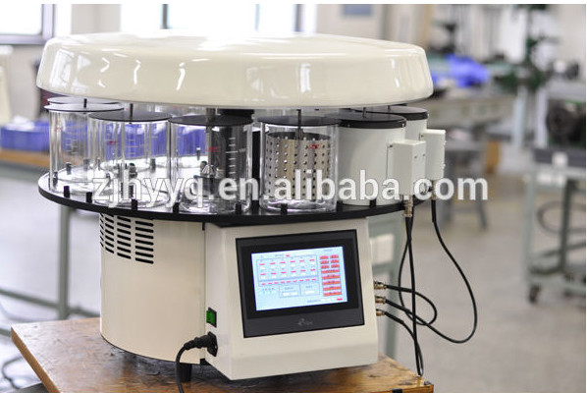

Slide 43
AUTOMATED TISSUE PROCESSING
16- Hour Schedule
Starting time: 4 P.M.
10% (buffered neutral formalin 4 hr
Changed daily
70% Ethyl alcohol 1 hr
80% Ethyl alcohol 1 hr
90% Ethyl alcohol 1 hr
100% Ethyl alcohol 1 hr
100% Ethyl alcohol 1 hr
100% Ethyl alcohol 1 hr

Slide 44
AUTOMATED TISSUE PROCESSING
Toluene or chloroform 1 hr
Toluene or chloroform 1 hr
Toluene or chloroform 1 hr
Wax Paraplast 1 hr
Wax Paraplast 2 hr

Slide 45
PRINCIPLES OF TISSUE PROCESSING

Slide 46
PRINCIPLES OF TISSUE PROCESSING
Tissue processing is designed to remove all extractable water from the tissue, replacing it with a support medium that provides sufficient rigidity to enable sectioning of the tissue without damage or distortion.

Slide 47
PRINCIPLES OF TISSUE PROCESSING
Stages of tissue processing are:
dehydration: removal of water and fixative from the tissue
clearing: removal of dehydrating solutions. making the tissue components receptive to the infiltrating medium
infiltrating: permeating the tissue with a support medium
embedding: orienting the tissue sample in a support medium and allowing it to solidify

Slide 48
Factors influencing the rate of processing
When tissue is immersed in fluid, interchange occurs between the tissue and the surrounding fluid. Several factors influence the rate at which interchange occurs.
Agitation
Heat
Viscosity
Vacuum
Fixation
Dehydration

Slide 49
Agitation
The rate of fluid exchange is dependent upon the exposed surface of the tissue that is in contact with the processing reagent.
Agitation increases the flow of fresh solutions around the tissue.
Automated processors incorporate vertical or rotary oscillation or pressurized removal and replacement of fluids at timed intervals as the mechanism for agitation.
Efficient agitation can reduce the overall processing time by 30%.

Slide 50
Heat
Heat increases the rate of penetration and fluid exchange.
It must be used sparingly to reduce the possibility of shrinkage, hardening, and brittleness of the tissue.
Temperatures limited to 45°C can be used effectively; higher temperatures may be deleterious to subsequent immuno-histochemical staining.

Slide 51
Viscosity
Viscosity is the property of resistance to the flow of a fluid. The smaller the size of the molecules in the solution, the faster the rate of fluid penetration (low viscosity).
Embedding mediums have varying viscosities. Paraffin has a lower viscosity in the fluid (melted) state, enhancing the rapidity of the impregnation.

Slide 52
Vacuum
Using reduced pressure to increase the rate of infiltration decreases the time necessary to complete each step in the processing of tissue samples.
Vacuum used on the automated processor should not exceed 15 inches of Hg (mercury) to prevent damage and deterioration to the tissue. Vacuum can aid in the removal of trapped air in porous tissue.
Impregnation time of dense, fatty tissue can be greatly reduced with the addition of vacuum during processing.

Slide 53
Fixation
Preserving cells and tissue components with minimal distortion is the most important step in the processing of tissue samples
Fixation stabilizes proteins, rendering the cell and its components resistant to further autolysis by inactivating lysosomal enzymes, and changes the tissues receptiveness to further processing. Fixation must be complete before subsequent steps in the processing schedule are initiated.

Slide 54
Maintenance of Automated Processor
An adequate exhaust ventilating system
Electrical supply should be ensured
An automatic switch to an emergency generator in case of a power failure
All beakers should be kept filled with correct strength fluids to correct levels
Beakers are firmly placed
Any spillage should be cleaned immediately
Temperatures of paraffin wax containers is maintained by an electrical supply, so that it is molten all the time

Slide 55
DEHYDRATION
The first stage of processing is the removal of unbound water and aqueous fixatives from the tissue components.
Many dehydrating reagents are hydrophilic ('water loving') possessing strong polar groups that interact with the water molecules in the tissue. Other reagents affect dehydration by repeated dilution of the aqueous tissue fluids. Dehydration should be accomplished slowly.

Slide 56
DEHYDRATION
If the concentration gradient between the fluid inside and outside the tissue is excessive, diffusion currents cross the cell membranes during fluid exchange, increasing the possibility of cell distortion.
For this reason specimens are always processed through a graded series of reagents of increasing concentration.
Excessive dehydration may cause the tissue to become hard, brittle, and shrunken.

Slide 57
DEHYDRATION
Incomplete dehydration will prohibit the penetration of the clearing reagents into the tissue, leaving the specimen soft and non-receptive to infiltration.
There are numerous dehydrating agents: ethanol, ethanol acetone, methanol, isopropyl, glycol and denatured alcohols.
If the dehydrant of choice is ethanol, the tissue is first immersed in 70% ethanol in water, followed by 95% and 100% solutions. For delicate tissue it is recommended that the processing start in 30% ethanol.

Slide 58
Ethanol C₂H₅0H
This is a clear, colorless, flammable liquid.
It is hydrophilic, miscible with water and other organic solvents, fast acting, and reliable.
Ethanol is taxable controlled by the federal government, and requires careful record keeping.
Graded concentrations of ethanol are used for dehydration. Ethanol ensures total dehydration, making it the reagent of choice for the processing of electron microscopy specimens.

Slide 59
Industrial methylated spirit ( denatured ethyl alcohol)
This has the same physical properties as ethanol. Denatured alcohol consists of ethanol, with the addition of methanol (about 1 %), isopropyl alcohol, or a combination of alcohols. For purposes of tissue processing it is used in the same manner as ethanol.

Slide 60
Methanol
This is a clear, colorless and flammable fluid which is highly toxic
It is miscible with water, ethanol, and most organic solvents.
It can be substituted for ethanol.

Slide 61
Acetone CH₃COCH₃
Acetone is a clear, colorless, flammable fluid, very volatile, miscible with water, ethanol, and most organic solvents.
It is rapid in action, with poor penetration, and causes brittleness in tissues if use is prolonged. Acetone removes lipids from tissue during processing.

Slide 62
Additives to dehydrating agents
When added to dehydrating agents such as phenol acts as a softening agent for hard tissues e.g; tendons, nail, dense fibrous tissue, and keratin masses.
A 4% solution is added to each of the 95% ethanol stations.
Alternatively, hard tissue can be immersed in a glycerol-alcohol mixture.

Slide 63
CLEARING
A clearing reagent acts as an intermediary 'between the dehydration and infiltration solutions. It should be miscible with both solutions. Most clearants are hydrocarbons with refractive indices similar to protein.
When the dehydrating agent has been entirely replaced by most of these solvents the tissue has a translucent appearance, hence the term 'clearing agent'.

Slide 64
The criteria for choosing a suitable clearing agent are:
rapid removal of dehydrating agent
ease of removal by melted paraffin
minimal tissue damage
flammability
toxicity
cost.

Slide 65
Most clearing agents are flammable liquids, which warrants caution in their use.
The boiling point of the clearing agent gives an indication of its speed of replacement by melted paraffin.
Fluids with a low boiling point are generally more readily replaced.
Viscosity influences the speed of penetration of the clearing agent.
Prolonged exposure to most clearing agents causes the tissue to become brittle.

Slide 66
Clearing agents
Xylene (Xylol)
Its an excellent and true clearing agent
Its cheap
A flammable, colorless liquid with a characteristic petroleum or aromatic odor.
Its miscible with most organic solvents and paraffin.
Suitable for blocks that are less than 5 mrn in thickness.
Over-exposure during processing will cause over-hardening.
Its not suitable for lymph nodes and brain
Xylene is commonly used in routine histology laboratories and is recyclable.

Slide 67
Toluene (Toluol)
Similar properties to xylene.
Although it is less damaging with prolonged immersion of tissue.
It is flammable and more volatile than xylene.
Its slower in action than xylene
Its fumes may be toxic

Slide 68
Chloroform
Chloroform is slower in action than xylene but causes less brittleness. Thicker tissue blocks can be processed
Tissues placed in chloroform do not become translucent.
It is non-flammable but highly toxic. It must be used in tightly closed containers.
Phosgene gas is given off when chloroform is heated.
Often used when processing specimens of the central nervous system, lymph nodes, and embryos.

Slide 69
Safety
Every histology laboratory should have a chemical hygiene plan that incorporates specific work practices to protect workers from potentially hazardous chemicals.
Information sheets should be available for all the chemicals used in the laboratory.
The basic information includes exposure limits and target organs, storage, disposal, and how to handle spills.
These sheets are placed in an easily accessible place for quick reference.

Slide 70
Impregnation and embedding
This process involves the impregnation of the tissues with a medium that will fill all natural cavities, spaces and interstices of the tissues, even the spaces within the cell constituents that will allow the cutting of suitably thin sections without undue distortion of tissue and cell elements
2 methods of embedding are used
Paraffin wax embedding
Celloidin embedding
Volume of the impregnating medium should be at least 25 times the volume of tissue

Slide 71
Impregnation and embedding
Impregnation with paraffin wax or Paraplast is done by immersion in a succession of molten wax baths.
It is usually done by agitation on an automatic tissue processor
Following impregnation, tissues are embedded in a wax block that enables them to be cut into thin sections (2-8 microns thick) on a microtome
If temperature in the laboratory is high then blocks may be cooled in the refrigerator before cutting and further cooled with ice cubes during cutting

Slide 72
Impregnation and embedding
SUBSTITUTES FOR PARAFFIN WAX
Paraplast
Carbowax
Resin-Paraffin Additives

Slide 73
Impregnation and embedding
Disadvantages of wax
Insufficient impregnation with wax will produce a “moist” block that tends to crumble and that smells of the clearing agent
Prolonged wax impregnation, on the other hand, will give a tissue block that is hard and unduly shrunken

Slide 74
Blocking Out Molds
These may be of many types
Leuckhart’s embedding irons
Trays or cups
Tissue-Tek system
Peel-A-Way
TIMS tissue processing and embedding system

Slide 75
Blocking Out Molds
The wax is kept molten in a wax oven
The final wax beaker is moved to sit-down work bench
The small metal buttons are fished out containing the tissue
The button is opened, the number is noted and a suitable mold is chosen and marked with the number
The mold is then filled with molten wax, the tissue is picked up with a blunt foreceps and is placed in the mold of molten wax

Slide 77
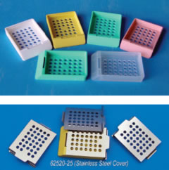

Slide 78
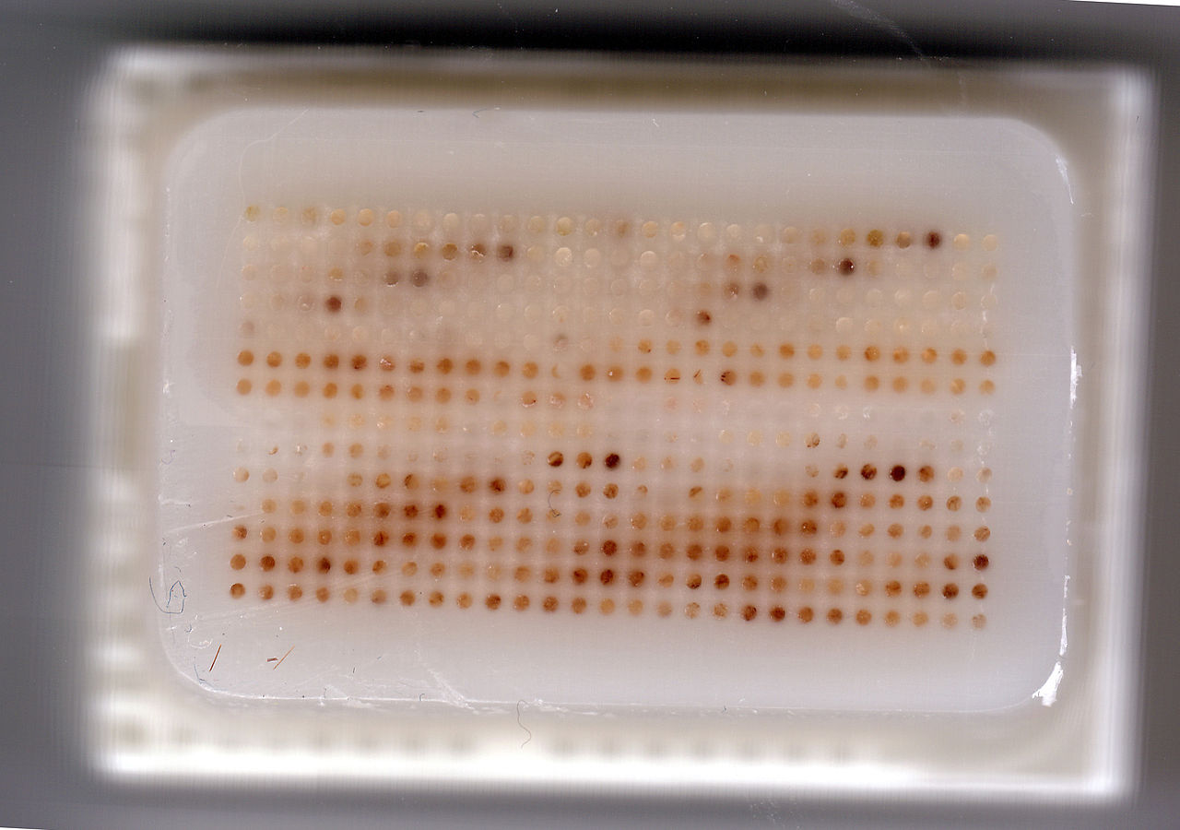

Slide 79
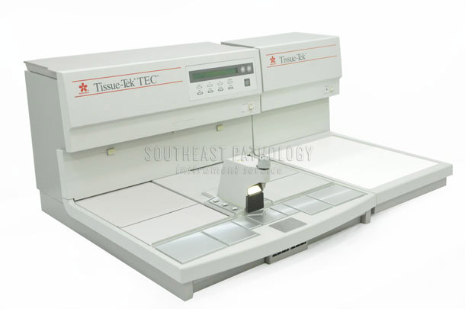

Slide 80
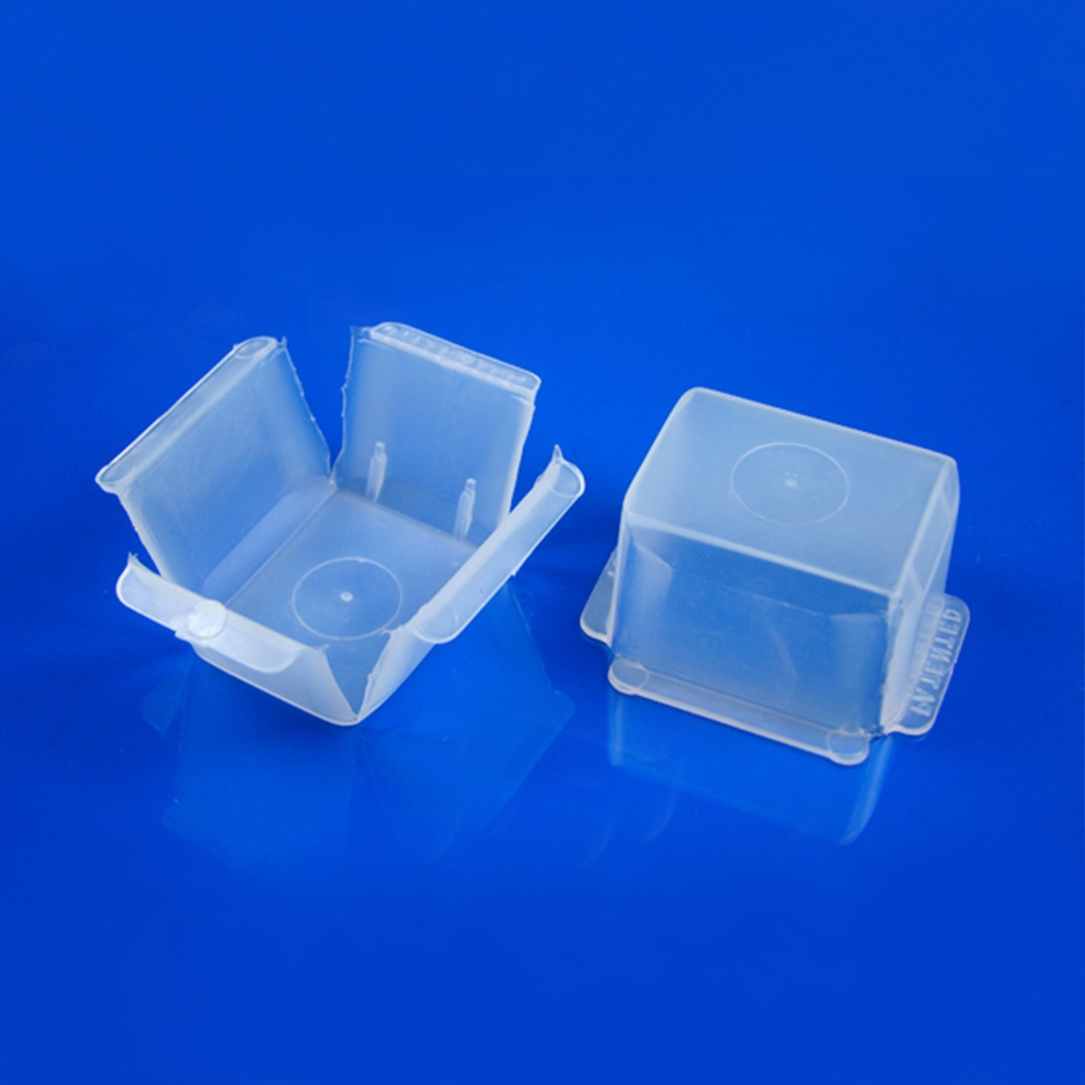

Slide 81
Blocking Out Molds
In case of a cyst, the walls of a cyst must be embedded edge down and biopsies of skin must be embedded so that the plane of skin surface is vertical to the bottom of mold
Its often necessary to press down the tissue specimen in the mold for a few seconds until it is held by the cooling wax
When the tissue blocks have thus been embedded, the cups should be kept in a basin of cold water or in refrigerator

Slide 84
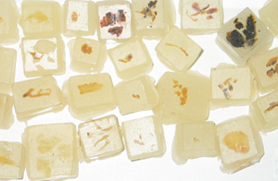

Slide 85
Trimming of Blocks
When the blocks have hardened in the cold water they are removed, the number is noted, and the mold is removed
If necessary, excess wax is removed
So, the block forms a prism or a truncated pyramid, the opposite sides being parallel
At least 2mm of wax must surround the tissue block
The small paper tag bearing the number must then be affixed to the tissue block

Slide 86
Section Cutting
MICROTOMES
These are machines or instruments design for accurate cutting of thin slices or sections of tissue
Many types of microtomes are used
1- Sliding
2- Rotary
3- Rocker
4- Freezing
5- Ultra-thin section

Slide 89
Section Cutting
Microtome Knives
Most knives are wedge shaped
The sides of wedge knives are inclined at an angle of approximately 15 degrees
Surfaces of these knives are highly polished so that the sections will not adhere to them but will move on the surface
It will reduce the chance of folding, distortion, and sticking and facilitating formation of good ribbon
Missed sections or alternatively thick or thin sections are the result of neglecting to allow a proper angle or clearance between the block surface and the cutting facet
Normally the plane of knife edge is at right angle to the plane of cutting

Slide 90
Section Cutting
Sharpening of Microtome Knives
Hand Sharpening
By hones
By plate glass and abrasives
Automatic Hones
Factory Grinding of Microtome Knives
Stropping

Slide 91
Section Cutting
Sharpening of Microtome Knives
By Hones
A hone also called oil stone is a natural stone or hard grinding surface for sharpening a knife or for other cutting tools
Good quality hones are expensive
Finer grains or hard hones are considered good quality stones
Carborundum hones, Arkansas stones (yellow Belgian and Belgian Black) are its examples
It is good to take combination hones

Slide 92
Section Cutting
Sharpening of Microtome Knives
Plate Glass Honing
This is excellent
A piece of plate glass ¼ to 3/8 inch thick, about 14 inch long and 1-2 inch wider than the length of knife blade is used
Abrasive powder is used for grinding and removing nicks

Slide 93
Section Cutting
Factory grinding of microtome knife
Stroping
A perfectly honed knife does not require stropping
Strops should be of the best quality shell-horse leather made from the rump or thick part of horse hide
The strop surface must be of good size and be mounted on a wooden block
2 types of Leather strops have to be mounted on a wooden block
The one with fine leather and the other impregnated with a fine abrasive like diamond dust

Slide 94
Cryostat machine

Slide 95
FROZEN SECTIONING
Advantages of frozen and cryostat sections
For certain staining procedures, e.g., the demonstration of fat by the oil O red method, for silver impregnation methods, and for certain methods in CNS frozen sections are required
They are indispensible in rapid diagnosis during operations
All enzymes except phosphatases are best studied in frozen sections

Slide 96
FROZEN SECTIONING
Disadvantages
It is almost impossible to obtain serial sections
Because of lack of an embedding mass, structural details tend to be somewhat distorted during cutting and handling
Staining of frozen sections of unfixed tissue is rarely as satisfactory as that obtained with properly stained material
Freezing artifact may be produced by presence of; ice crystals in the tissue, nuclear ballooning and vacuolation and separation of mucosal or epithelial surfaces

Slide 97
FROZEN SECTIONING
THE CRYOSTAT
It maintains the tissue block, knife, and section at the same temperature
It does this by housing the entire operation in an insulated, thermostatically controlled, refrigerated cabinet
Temperature control range varies from +10 to -30℃
The cryostat should be left on at all time, since several hours are required to obtain operating temperature from a room temperature start

Slide 98
FROZEN SECTIONING
Because of differences in composition, cellularity, connective tissue and fat content, the optimum temperature varies
Brain, lymph-nodes, liver, spleen, kidney, testis, uterine curettings, soft cellular tumors and thyroid sections best at -5 to -25℃
Muscle, connective tissue, cervix, uterus, skin, non fatty breast tissue, ovary, tongue, prostate and gut sections best at-15 to -25℃
Fatty tissue from skin, breast, omentum best at about -35℃. These tissues may be quickly frozen in CO2- freezing chamber before putting them in cryostat

Slide 99
FROZEN SECTIONING
A suitable block of fresh tissue is selected and trimmed with a sharp scalpel
Block should be 2-4 mm thick
Blocks are then put in O.C.T compound( water, 20-30% bovine albumin, and von Apathy s gum syrup )
Small fragments of tissue are placed on a thick base of O.C.T compound
Tissue blocks are then surrounded and covered with a matrix of O.C.T. compound and placed in freeze shelf of cryostat, where they will become adequately cooled and frozen in 1-3 minutes

Slide 100
FROZEN SECTIONING
Now tissue blocks are put in a microtome. Using manual or quick advance, trim the blocks until desired tissue section is obtained
At this point it is good to close the cabinet for a minute or 2 to allow temperatures to equilibrate, using this time to get slides and stains ready
Cryostats cuts individual sections not the ribbon
Then cryostat is opened and a clean glass slide is put under the section
No adhesive material is used, fresh unfixed tissue will adhere with slide easily
Hematoxylin-eosin and polychrome methylene blue staining techniques are more commonly used for frozen sections

