Slide 4
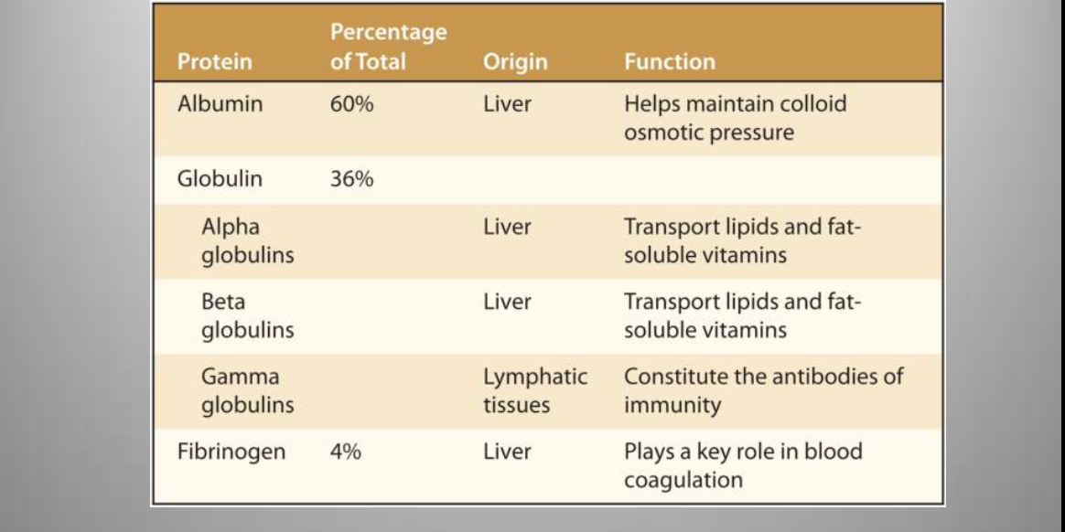

Slide 6
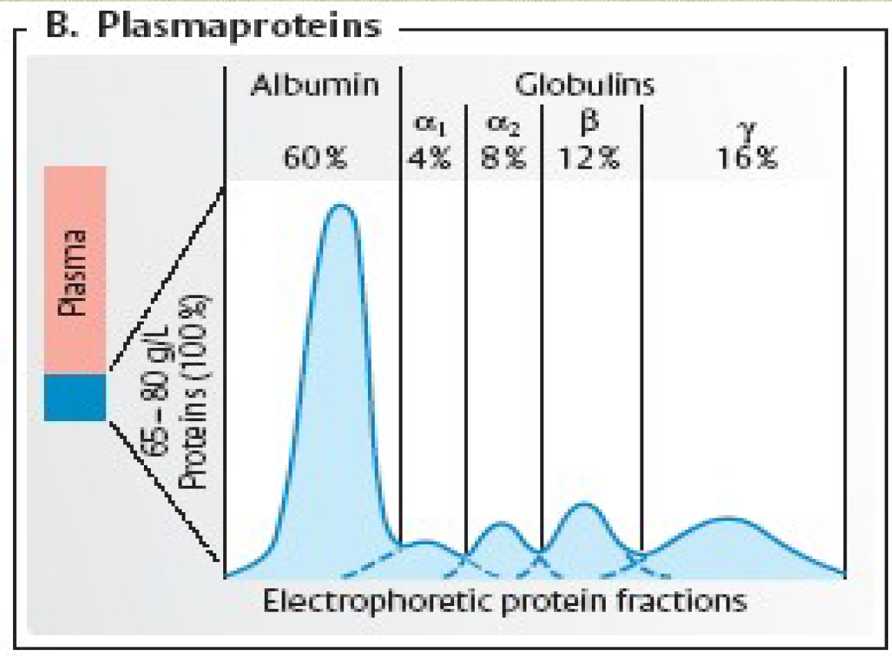

Slide 12
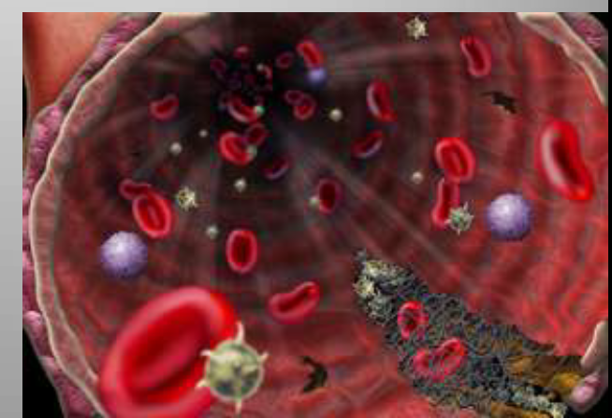
Hemostasis refers to the stoppage of bleeding
• Actions that limit or prevent blood loss include:
1. Blood vessel spasm (vasospasm)
2. Platelet plug formation
3. Blood coagulation

