Slide 1
Powdery Mildew of Mango

Slide 2
Importance
Serious disease
Occurs regularly in Pakistan
100% incidence in some orchards
Sporadic in world

Slide 3
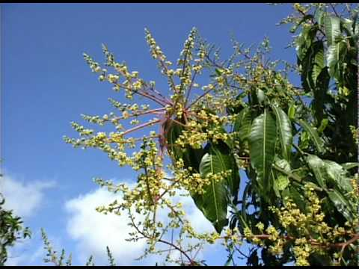
Description
It infects panicles
flowers, flower stalks, and young fruits
Leaves
Poor fruit set, heavy flower and fruit drop

Slide 4
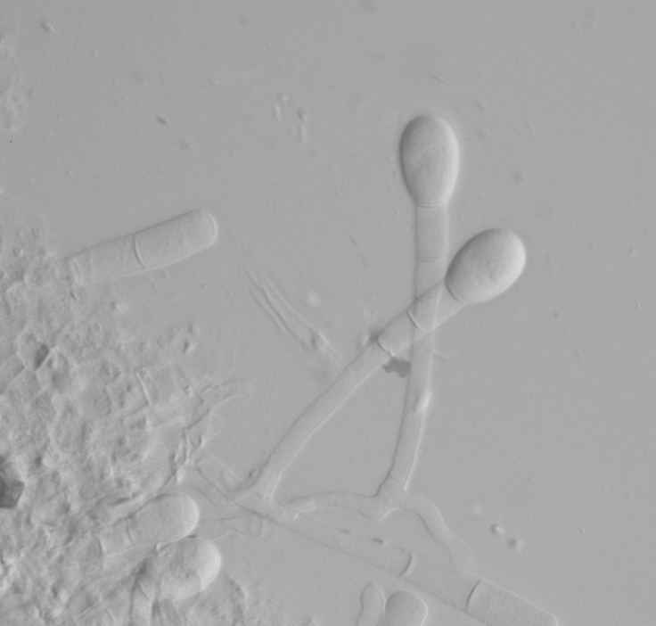
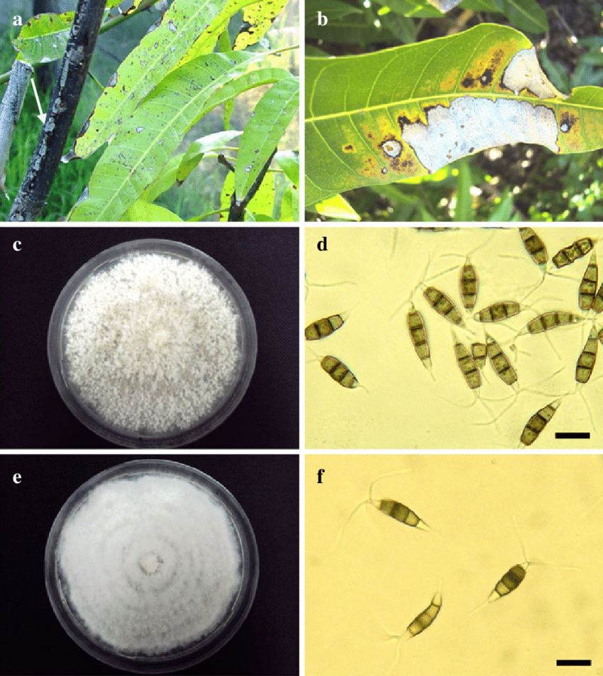
Etiology
Causal organism: Oidium mangiferae
Order: Erysiphales
Family: Erysiphaceae

Slide 5
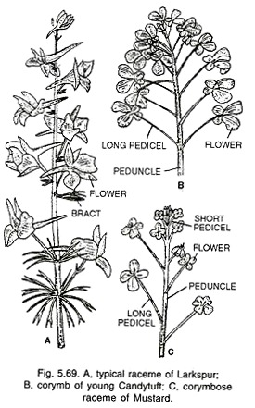
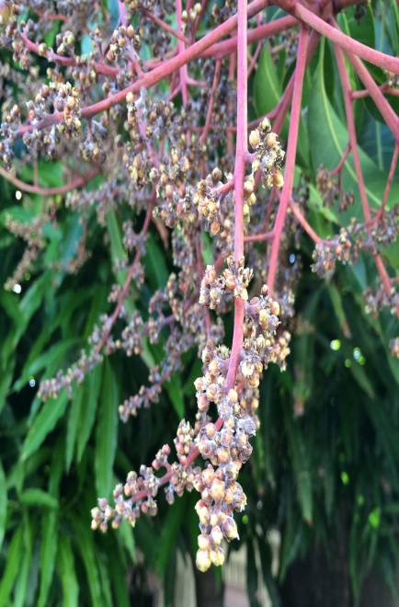
Infected Plant Response
General: whitish, superficial, powdery fungal growth
Small white spots
on all parts of
inflorescence

Slide 6
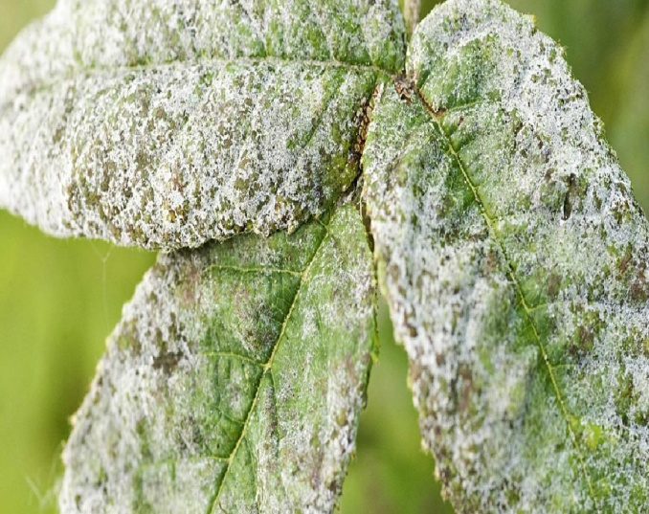
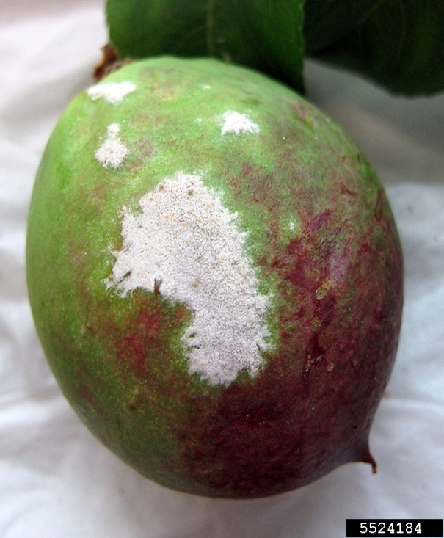
Symptoms
Whitish powdery spots on leaves
Fruits

Slide 7
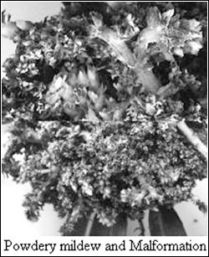
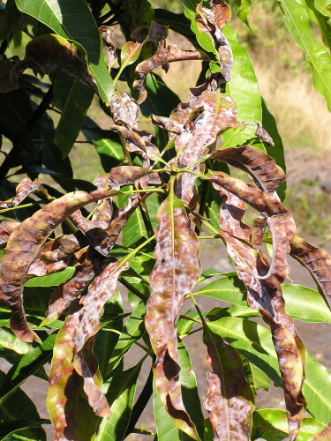
Symptoms
In severe cases, inflorescence completely covered by mildew
Young leaves curl,
distorted (Twisted)

Slide 8
Disease Cycle
Survival phase:
malformed*(mishappen)/off season panicles & mildew leaves
as mycelium in dormant buds and as haustoria on old infected leaves
Under dense foliage
Primary spread:
Wind
Parasitic phase:
After landing on the plant tissue, a conidium of O. mangiferae germinates, enters a stoma/pore and then grows

Slide 9
Disease cycle
After two or three weeks, the fruiting bodies grow out of the stomata
Secondary spread:
release conidia into the air, to be carried to other plants or plant parts
Incubation period:
15 days

Slide 10
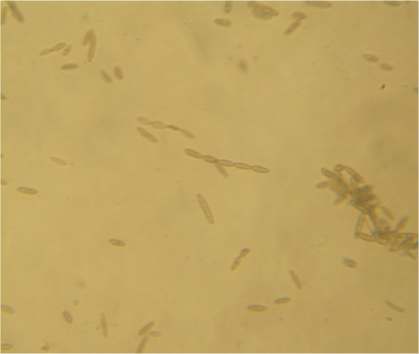
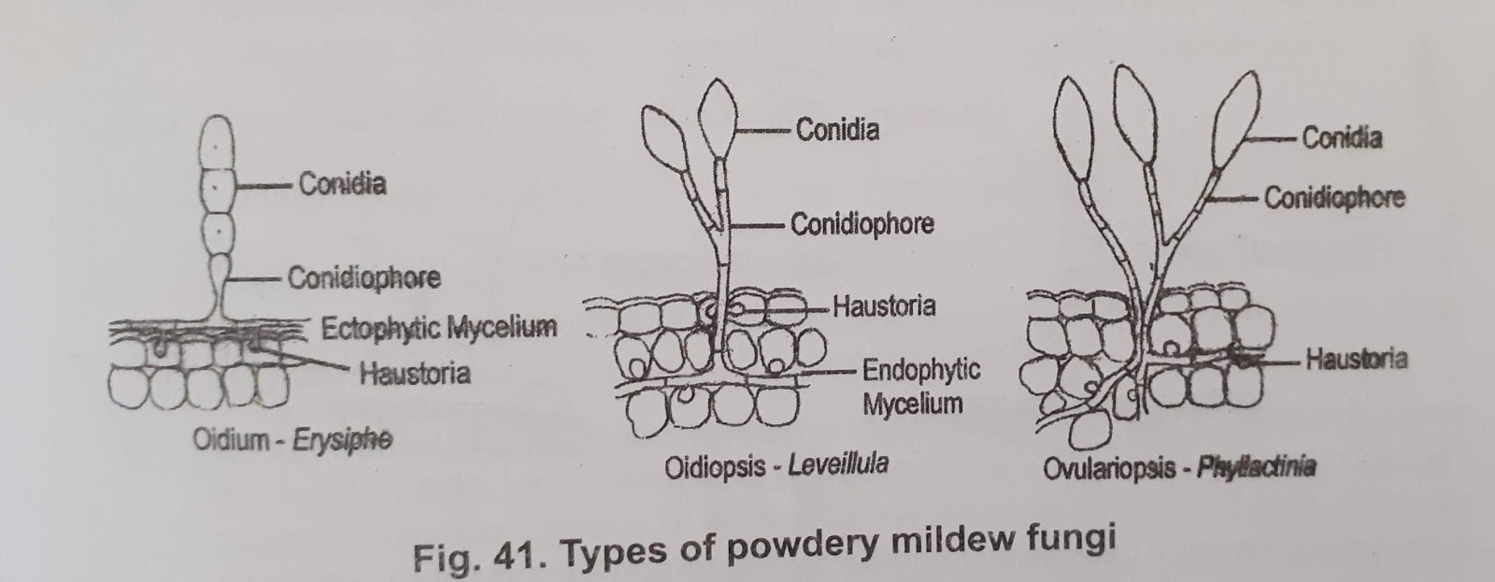
Conidia of Oidium mangiferae
Haustoria of OM

Slide 11
Epidemiology
Max temp 25-30°C
Min temp 10-16°C
75-91 % RH

Slide 12
Management
Cut & burn infected inflorescence in Sep & Oct
3 spray of Benomyl (0.2%), Bavistin (0.1%) at flowering (A- pre bloom, B- full bloom, C- after fruit setting)
A bacterium Bacillus subtilis use as biological control

